Slide 1

Credit card churn prediction
Azure ML Project
By Albert Zihan Zeng
2023-11-17

Slide 2
Introduction
Business Problem: A business manager of a consumer credit card bank is facing the problem of customer attrition. They want to analyze the data to find out the reason behind this and leverage the same to predict customers who are likely to drop off.
Objective: Develop a machine learning model that correctly predicts customers churn on Azure Machine Learning platform.

Slide 3
Data Source
The dataset used in this project consists 10,127 customer data, with 21 features on customer profile and credit card characteristics.
The original dataset was downloaded from:
https://www.kaggle.com/datasets/anwarsan/credit-card-bank-churn
COLUMN | DESCRIPTION
CLIENTNUM | Client number
Attrition_Flag | Target variable (Existing / Attrited)
Customer_Age | Customer age in years
Gender | M=Male / F=Female
Dependent_count | Number of dependents
Education_Level | Graduate / College / High School / ...
Marital_Status | Married / Single / Divorced / Unknown
Income_Category | Less than $40K / $40K - $60K / $60K - $80K / ...
Card_Category | Credit card type (Blue / Silver / Gold / Platinum)
Months_on_book | Period of relationship with bank
Credit_Limit | Credit limit on the credit card
... | ...

Slide 4
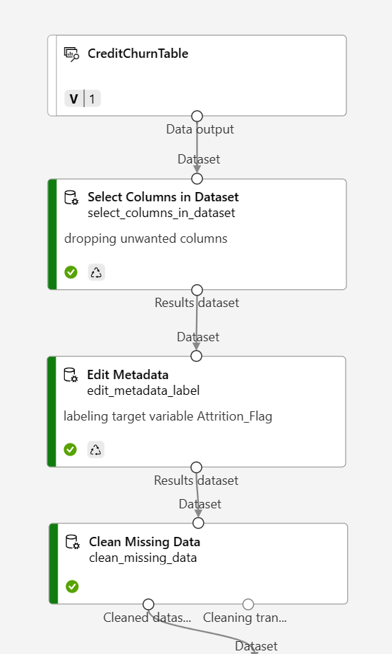
Data Preprocessing
Data Input
Dropping 3 unwanted columns
Exclude column names: CLIENTNUM, Naive_Bayes_Classifier_Attrition_Flag_..._1, Naive_Bayes_Classifier_Attrition_Flag_..._2
Labeling target variable as Label
Column Name: Attrition_Flag
Fields: Labels
Clean Missing Data
Columns to be cleaned: All features
Cleaning mode: Remove entire row

Slide 5
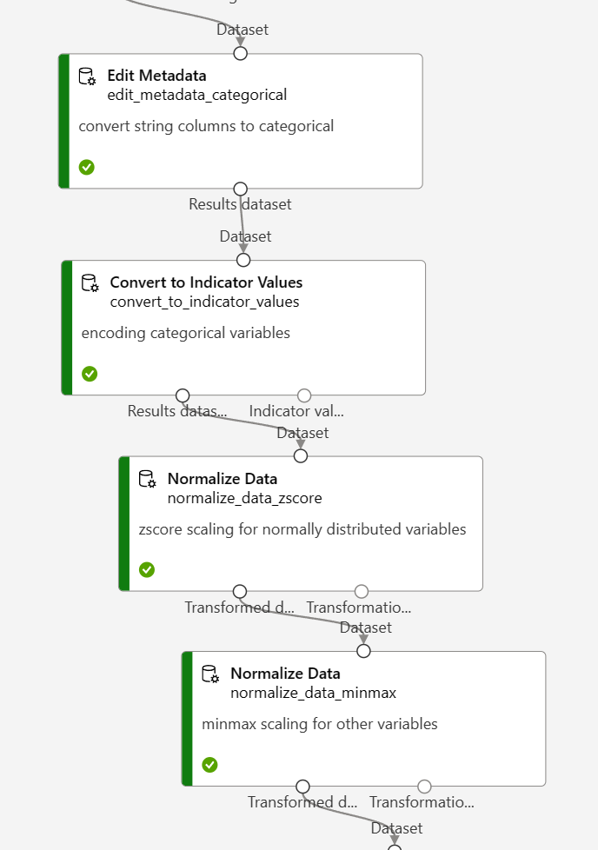
Data Preprocessing
Converting string columns to categorical
Column types: string
Exclude all labels
Categorical: Categorical
One-hot Encoding on categorical variables
Column types: Categorical
Overwrite: True
Scaling for near normally distributed variables
Transformation method: zscore
Column names: Customer_Age, Months_on_bank, Total_Trans_Ct
Scaling for other variables
Transformation method: MinMax
Exclude column names: Customer_Age, Months_on_bank, Total_Trans_Ct

Slide 6
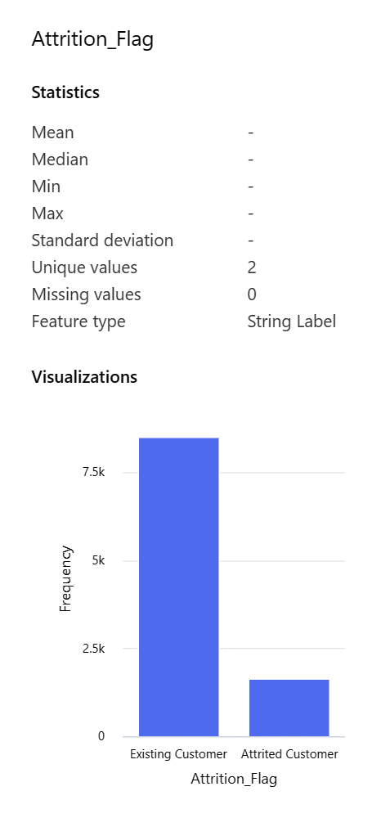
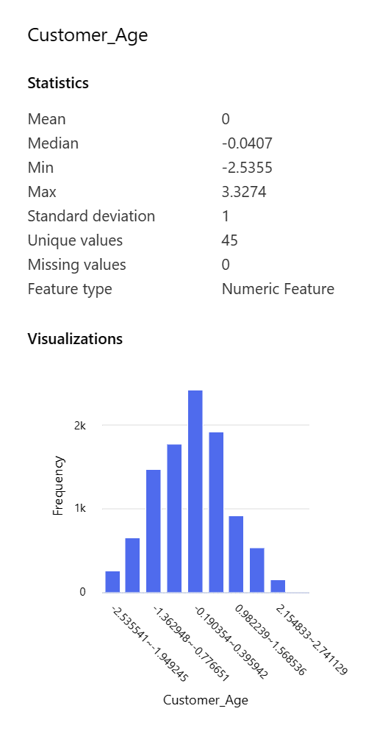
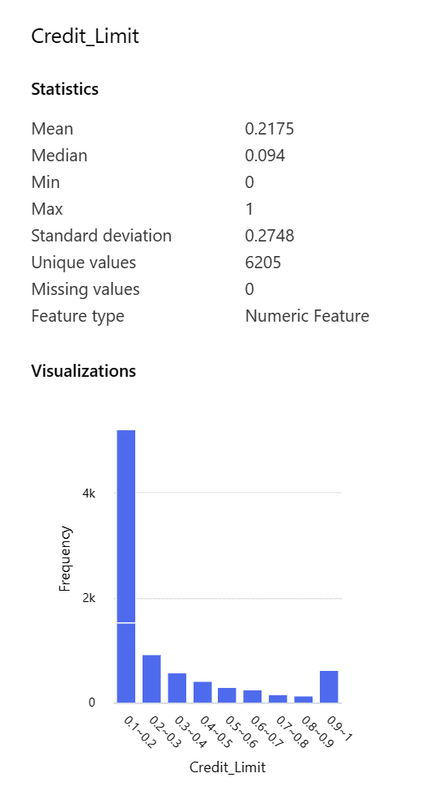
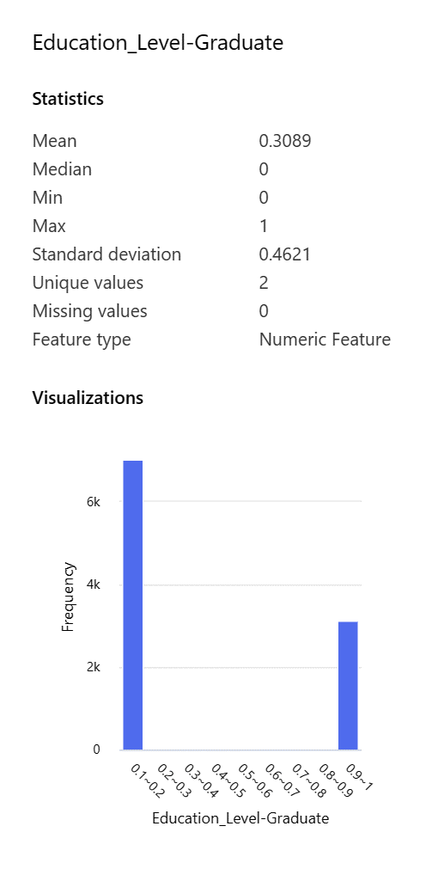
processed Data
10,127 rows x 36 columns

Slide 7
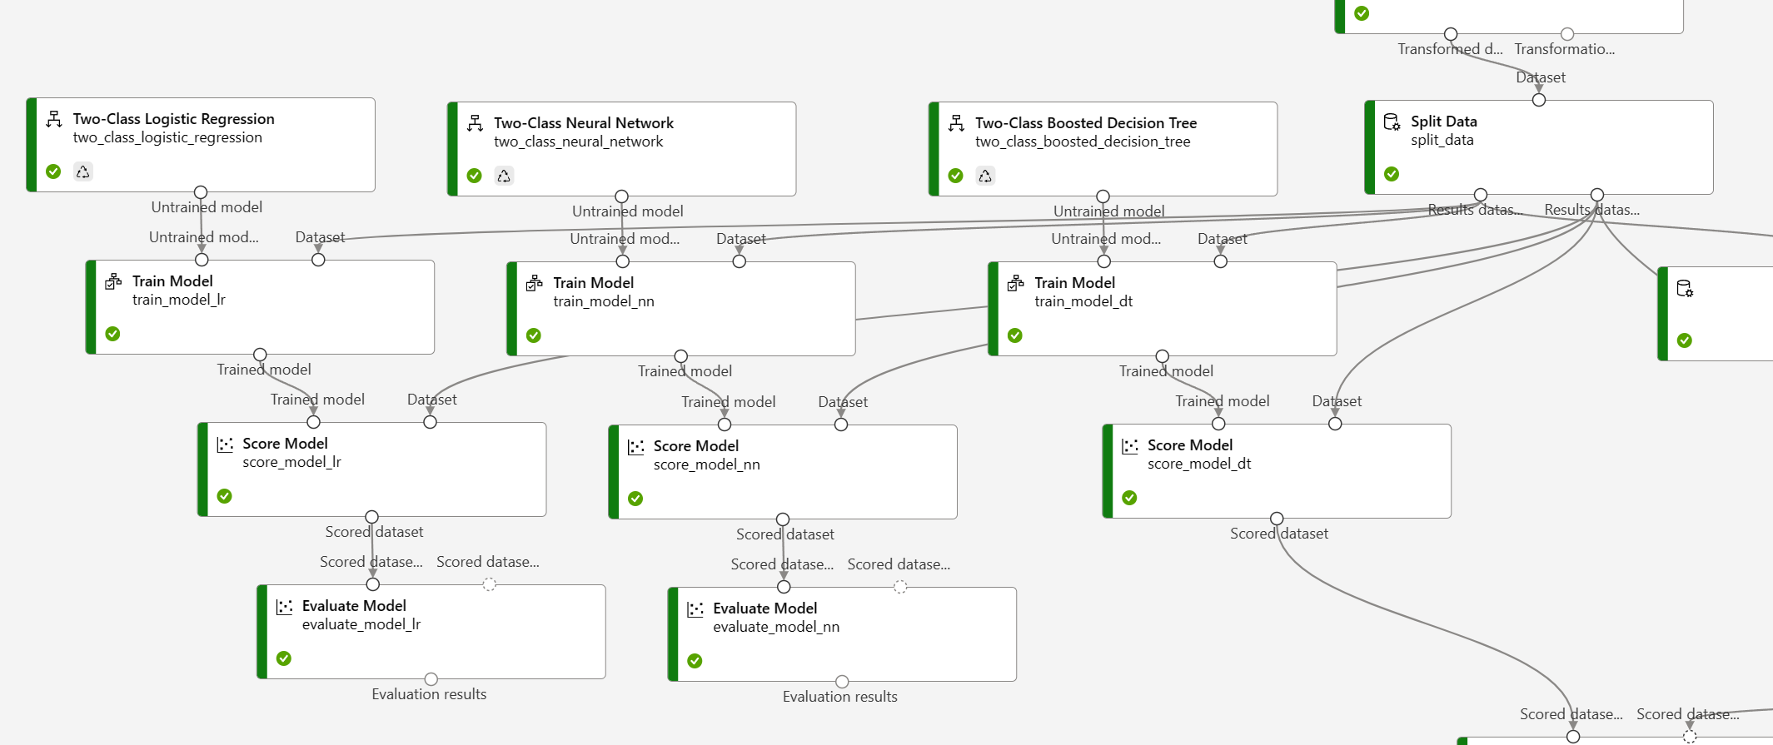
Model Training
Split Data (80% training, Stratified)
Models: Logistic Regression, Neural Network, Boosted Decision Tree

Slide 8
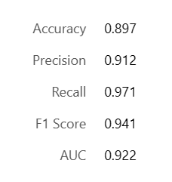
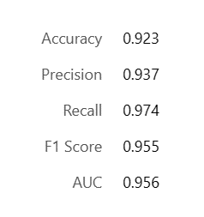
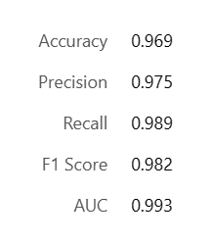
Model Training
Logistic Regression
ParameterRange
Optimization tolerance: 0.00001; 0.00000001
L2 regularization weight: 0.2; 1.0; 5
Neural Network
ParameterRange
Number of hidden nodes: 40, 10
Learning rate: 0.1; 0.2; 0.4
Number of learning iterations: 20; 40; 80; 160
Boosted Decision Tree
ParameterRange
Maximum leaves: 2; 5; 8;
Minimum samples: 1; 5; 10;
Learning rate: 0.025; 0.05; 0.1; 0.2; 0.4
Number of trees: 10; 20;

Slide 9
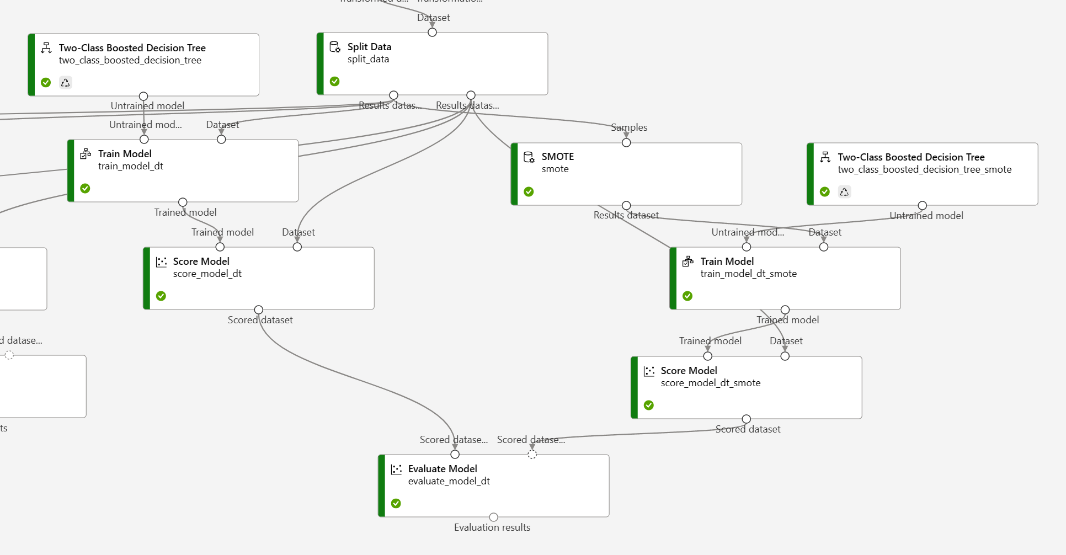
Model Training
SMOTE on training set (boost minor class by 300%)
Models: Boosted Decision Tree

Slide 10
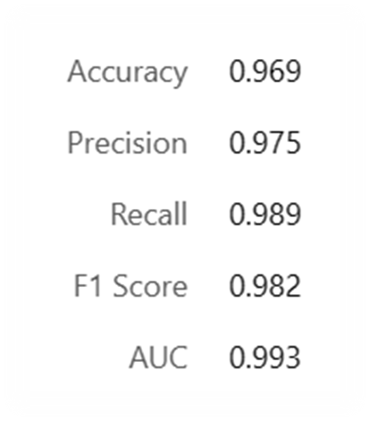
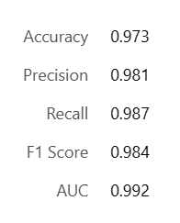
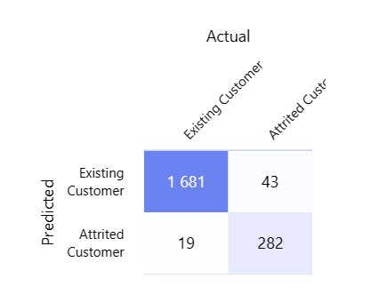
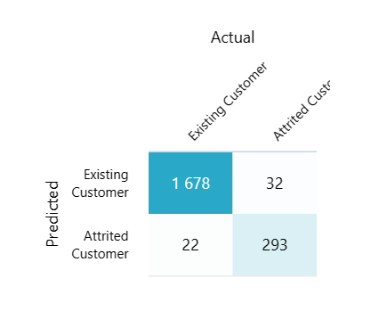
Model Training
SMOTE on training set (boost minor class by 300%)
Models: Boosted Decision Tree
Model with SMOTE shows a slight higher accuracy score on attrited class
Before SMOTE
With SMOTE

Slide 11
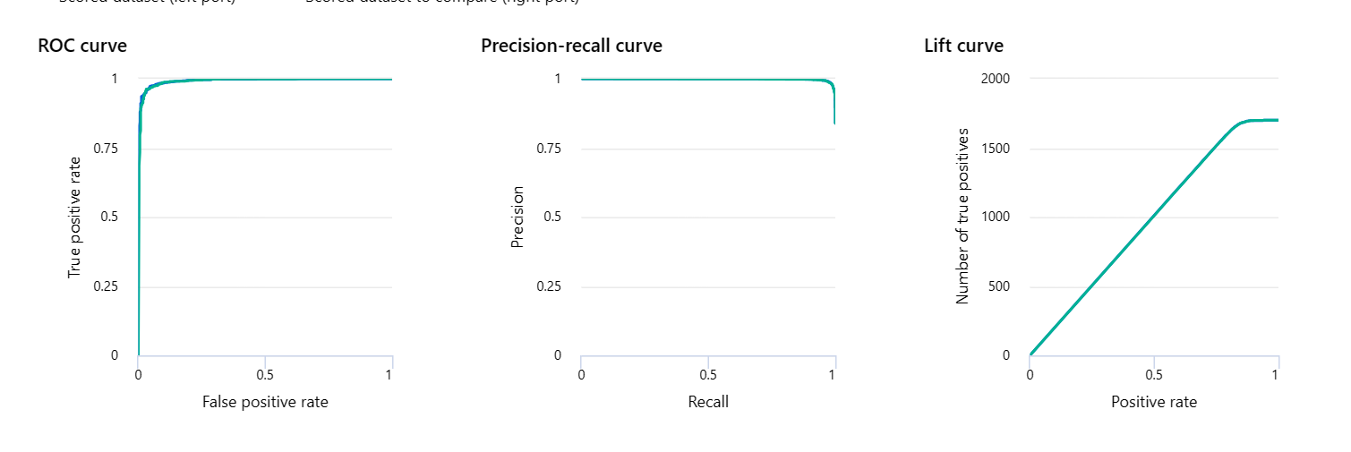
Model Evaluation
Best Model: Boosted Decision Tree with SMOTE
Precision: 0.981
F1 Score: 0.984

Slide 12
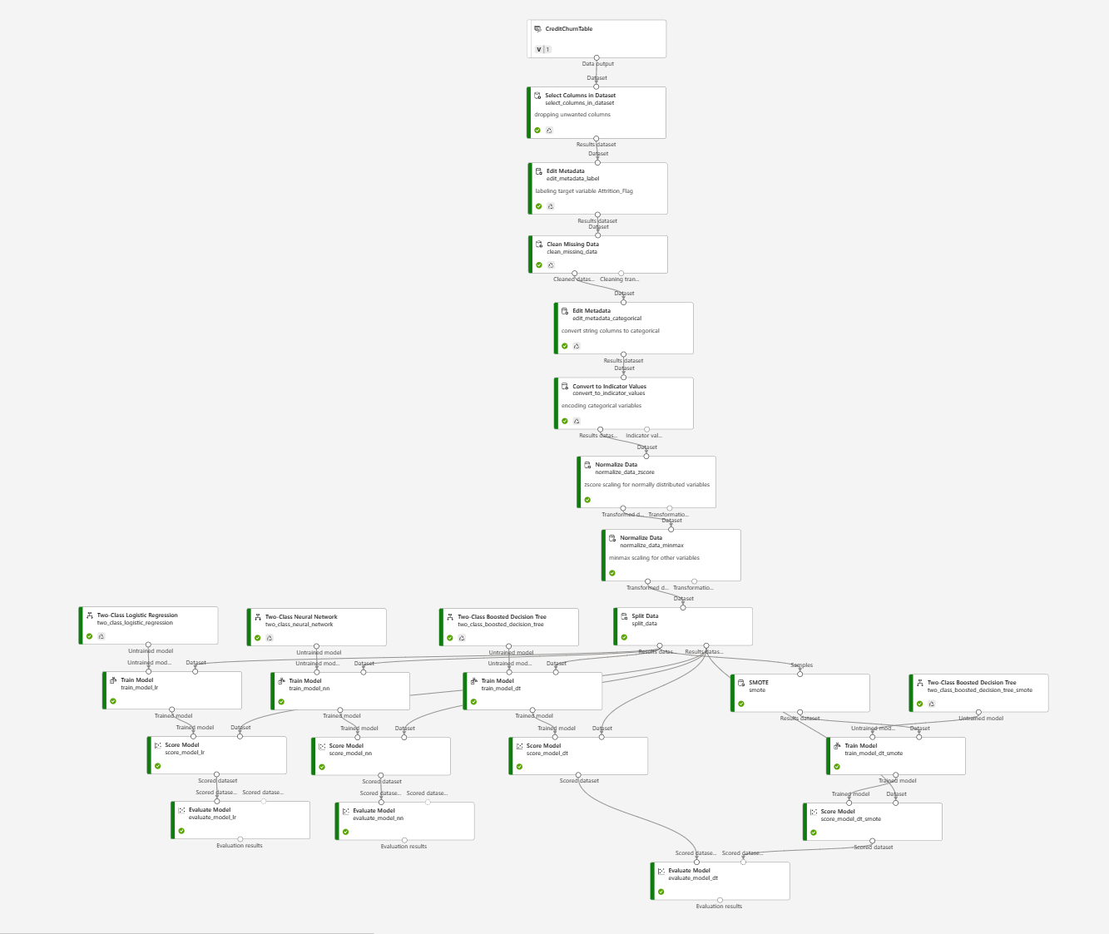
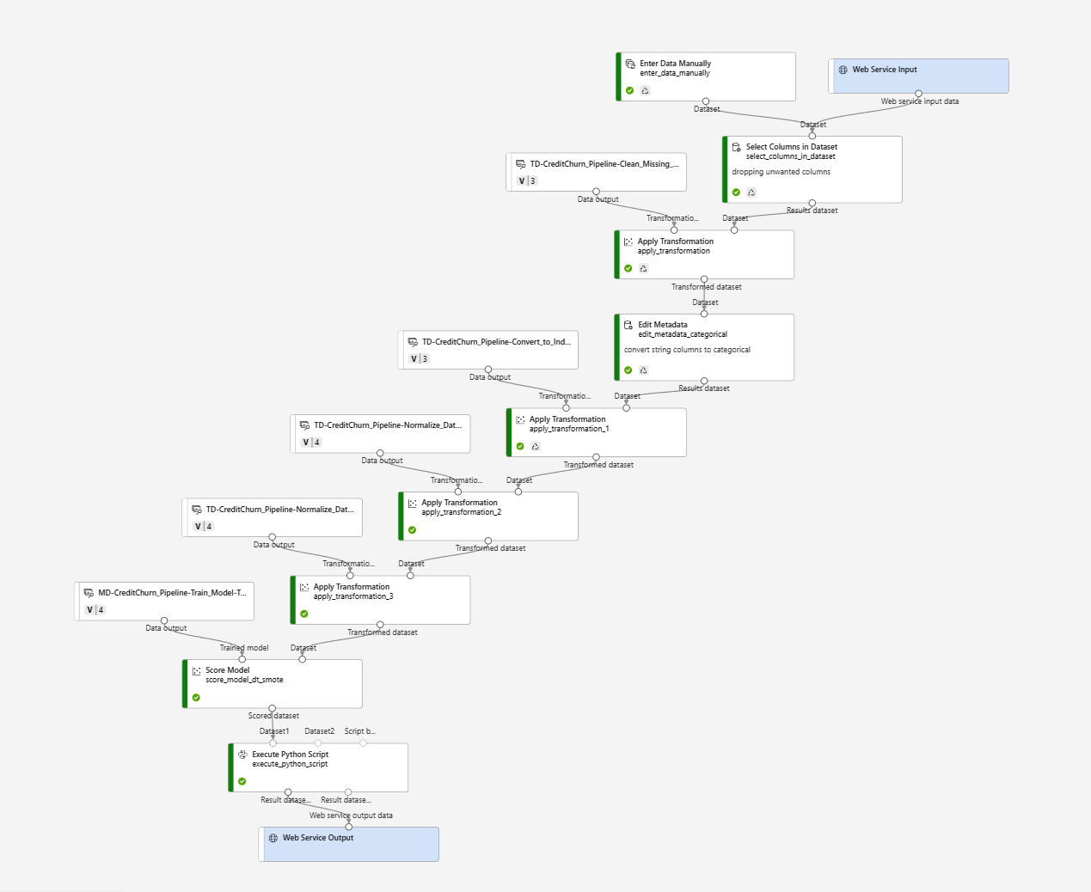
Pipelines
CreditCard Churn Model
CreditCard Churn Prediction

Slide 13
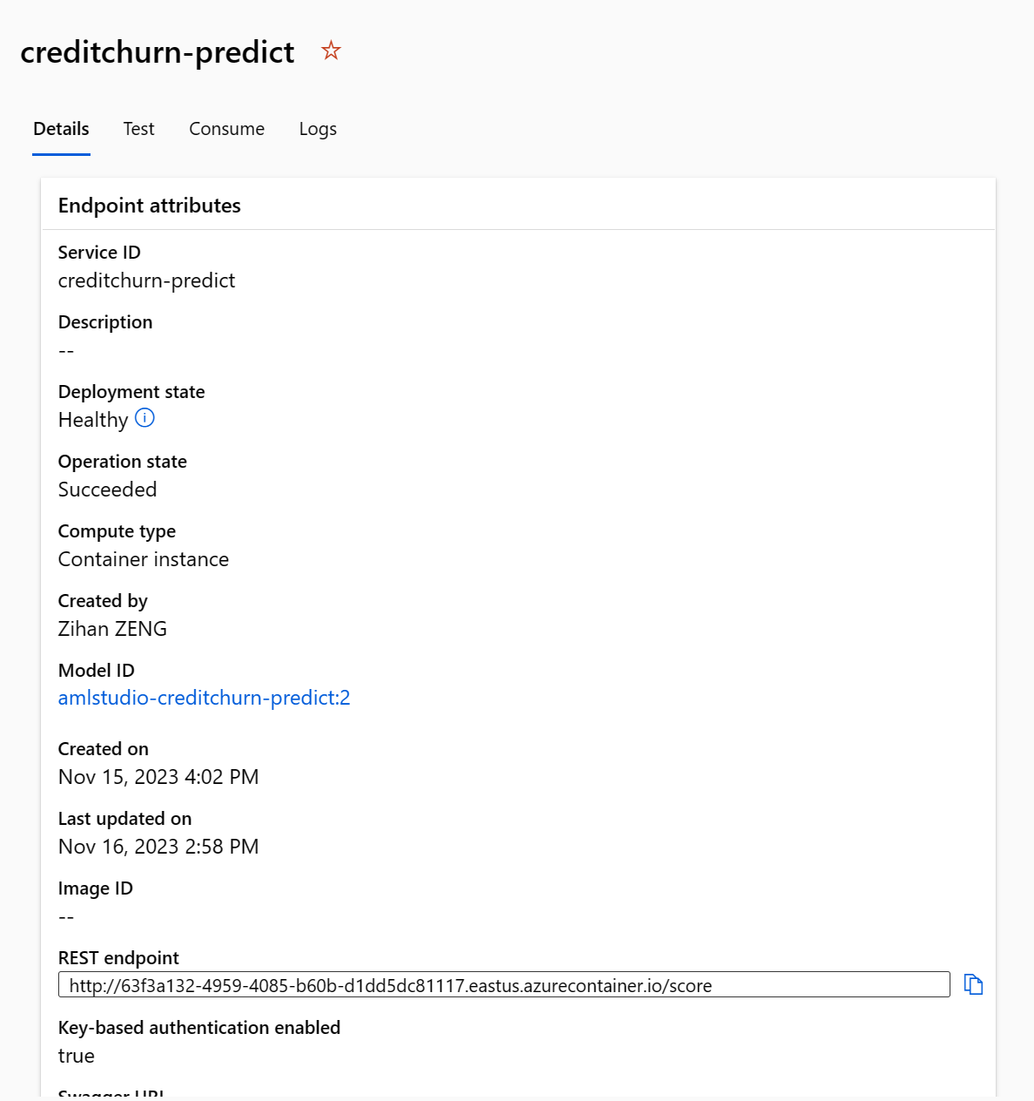
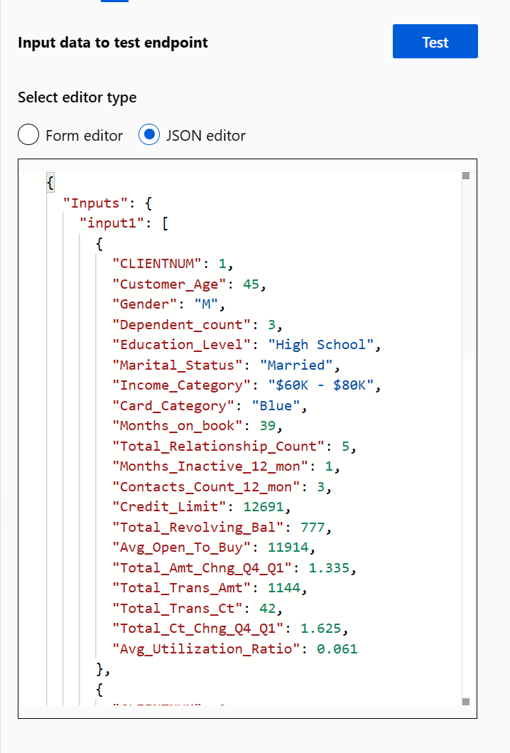
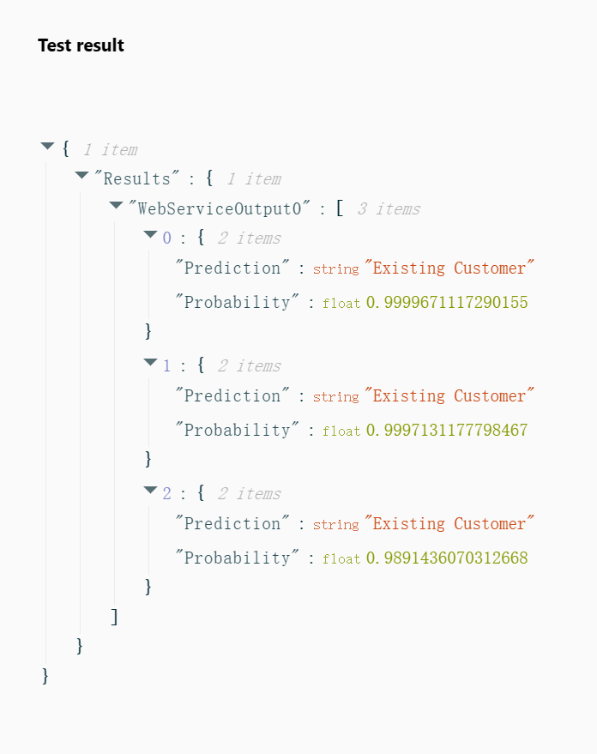
Prediction by Endpoint
REST Endpoint: http://63f3a132-4959-4085-b60b-d1dd5dc81117.eastus.azurecontainer.io/score
Primary key: 6tGRelfokNpFHY00D2OLgetPDAqlP6ry

Slide 14

Prediction by Python
endpoint = 'http://63f3a132-4959-4085-b60b-d1dd5dc81117.eastus.azurecontainer.io/score' #Replace with your endpoint
key = '6tGRelfokNpFHY00D2OLgetPDAqlP6ry' #Replace with your key
import urllib.request
import json
import os
# Prepare the input data
data = {
"Inputs": {
"input1":
[
{
"CLIENTNUM": 3,
"Customer_Age": 62,
"Gender": "F",
"Dependent_count": 0,
"Education_Level": "High School",
"Marital_Status": "Married",
"Income_Category": "Less than $40K",
"Card_Category": "Blue",
"Months_on_book": 46,
"Total_Relationship_Count": 12,
"Months_Inactive_12_mon": 8,
"Contacts_Count_12_mon": 6,
"Credit_Limit": 2000,
"Total_Revolving_Bal": 1000,
"Avg_Open_To_Buy": 1000,
"Total_Amt_Chng_Q4_Q1": 0.1,
"Total_Trans_Amt": 1300,
"Total_Trans_Ct": 2,
"Total_Ct_Chng_Q4_Q1": 0.1,
"Avg_Utilization_Ratio": 0.08
}
],
},
"GlobalParameters": {
}
}
body = str.encode(json.dumps(data))
headers = {'Content-Type':'application/json', 'Authorization':('Bearer '+ key)}
req = urllib.request.Request(endpoint, body, headers)
try:
response = urllib.request.urlopen(req)
result = response.read()
json_result = json.loads(result)
y = json_result["Results"]["WebServiceOutput0"][0]["Prediction"]
print(f'Prediction: {y}')
except urllib.error.HTTPError as error:
print("The request failed with status code: " + str(error.code))
# Print the headers to help debug the error
print(error.info())
print(json.loads(error.read().decode("utf8", 'ignore')))

Slide 15
Thank you

