Slide 1
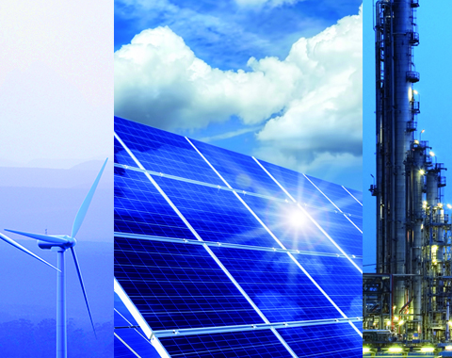
Energy Study on 15 Selected Countries Python Class Project by Archana Narasimhan and Zihan Zeng
Guided by
Amit Kukreja

Slide 2
Key Objectives
The objective of this project is to gather, clean and analyze data related to Energy Indicators, GDP (Gross Domestic Product), and journal contributions in the field of Energy Engineering and Power Technology.
The primary tasks include reading and processing data from various sources.
Performing data transformations and calculations to remove unnecessary columns, rename countries, convert units, and handle missing values.
Ensuring a comprehensive dataset is created suitable for further analysis
From answering the given questions, we gain insights
into the economic and energy landscape of different countries
identify the trends
compare statistics and understand the correlation

Slide 3
Data Scope
Obtained data from three sources :
United Nation energy supply and renewable electricity production for year 2013 (http://unstats.un.org/unsd/environment/excel_file_tables/2013/Energy%20Indicators.xls)
World Bank country GDP from year 1960 to 2015 (http://data.worldbank.org/indicator/NY.GDP.MKTP.CD)
Sciamgo Journal and Country Rank data for Energy Engineering and Power Technology (http://www.scimagojr.com/countryrank.php?category=2102) from year 1996 to 2015.
Top 15 countries from this ranking were selected for this study.

Slide 4
Key Findings
High positive correlation between country GDP and energy research citation
High positive correlation between country GDP and energy supply
Research citations do not have a significant direct impact on the percentage of renewable energy
Insights on:
GDP
Population
Energy Supply, Renewable Energy
Scientific Research in Energy Field

Slide 5
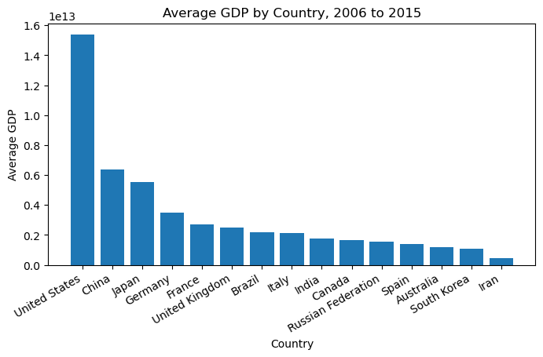
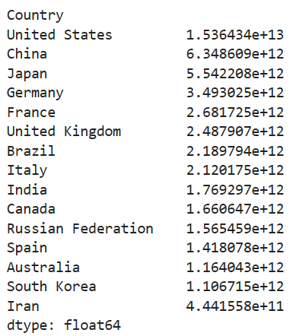
GDP by Country
GDP for years 2006 to 2015
Rank 15 countries by average GDP over ten years period

Slide 6
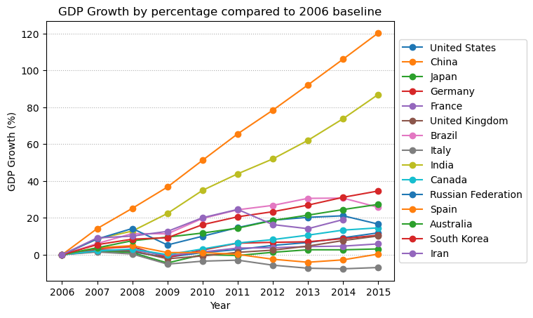
GDP Growth
GDP growth from 2006 to 2015
China shows the leading GDP growth over the ten years period
Followed by India, which serves as the model of economic growth strategies.
United Kingdom had a GDP growth of 246.7 billion dollars, 10.2%, over 10 years.
Other Countries can analyze these models to increase their economic growth.

Slide 7
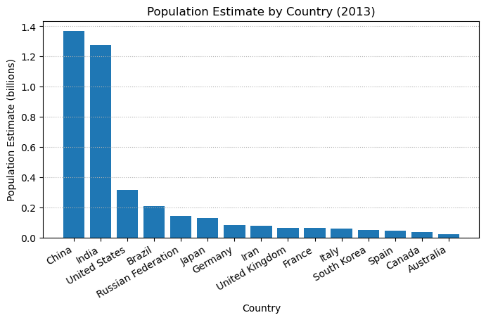
Population Estimate
Population estimated by data of Energy Supply and Energy Supply per capita by country
China is the most populous country among the 15 countries
High population countries are expected to have less energy consumption per capita

Slide 8
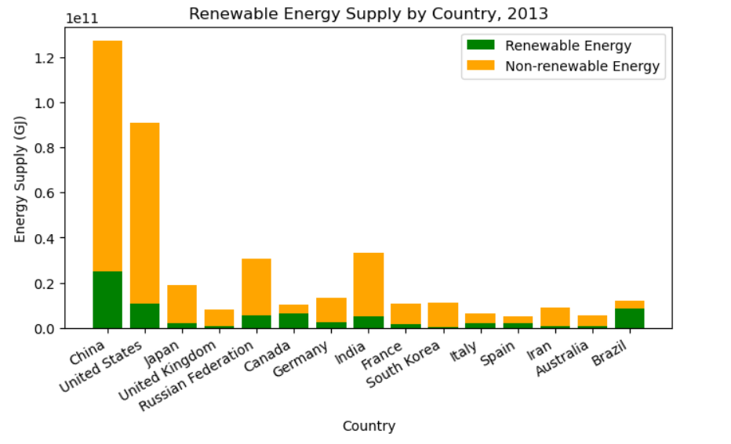
Renewable Energy
Avg energy supply per capita is 99.6 GJ
Avg renewable energy supply per capita is 18.6 GJ
Avg % renewable is 18.68%
Brazil has the highest percentage renewable energy, 69.65%.
Other Countries should consider investing in renewable energy sources
a)To contribute on the environmental sustainability and
b)To reduce the dependence on non-renewable resources.

Slide 9
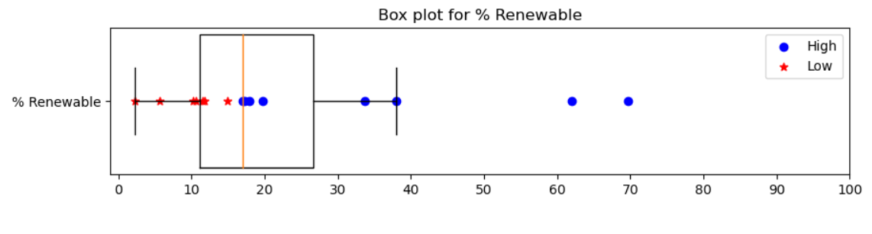
COUNTRIES WITH HIGH & LOW RENEWABLE ENERGY PRODUCTION
Grouped countries by % Renewable energy median
8 countries in high % renewable, 7 countries in low % renewable
These 7 Countries below the median should consider investing in renewable energy sources .

Slide 10
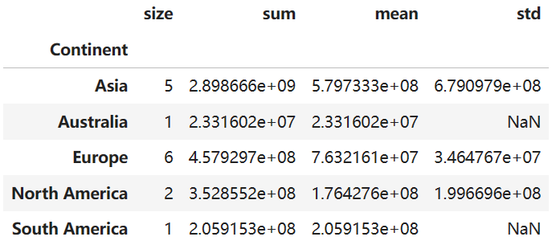
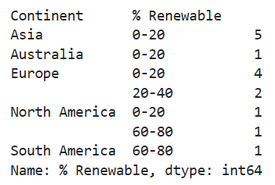
Population and % Renewable by continent
Population by Continent Summary
% Renewable by Continent

Slide 11
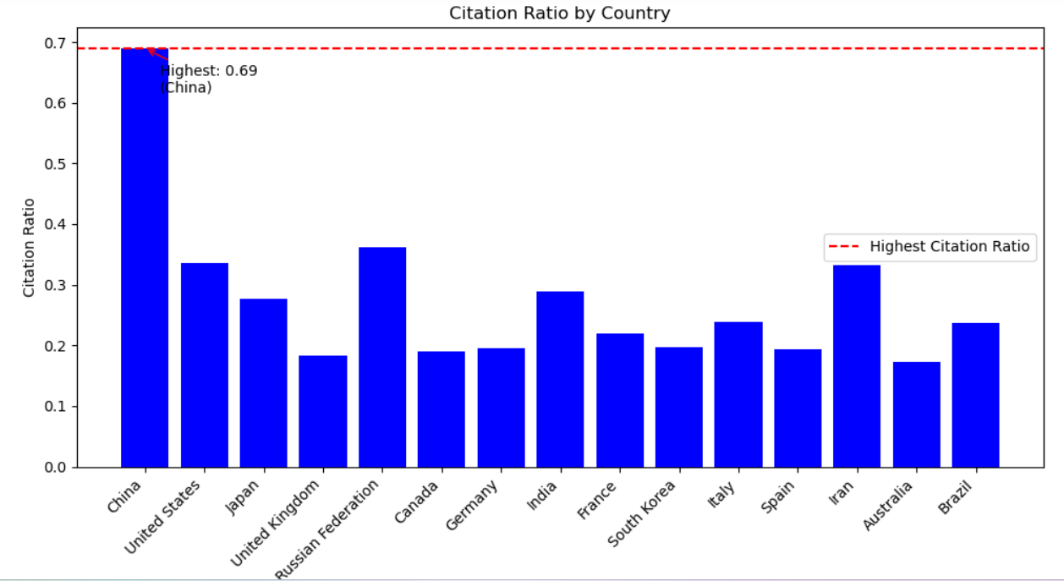
Research in Energy field
China is the country with the highest self-citation to total citation ratio, with a ratio of 0.689
Shows these leading countries on Citable documents or Citation have a strong focus on research and innovation.
For other countries, the government and institutions can encourage more research activities by the researchers and scientists.

Slide 12
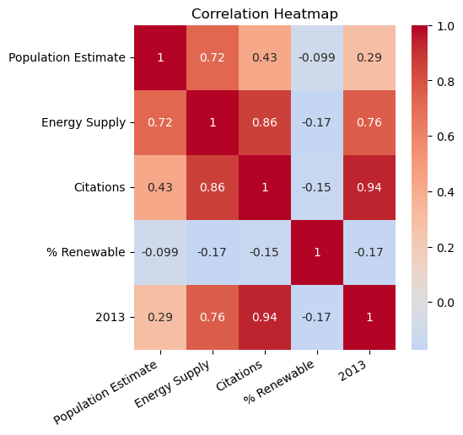
Correlations
Countries with higher populations tend to have higher energy supplies
Countries with higher energy supply tend to produce more research output
Countries with higher GDPs tend to have higher research productivity, leading to more citations, could be due to increased research funding and better infrastructure
Research citations do not have a significant direct impact on the percentage of renewable energy supplied
Countries with varying levels of energy supply have different proportions of renewable energy which shows other factors may influence the choice of energy sources.

Slide 13
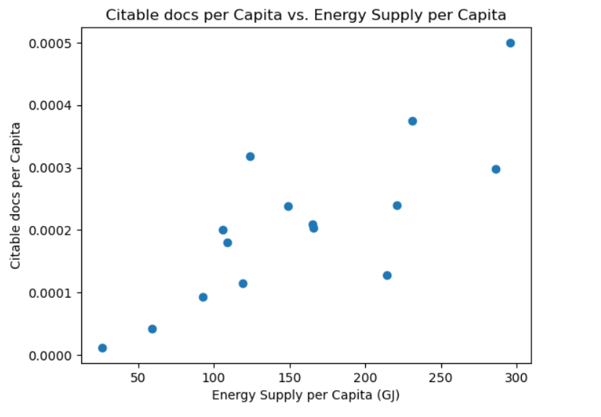
energy supply vs research
Correlation of 0.794
Energy availability can positively impact research output and economic growth
The Countries with higher energy availability tend to produce more research activities including the number of citations.

Slide 14
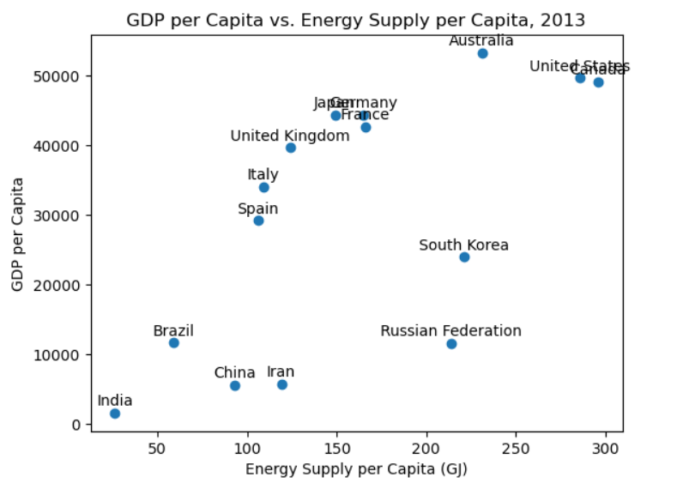
energy supply vs GDP
Correlation of 0.762 – highly positive correlation between GDP and Energy supply
Shows here the Countries like Australia, United States, Canada with higher economic development tend to have higher energy availability per person
Can assume that economic growth and energy availability are inter-related

Slide 15
recommendations
Countries using higher percentage of renewable energy in their energy supply should continue to invest in renewable energy sources for sustainability.
Promoting research and innovation in energy–efficient technologies can lead to reduced energy consumption and associated costs.
Countries with higher levels of energy consumption and renewable energy production tend to have more research output and citations.
Policies aimed at increasing energy availability can potentially stimulate economic development.
Renewable energy sources plays a significant role in meeting energy demands while still minimizing environmental impact.

