Slide 1
Housing Price Prediction
Data Mining Project
By Group1 – Albert Zeng & Eleanor Ma
2023-09-12

Slide 2
AGENDA
Objectives
Data Source
Exploratory Analysis
Preparation for Model Training
Different Model Performance
Model Selection
Model Evaluation
Conclusion

Slide 3
Objectives
Business Problem: To predict the sale price of houses based on various features and understand the factors that influence house prices in the real-estate market.
Technical Problem: Build a multiple linear regression model and evaluate the performance of this model using metrics such as root mean square error (RMSE), adjusted R-squared, R-squared, and Cross Validation to measure how well it predicts sales prices.

Slide 4
Data Source
Columns | Description
Sale Price | The sale price of each house
Date House was Sold | The date house was sold on
No of Bedrooms | The number of bedrooms in each house
Flat Area (in Sqft) | The flat portion of the house in square feet.
No of Floors | The number of floors or stories in each house.
Waterfront View | The house has a waterfront view ("Yes" or "No")
No of Times Visited | How many times the property was visited by potential buyers or agents
Overall Grade | The overall grade or quality of the house
Basement Area (in Sqft) | The area of the basement in square feet
Age of House (in Years) | The age of the house in years
Latitude | Latitude of the house address
… | …
Data download from Kaggle:
https://www.kaggle.com/datasets/anmolchopra2012/basics-of-ml?select=1.+Regression+-+Module+-+%28Housing+Prices%29.csv
21613 rows and 21 columns
Various features related to house characteristics, prices, and other relevant information.

Slide 5
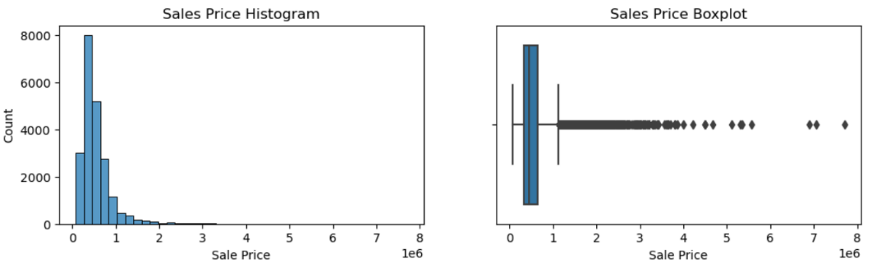
Exploratory Analysis
Based on basic data, Cleaning and Transformation, including “0 duplicated” “dropna”(na number are less than 10)” Extracting Sold Year and Month” ” Transforming Renovated Year”
Sales Price has some outliers, which need to be judged and processed later.

Slide 6
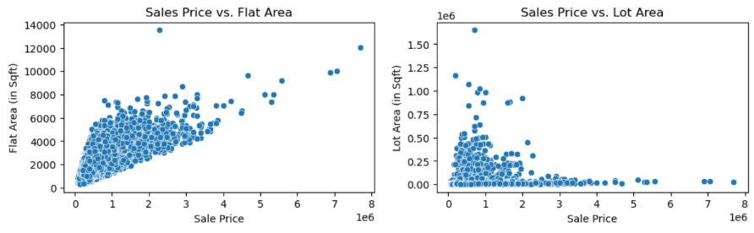
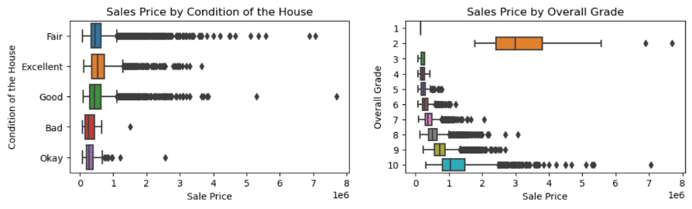
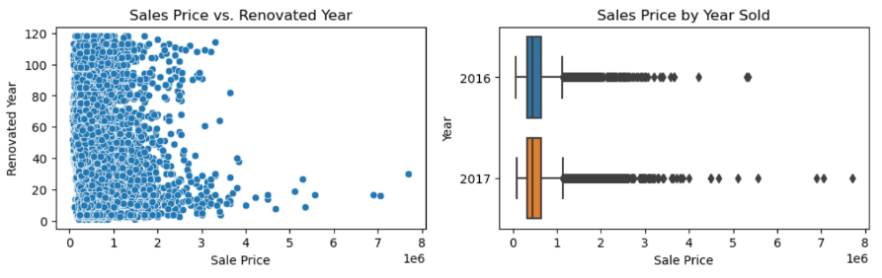
Exploratory Analysis

Slide 7
Preparation for Model Training
Encoding
Outliers
Split Training and Testing Set
Scaling
Encode columns 'Waterfront View', 'No of Times Visited', 'Condition of the House'
Using LocalOutlierFactor method first round cleaning
Removing 'Overall Grade' outliers
Removing 'Sale Price' outliers over 99% quantile
Using 0.2 test set proportion
StandardScaler method on x
Log transformation on y

Slide 8
Different Model Performance
Model 1 – base model, without feature selection
Total 19 features
Key Index
R2 is 0.752, Adj_R2 is 0.752, RMSE is 0.247
Low multicollinearity: close R2 and Adj_R2 scores
No overfitting: stable cross validation scores, close training and test R2 scores

Slide 9
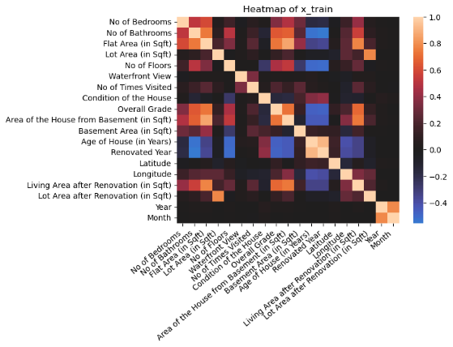
Different Model Performance
Model 2 - pairwise correlation
Feature selection on base model
7 features removed by high pairwise Pearson’s correlation (> 0.6)
Key Index
R2 is 0.572, Adj_R2 is 0.572, RMSE is 0.32
R2 is much lower than base model
Low multicollinearity
No overfitting

Slide 10
Different Model Performance
Model 3 - VIF filtering
Feature selection on base model
1 feature removed by high VIF value (> 10)
Key Index
R2 is 0.752, Adj_R2 is 0.752, RMSE is 0.247
Not much difference from base model

Slide 11
Different Model Performance
Model 4 - backward P-value elimination
Feature selection on base model
1 feature removed by high p-value in OLS model (> 0.05)
Key Index
R2 is 0.752, Adj_R2 is 0.752, RMSE is 0.247
Not much difference from base model

Slide 12
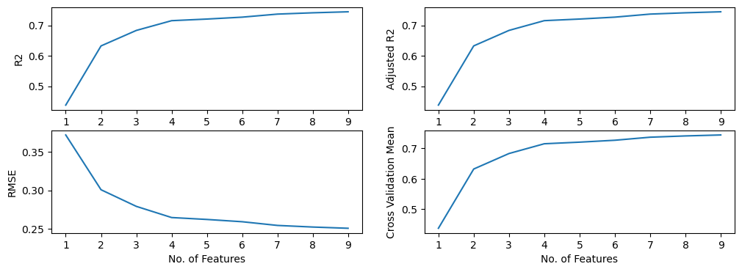
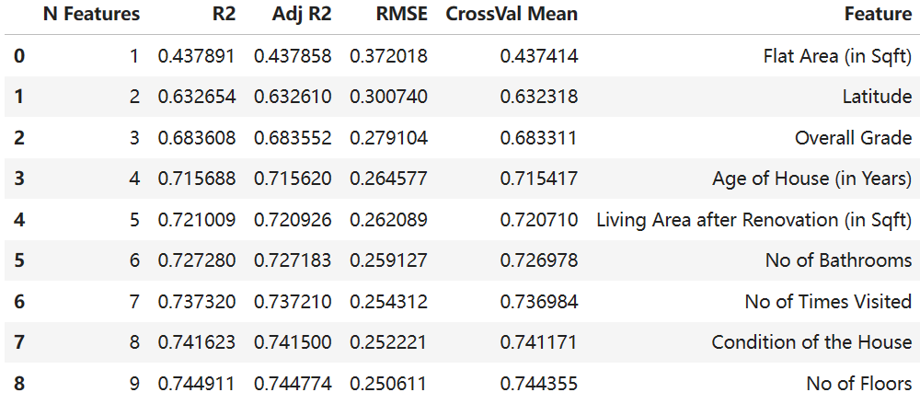
Different Model Performance
Model 5 - RFE
Feature selection on base model
Picked 5 best features by recursive feature elimination
Key Index
R2 is 0.721, Adj_R2 is 0.721, RMSE is 0.262
Low multicollinearity
No overfitting

Slide 13
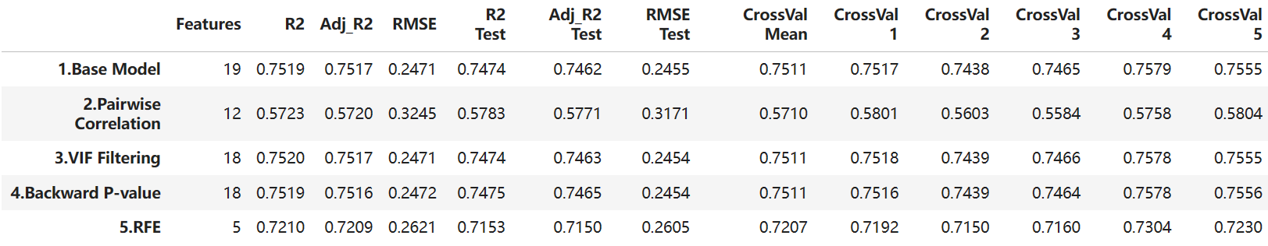
Model Selection
In all 5 models we can see the training metrics are similar to the testing metrics, and all cross validations are roughly the same values, indicating there is no overfitting in all 4 models.
Model 1, 3, 4 all have the best performing R2 scores and RMSE, while model 5 is slightly lower in R2 score and slightly higher in RMSE.
Conclusion: Model 5 uses only 5 features compared to 18 and 19 in the other 3 models, it is the best model among all considering the complexity and performance.

Slide 14
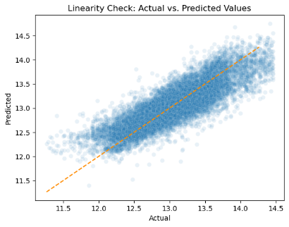
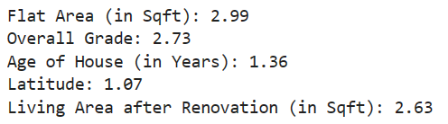
Model Evaluation
Model 5 - The assumptions for linear regression will be checked for Model 5.
Linearity
Independence
By checking the VIF values for all features used in this model, we can see there is no VIF > 5, indicating that there is no multicollinearity occurring in the selected features of this model. The assumption of independency is valid.
Most of the data points are closely distributed around the diagonal line, so the linearity assumption is valid.

Slide 15
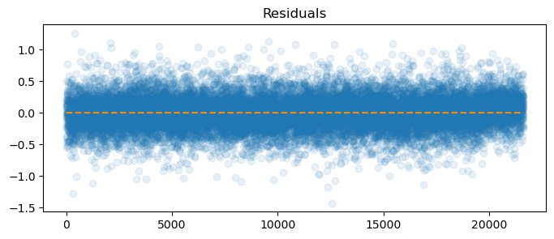
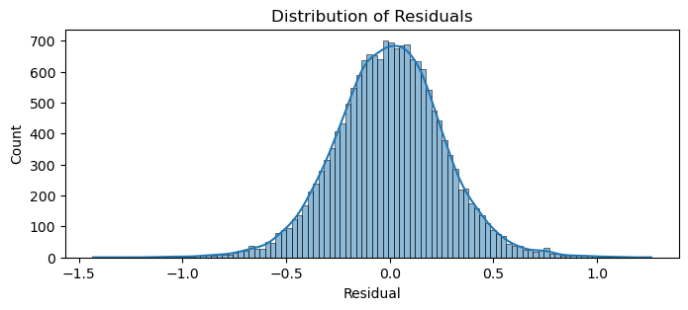
Model Evaluation
Model 5 - The assumptions for linear regression will be checked for Model 5.
Normality
Equal Variances
There is no visual correlation between the residuals and the predictors. Homoscedasticity is satisfied.
Normal test p-value < 0.05 indicating non-normal distribution.
Minor violation of normality assumption.
Autocorrelation
Durbin-Watson test value is 2.0067, values of 1.5<d<2.5 generally show that there is no autocorrelation in the data.

Slide 16
Conclusion
Model 5: R2 score 0.72
No overfitting
No multicollinearity
Most related features: Flat Area
Latitude
Overall Grade
Age of the House
Minor violation in normality may cause small inaccuracy in prediction

Slide 17
Thanks

