Slide 1
Customer Distribution and Deactivation Analysis
Advanced SAS Project
By Albert Zihan Zeng
2023-08-29

Slide 2
AGENDA
Objectives
Key Findings
Exploratory Analysis
Hypothesis Testing
Recommendations

Slide 3
OBJECTIVE
Investigate the customer distribution and business behaviors of the wireless company’s CRM data
Explore the statistical relationships between the sales and customer account features
Learn the impact of each feature to build a foundation for deactivation trend forecasting

Slide 4
KEY FINDINGS
Tenure segment is associated with Status, GoodCredit, RatePlan, and Dealer Type
Deactivation rate is not associated with age groups and provinces
Deactivation rate is different among groups of GoodCredit, RatePlan, and DealerType
No evidence for significant sales difference among Status, GoodCredit, and Age groups
Strong association with Status for tenure segment at 5, 20, 60, and 400 days

Slide 5
Account Summary
Total 102,255 unique accounts
Data ranges from account date 1999-01-20 to 2001-01-20
First deactivation occurrence on 1999-01-25, last on 2001-01-20
Overall deactivation rate 19.20%
Variable | N | N Miss | Mean | Std Dev | Minimum | Median | Maximum
Actdt Deactdt Age Sales | 102255 19635 94547 93650 | 0 82620 7708 8605 | 14675.35 14801.92 47.59 181.25 | 200.1 163.9 18.56 233.97 | 14264.00 14269.00 0 0 | 14660 14853 48 91.00 | 14995.00 14995.00 99 1200.00

Slide 6
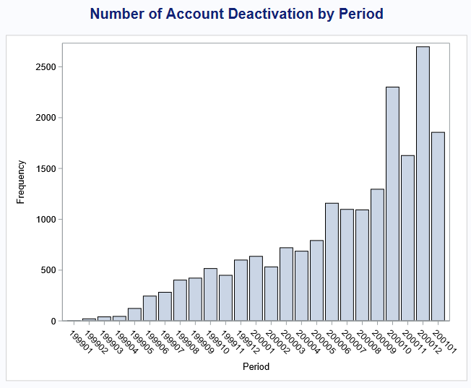
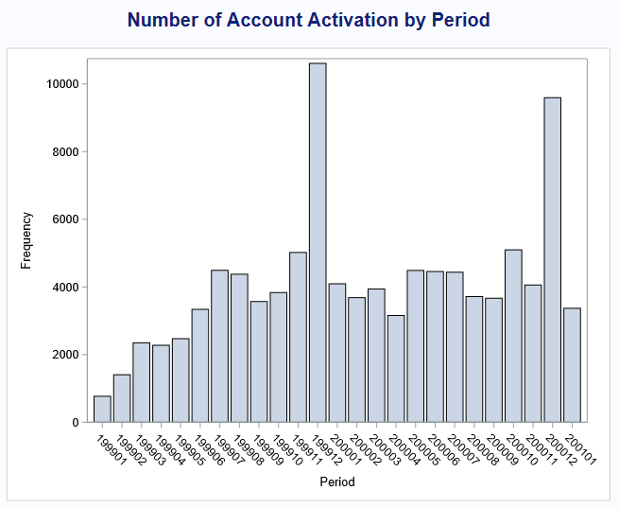
Account Deactivation by Period

Slide 7
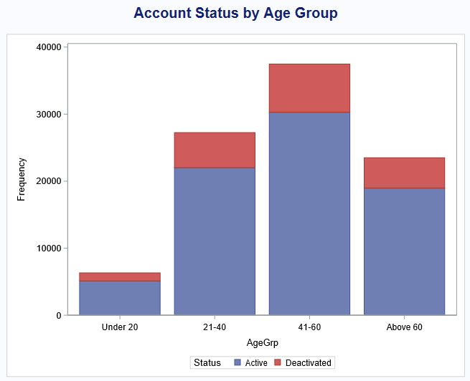
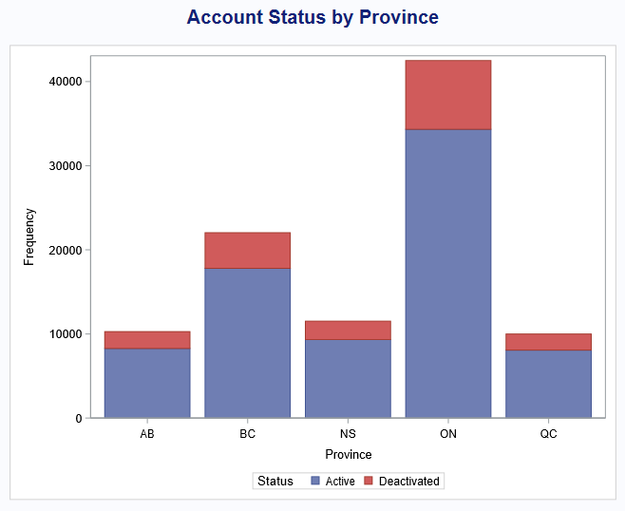
Status by Age and Province
Null hypothesis: equal proportions (independent)
Chi-square test: 0.9057
Independent
Chi-square test: 0.9754
Independent

Slide 8
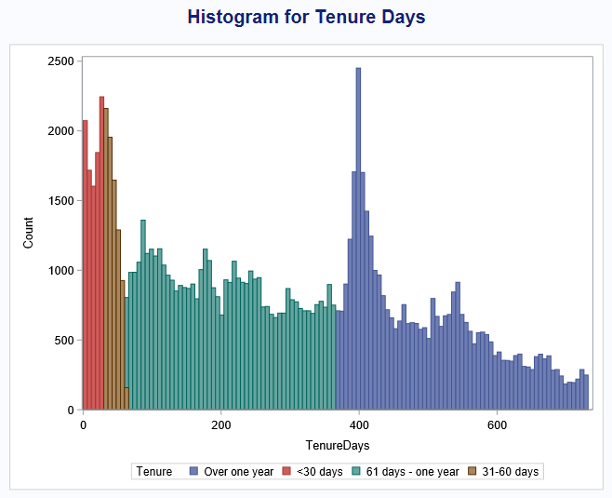
Tenure Days and Segments
Min 0 days, Max 731 days
Median 265 days
Segment into 4 groups:
<30 days
31-60 days
61 days – one year
Over one year

Slide 9
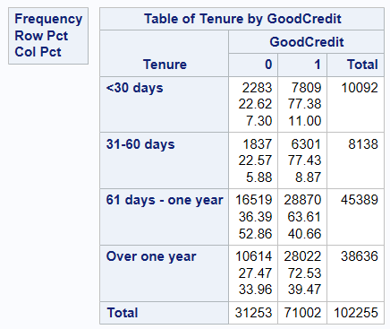
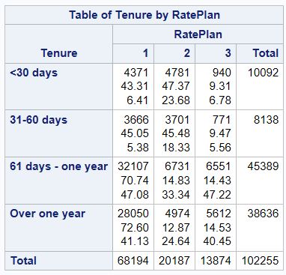
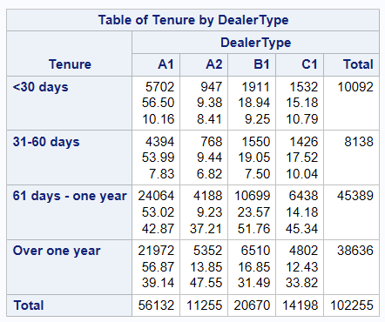
Tenure VS. GoodCredit / RatePlan / DealerType
Null hypothesis: equal proportions (independent)
vs. GoodCredit
Chi-square P<0.0001
Significant association
vs. RatePlan
Chi-square P<0.0001
Significant association
vs. DealerType
Chi-square P<0.0001
Significant association

Slide 10
Status VS. GoodCredit / RatePlan / DealerType
Null hypothesis: equal proportions (independent)
Status vs. GoodCredit
Chi-square P<0.0001
Deactivation rate has significant difference
Status vs. RatePlan
Chi-square P<0.0001
Deactivation rate has significant difference
Status vs. DealerType
Chi-square P<0.0001
Deactivation rate has significant difference

Slide 11
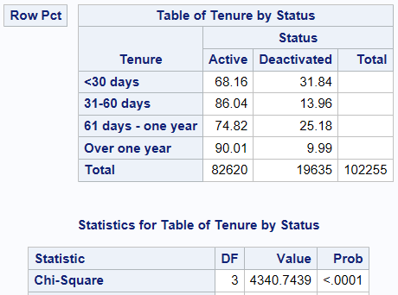
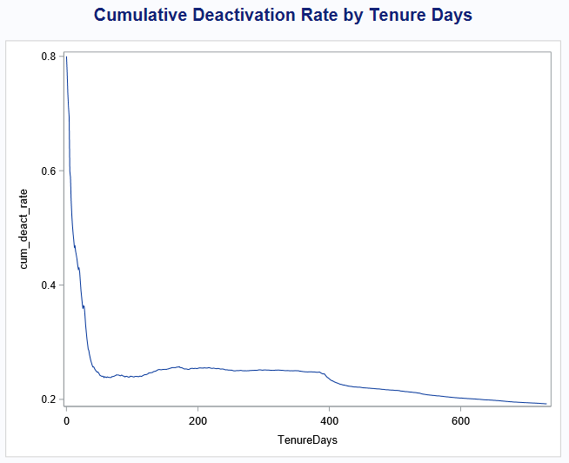
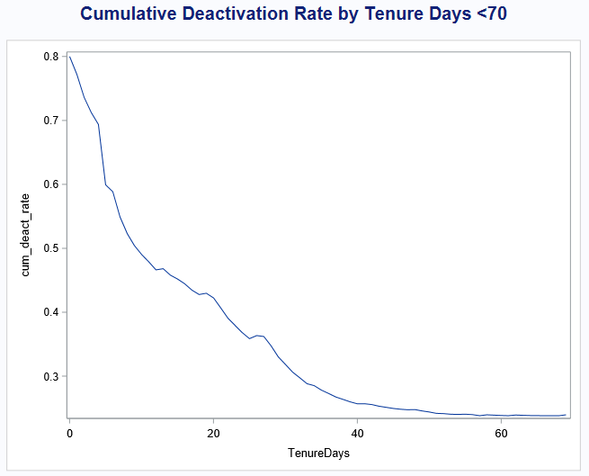
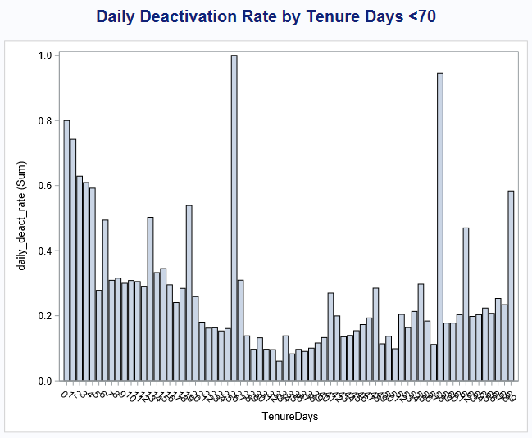
Tenure VS. Status and Optimization
Chi-square 4340.74
P < 0.0001
Significant association

Slide 12
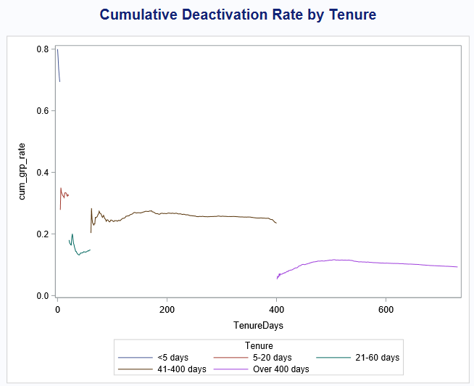
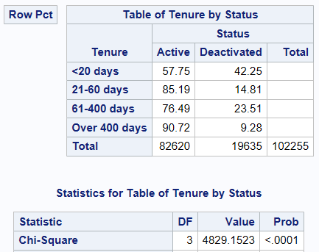
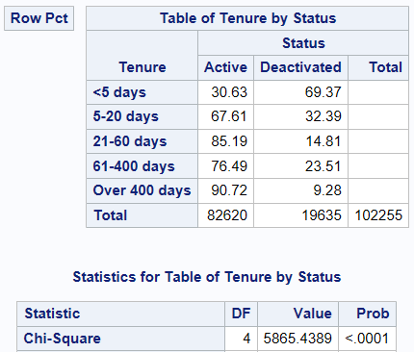
Tenure VS. Status and Optimization
Original 4 bins
Chi-square 4340.74
New 4 bins
Chi-square 4829.15
New 5 bins
Chi-square 5865.44
Stronger association

Slide 13
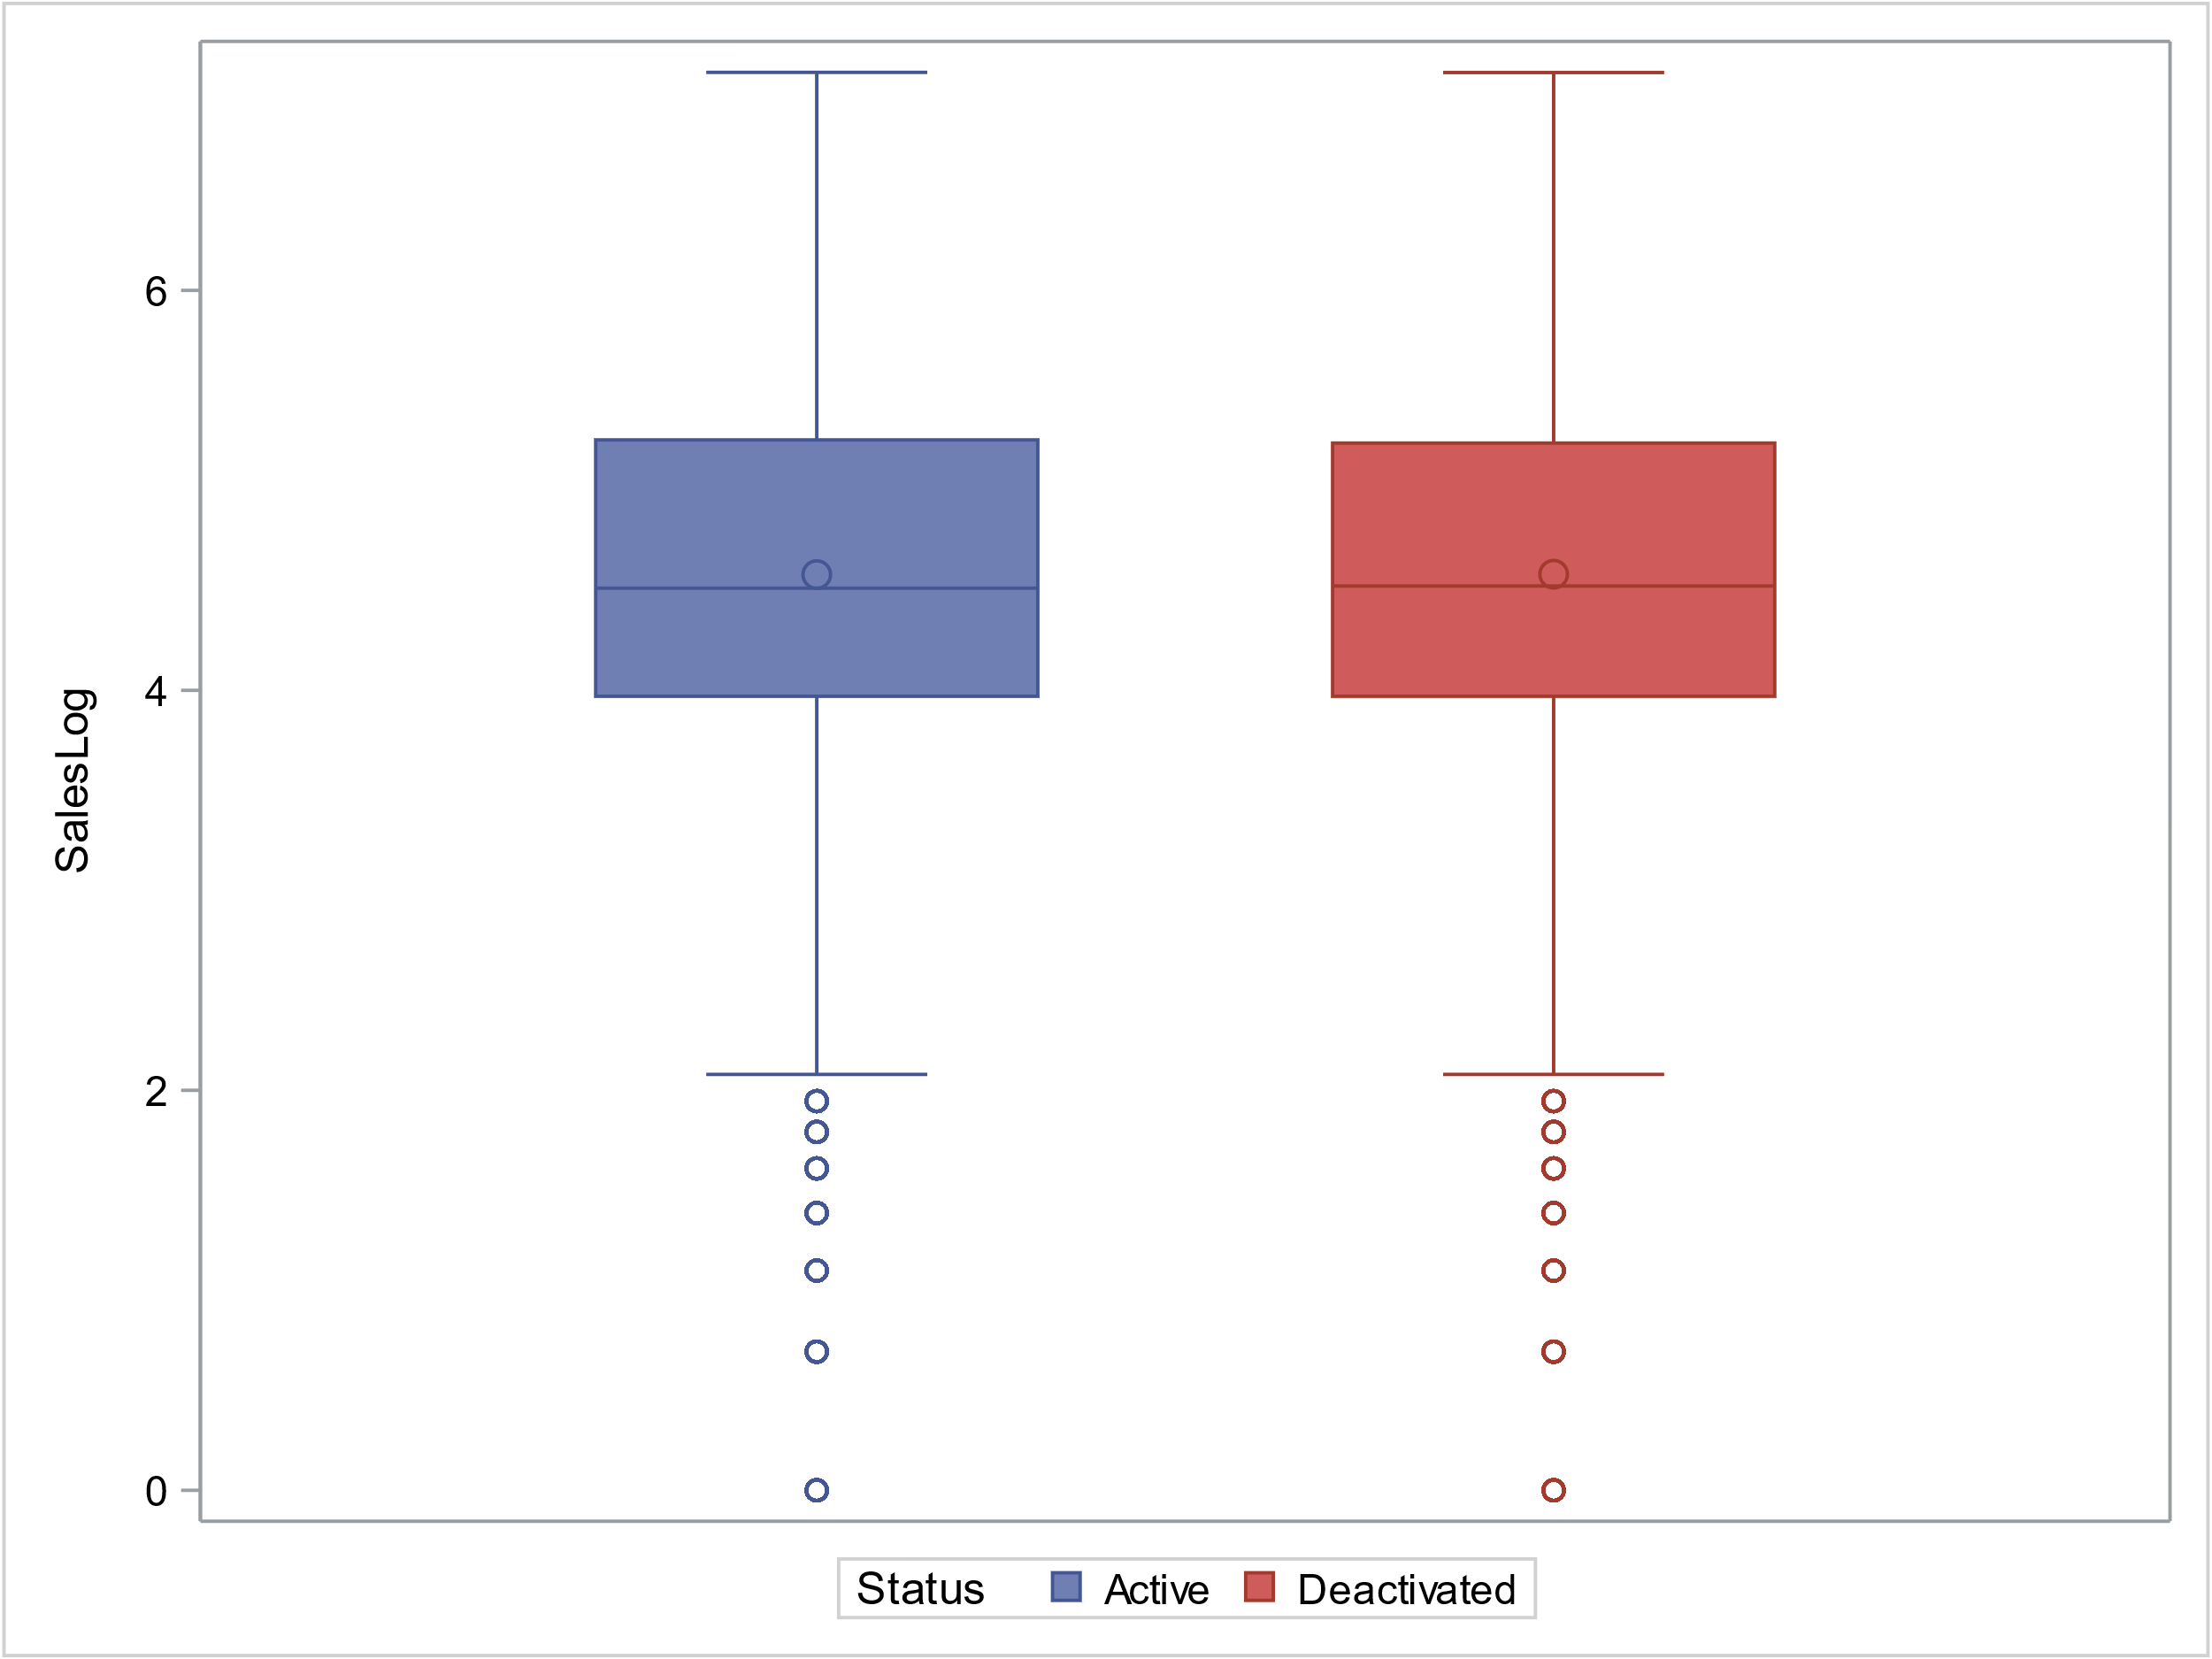
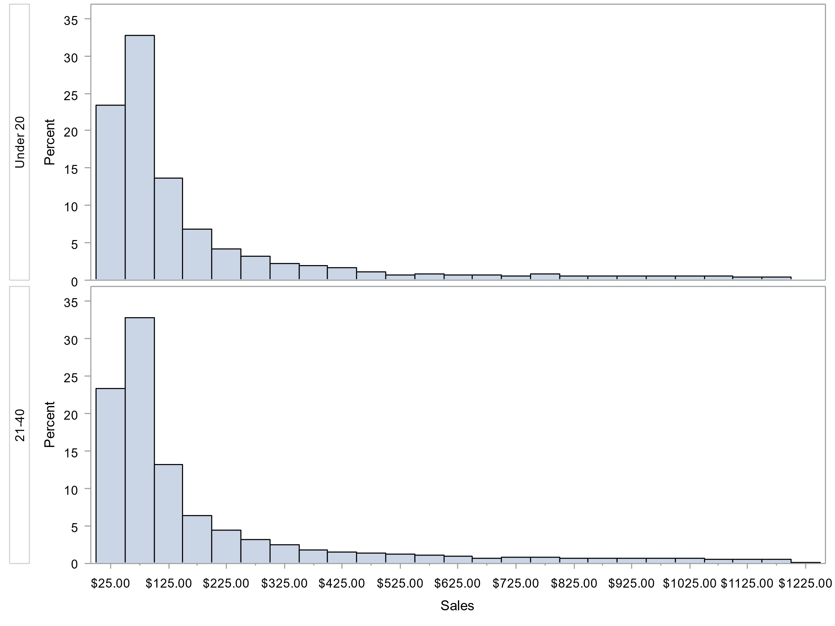
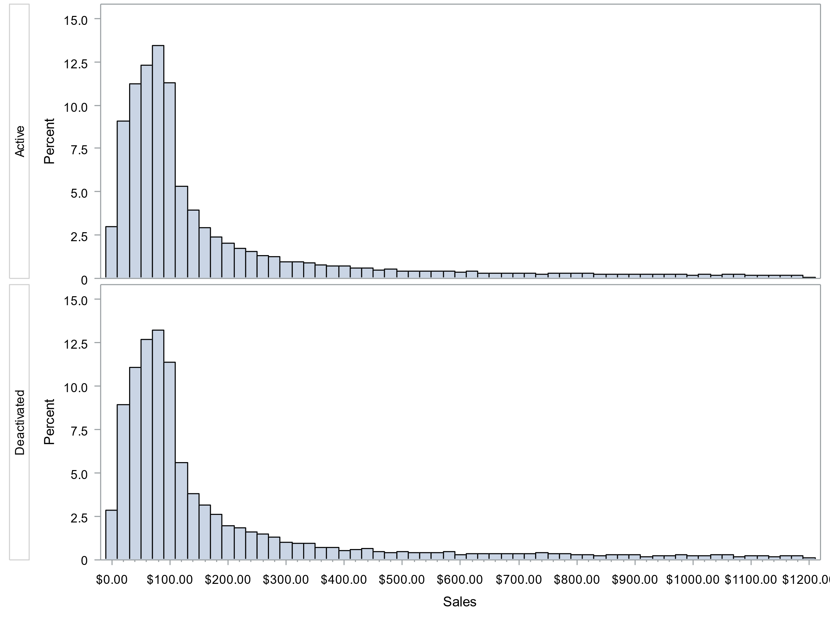
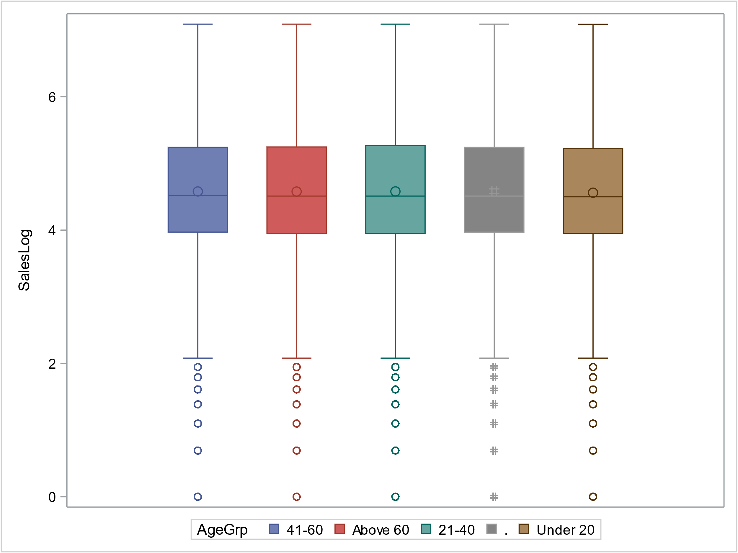
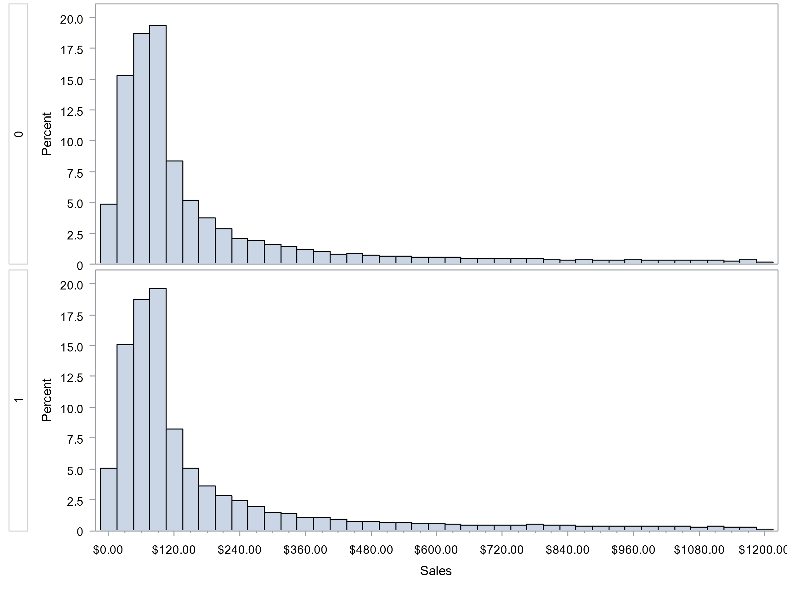

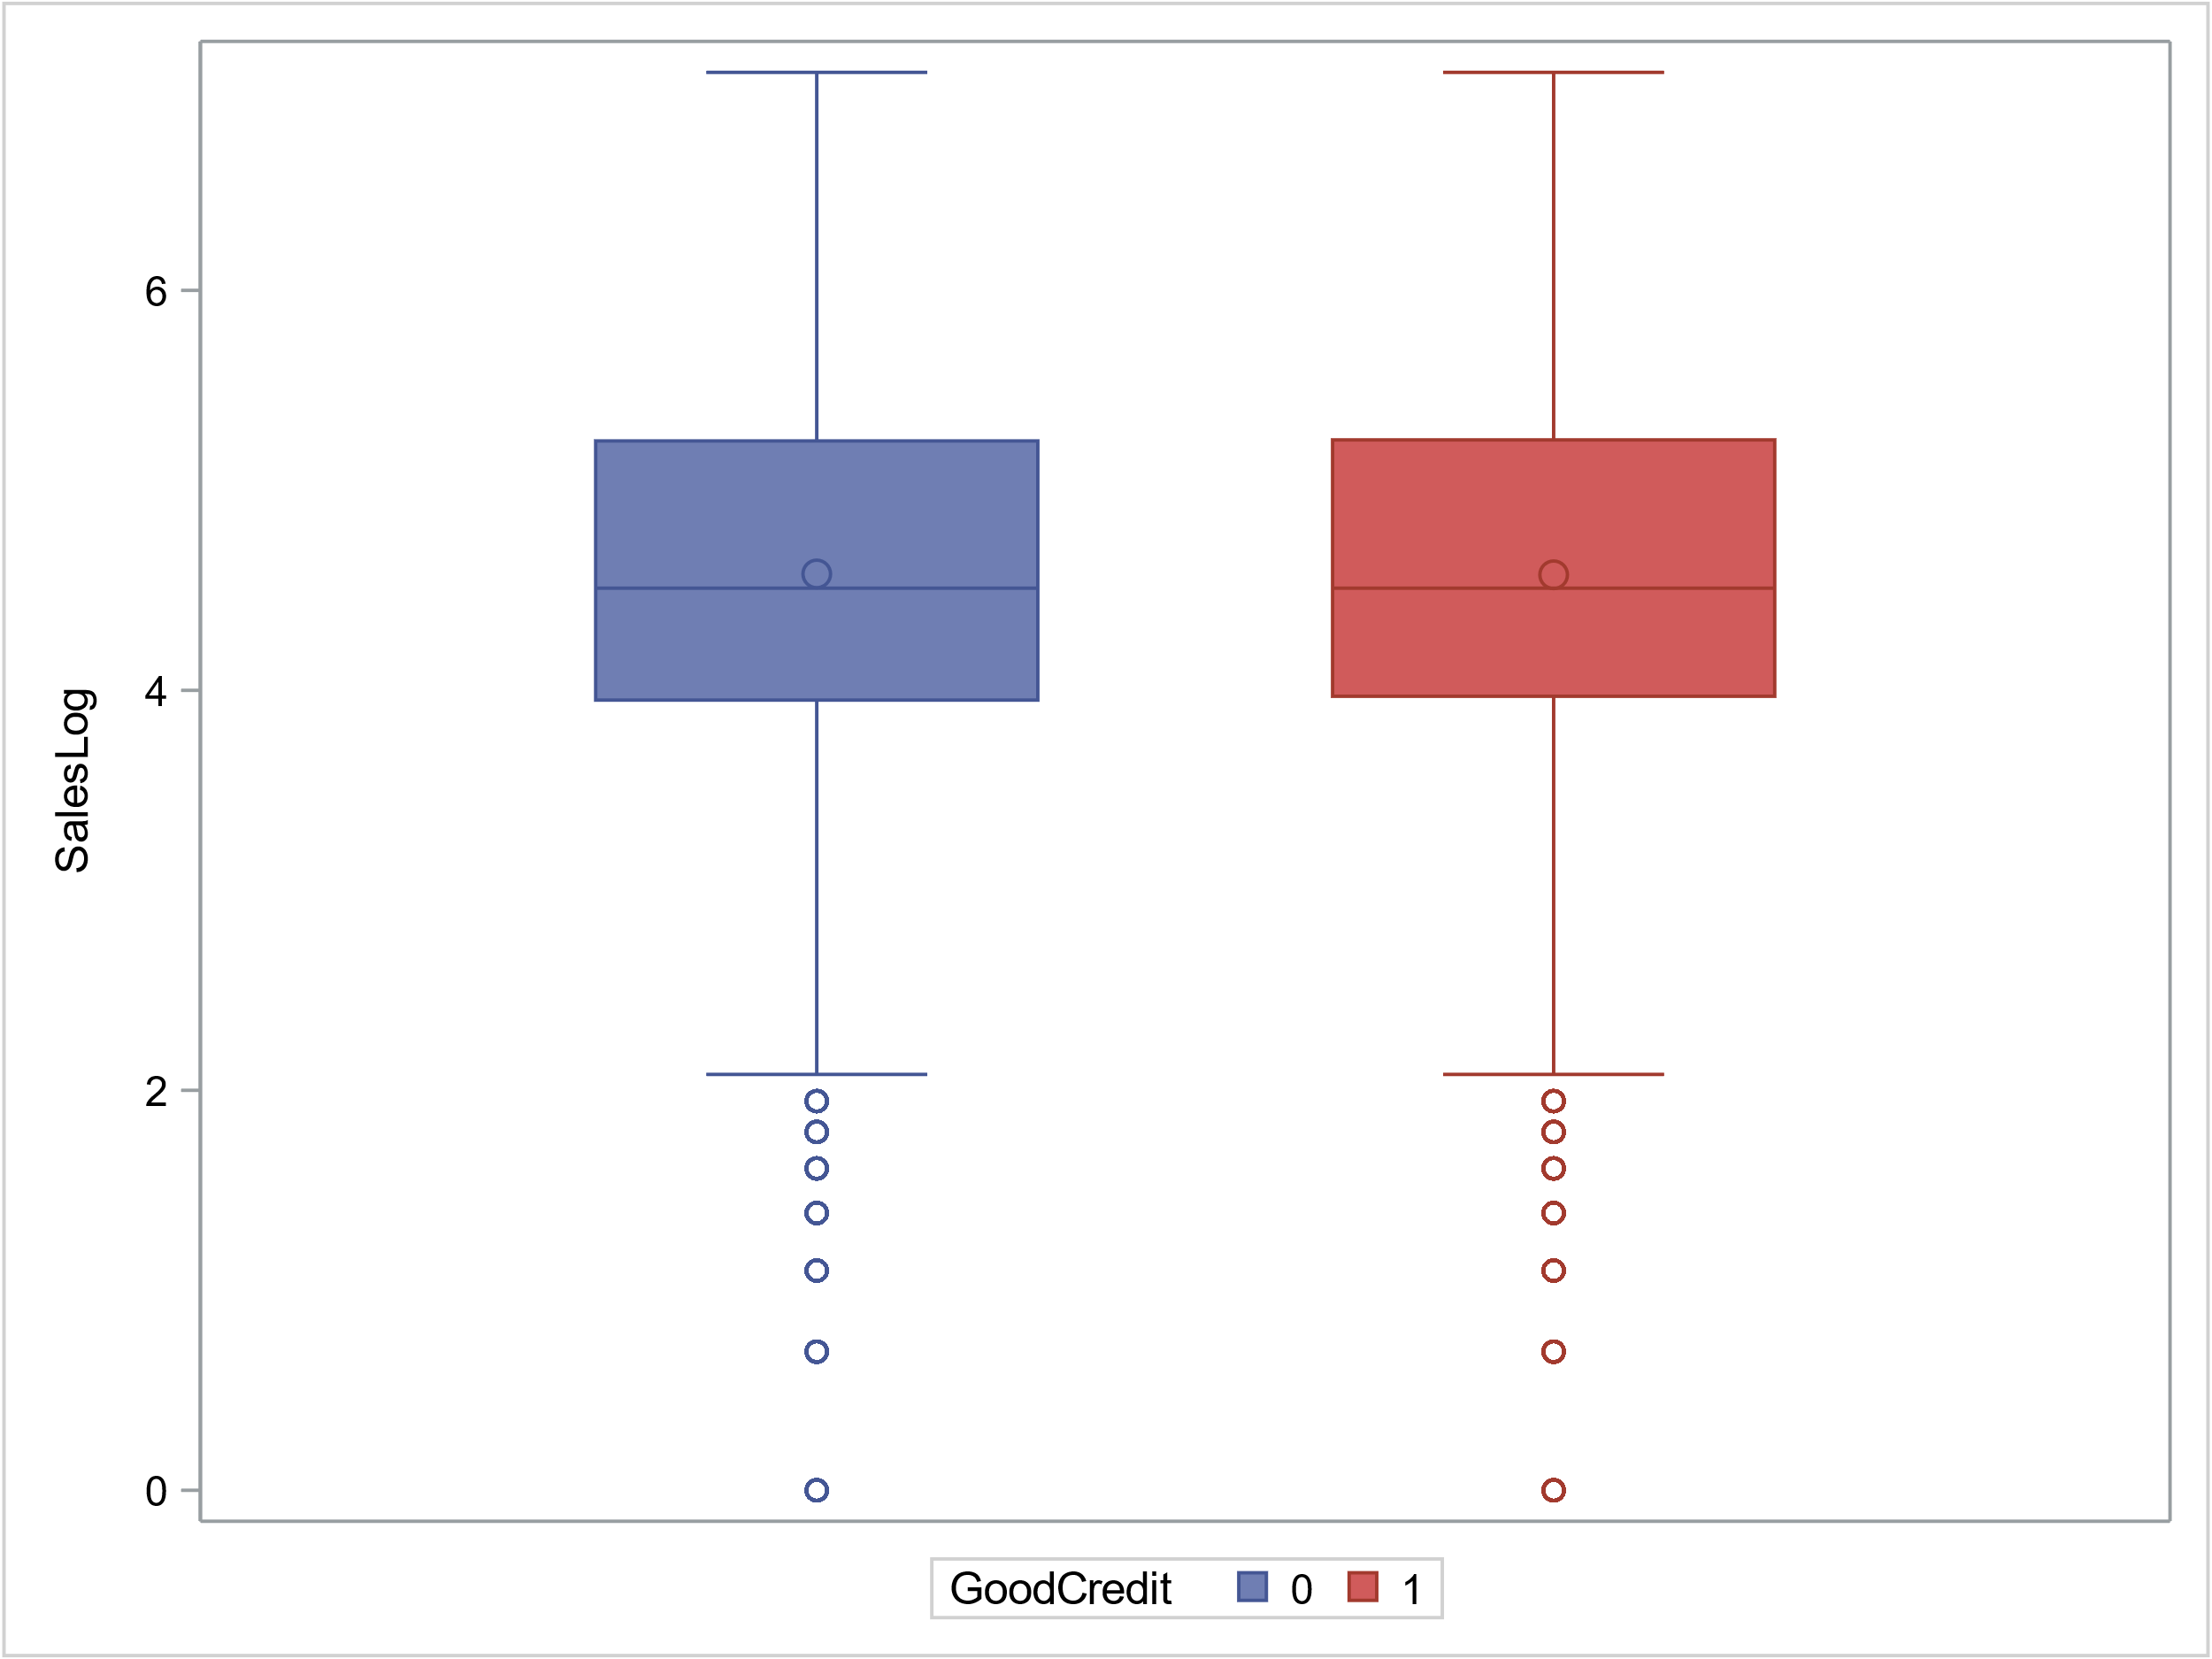
Sales VS. Status / GoodCredit / AgeGrp
Continuous vs. Categorical
Independency
All accounts unique
Normality
Central Limit Theorem
Outliers
Log transformation
Homoscedasticity
Levene’s Test: P > 0.05

Slide 14
Sales VS. Status / GoodCredit / AgeGrp
Null hypothesis: equal means
Sales vs. Status
Pooled T-test: P = 0.8416
No difference in sales between two Status
Sales vs. GoodCredit
Pooled T-test: P = 0.6067
No difference in sales between two GoodCredit
Sales vs AgeGrp
One-way Anova: P = 0.7092
No difference in sales among age groups
Alternative: Mann Whitney U or Kruskal-Wallis test, H0: equal medians

Slide 15
RECOMMENDATION
Analyze sales by month, learn what caused the activation peaks in Decembers and use in future
Build models to study the effects of features GoodCredit, RatePlan, and DealerType have on Tenure and deactivation rate
Consider different marketing strategies for different Tenure segment

Slide 16
Thanks

