Slide 1





Model #1
Model #2
Unlearning Processes/Frameworks
Model #n

Slide 2





Model #1
Unlearning Method #1
Model #2
Unlearning Method #2
Model #n
Unlearning Method #n

Slide 3
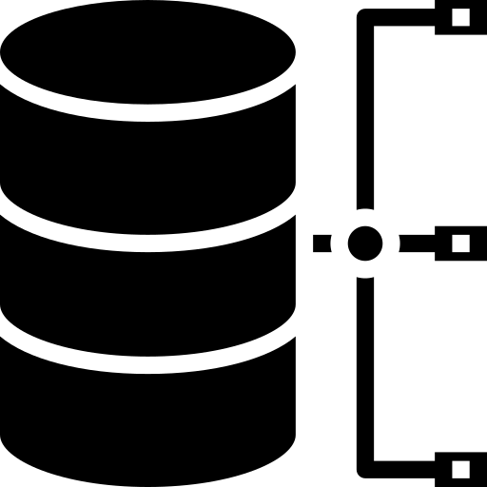

Data Partition
Data Augmentation
Data Influence
Original Data
Data Manipulation Methods
Manipulated Data

