Slide 1

CropScope
ALLOCATION OF SENSORS TO MONITOR
VITAL SOIL AND ATMOSPHERIC FACTORS
THAT AFFECT PLANT GROWTH
Amoah Junior Albert - 3022620
Bonney Samuel Nii Awuley - 3028320
Lawson Isaac Nii Lante - 3033820
Akaya Uche Daniel - 8252419
Supervised by: Dipl. -Ing Benjamin Nii Kommey
01

Slide 2
CropScope
OUTLINE
Proposed Methodology
Introduction
Review of Existing Technology
Conclusion
02

Slide 3



CropScope
WHY ?
Problem Statement
Farmers have been providing farm essentials to
crops based on guesswork. They are not able to accurately determine the needs of
the farms.
03

Slide 4
CropScope
Mobile App
Scope
Specific Factors
Cloud Service for backend analysis
Wireless Sensor Based Network
Frontend Interface
SMS Service
SMS
OBJECTIVES
Sensor Network
Cloud Service Analyzer
04

Slide 5
CropScope
Literature Review
Oguz, Faruk Enes and Ekersular, Mahmut Nedim and Sunnetci, Kubilay Muhammed and Alkan, Ahmet (Enabling Smart Agriculture: An IoT-Based Framework for Real-Time Monitoring and Analysis of Agricultural Data)
Introduced IoT-based framework for agricultural data monitoring.
Integrates sensors for light intensity, temperature, pressure, smoke detection, humidity, and soil moisture.
Facilitates proactive intervention to optimize agricultural practices.
Requires stable Wi-Fi connectivity for data transmission.
05

Slide 6
CropScope
Literature Review
Vijh, Surbhi and Arpita and Bora, Jyoti Prakash and Gupta, Prateek Kumar and Kumar, Sumit (IOT Based Real-Time Monitoring System for Precision Agriculture)
Introduced an IoT-based real-time monitoring system for precision agriculture.
Utilizes DHT11 Humidity Temperature Sensor and capacitive soil moisture sensor for monitoring humidity, air temperature, and soil moisture levels.
Enables farmers to enhance agricultural operations through real-time monitoring and control.
Dependency on stable internet connectivity for remote monitoring and a limited scalability for large-scale agricultural operations.
06

Slide 7
CropScope
Literature Review
Saputra, Dezdyta Poszarevac and Nugraha, M.B. and Tampubolon, Marojahan and Arhan, Kahfi Sabillah (Design and Development of Soil Monitoring System for Precision Farming On Small-Scale Outdoor Farm)
Introduced a user-friendly interface for monitoring plant conditions and nutrition.
Incorporated sensors like DHT-11, YL-69, MQ-135, and BH1750 to measure temperature, soil moisture, humidity, light intensity, and CO2 levels.
Optimizes growth conditions for vegetable crops, catering to the needs of the automated farming industry.
Initial setup and maintenance may require technical expertise
07

Slide 8
CropScope
Literature Review
Audyanisa, Salsabila and Darmawan, Abdi (DESIGN A MONITORING SYSTEM FOR TEMPERATURE, HUMIDITY AND SOIL PH IN IOT-BASED ONION CULTIVATION)
Designed a monitoring system for temperature, humidity, and soil pH in IoT-based onion cultivation.
Utilizes soil pH and DHT11 sensors for measuring soil pH, temperature, and humidity.
Provides real-time monitoring of crucial environmental factors tailored specifically for onion cultivation needs.
Requires regular maintenance and calibration for accurate readings.
08

Slide 9
CropScope
Literature Review
Sabu, Dhiya and Alagumariappan, Paramasivam and Sankaran, Vijayalakshmi and Pittu, Pavan Sai Kiran Reddy (Design and Development of Internet of Things-Based Smart Sensors for Monitoring Agricultural Lands)
Introduce standalone soil monitoring device with solar cells, battery units, and pH/moisture sensors.
pH and moisture sensors interfaced with ESP8266 microcontroller for data collection.
Enhances agricultural management practices for improved crop cultivation.
Initial setup and maintenance may require technical expertise
09

Slide 10
CropScope
Literature Review
Gomathi, S and Raj, Kumar V and Aakash, R Vishnu (Design and implementation of an IoT-based system for monitoring nutrients and irrigation in agricultural soil)
Presented an IoT-based system for monitoring soil nutrients and irrigation, integrating Arduino and ESP8266 modules with sensors like soil moisture, temperature, and NPK.
Utilizes real-time data collection for informed irrigation and nutrient management. Incorporates a smart irrigation system to optimize water usage.
Enhances accessibility and resource efficiency in agriculture.
System scalability may limit practical deployment.
10

Slide 11
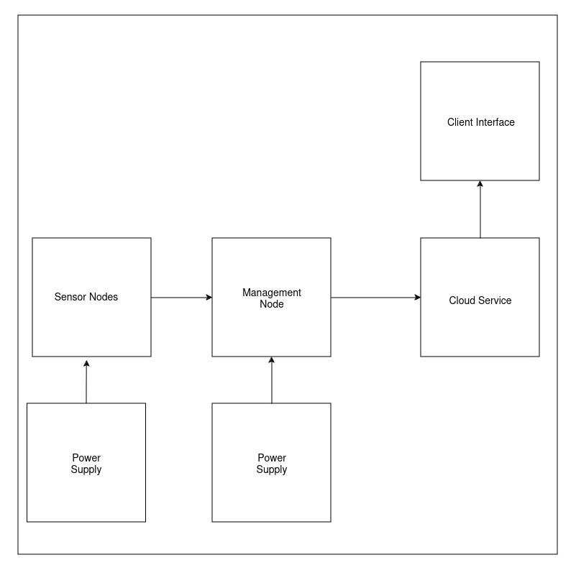
CropScope
SYSTEM ARCHITECTURE
13

Slide 12
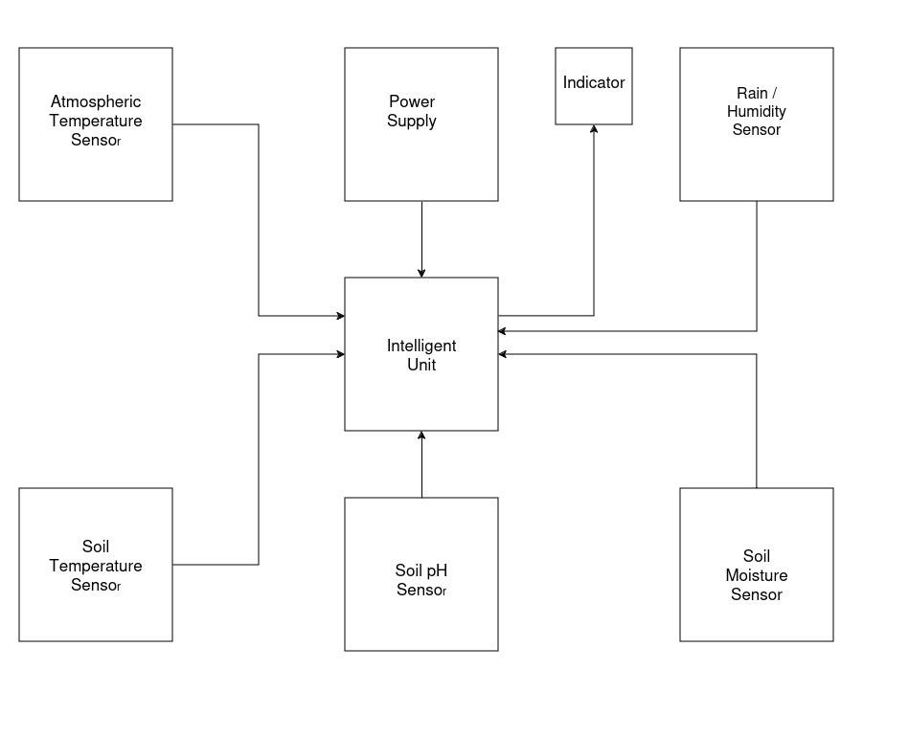
CropScope
HARDWARE ARCHITECTURE
13

Slide 13
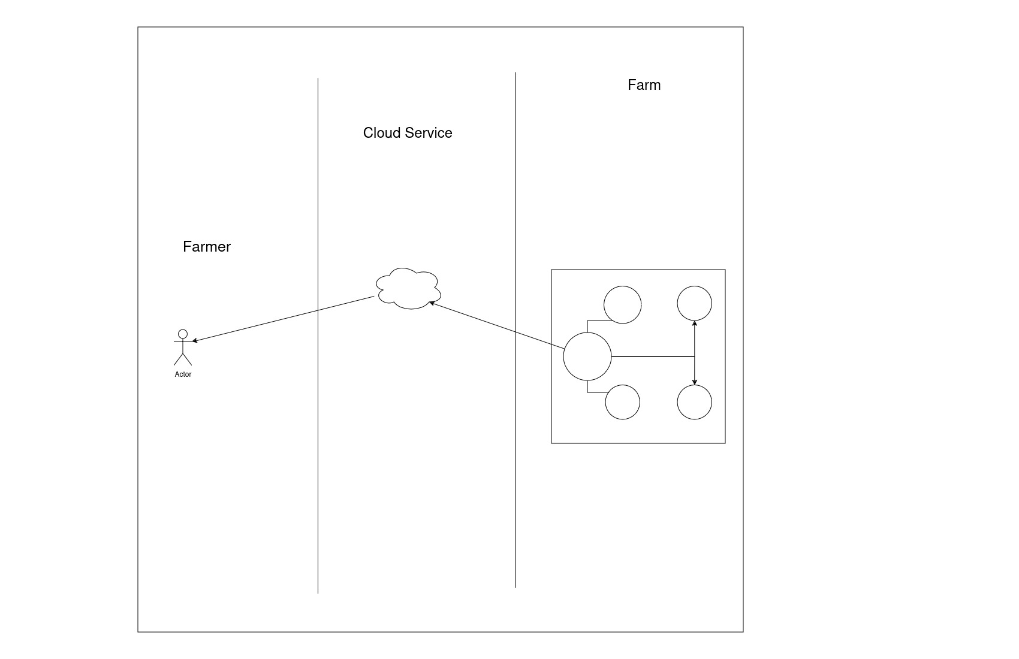
CropScope
USE CASE DIAGRAM
13

Slide 14
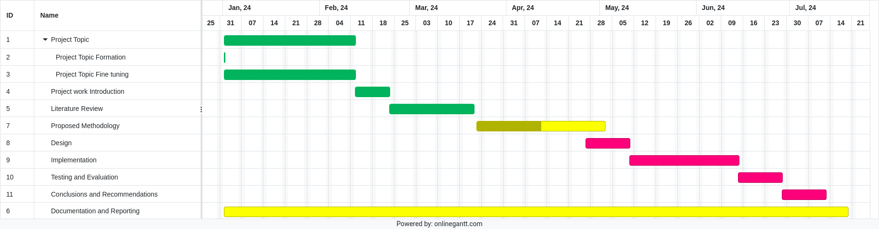

PROJECT TIMELINE
14

Slide 15
CropScope
THANK YOU
15

