Slide 1
Understanding Big Data and Distributed Data Processing
Hadoop
Is a way to distribute very large files across multiple machines.
It uses Hadoop Distributed File System(HDFS).
HDFS allows a user to work with large data sets
HDFS uses MapReduce, which allows computations on that distributed data.
MapReduce is a way of splitting a computation task to a distributed set of files(such as HDFS)
So, we use:
-HDFS to distribute large data sets
-MapReduce to distribute a computational task to a distributed data set.
Notes:
Big Data challenges traditional data processing tools. Hadoop uses HDFS for storage and MapReduce for computation. HDFS allows users to work with large datasets efficiently. MapReduce distributes computational tasks for scalability.

Slide 2
Understanding Big Data and Distributed Data Processing
Spark vs MapReduce
-MapReduce requires files to be stored in HDFS, Spark DOES NOT
-Spark can perform up to 100x faster than MapReduce
-Spark can spill over to disk if the memory is filled
-At the core of Spark is Resilient Distributed Dataset(RDD)
-RDD has 4 main features:
*Distributed Collection of Data
*Fault-tolerant
*Parallel operation-partitioned
*Ability to use many data sources
RDDs are immutable
-Two types:
*Transformations: Are the recipe to follow
*Actions: Perform what the recipe says to do and return sth. back.
RDD vs Dataframe
-Spark 2.0 moved from RDD to Dataframes
-Spark dataframe documentation
Notes:
Big Data challenges traditional data processing tools. Hadoop uses HDFS for storage and MapReduce for computation. HDFS allows users to work with large datasets efficiently. MapReduce distributes computational tasks for scalability.

Slide 3
Spark vs MapReduce & RDDs
Spark vs MapReduce:
- Spark doesn’t require HDFS; up to 100x faster.
- Can use disk storage if memory is full.
Resilient Distributed Dataset (RDD):
- Distributed, fault-tolerant, partitioned, supports many data sources.
- Immutable; supports transformations (recipes) and actions (execution).
DataFrames: Spark 2.0 introduced DataFrames for more efficient data handling.
Notes:
Spark offers significant speed and flexibility advantages over MapReduce. RDDs are the core of Spark, enabling distributed and fault-tolerant data processing. DataFrames provide a more efficient and user-friendly way to handle data in Spark.

Slide 4
SETTING UP PYTHON WITH SPARK
Realistically Spark wont' be running on a single machine, it will run on a cluster(a group of machines) on a service , like AWS.
-Databricks is a company founded by the creator of Spark. It provides clusters that run on top of AWS and has Notebook System already set up.
-It has a free community version that supports a 6 GB cluster.
-It also has its own storage format known as DBFS.
Go to: https://databricks.com/try-databricks
Login with email, you'll get sent a verification code. 29@
or use the P. DB_hbl432025

Slide 5
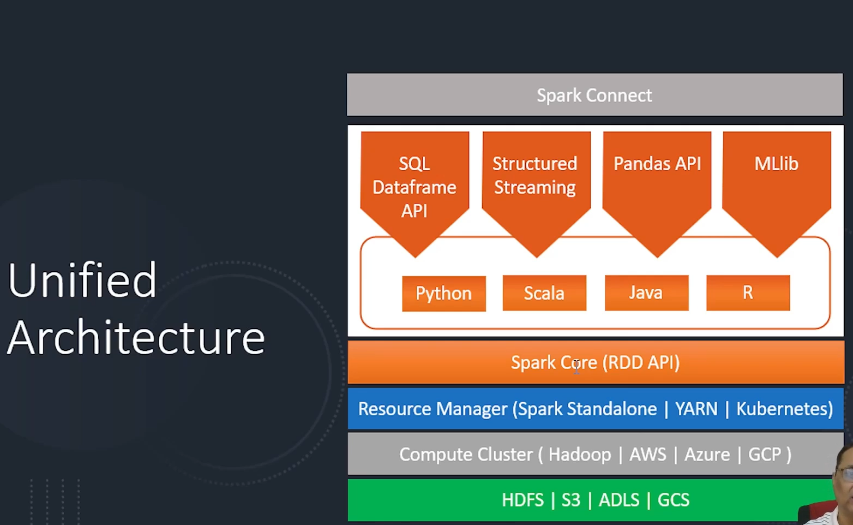
Architecture
Spark only includes these in yellow.
The others below are not part of Spark
Spark needs all the complete plateform (all the modules)
There are two types:
Cloud Platform; Databricks
On Premise Platform; Cloudera Hadoop
Cluster is a group of computers working together
Notes:
Spark is designed for cluster computing, making it scalable and efficient. Databricks simplifies Spark setup and management, especially for Python users. Spark’s architecture supports robust distributed processing.

Slide 6
Architecture
Spark only includes these in yellow.
The others below are not part of Spark
Cluster is a group of computers working together
Notes:
Spark is designed for cluster computing, making it scalable and efficient. Databricks simplifies Spark setup and management, especially for Python users. Spark’s architecture supports robust distributed processing.

Slide 7
Spark needs a development environment
Notebooks –Cloud.
IDE-Local Machine. Any IDE to program
Notes:
Spark is designed for cluster computing, making it scalable and efficient. Databricks simplifies Spark setup and management, especially for Python users. Spark’s architecture supports robust distributed processing.

Slide 8
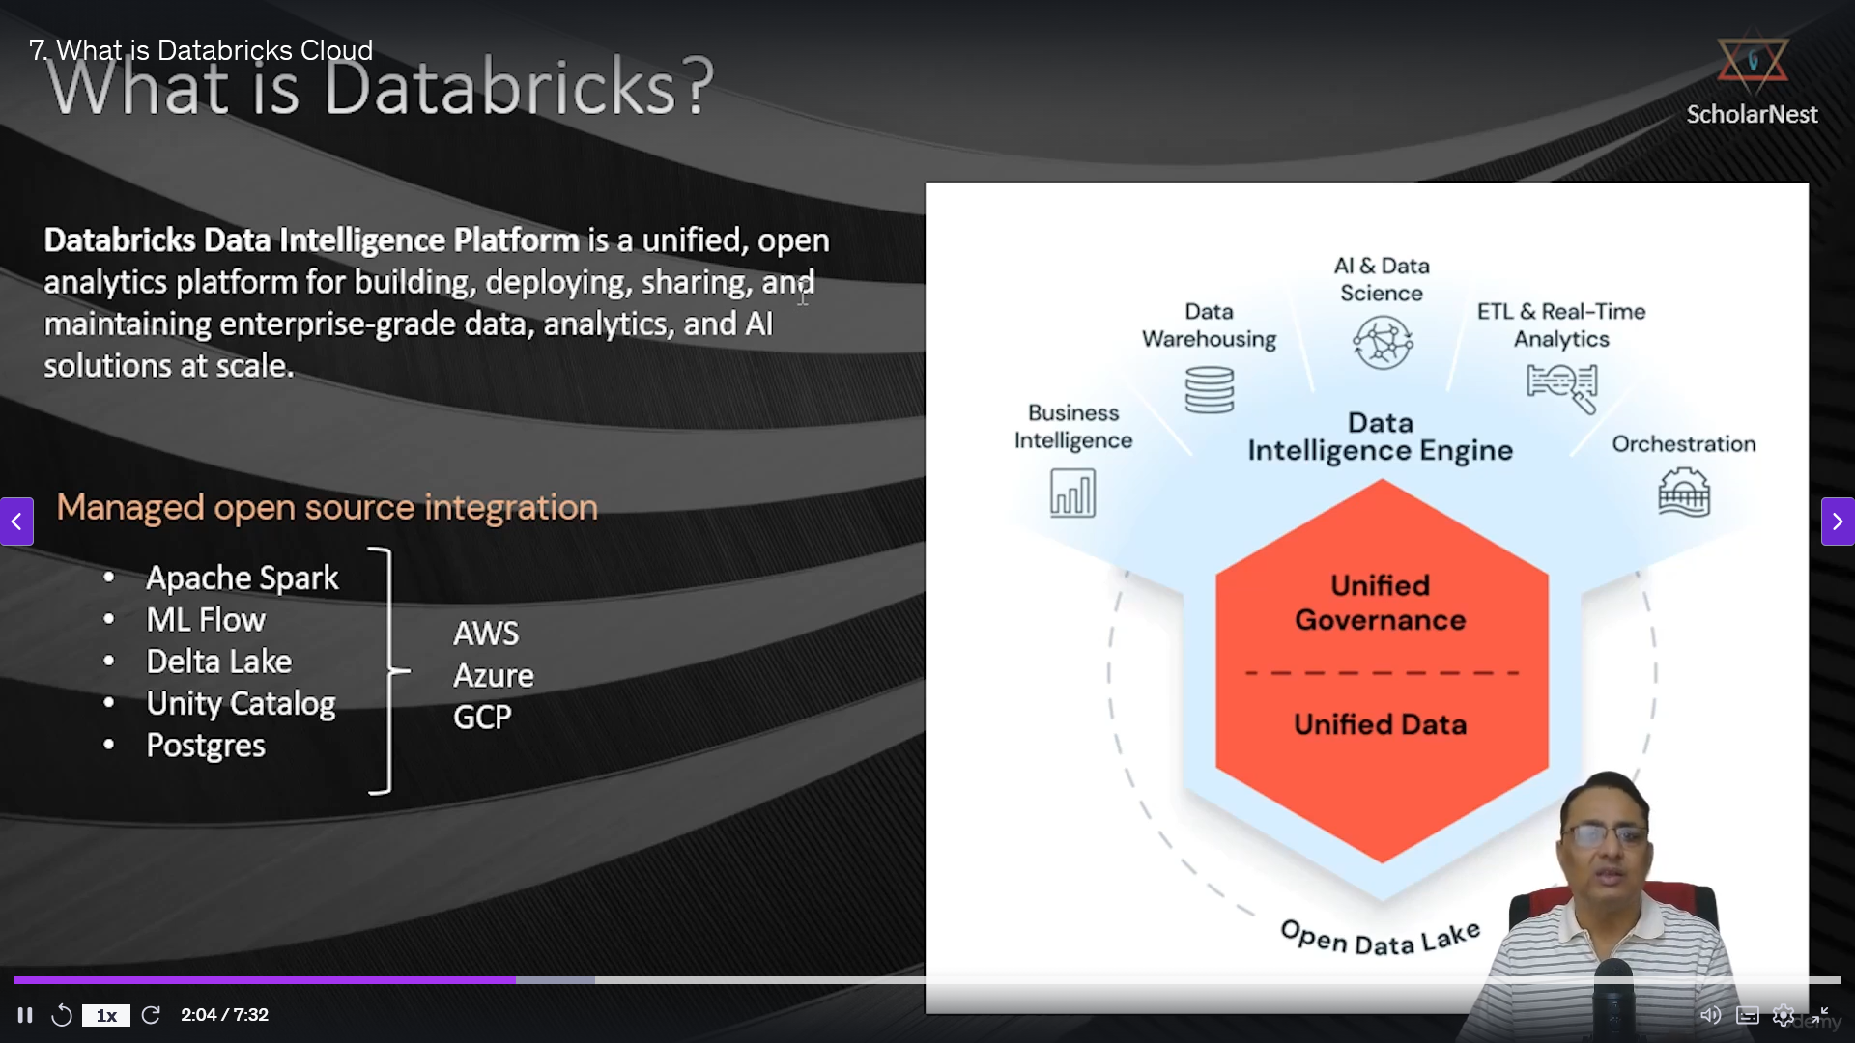
What is DatBricks?

Slide 9
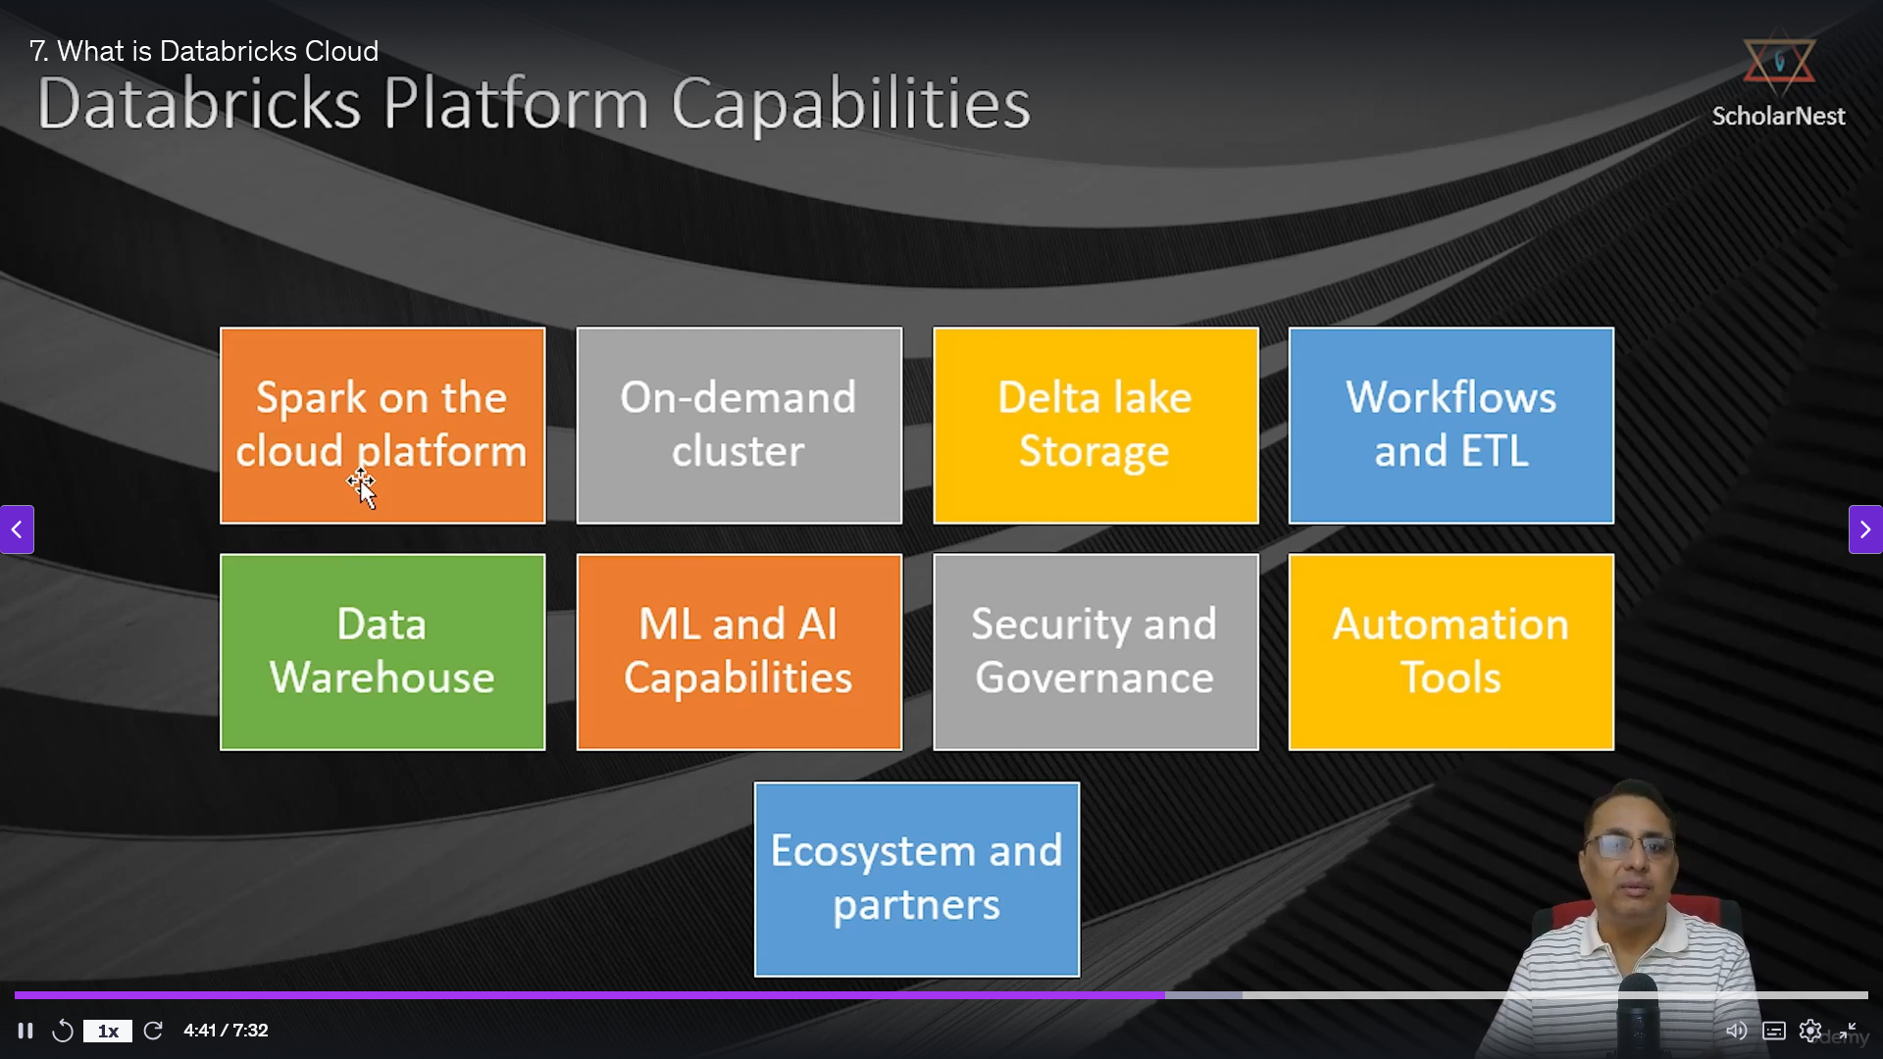
Spark main capability

Slide 10
What is DatBricks?
Create Catalog, Database, Volume
Section 2: Setup your hands on environment
A catalog is the primary unit of data isolation and organization. It contains schemas and volumes.
Catalog
A catalog is the primary unit of data isolation and organization. It contains schemas and volumes.
Database (Schema)
A schema (also called a database in Databricks SQL terminology) represents a more granular grouping within a catalog
Volume
A Unity Catalog object used to access, govern, and organize files in cloud object storage, including non-tabular data. Volumes are created within a schema. A volume is a Directory where files are stored

Slide 11
What is DatBricks?
Import Data ingestion utilities
Open the data-ingestion file
Workspace/ utils/ data-ngestion
What is DatBricks?
Ingest Datasets
See the code in the notebook

Slide 12
What is DatBricks?
Create a table
See the code in the notebook
What is DatBricks?
Load course data
See the code in the notebook

Slide 13
What is DatBricks?
Query the table
See the code in the notebook

Slide 14
What is DatBricks?
Run a notebook
To run any Notebook you need either a node(single computer) or a cluster(group of computers)

Slide 15
What is DatBricks?
Run a notebook
To run any Notebook you need either a node(single computer) or a cluster(group of computers)

Slide 16
What is DatBricks?
Dat Enginneering ETL/ELT
Extract
- What: Read from the source system
- How: Ingestions tools/Spark Source System Connector
Load
- What: Save to Data Lake
- How: Ingestions tools/Spark Source System Connector
Transform
- What: Process/Prepare data as per your requirement
- How: Spark Dataframe/Spark SQL
1. Read from data lake: Spark Session
2. Transform: Dataframe/SQL
3. Save: Dataframe/SQL
The order of applying them varies. Apache ONLY SUPPORTS ELT

Slide 17
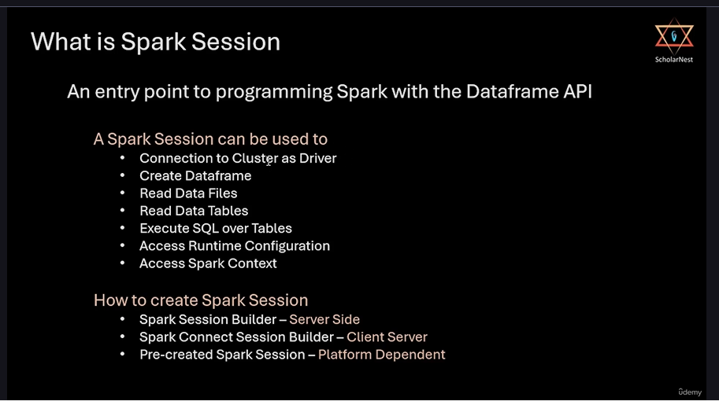
What is DatBricks?
Spark Session

Slide 18
How to create a Spark session?
Two main ways:
Spark session builder
- Server Side
Spark Connect Session builder
- Client Server
Spark Session

