Slide 1

Running LLM’s locally
‹#›
July 2024

Slide 2
What are LLMs?
Some important areas LLMs benefit:
Large language models (LLMs) are a category of foundation models trained on immense amounts of data making them capable of understanding and generating natural language and other types of content to perform a wide range of tasks.
Text generation
Content summarization
AI assistants
Code generation
Sentiment analysis
Language translation

Slide 3
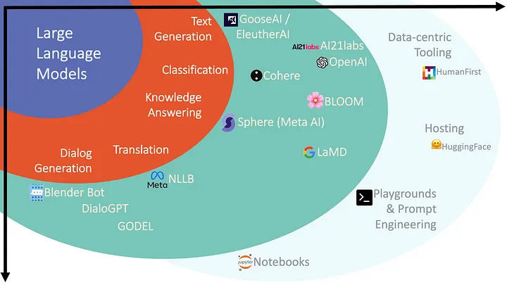
Large Language Model landscape
Ref: https://cobusgreyling.medium.com/the-large-language-model-landscape-9da7ee17710b

Slide 4
Why run locally?
Data privacy and Security
Compliance with data protection regulations
Reduce latency and Improve performance
Cost efficiency
Hardware performance Tuning and Optimization

Slide 5
Running LLMs locally:
Hugging Face and Transformers: Hugging Face is the Docker Hub equivalent for Machine Learning and AI, offering a large array of open-source models. It provides transformers, a Python library that streamlines running a LLM locally.
Langchain: is a Python framework for building AI applications. It provides abstractions and middleware to develop your AI application on top of one of its supported models.
Llama.cpp: is a C and C++ based inference engine for LLMs, optimized for Apple silicon and running Meta’s Llama2 models.
Llamafile: developed by Mozilla, offers a user-friendly alternative for running LLMs. Llamafile is known for its portability and the ability to create single-file executables.

Slide 6
Ollama: is a more user-friendly alternative to Llama.cpp and Llamafile. You download an executable that installs a service on your machine. Once installed, you open a terminal and run a LLM locally.
GPT4ALL: GPT4ALL is an easy-to-use desktop application with an intuitive GUI. It supports local model running and offers connectivity to OpenAI with an API key.
Some other solutions are LM Studio, Nextchat, Jan AI, ONNX etc

Slide 7

DEMO

