Slide 1

CarMax College Analytics Contest
—--Albert Long, Steve Zeng, Hank Xing

Slide 2
Contents
Introduction and Problem Definition
Methodology
Result
Conclusion

Slide 3
Background
Depression due to COVID-19 pandemic
Regulations to reduce emissions
Chip shortage
Need to do more….

Slide 4
Problem Defination
Predict Price→Customer Satisfaction
Tree Model: 1. Find Important Factor
2. Classify Customer Type
3. Push AD According to Type

Slide 5
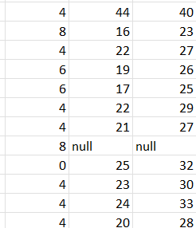
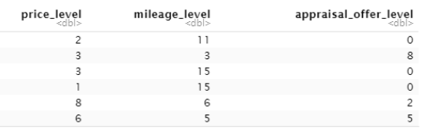
Methodology
Remove null values
Firstly, we do data mining to remove all the observations that have missing data. Then, we notice that there are some string variables that are distributed in some intervals, such as price, appraisal offer, mileage, etc. Consequently, we convert the variables to some digit levels, so that we can use these variables to make our prediction.

Slide 6
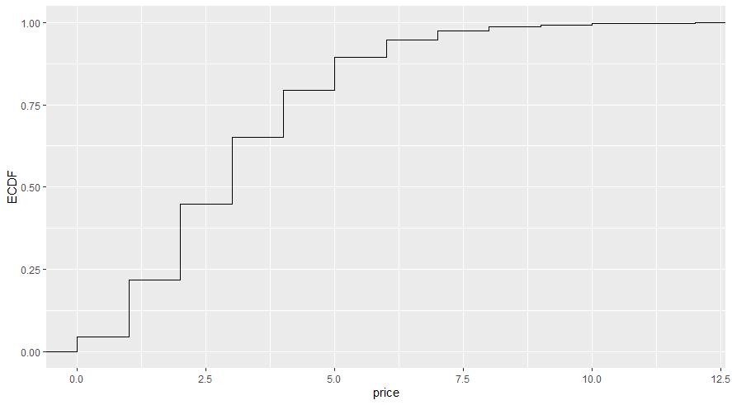
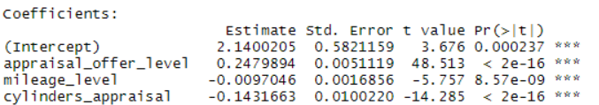
Methodology
***: The P-value is less than 0.001. We reject the null hypothesis and conclude that these variables are significant.
In addition, we choose some variables that can be used to predict the price level. After that, we firstly use linear regression to find out the relationship between variables and the price level of the car, and we find out that the linear regression model is significant.

Slide 7
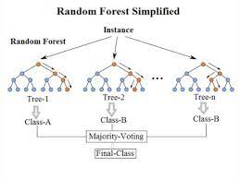
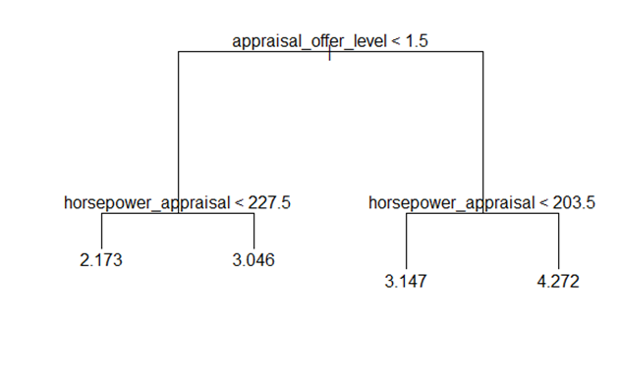
Methodology
To improve our model, we choose the tree-based model to classify how we should triage the customers of various different models. Finally, use random forest to improve further to provide customers with the corresponding new car price level information.

Slide 8
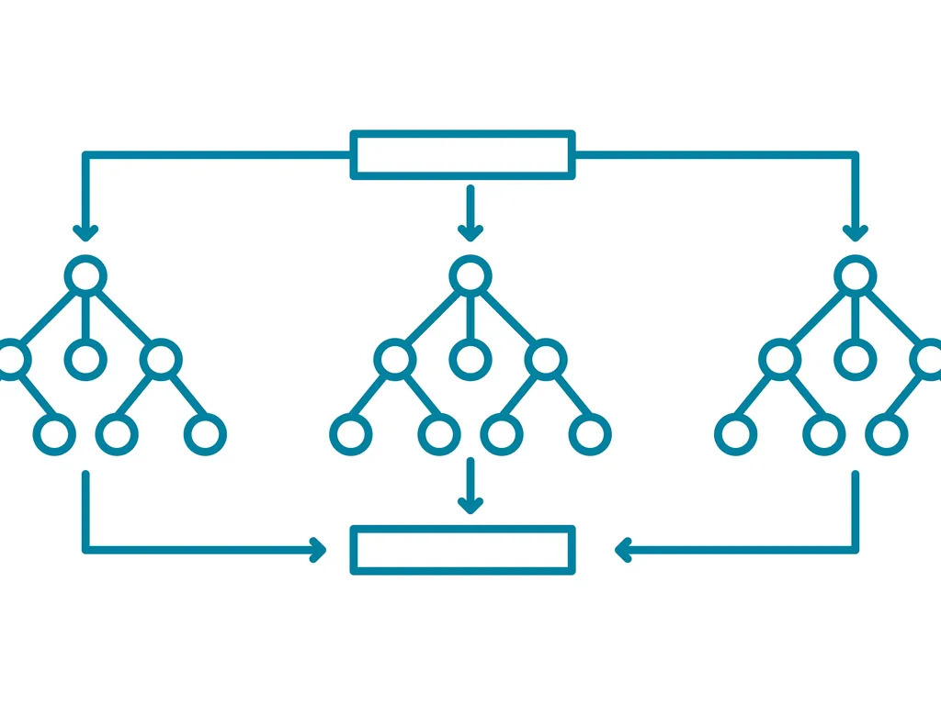
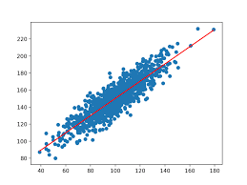
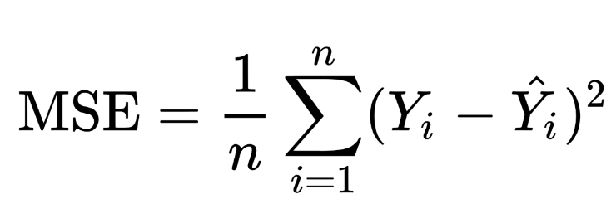
Conclusion
As a result, we compare the prediction results of three regression methods for price bias between sold price and appraisal price, and finally choose the random forest model as our predict model, since it has the lowest Mean squared error.

Slide 9
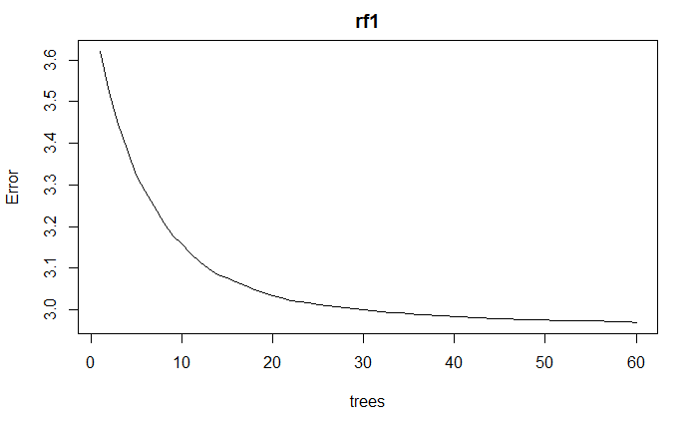
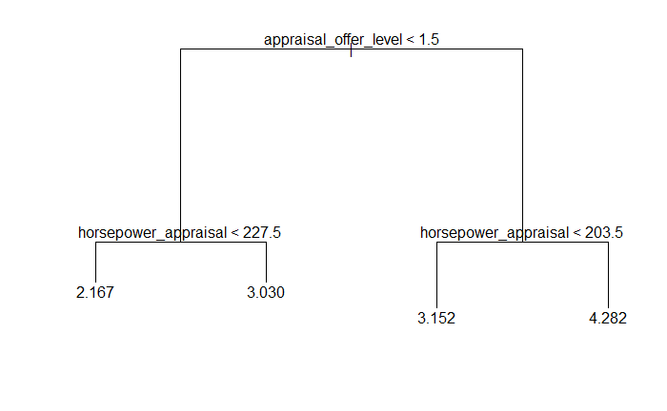
Conclusion
As you can see, as the number of trees increases, the final error decreases, and our predicted final price error drops from about 3.6 in the original linear regression to less than 3.

Slide 10
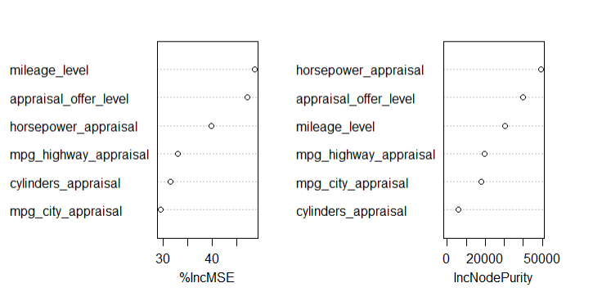
Conclusion
Finally, in our regressions, we found the numerical factors with the most weight, mainly due to the owner's original car's horsepower, the appraisal offer we provided, and the mileage.
We think that this may be most directly indicative of the original owner's car habits. Based on this we can also make the most valuable and closest recommendation to his needs.

Slide 11

Conclusion
Predicting customer needs and personalizing recommendations through data will be a major trend in the future of business, and this approach will accurately save users' time and effectively lead to transactions. We have deduced the range where the user's possible new car is located based on the data of all the customer's previous cars, and developed a new training model to successfully reduce the accuracy of the predicted range from level 6 to about level 2, which will bring more effective help and detailed service to the user.
In the future, the introduction of more accurate, mathematical models with more data and better fitting in used car transactions would revolutionize our recommendation system. We believe that today's experiment is just the beginning, and the continuous progress will eventually make the CarMax platform give users more detailed, thorough and rapid recommendations and services.

Slide 12
Thank you very much for watching this video!

