Slide 1

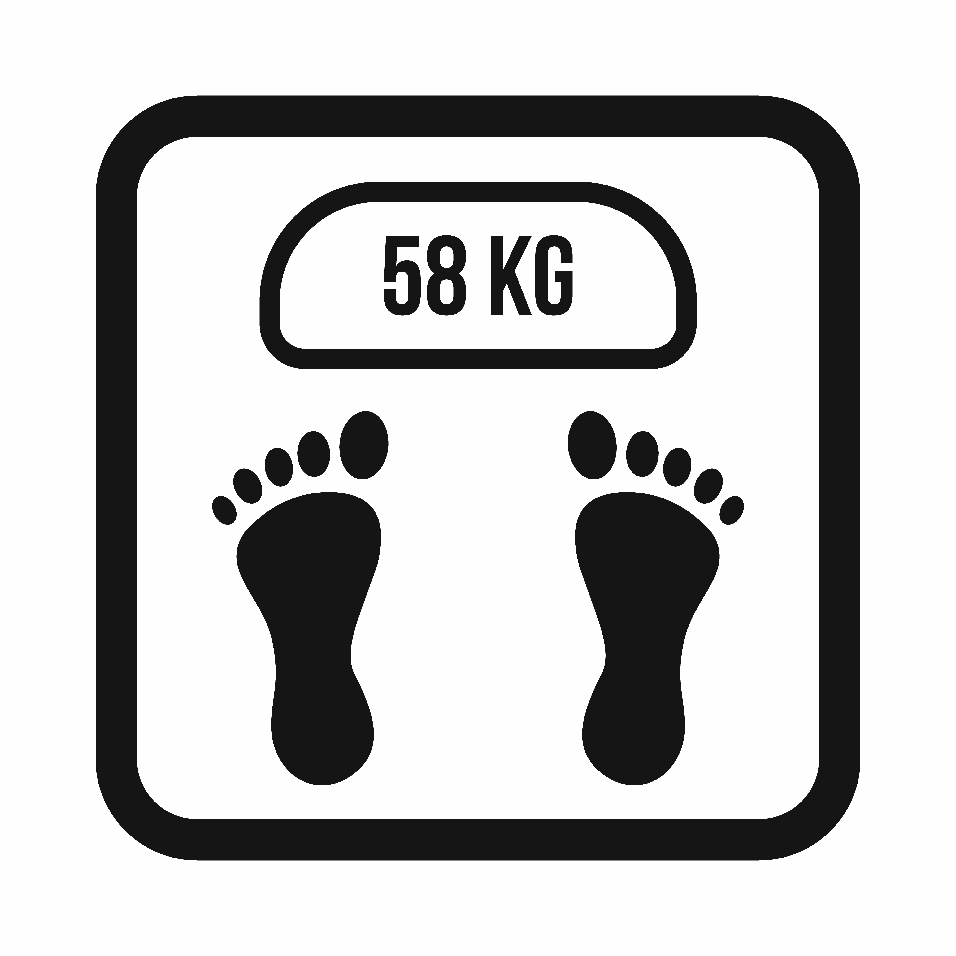

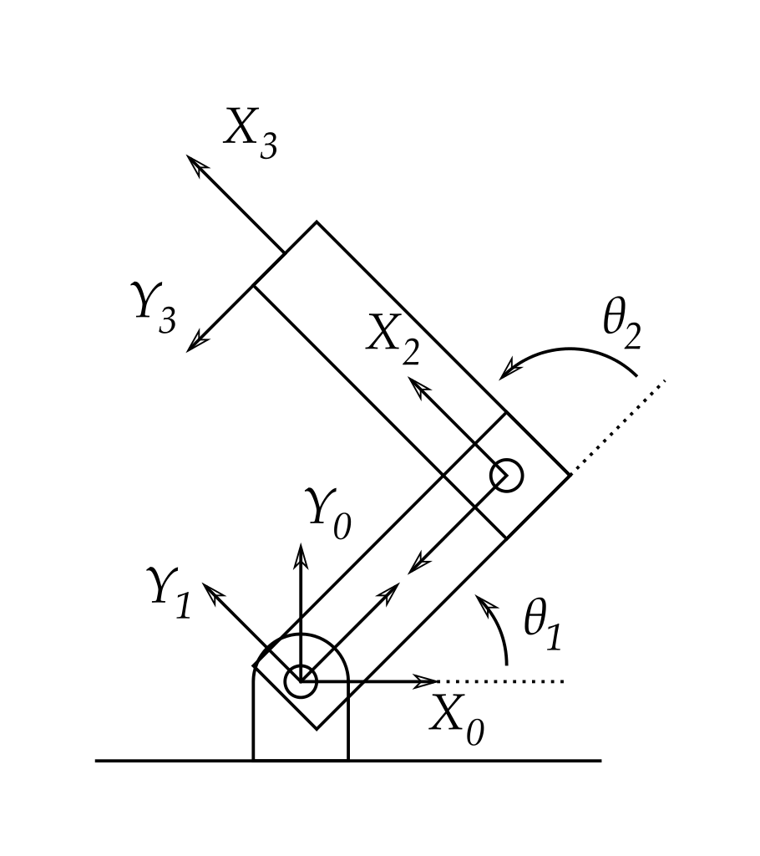
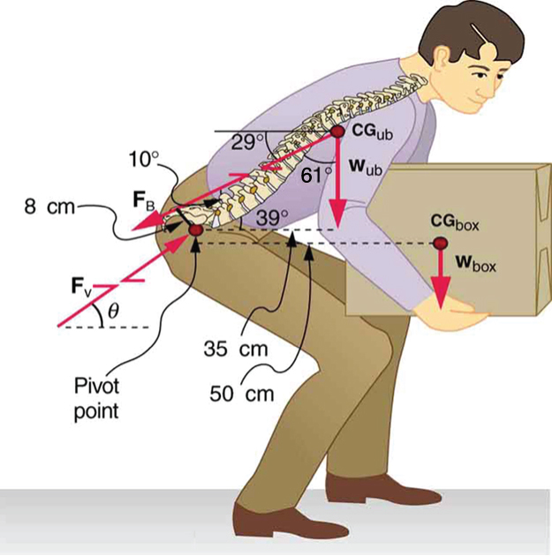
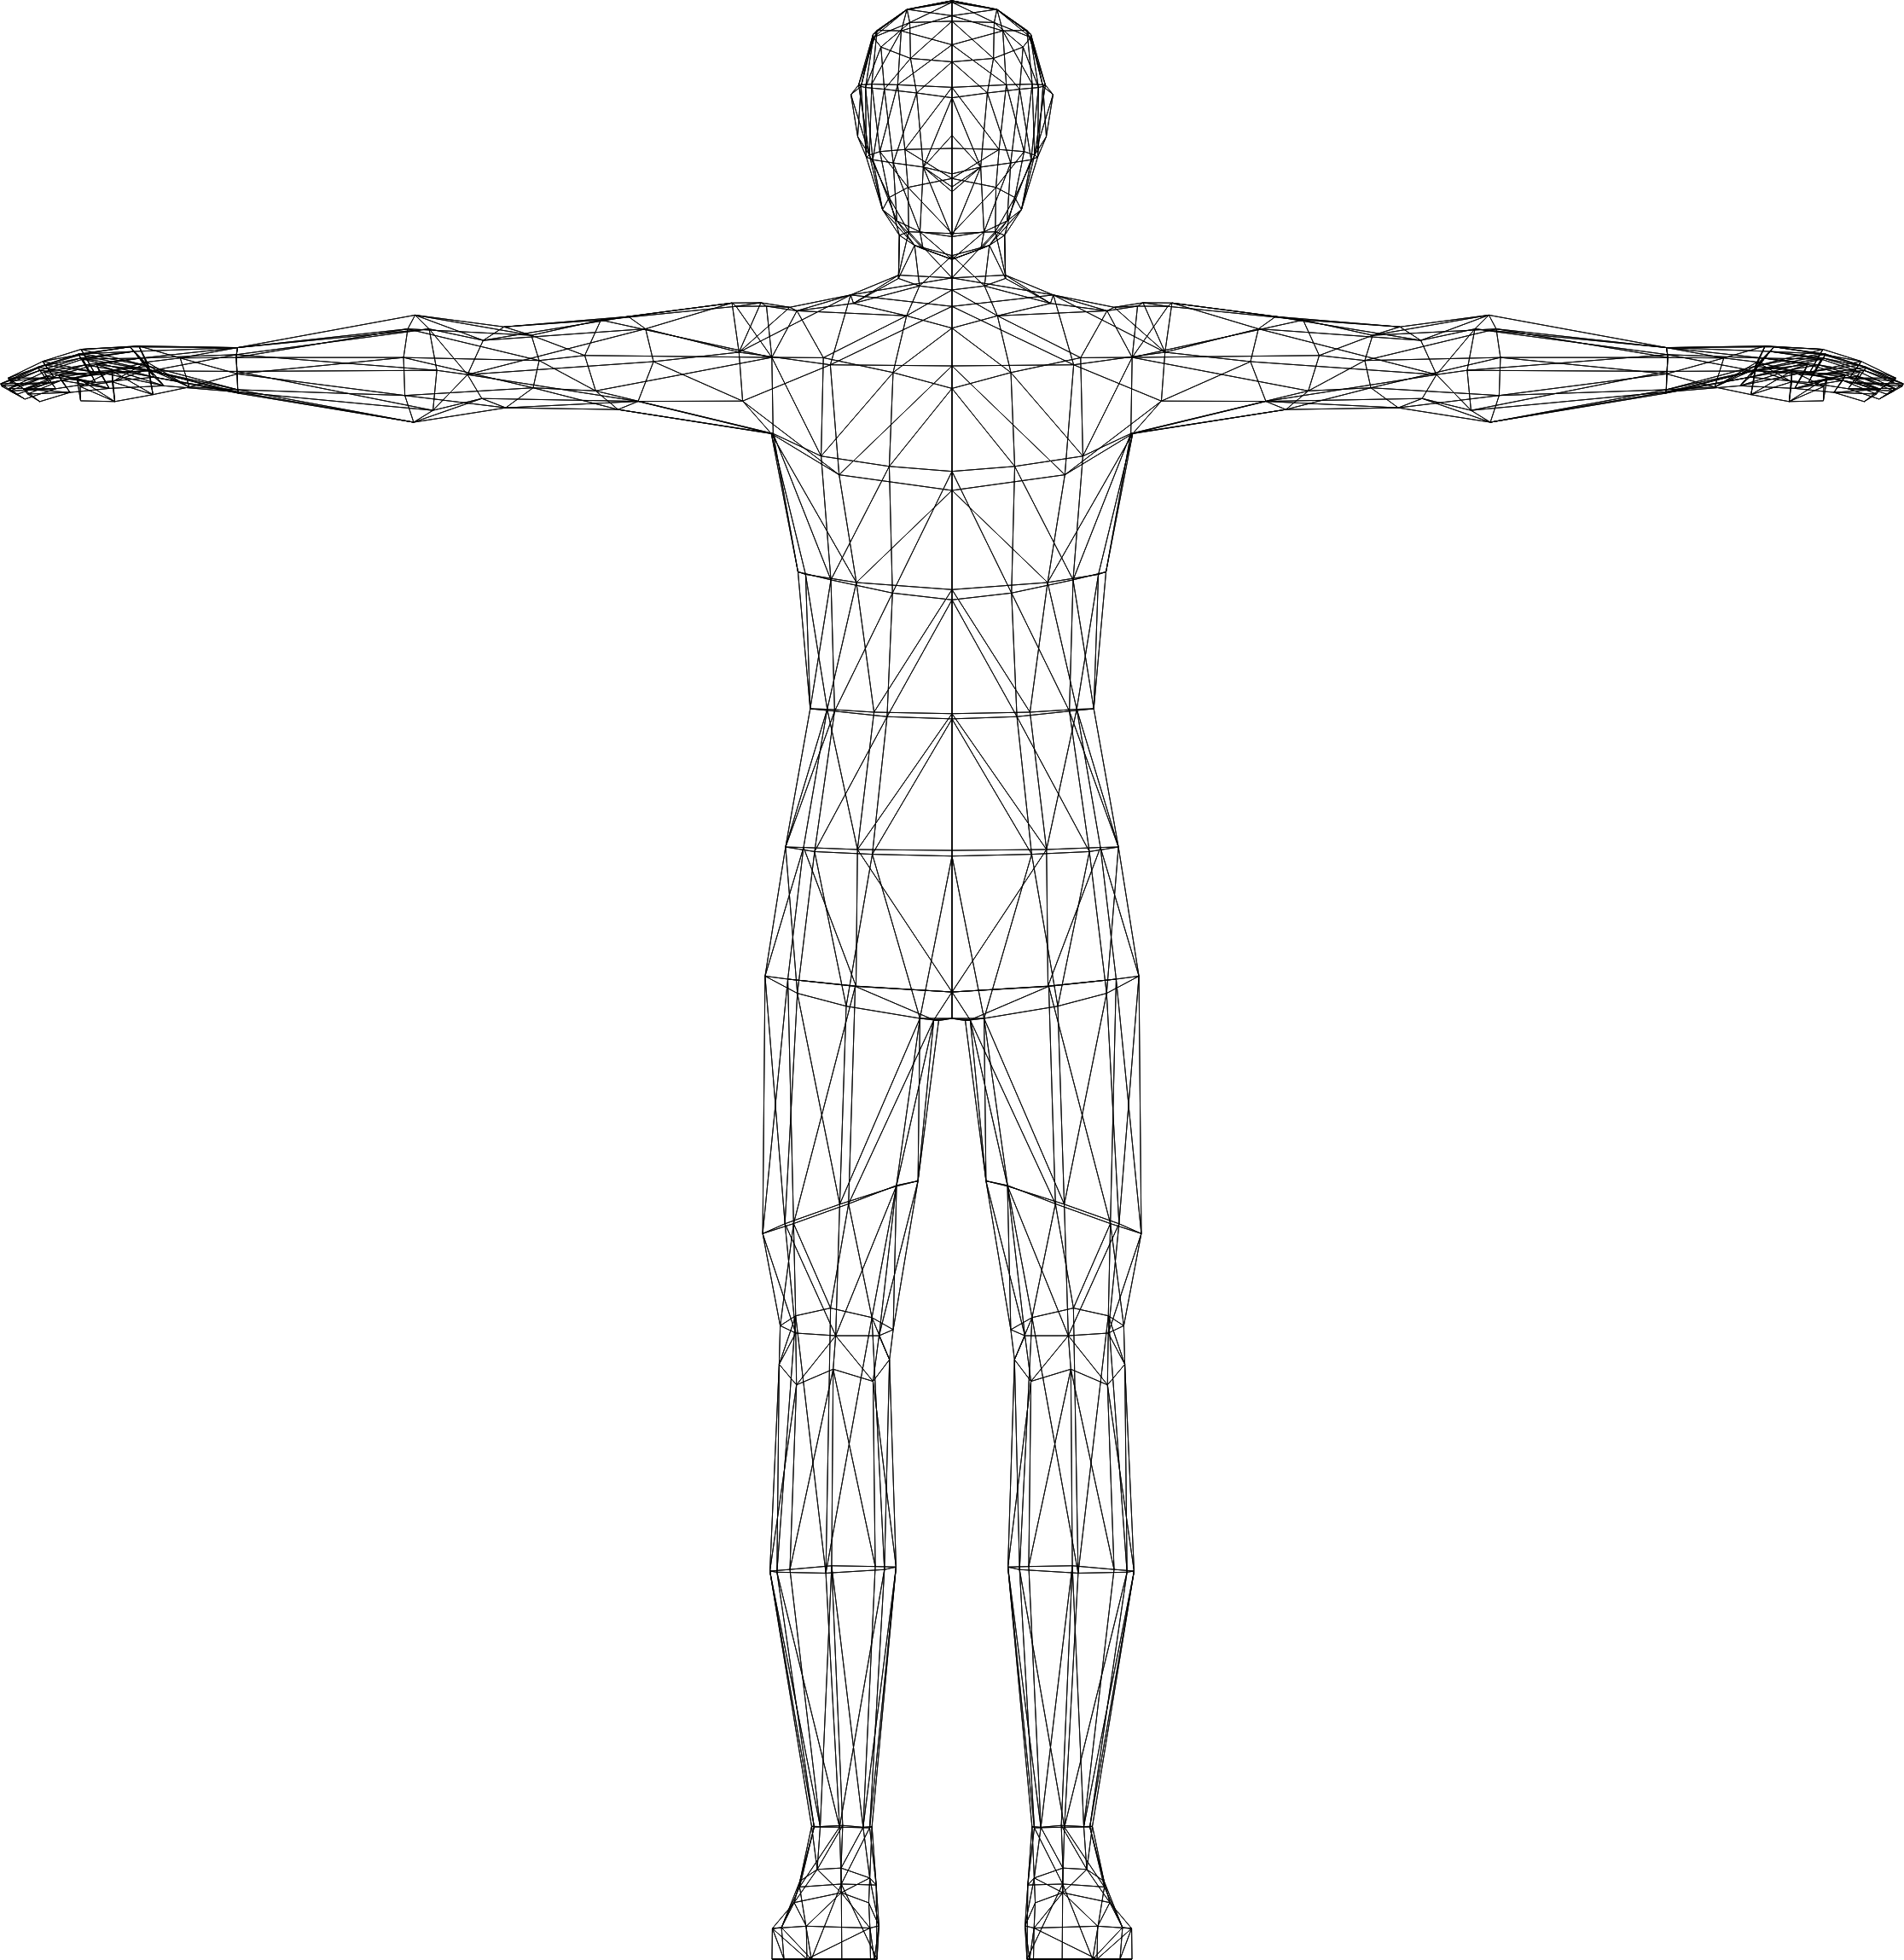
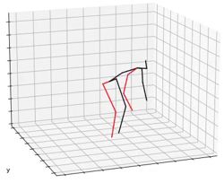
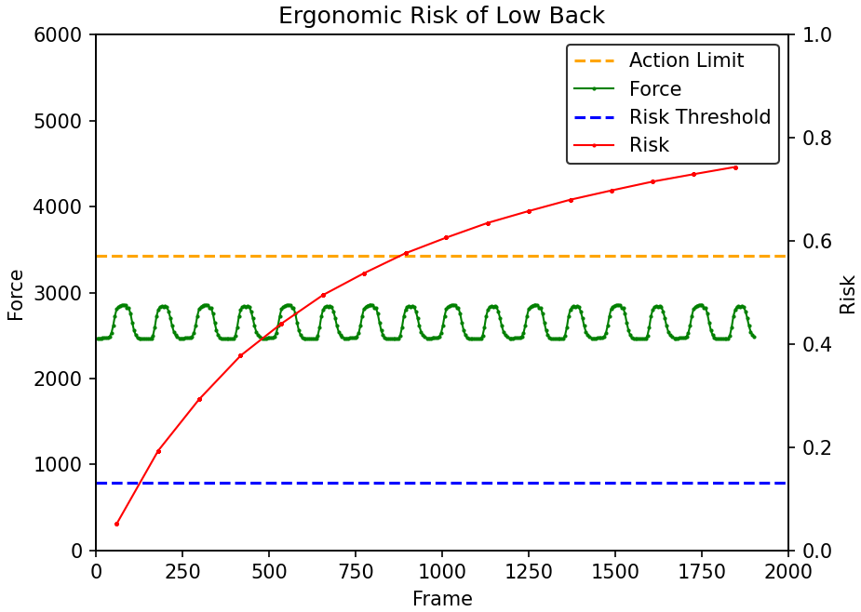
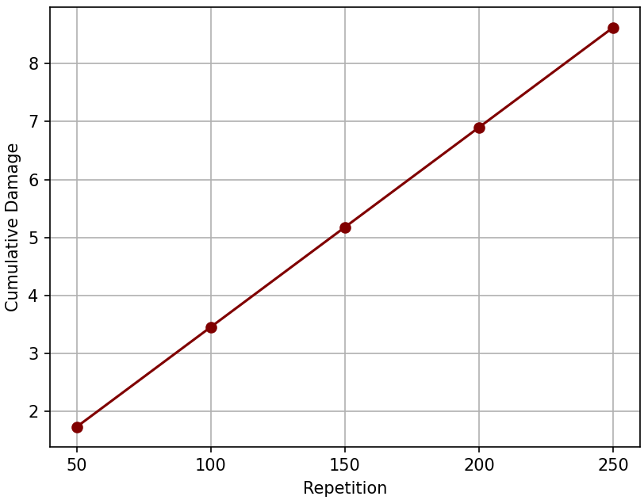
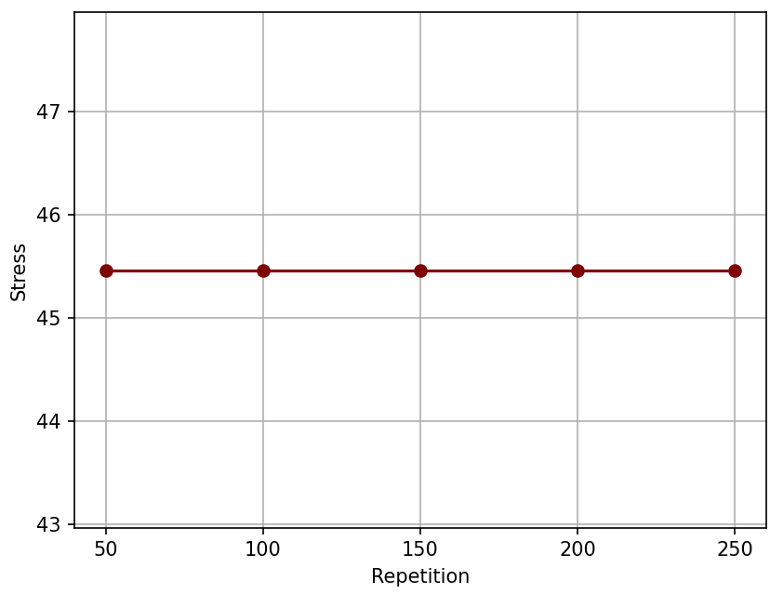
(a) Biomechanics Analysis Model
Normal Camera
Camera’s Frame Rate
Body Weight
Load Weight
Extract Every 4 frames
Human
3D Pose Estimation
Acceleration Analysis
Inverse Dynamics
(b) Ergonomic Cumulative Damage and Risk Assessment Model
Injury Risk % over Time
Cumulative Damage over Time
Stress over Time
Figure 1. Overall Pipeline of the Ergonomic Injury Risk Assessment

Slide 2


Figure 2. The entire set up of the monocular vision-based human pose estimation

Slide 3
0
5
10
15
0’
1’
2’
3’
Figure 3. Illustration of Frame Extraction

Slide 4
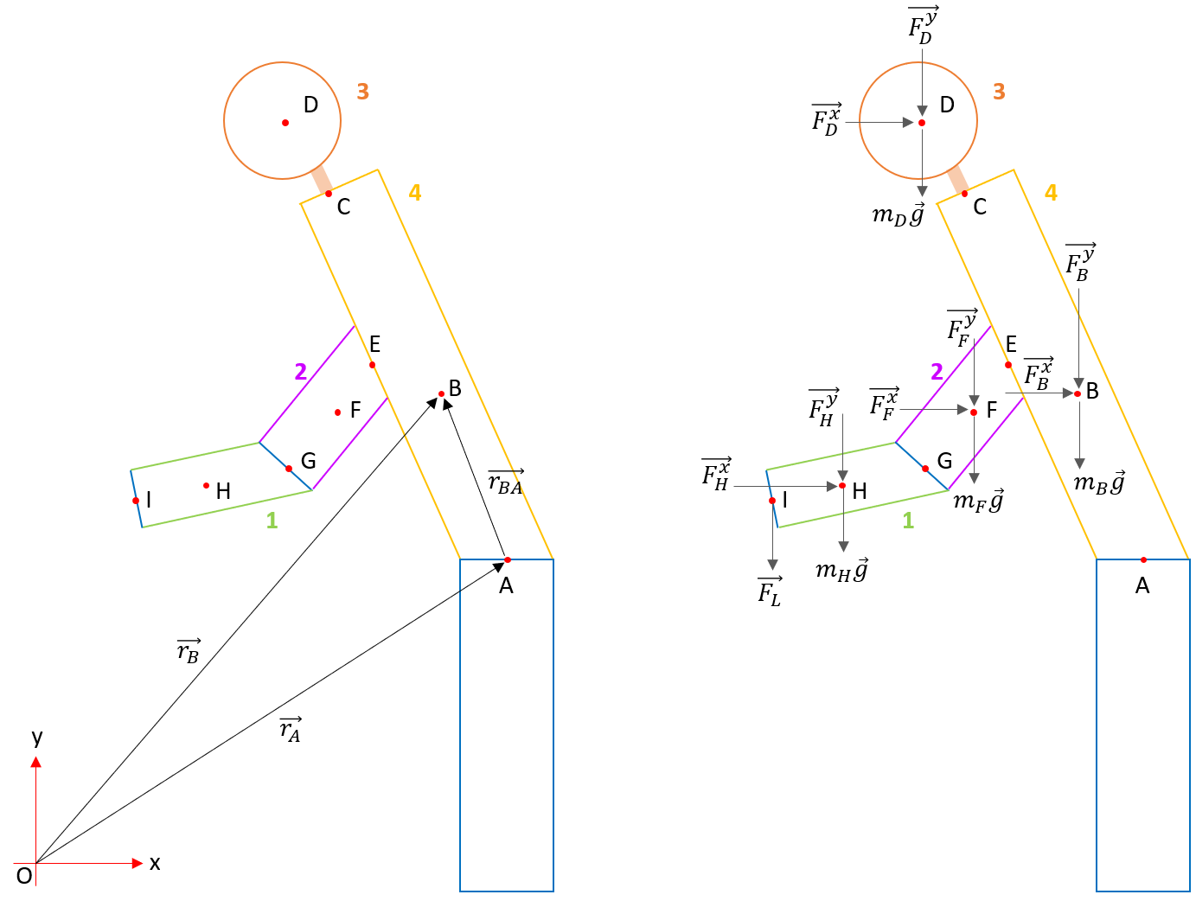
(a)
(b)
Figure 4. (a) Coordinate system and (b) free body diagram of the subject

Slide 5
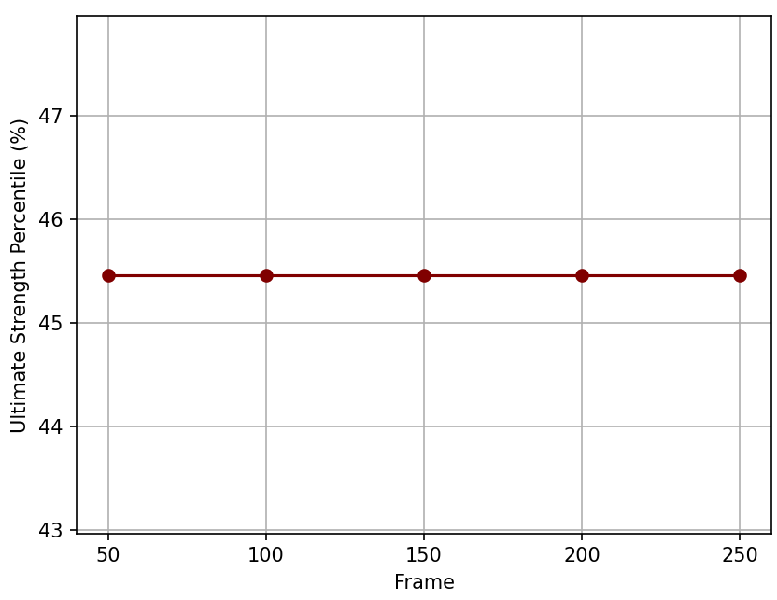
Figure 5. Graph of Ultimate Strength Percentile versus Frame Number

Slide 6
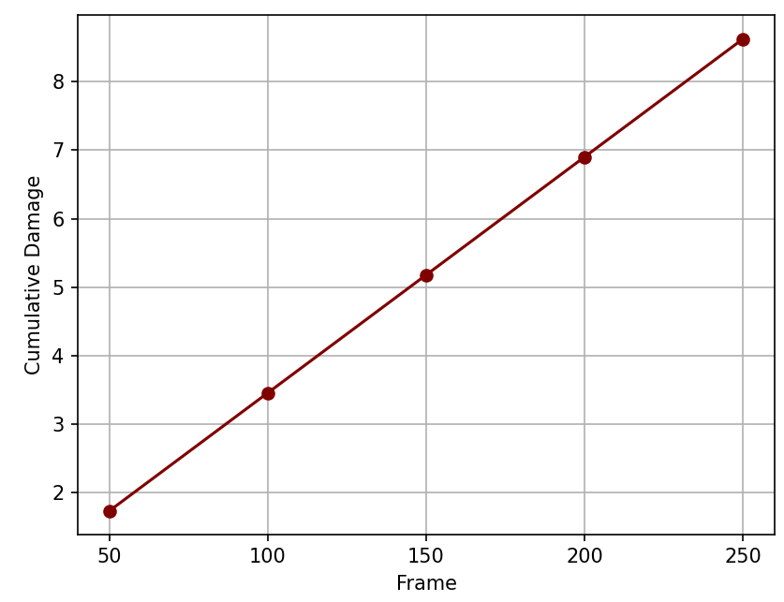
Figure 6. Graph of Cumulative Damage versus Frame Number

Slide 7
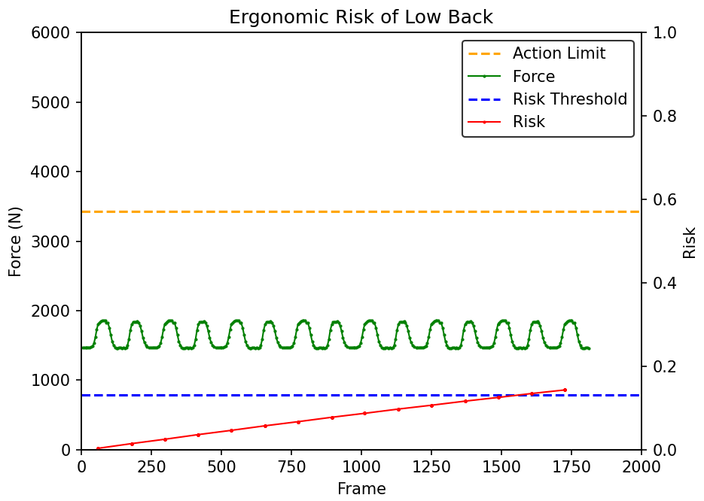
Figure 7. Graph of injury risk % and total lumbar compressive force versus frame number, respectively with 50N of load

Slide 8
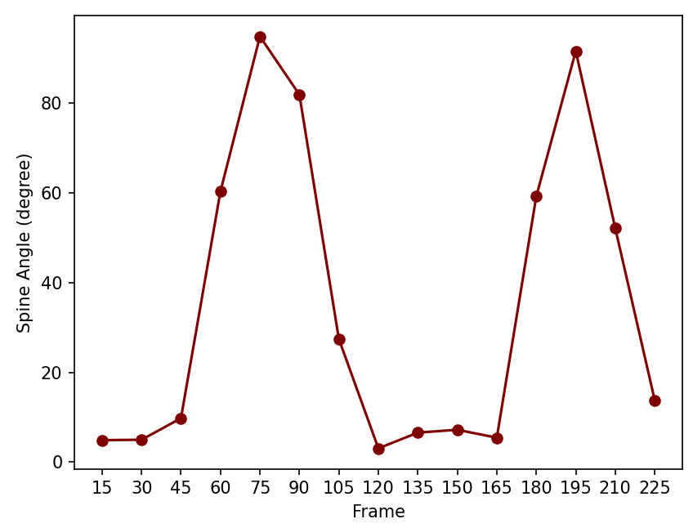
Figure 8. Spine angle versus frame number

Slide 9
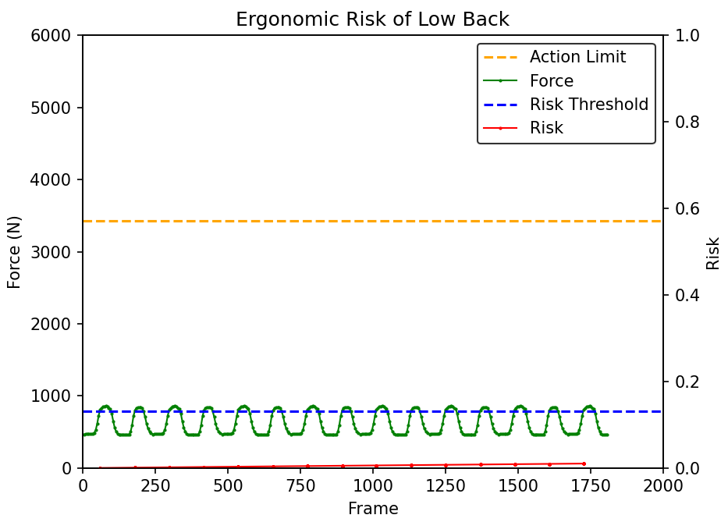
Figure 9. Graph of injury risk % and total lumbar compressive force versus frame number, respectively in no-load condition

Slide 10
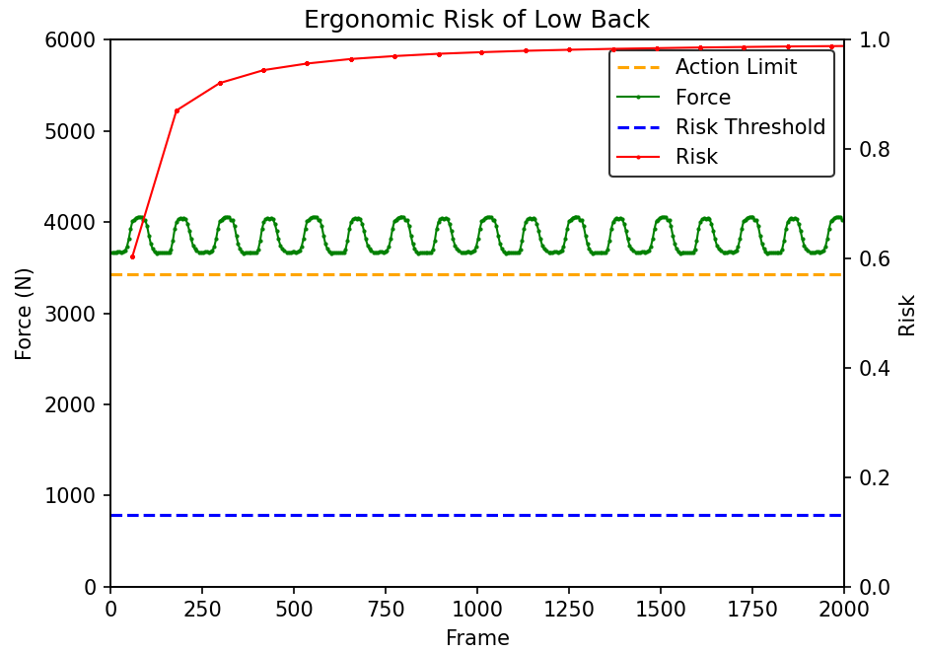
Figure 10. Graph of injury risk % and total lumbar compressive force versus frame number, respectively with 160N of load

Slide 11
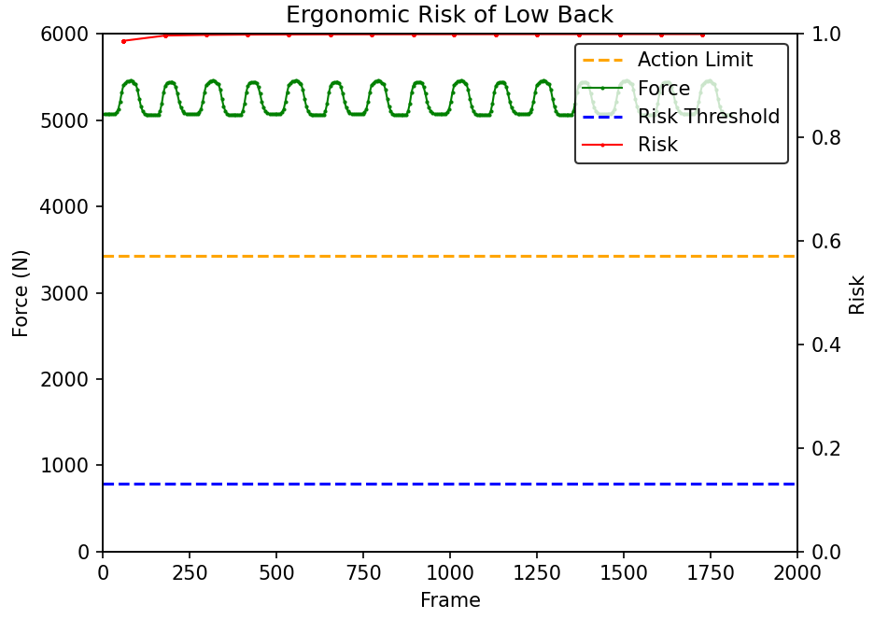
Figure 11. Graph of injury risk % and total lumbar compressive force versus frame number, respectively with 230N of load

Slide 12
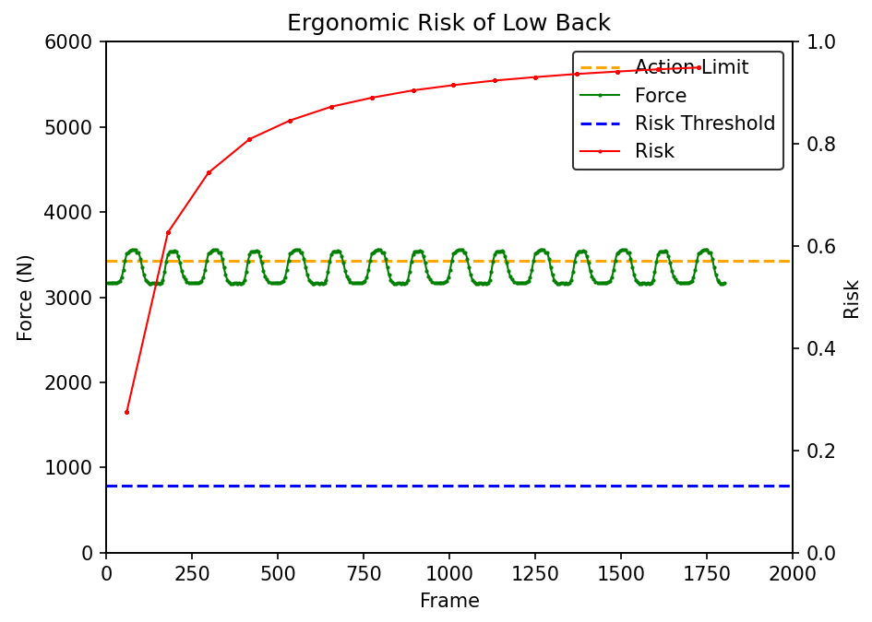
Figure 12. Graph of injury risk % and total lumbar compressive force versus frame number, respectively with 135N of load

