Slide 1



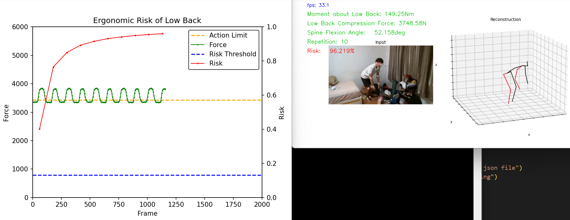
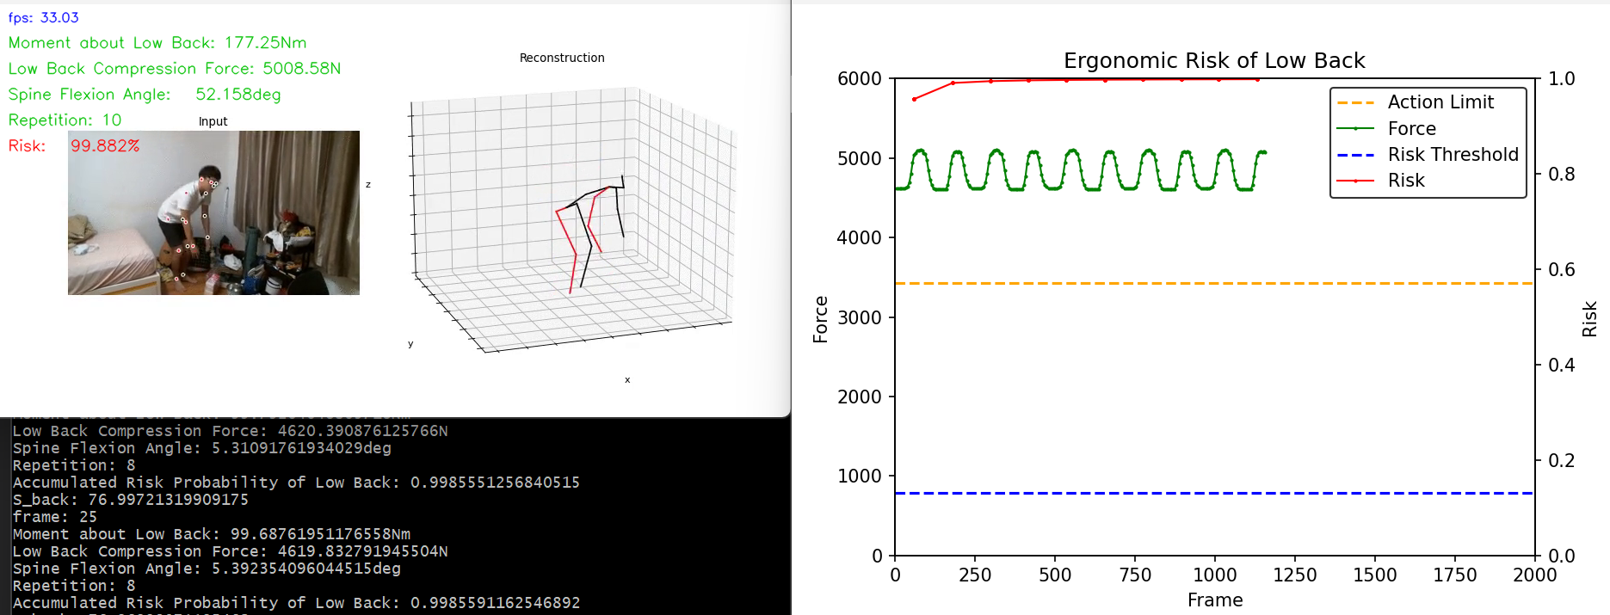

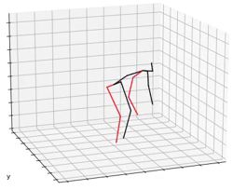

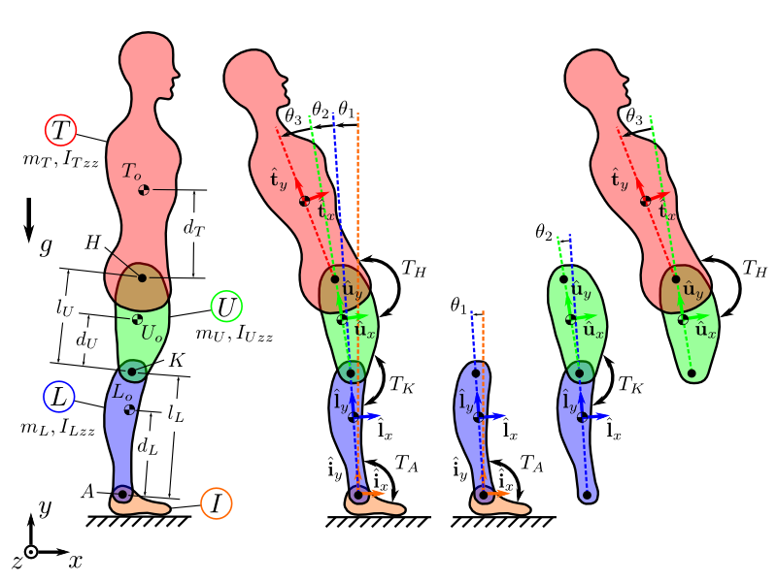
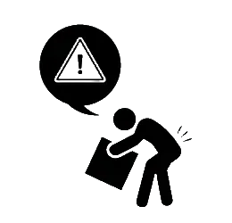

CEE22022 - Vision-Based Ergonomic Risk Assessment
Presented by Lor Wen Sin (MAE)
Supervised by Asst Prof Kim Jinwoo (CEE)
Background
Findings
Ensuring worker safety is our top priority in workplaces. However, the assessments of ergonomic risk such as working posture and duration are often incomplete. The consideration of cumulative damage is critical in estimating ergonomic risk, yet leading assessments such as NIOSH do not account for this factor. (see Table 1)
To improve worker comfort and convenience during posture data collection, our research has two objectives:
Understand the relationship between the workers’ working behavior and the injury risk probability.
In Figure 1 and Figure 3, notice that the spine angle value shows that the 3D reconstruction is quite reliable based only on image features.
Setting the load as 160N, the red curve in Figure 2 displays injury risk over 10 repetitions. It indicates an accumulation of risk and increasing danger with more repetitions, contrasting with the green curve remaining constant value of risk probability.
By adjusting the load’s weight to 230N, we obtain the result as shown in Figure 4, apparently the risk is much higher than Figure 2 over the same number of repetitions.
Understand the reliability of visual AI-enabled pose estimation techniques for ergonomic cumulative damage assessment in comparison to wearable-based techniques like IMU.
The value of the red curve (risk) is increased significantly at the peak value of the green curve which can be observed from Figure 2 and Figure 4, where the peak value of the green curve represents the peak lumbar compression force at the peak low back flexion angle.
NIOSH
Our Method
1
Only classified as high risk or low risk
1
Assess risk % for each repetition
2
Indirect Repetition
2
Dynamic Damage per Repetition
3
No Knowledge of Fatigue
3
Able to Estimate Endurance Limit
Figure 1. Visualization of 3D reconstruction at the load of 160N
4
Using Action Limit as an injury risk threshold
4
Able to Estimate Risk %
Figure 2. Risk % at the load of 160N
Table 1. Comparison between Conventional Risk Assessment and Our Method
Methodology
Figure 3. Visualization of 3D reconstruction at the load of 230N
Figure 4. Risk % at the load of 230N
Conclusion
VideoPose3D 3D Pose Estimation
To conclude, heavier load’s weight, larger spine angle, and greater number of repetitions are the 3 key factors to injury risk probability. By considering the number of repetitions of the activity allows us to identify more high-risk behaviours.
Furthermore, the accuracy of the 3D pose estimation technique allows us to replace wearable-based technique such as IMU by computer vision.
0
1
2
3
dt =
1
fps
Future Work
Data Preprocessing
Biomechanics Analysis
Using average muscle area of both genders at a certain range of age may not apply to more extreme cases in terms of body fitness. And hence, more customizable ergonomic risk assessment framework can be developed in future to enhance the work. Besides, the hyperparameters adjustment may be optimized for the risk probability prediction.
Injury Risk Probability
_{URECA}
Undergraduate Research Programme
www.ntu.edu.sg

