Slide 1

Proposal

Slide 2
Research Question
Can we perform ergonomic cumulative assessment using computer vision with deep learning without wearing any equipment to learn the ergonomic characteristics of expert masons?
Justification:
This research direction is meaningful because in the paper written by JuHyeong Ryu, A.M.ASCE1; Bennett Banting2; Eihab Abdel-Rahman3; and Carl T. Haas, F.ASCE4, titled as ‘Ergonomic Characteristics of Expert Masons’, we can tell from the data that the working posture of an expert mason causes the lowest compression force and moments at the respective body parts. However, the expert may not realize that their certain postures are proper postures, therefore they cannot efficiently teach the apprentices. Hence, a scientific analysis can help us to collect proper postures and train the beginners in a more systematic way.

Slide 3
Background
To develop from paper written by JuHyeong Ryu, A.M.ASCE1; Bennett Banting2; Eihab Abdel-Rahman3; and Carl T. Haas, F.ASCE4, titled as ‘Ergonomic Characteristics of Expert Masons’.
We would like to introduce cumulative damage ergonomic assessment to the same experiment conducted in the paper mentioned previously. Cumulative Damage is an important risk indicator in ergonomics because some posture might not be considered as risky at that moment, but it causes serious musculoskeletal disorder in a long run.
Another thing we would like to introduce is using only computer vision with deep learning to perform the posture estimation without wearing any suit such as IMU. Wearing a suit while working in construction site is less convenient and less comfortable for workers. In addition, to purchase the suit, the budget is higher compared to only using camera for posture estimation.
In the end, we can compare our outcome in terms of cumulative damage to the outcome in the paper mentioned above. We expect our outcome has some similarity to the outcome in the reference paper, but some differences occur due to the consideration of cumulative damage assessment.

Slide 4
Technical Framework of CD
Motion Capture
Data
Pre-processing
Cumulative Damage
Validation

Slide 5


Motion Capture
x
y
Normal Camera
3D Coordinates
Openpose
z
Low Back Flexion $θ_{l}$
Arm Elevation $θ_{a}$
Accuracy
Microsoft Kinect Azure DK
Ground Truth

Slide 6
Experiment for Motion Capture
1
First Course
2~6
Standard Wall
Session 1
6~7
Reinforced Wall
8~10
Constrained Space
Individual 23kg
2~6
Session 2
Colab 23kg
Standard Wall
Colab 35.2kg

Slide 7


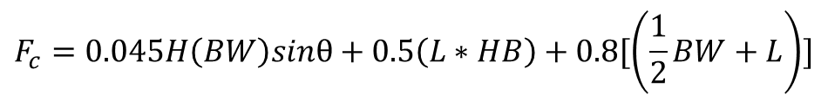
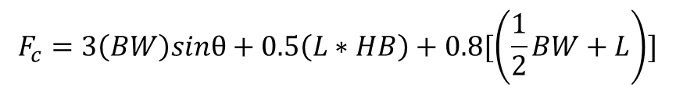
Data Pre-processing (Low Back)
$$F_{c}=3\left(BW\right)sinθ+0.5\left(L∗HB\right)+0.8[\left(\frac{1}{2}BW+L\right)]$$
x, y, z, $θ_{l}$, $θ_{a}$
Lever Arm
Moments + Forces
Revised version
Load’s Weight
$$F_{c}=0.045H\left(BW\right)sinθ+0.5\left(L∗HB\right)+0.8[\left(\frac{1}{2}BW+L\right)]$$
Symbol | Meaning
BW | Body Weight
H | Body Height
HB | Horizontal Location of the object relative to the body
L | Load Weight
$$σ_{x}^{peak}=\frac{F_{c}^{peak}}{A}$$

Slide 8













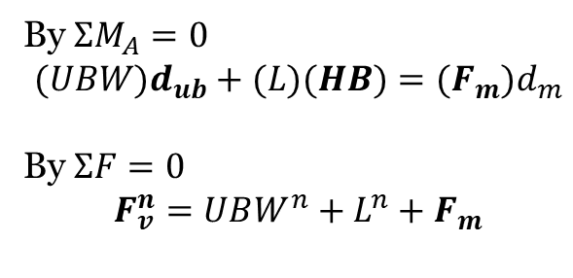




Data Pre-processing (Low Back)
$$\hat{n}$$
$$\hat{t}$$
$$L$$
$$θ$$
$$F_{m}$$
$$UBW$$
$$P_{L}$$
$$L$$
$$F_{v}$$
$$F_{m}^{′}$$
$$P_{ub}$$
$$F_{v}^{′}$$
A
$$HB$$
A
https://health.usf.edu/publichealth/tbernard/~/media/D7F7CFCBC5EF43EBB9A23E592BC84411.ashx
https://www.researchgate.net/publication/40785995_A_revised_back_compressive_force_estimation_model_for_ergonomic_evaluation_of_lifting_tasks
By $ΣM_{A}=0$
$$(UBW)d_{ub}+(L)(HB)={(F}_{m})d_{m}$$
By $ΣF=0$
$$F_{v}^{n}=UBW^{n}+L^{n}+F_{m}$$
$$F_{m}$$
$d_{ub}$, $HB$
$$F_{m}$$
$$F_{v}^{n}$$

Slide 9



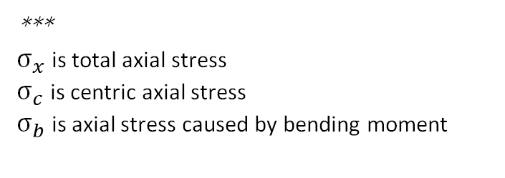

Data Pre-processing (Shoulder)
x, y, z, $θ_{l}$, $θ_{a}$
Lever Arm
$$σ_{c}=\frac{F_{m}}{A}$$
Moments + Forces
$$σ_{x}=σ_{c}+σ_{b}$$
Load’s Weight
$σ_{b}=\frac{M_{L}y}{I}$+ $\frac{M_{ub}y}{I}$
***
$σ_{x}$ is total axial stress
$σ_{c}$ is centric axial stress
$σ_{b}$ is axial stress caused by bending moment

Slide 10






Data Pre-processing (Shoulder)
$$F_{m}$$
$$F_{x}$$
A
$$F_{y}$$
$$W_{s}$$
$$L$$
$$P_{L}$$
$$F_{m}$$
or
$$M$$
$$F_{x}$$
A
$$F_{y}$$
$$W_{s}$$
$$L$$

Slide 11
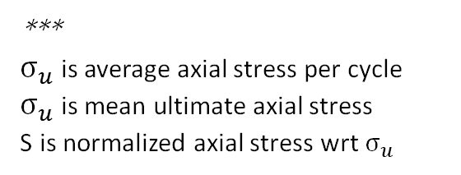



Cumulative Damage
Low Back
$$N=902416∗e^{−0.162∗S}$$
$$S=\frac{σ_{x}^{peak}}{σ_{u}^{avg}}$$
CD = DPC * Number of Repetitions
Shoulder
$$S=101.25−14.83\log{N}$$
***
$σ_{u}$ is average axial stress per cycle
$σ_{u}$ is mean ultimate axial stress
S is normalized axial stress wrt $σ_{u}$

Slide 12
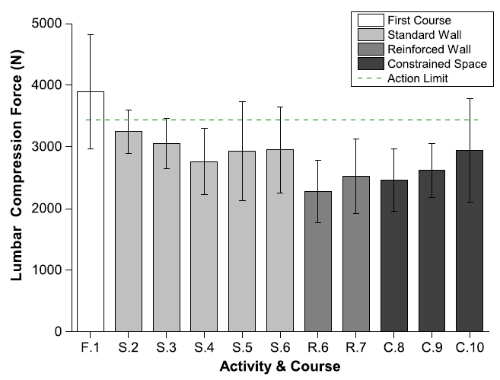
Validation – 1st Session
Benchmark
Lumbar Compression Force
Cumulative Damage
Observe and Compare

Slide 13
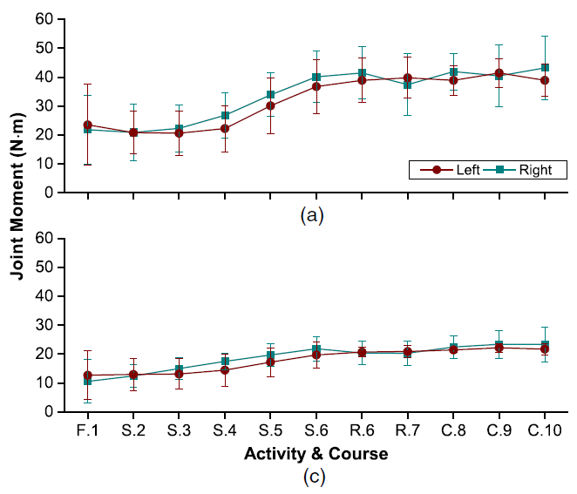
Validation – 1st Session
Benchmark
Shoulder Moment
(c) Elbow Moment
Cumulative Damage
Observe and Compare
*The author made a mistake, (c) is elbow moment not hip moment

Slide 14
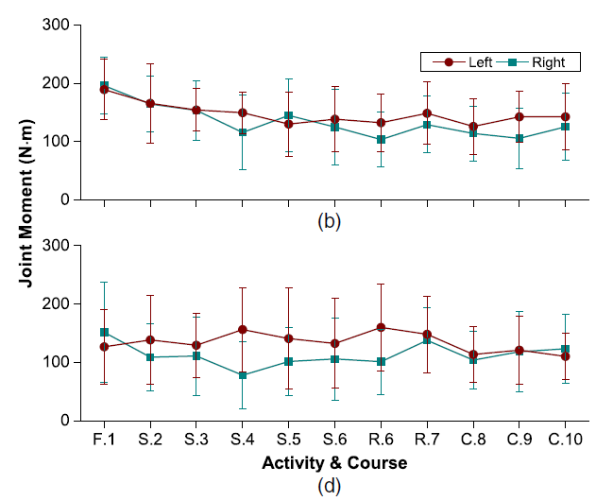
Validation – 1st Session
Benchmark
(b) Hip Moment
(d) Knee Moment
Cumulative Damage
Observe and Compare
*The author made a mistake, (b) is hip moment not elbow moment

Slide 15
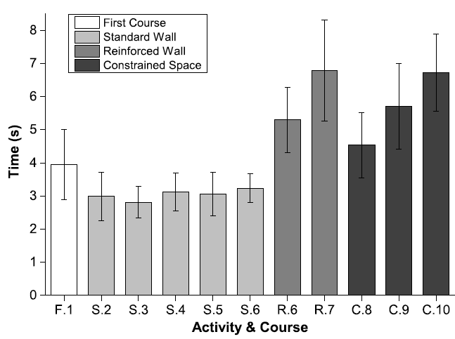
Validation – 1st Session
Benchmark
All 1st - session activities
Efficiency
Observe and Compare

Slide 16
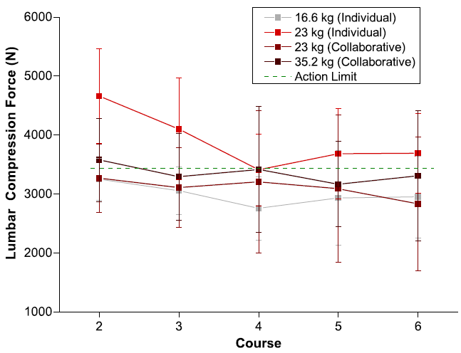
Validation – 2nd Session
Benchmark
Lumbar Compression Force
Cumulative Damage
Observe and Compare

Slide 17
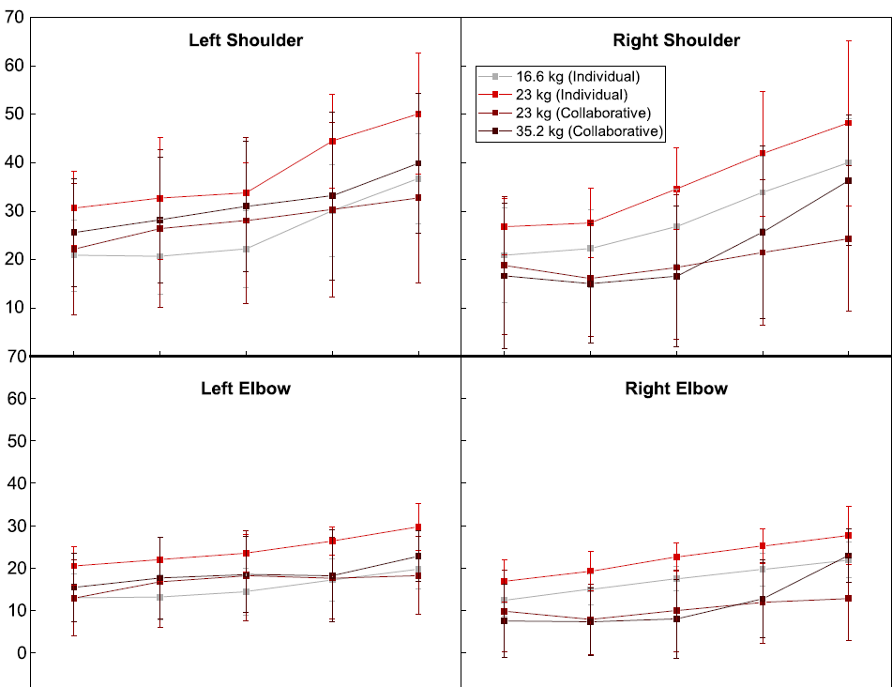
Validation – 2nd Session
Benchmark
Shoulder Moment
(c) Elbow Moment
Cumulative Damage
Observe and Compare

Slide 18
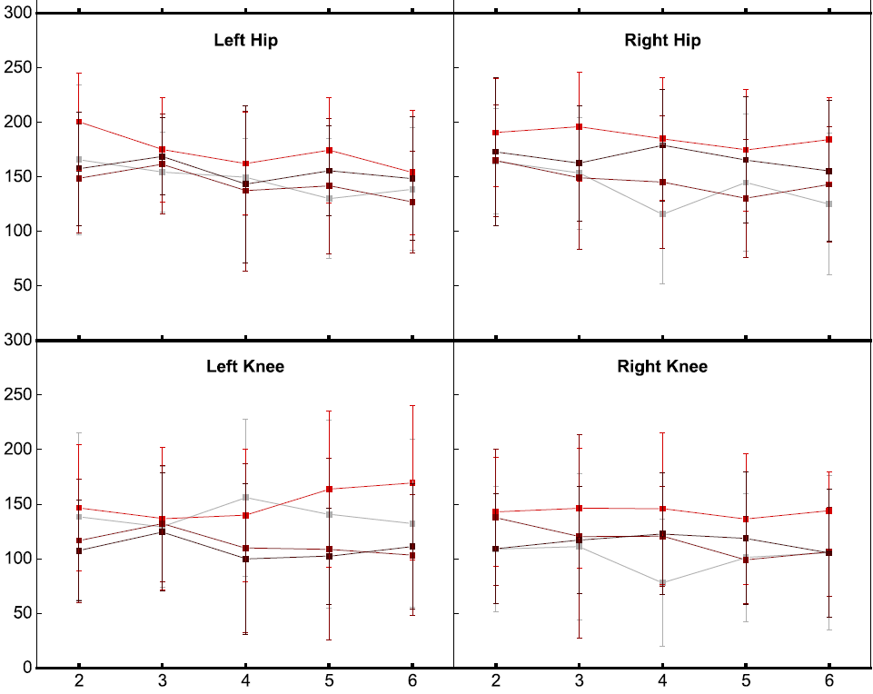
Validation – 2nd Session
Benchmark
(b) Hip Moment
(d) Knee Moment
Cumulative Damage
Observe and Compare

Slide 19
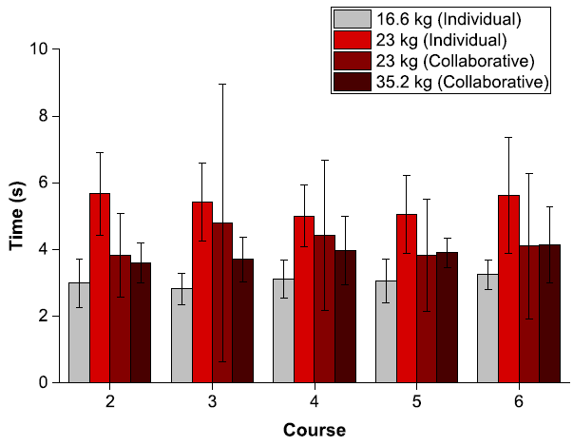
Validation – 2nd Session
Benchmark
All 2nd - session activities
Efficiency
Observe and Compare

