Slide 1



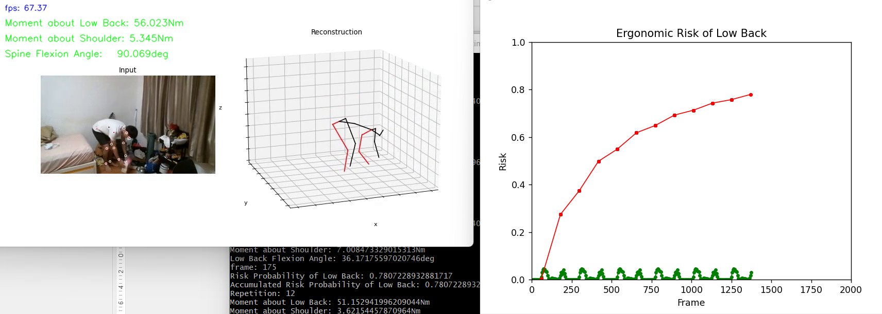
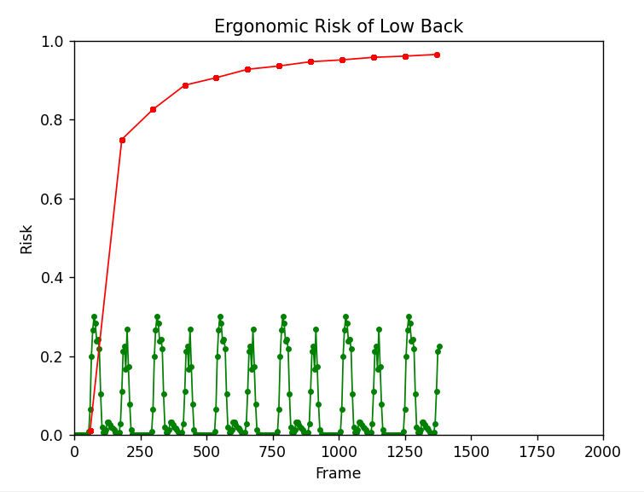


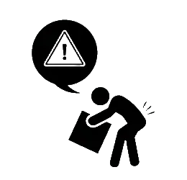
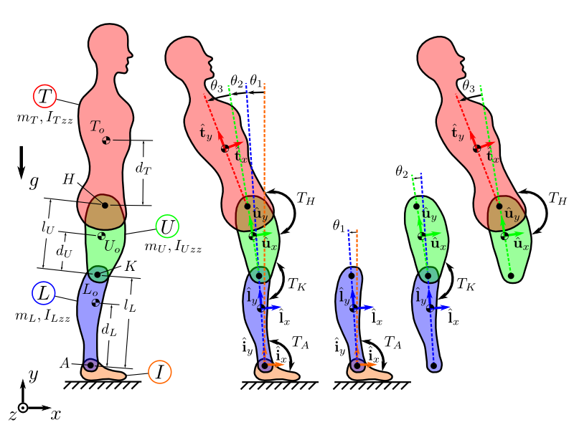

Visual AI-Enabled Ergonomic Risk Assessment
Presented by Lor Wen Sin (MAE)
Supervised by Asst Prof Kim Jinwoo (CEE)
Background
Findings
Ensuring worker safety is our top priority in workplaces. However, the assessments of ergonomic risk such as working posture and duration are often incomplete. The consideration of cumulative damage is critical in estimating ergonomic risk, yet leading assessments such as REBA & RULA do not account for this factor. (see Table 1)
To improve worker comfort and convenience during posture data collection, our research has two objectives:
Understand the relationship between the workers’ working behavior and the injury risk probability.
In Figure 1, notice that the spine angle value shows that the 3D reconstruction is quite reliable based only on image features.
Setting the load as 120N, the red curve in Figure 2 displays injury risk over 12 repetitions. It indicates an accumulation of risk and increasing danger with more repetitions, contrasting with the green curves remaining constant value of risk probability.
By adjusting the load’s weight to 150N, we obtain the result as shown in Figure 3, apparently the risk is much higher than Figure 2.
Understand the reliability of visual AI-enabled pose estimation techniques for ergonomic cumulative damage assessment in comparison to wearable-based techniques like IMU.
Lowering the back while carrying the same weight significantly increases the risk of injury (peak value of green curves represents peak low back flexion angle).
REBA/ RULA
Our Method
1
Assess risk score for each activity
1
Assess risk % for each repetition
2
Indirect Repetition
2
Dynamic Damage per Repetition
3
No Knowledge of Fatigue
3
Able to Estimate Endurance Limit
Figure 1. Visualization of 3D reconstruction
4
Only using Risk Score with Range 1 - 7
4
Able to Estimate Risk %
Table 1. Comparison between Conventional Risk Assessment and Our Method
Methodology
0
1
2
3
Figure 2. Risk % at the load of 120N
Figure 3. Risk % at the load of 150N
Conclusion
dt =
1
fps
VideoPose3D 3D Pose Estimation
To conclude, heavier load’s weight, larger spine angle, and greater number of repetitions are the 3 key factors to injury risk probability. By considering the number of repetitions of the activity allows us to identify more high-risk behaviours.
Furthermore, the accuracy of the 3D pose estimation technique allows us to replace wearable-based technique such as IMU by computer vision.
Data Preprocessing
Future Work
Currently, we are using average muscle area of both genders at a certain range of age, this may not apply to more extreme cases in terms of body fitness. And hence, more customizable ergonomic risk assessment framework can be developed in future to enhance the work. Other than that, the hyperparameters adjustment may be optimized further for the risk probability prediction.
Injury Risk Probability
Biomechanics Analysis
_{URECA}
Undergraduate Research Programme
www.ntu.edu.sg

