Slide 1
Maze Solver
Albert Lor Wen Sin

Slide 2
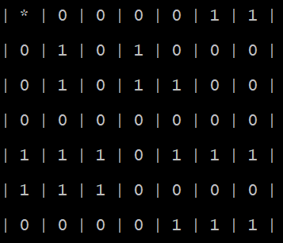
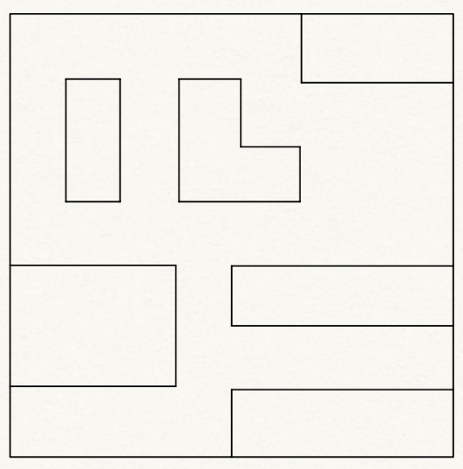
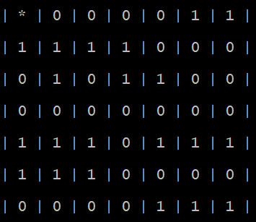
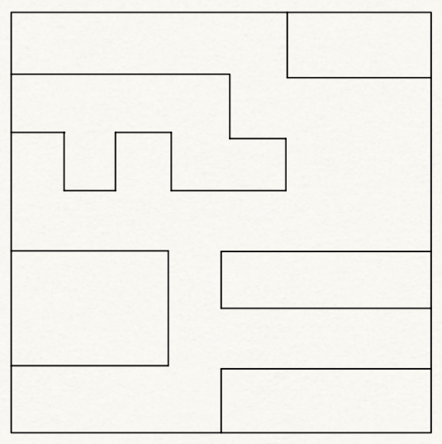
Training Data
Train Maze 1
Train Maze 2

Slide 3
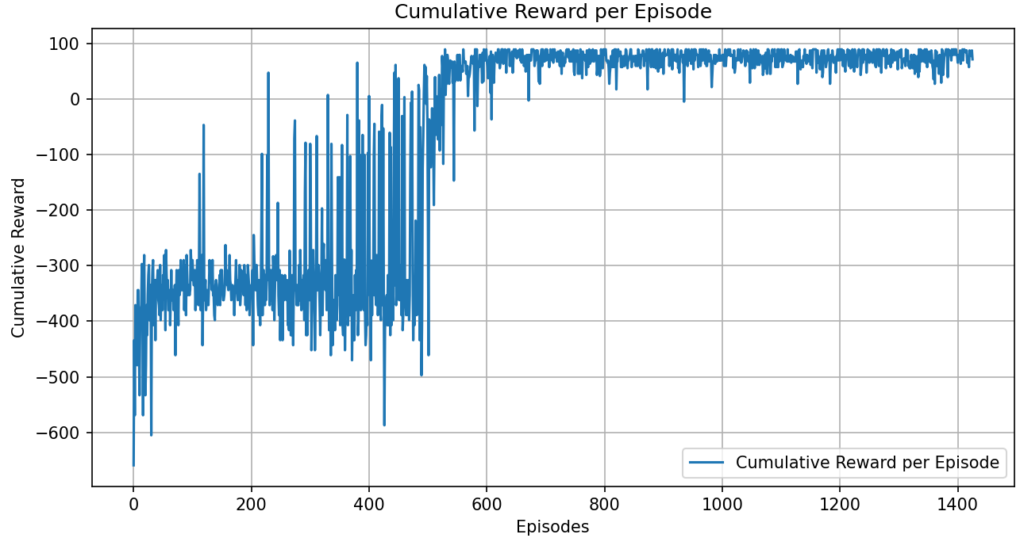
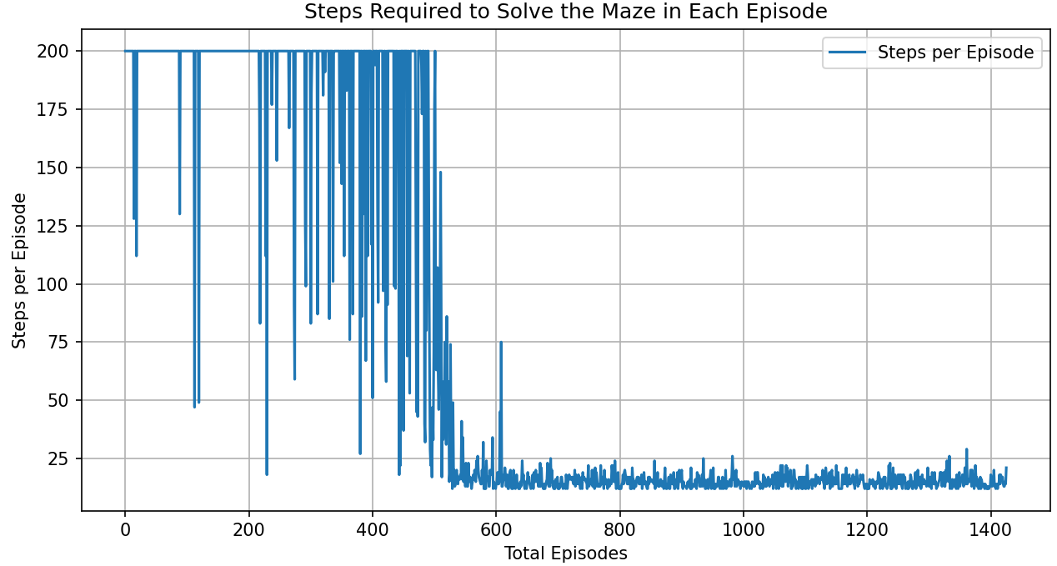
Training Results – Train Maze 1
Cumulative Rewards per Episode
Solving Steps per Episode
Learning rate: 0.05
Discount factor: 0.9
Explore rate: 0.2

Slide 4
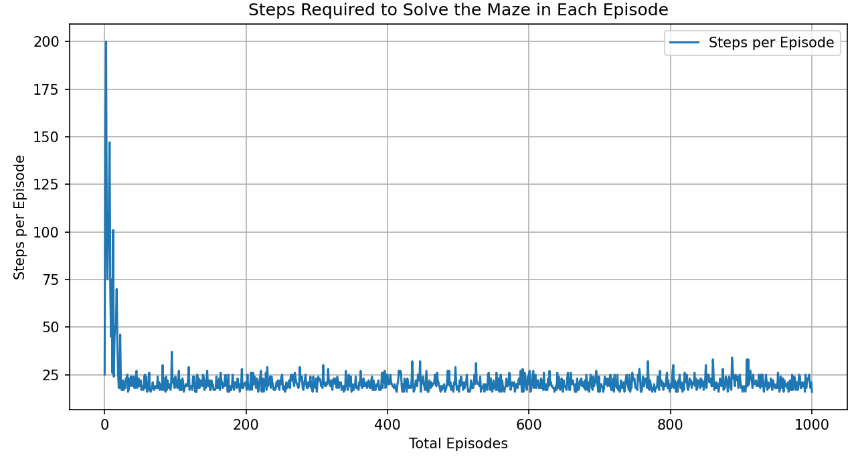
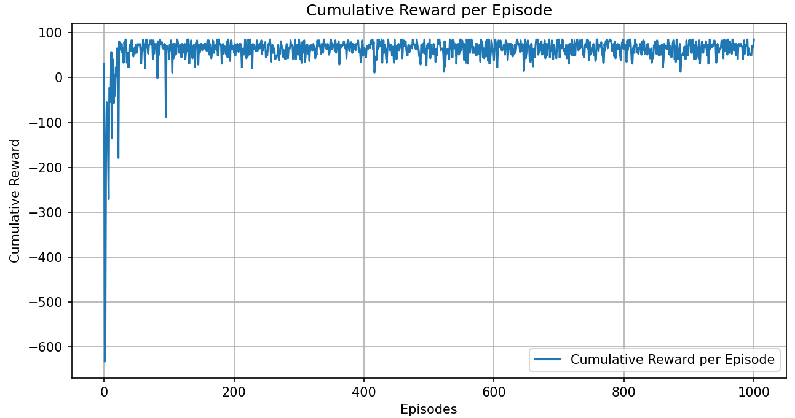
Training Results – Train Maze 2
Cumulative Rewards per Episode
Solving Steps per Episode
Learning rate: 0.05
Discount factor: 0.9
Explore rate: 0.2

Slide 5
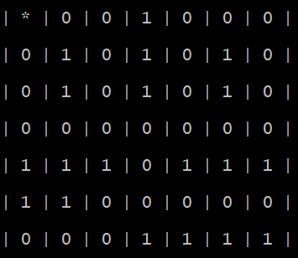
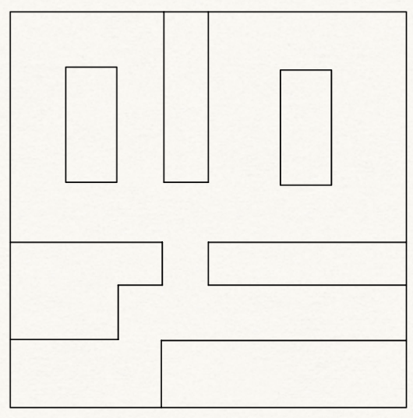
Test Data
Test Maze

Slide 6
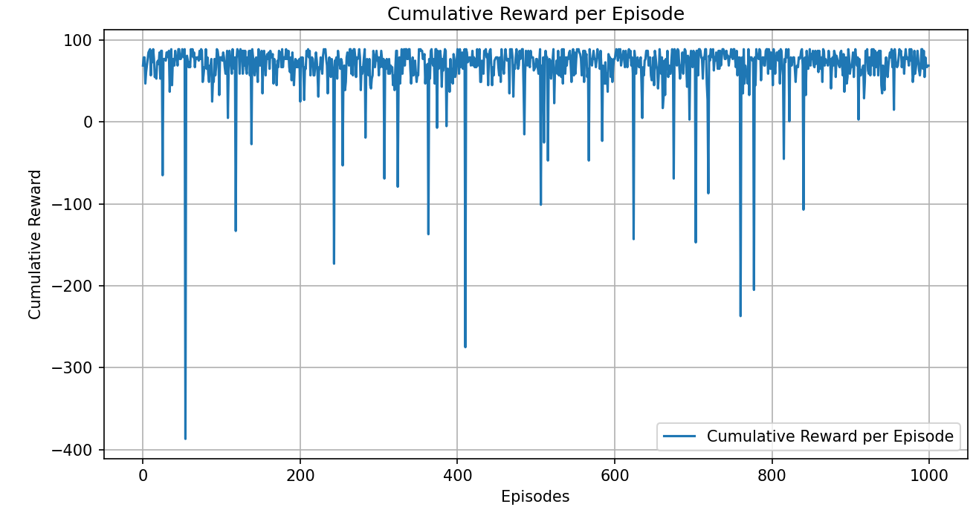
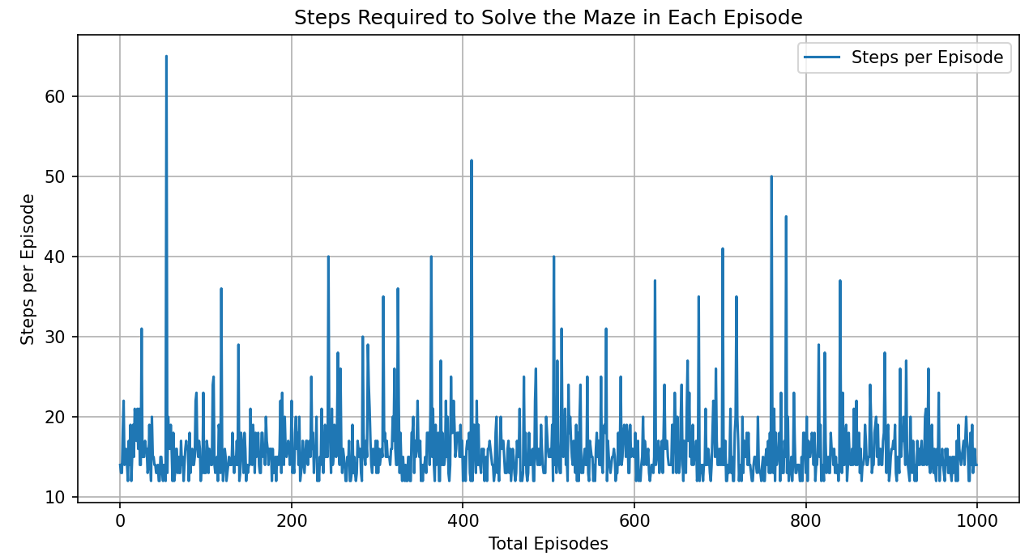
Test Results – Config 1 (Pure Evaluation)
Cumulative Rewards per Episode
Solving Steps per Episode
Learning rate: 0
Discount factor: 0.9
Explore rate: 0

Slide 7
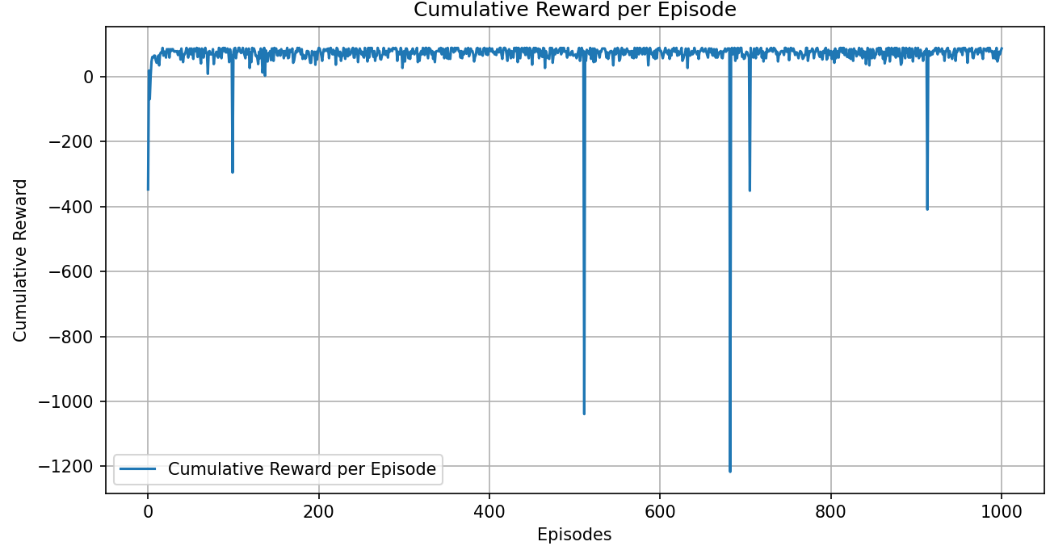
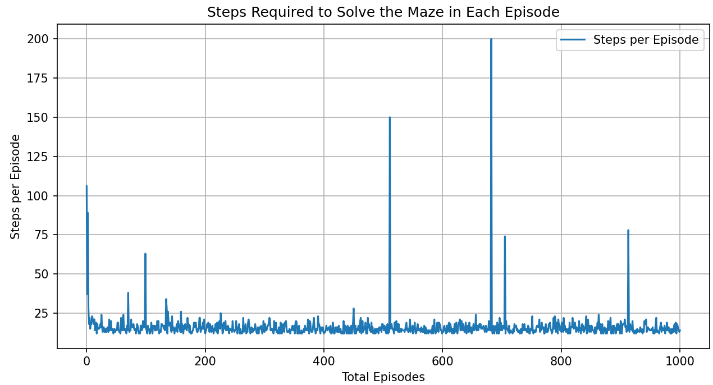
Test Results – Config 2 (Keeps Learning)
Cumulative Rewards per Episode
Solving Steps per Episode
Learning rate: 0.05
Discount factor: 0.9
Explore rate: 0.2

