Slide 1
Maze Solver with Q Learning & Linear Regression
Albert Lor Wen Sin

Slide 2
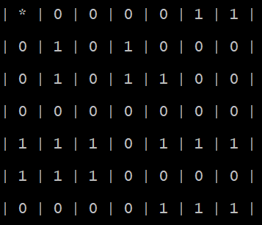
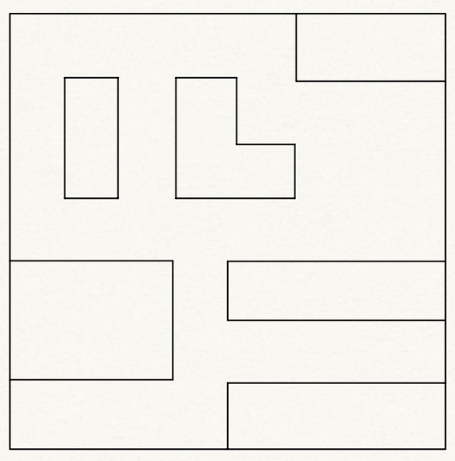
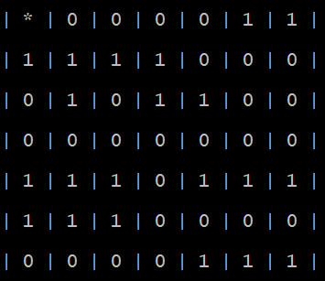
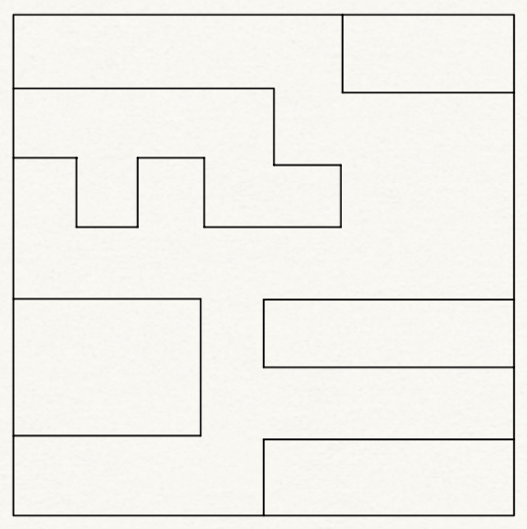
Training Data
Train Maze 1
Train Maze 2

Slide 3
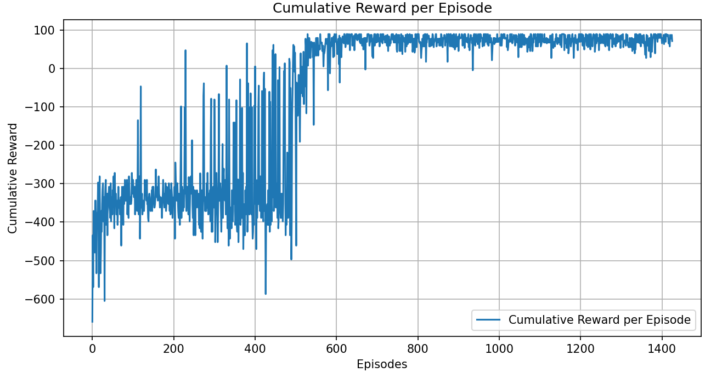
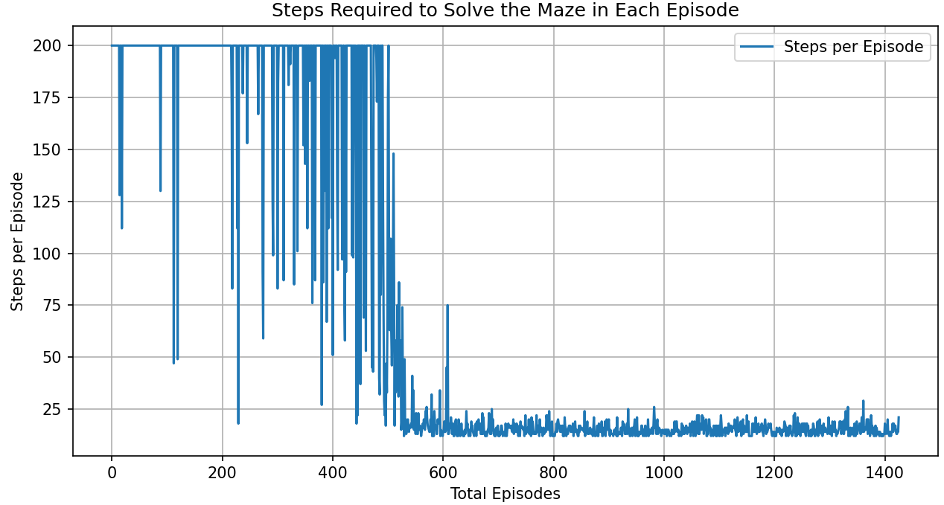
Training Results – Train Maze 1
Cumulative Rewards per Episode
Solving Steps per Episode
Learning rate: 0.05
Discount factor: 0.9
Explore rate: 0.2

Slide 4
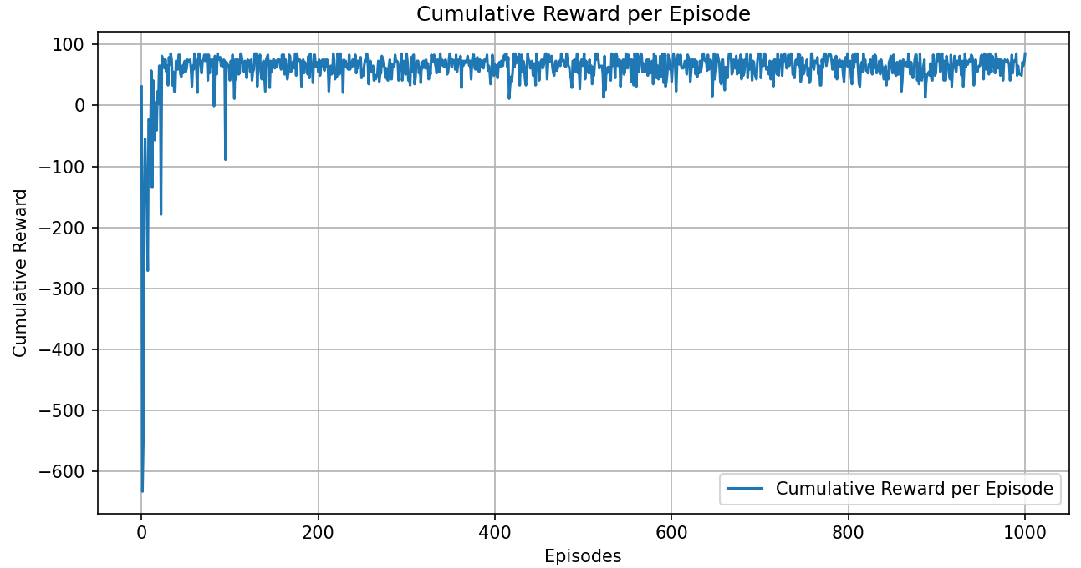
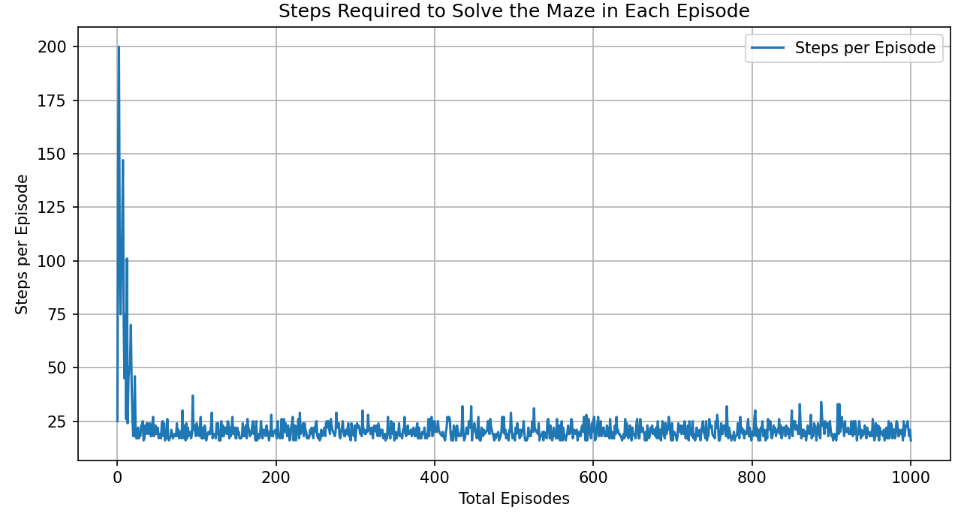
Training Results – Train Maze 2
Cumulative Rewards per Episode
Solving Steps per Episode
Learning rate: 0.05
Discount factor: 0.9
Explore rate: 0.2

Slide 5
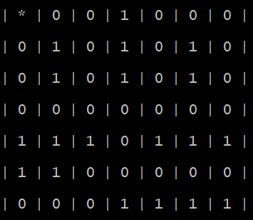
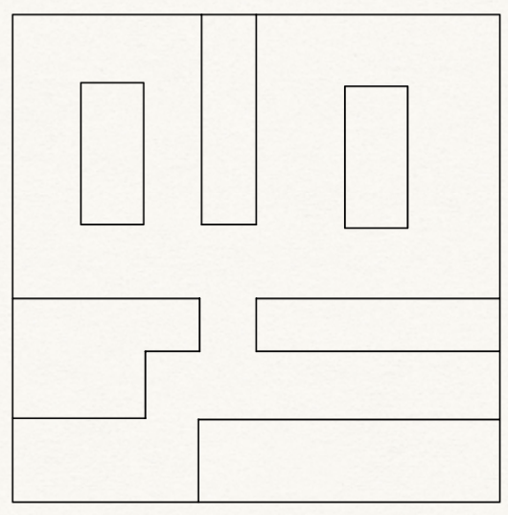
Test Data
Test Maze

Slide 6
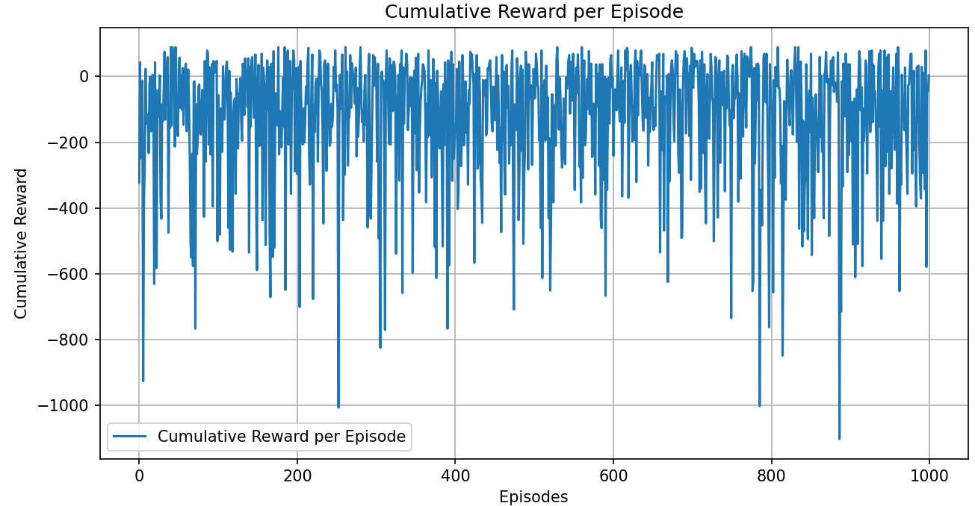
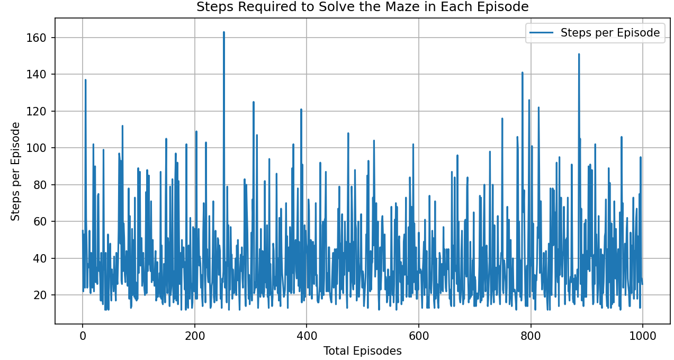
Test Results
Cumulative Rewards per Episode
Solving Steps per Episode
Discount factor: 0.9
Explore rate: 0 (Purely evaluation)

Slide 7
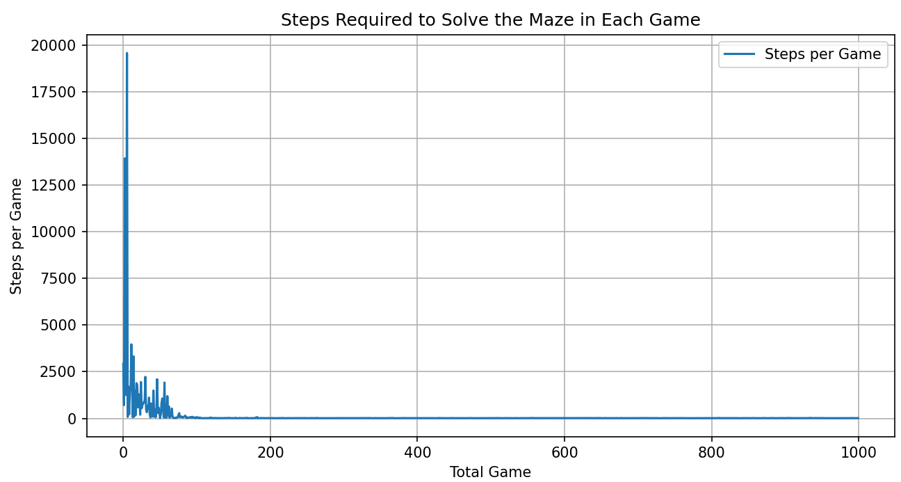
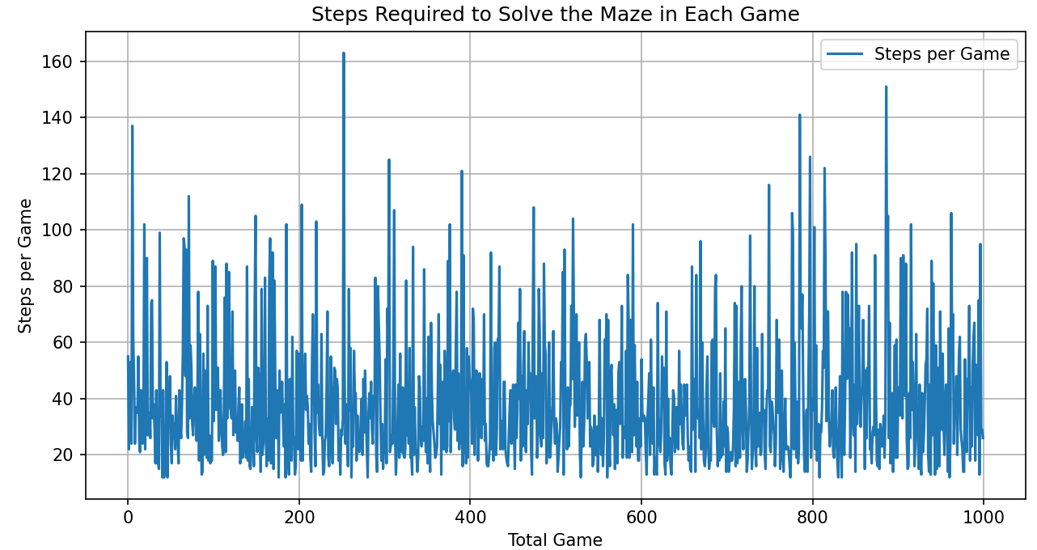
Total Steps per Game Before vs After Training
Before Training
After Training
We notice that after training, the total steps required to solve the maze per game is same as the steps required to solve the maze per episode, which means the agent can solve the maze in one episode (<=200 steps) after training.

Slide 8
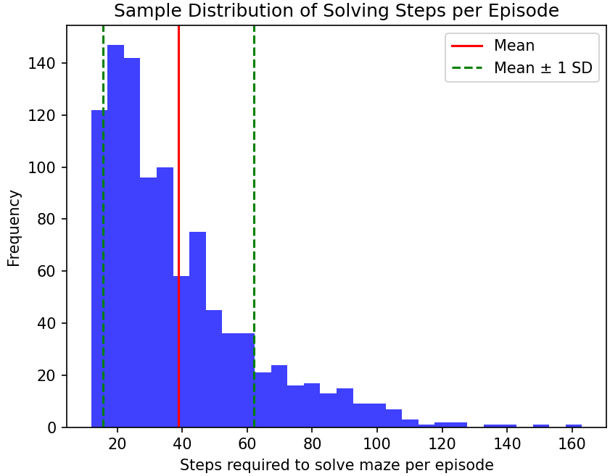
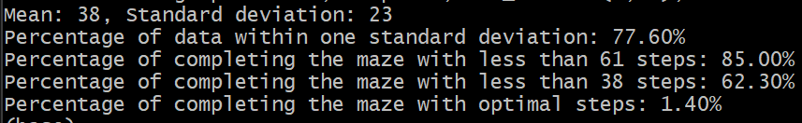
Statistical Analysis
Sample Distribution of Solving Steps per Episode

Slide 9
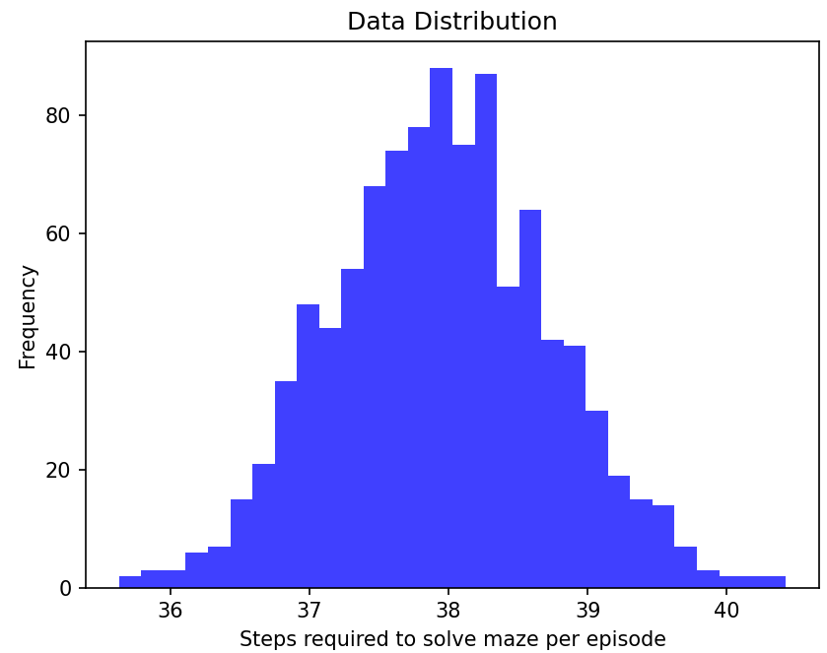
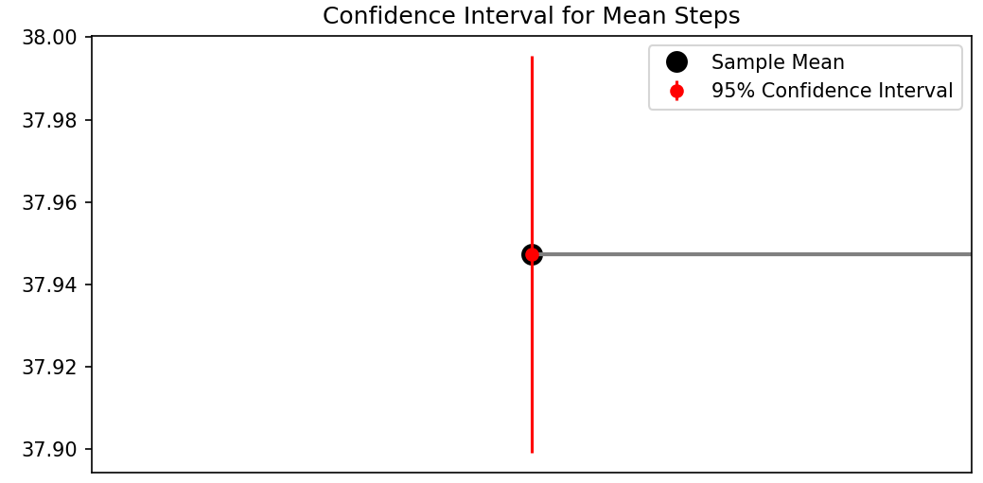
Statistical Analysis
Distribution of Sample Mean of Solving Steps per Episode
Distribution of Sample Means
We are 95% confident that the true mean steps required to solve a maze per episode lies around 38 steps.
Mean
Random variables are IID, therefore their sample means approximately form a normal distribution

