Slide 1

void PassChain_IoT() {
PassChain.ino
Details.ino
/* Presentation of Alberto Montefusco */
const char *course = ‘IoT Security’;
const char *Prof = ‘Christiancarmine Esposito’;
const char *aa = ‘2022 - 2023’;
Presentation.begin(course, Prof, aa);
}
Arduino Language
Notes:
Hello everyone, today I present the PassChain project for the IoT Security course

Slide 2
Table Of ‘Contents’ {
01
02
03
PassChain.ino
Details.ino
Introduction
/* Presentation of PassChain and of Password Manager */
Hardware
/* Sensors used and how did I connect them */
Software
/* Libraries used, SSL communication, server Python */
04
Vulnerabilities_&_Security
}
/* Attacks and Security Solutions */
Arduino Language

Slide 3
01 {
[Introduction]
PassChain.ino
Details.ino
/* What is a PassWord Manager
and PassChain device */
}
Arduino Language

Slide 4
Password_Manager {
PassChain.ino
Details.ino
/* What are them? */
Serial.println(‘Online services that allow users to store password’);
delay(100);
Serial.println(‘ and sync them across all your personal devices’);
}
Arduino Language

Slide 5
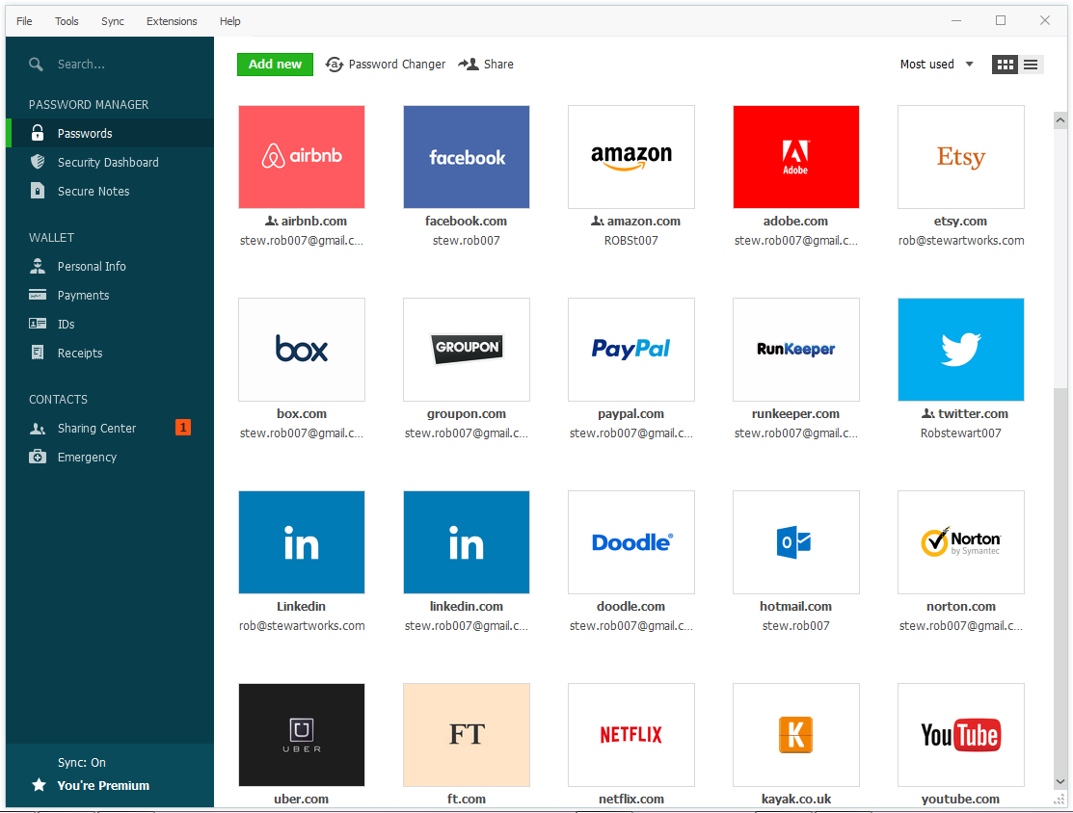
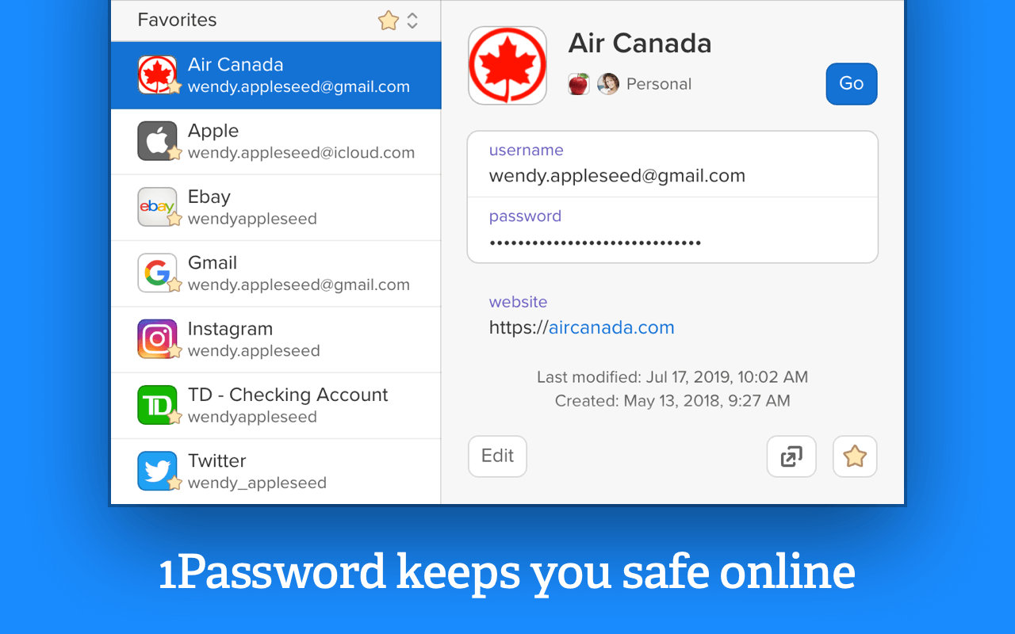
tft.pushImage (
PassChain.ino
Details.ino
Dashlane and 1Password are most popular password manager
);
Arduino Language
Notes:
Among the most famous password managers we mention LastPass, Bitwarden and other…

Slide 6
Serial.println (‘Advantages: ‘ +
PassChain.ino
Details.ino
Step 01
Apps available for all platforms
Step 02
Browser extensions allow to automatically enter passwords
Step 03
Sync on all devices
Step 04
Fast access
);
Arduino Language

Slide 7
Serial.println (‘Disadvantages: ‘ +
PassChain.ino
Details.ino
Step 01
Online and cloud services can be violated even remotely
Step 02
Need to install an application or extension on each of your personal devices
Step 03
Less practical when using
non-personal devices
Step 04
Sigle Point of Failure because access to all of your passwords is protected by a single strong password
);
Arduino Language

Slide 8



PassChain_IoT {
PassChain.ino
Details.ino
/* What is It? */
Serial.println(‘PassChain is an IoT device that aims to facilitate the user in digital authentication’);
delay(100);
Serial.println(‘but also to ensure their security through its function of password manager’);
Bluetooth
Authentication
< Connect to other devices with Bluetooth to send user’s credentials >
< Every operation is done through Fingerprint authentication >
Cryptography
SSL Communication
}
< All data are encrypted with AES 128 bit – GCM mode >
< SSL allows secure communication with the python server >
Arduino Language

Slide 9
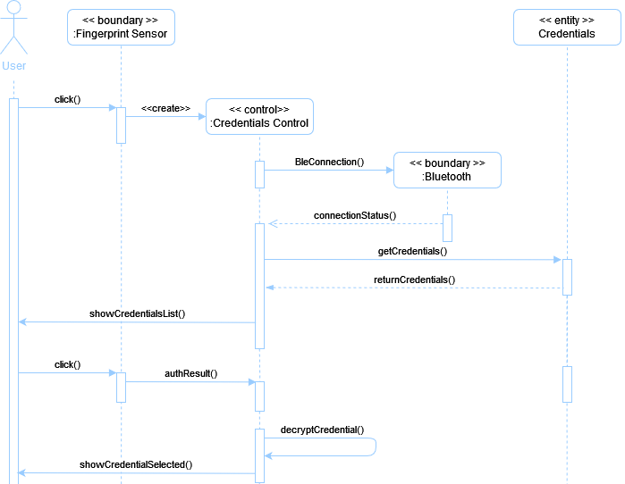
SD_Send_Credential {
PassChain.ino
Details.ino
}
Arduino Language

Slide 10
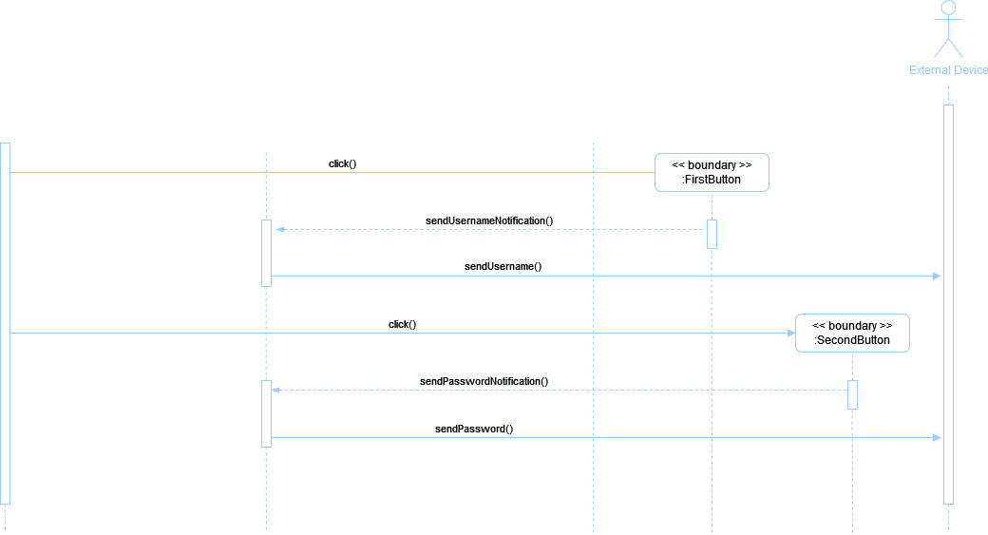
SD_Send_Credential {
PassChain.ino
Details.ino
}
Arduino Language

Slide 11
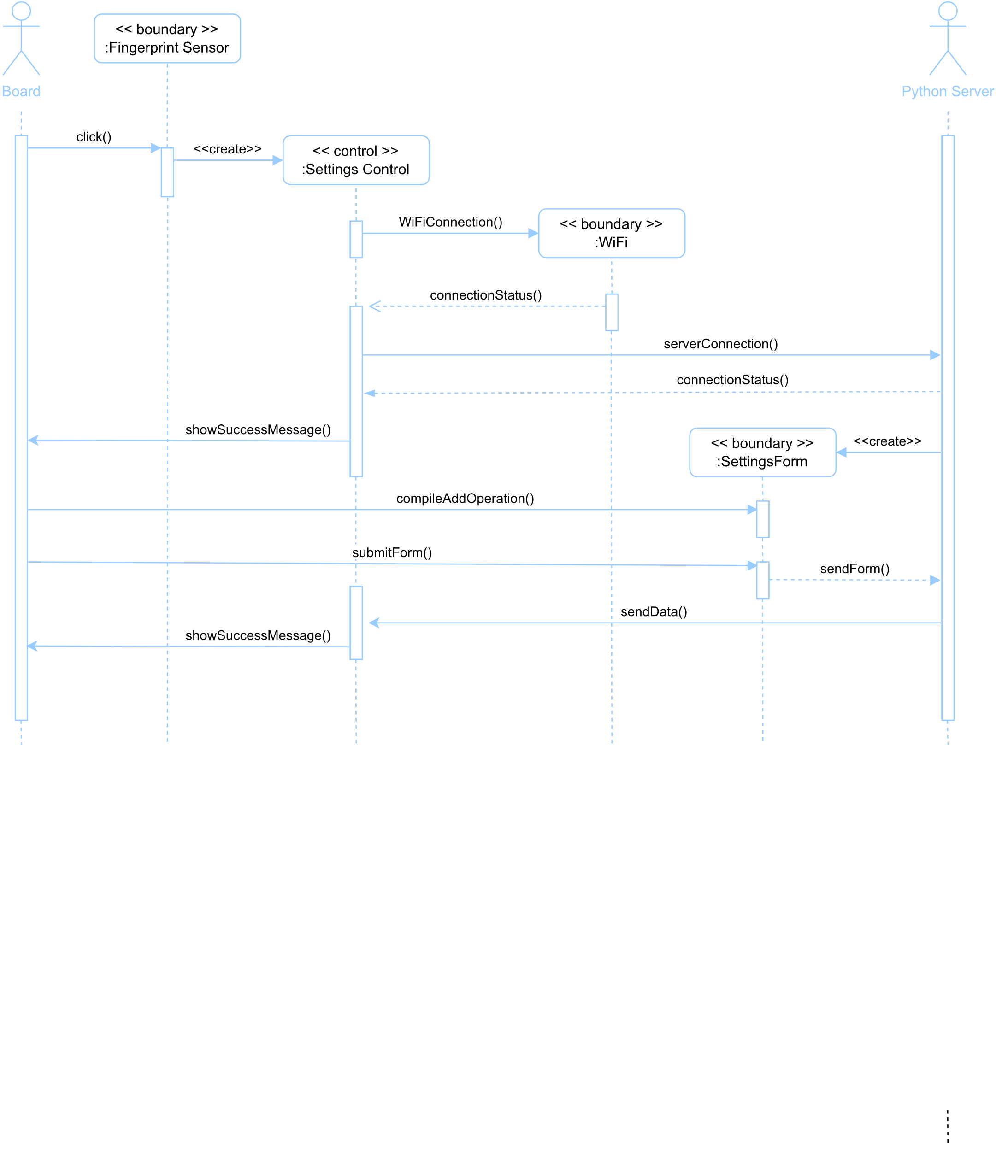
SD_Server_Operation {
PassChain.ino
Details.ino
}
Arduino Language

Slide 12
02 {
[Hardware]
PassChain.ino
Details.ino
/* Lora TTgo Esp32 16 Mb,
Fingerprint, Battery */
}
Arduino Language
Notes:
Now we can see the Hardware used

Slide 13
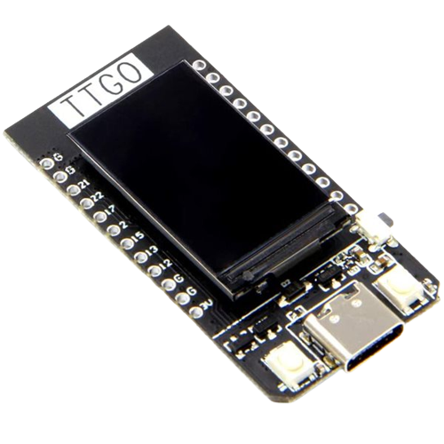
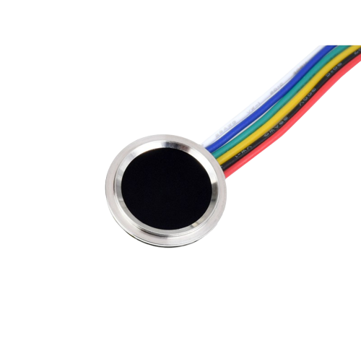
void Lora_TTgo_Esp32 () {
PassChain.ino
Details.ino
< The board has an integrated 0.96'' OLED display, two programmable buttons and one for restarting, a power connector for batteries and a type-C port for connecting devices and powering the board itself. It has a memory of 16 Mb with SPIFFS as file system >
}
void Fingerprint () {
< Capacitive fingerprint sensor allows to authenticate the user. The sensor ensures the uniqueness of the user. The sensor can store 126 fingerprint: one of them is used to go back to the settings >
}
Arduino Language

Slide 14

void Lora_Ttgo_Esp32 () {
PassChain.ino
Details.ino
< LiPo battery 1 cell of 500 mAh 3.7 V allows to have a portable and independent device >
}
void show_circuit (Board esp32, Sensor fingerprint, Sensor battery) {
Circuit circuit = new Circuit(Esp32, fingerprint, battery);
tft.pushImage(circuit.show());
}
Arduino Language

Slide 15
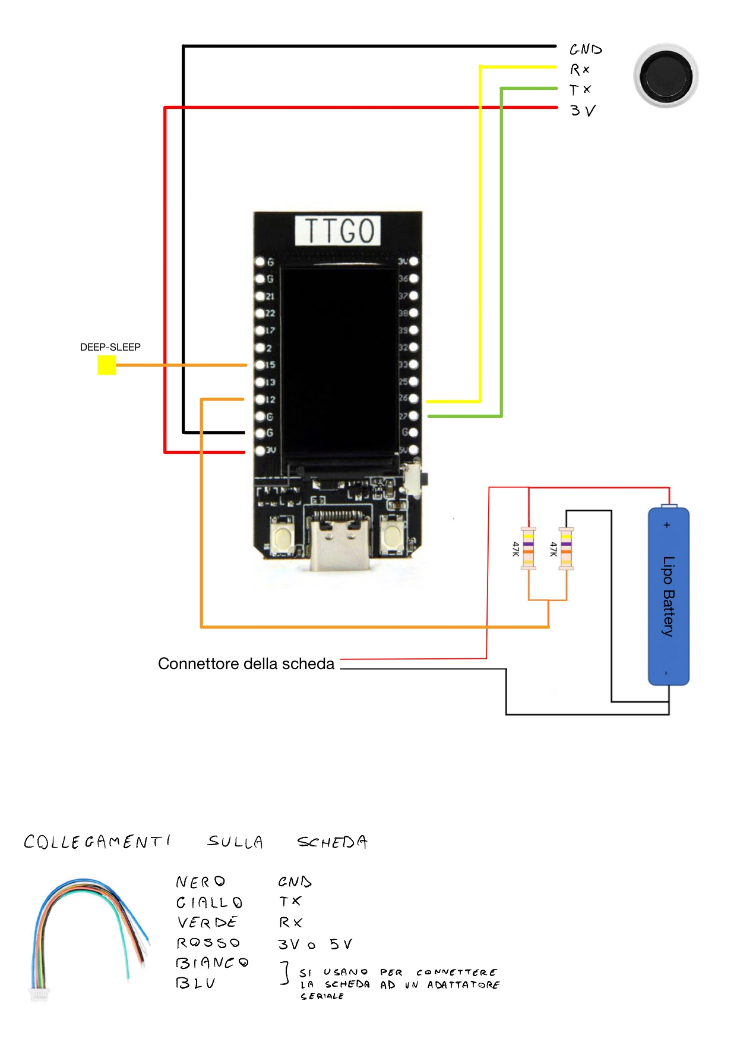
tft.pushImage (
PassChain.ino
Details.ino
GPIO 15: metal plaque to wake up the device when it goes in deep sleep after a constant time
GPIO 12: battery circuit
);
Arduino Language
Notes:
On GPIO 15 is connected metal plaque to wake up the device when it goes in deep sleep after a constant time.
On GPIO 12 is connected the battery, in particular the battery circuit is composed of two resistence of 47K, because the board has a voltage between 2.3V - 3.6V. The line red and black are connected to the back of the board: here there is a connector that connect battery to the board.

Slide 16
tft.pushImage (
PassChain.ino
Details.ino
G: connection with GND
Red line is connected to 3V
GPIO 26: TX on the board
GPIO 27: RX on the board
);
Arduino Language
Notes:
Then, we can see the connection with the fingerprint:
G is the connection with GND (black line);
Red line is the connection with 3V;
GPIO 26 (yellow line) is TX on the board (RX on the finger);
GPIO 27 (green line) is RX on the board (TX on the finger);
The blue and white line of the fingerprint are used to connect it to serial adapter but in this case we don’t need to use them.

Slide 17
03 {
[Software]
PassChain.ino
Details.ino
/* Libraries used, SSL communication,
server Python */
}
Arduino Language

Slide 18
Libraries_used(bool external) {
< TFT_eSPI.h >
< SD.h >
PassChain.ino
Details.ino
if (!external) { /* details of Arduino’s libraries */
Arduino libray used to write text or
images on display OLED.
Arduino library to read and write on
memory. The file system used is SPIFFS.
Arduino library used to manage JSON
file in which stored user and HotSpot
credentials
< ArduinoJson.h >
Arduino Language

Slide 19
< WiFiClientSecure.h >
< BleKeyboard.h >
PassChain.ino
Details.ino
Arduino libray used to create and setup
SSL communication
Used to encrypt and decrypt credentials
with cipher AES - 128 bit GCM mode
< mbedtls/gcm.h >
} else { /* details of external libraries */
Used to simulate a virtual keyboard and
to send messages with Bluetooth
Used to enroll and delete user’s
fingerprints
< Adafruit_Fingerprint.h >
}
}
Arduino Language

Slide 20




SSL_Communication {
PassChain.ino
Details.ino
/***********************************************************************
* In this case, I create a secure communication between my Esp32 and *
* the external device that works as server to setup board’s data. *
***********************************************************************/
Create Certificates
Store certificates
< CA and client certificates with the key associated to the client >
< The cerificates are stored in Arduino code and send to server >
Start Server Python
Receive datas
< Load server certificate and verify it and client certificate >
< Server creates a socket and receives data by Esp32 >
}
Arduino Language
Notes:
SSL communication allows a secure communication between two devices. In this case, I create a secure communication between my Esp32 and the external device that works as server to setup data’s board.
1. First steps is the creation of CA, client and server certificates with their associated keys (I used openssl, in particular rsa 2048 bit);
2. Second steps is to store CA, client and its key in Arduino code and then send client certificate to server to verify it.
3. Server python load server certificate and verify it and then the client certificate.
4. The server create a socket on a specific port and readies to receive data by Esp32.

Slide 21
Server_Python {
PassChain.ino
Details.ino
/***********************************************************************
* It allows to setup Esp32 data. The operations concern: Add, Update, *
* Delete, Setup Fingerprints, Setup Hotspot credentials *
***********************************************************************/
Start server
CRUD operations
< welcome string, number of fingerprints, user and hotspot JSON credentials >
< To setup Esp32, we can run CRUD operations on data: hotspot and credentials >
Setup Fingerprints
Setup Hotspot
< Server can modify the SSID and password hotspot >
< Server verify if exist at least two FP: one to confirm operation and one to come back to settings in Esp32 >
}
Arduino Language
Notes:
1. At starts, server receives welcome string, number of fingerprints, user and hotspot credentials json;

Slide 22
04 {
[Vulnerabilities & Security]
PassChain.ino
Details.ino
/* Attacks and Security Solution */
}
Arduino Language

Slide 23
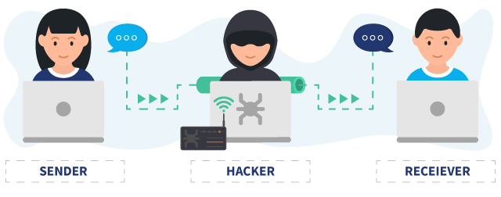
void MITM_attack (Adv, Alice, Bob) {
PassChain.ino
Details.ino
PassChain.ino
Details.ino
/*******************************************************************
* PassChain is vulnerable to MITM attack about Bluetooth because *
* it misses authentication between two devices. One solution is *
* to use BLE v4.2 BR/EDR using ECDH based encryption and using *
* the numeric compare binding model for authentication. *
*******************************************************************/
< This solution is not strong because v4.2 to 5.0 have a vulnerability called "BLURtooth" which exploits CTDK >
< This detection has been protected by the
GATT protocol available in the latest
versions of devices equipped with BLE >
}
Arduino Language
Notes:
This solution is not strong because v4.2 to 5.0 have a vulnerability called "BLURtooth" which exploits CTDK (Cross-Transport Key Derivation). This component manages two different sets of authentication keys to ensure that the relative keys are always ready for use, delegating the devices to decide during the pairing phase which version of the standard to use with the respective group of keys. The attack compromises the CTKD process overwriting the authentication keys or downgrading them to a lower level to take advantage of a less robust encryption protocol.

Slide 24
void Exploit_FP (memory) {
PassChain.ino
Details.ino
PassChain.ino
Details.ino
/*******************************************************************
* PassChain use Fingerprint to authenticate when user want run *
* some operation. *
*******************************************************************/
< The vulnerability consists in UART exploitation because this sensor uses TTL Serial to communicate. For example, we can use Attify Badge to emulate a serial connection to access the target device >
< A solution is to isolate PassChain from this device, in
particular, user must not leave the device unattended >
}
Arduino Language

Slide 25
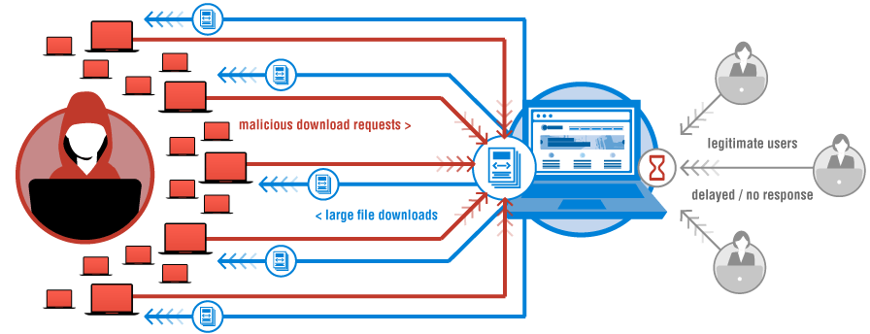
void DoS_attack (resources) {
PassChain.ino
Details.ino
PassChain.ino
Details.ino
/*******************************************************************
* User can do setup of PassChain connecting the board to the *
* server Python. *
*******************************************************************/
< A malicious can do a DoS attack exhaust the host’s resources that run server disrupting services of a host connected to a network >
< In this way the user cannot
connect to server and to do the
setup of the board >
}
Arduino Language

Slide 26
void Security_Solution (crypto, SSL) {
Tag AES_128 (plainText, key, IV);
void SSL (certs);
PassChain.ino
Details.ino
< The security solutions adopted are cryptography and SSL communication >
The user’s credentials are stored
encrypted using the AES-128 bit
in GCM mode
Data are sended by server Python to
Esp32 in clear because the
communication are made by SSL that
allows confidentiality, integrity and
authentication
}
Arduino Language

Slide 27
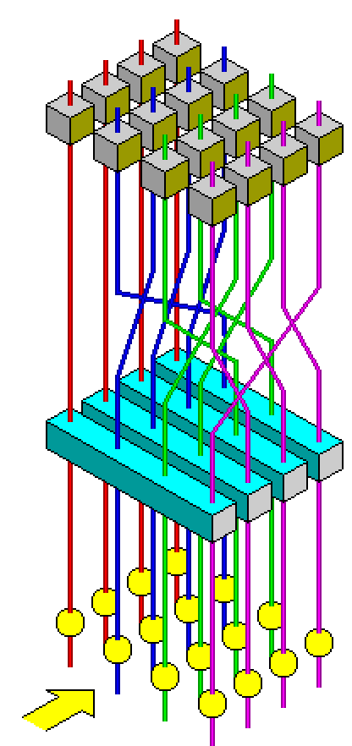
Tag AES_128 (plainText, key, IV) {
PassChain.ino
Details.ino
/**********************************************************************
* AES-GCM is a block cipher provides authentication, confidentiality *
* and integrity. *
**********************************************************************/
< We have 4 input:
Secret key (128-bit);
IV (96-bit);
Plaintext;
Optional addition authenticated data (AAD) >
}
Arduino Language
Notes:
AES-GCM is a block cipher provides authentication, confidentiality and integrity. We have 4 input:
Secret key (128 bit);
IV (96 bit);
Plaintext;
Option additional authenticated data (AAD).

Slide 28

Tag AES_128 (plainText, key, IV) {
PassChain.ino
Details.ino
/**********************************************************************
* The key must be generated randomly, for example by implementing *
* PUFs in Esp32. *
**********************************************************************/
< This is useful because the PUF is used to create keys that are generated on-demand and instantaneously erased once used. The PUF key value never exists in digital form within the circuitry of the security IC and the key is derived and produced on-demand from physical characteristics of circuit elements, they are never present in the device’s nonvolatile memory >
< In our case we have a hard-coded non-random
test key >
}
Arduino Language
Notes:
The key is a hard-coded non-random test key. The key must be generated randomly, for example by implementing PUFs in Esp32. This is useful because the PUF is used to create keys that are generated on-demand and instantaneously erased once used. The PUF key value never exists in digital form within the circuitry of the security IC. Further, since the key is derived and produced on-demand from physical characteristics of circuit elements, they are never present in the device’s nonvolatile memory. Any attempt to discover the PUF key through micro-probing or other invasive techniques will disrupt the sensitive circuitry used to construct the PUF key and render the output useless.

Slide 29
Tag AES_128 (plainText, key, IV) {
PassChain.ino
Details.ino
/******************************************************************
* The IV are generated casually by Esp32 RNG Hardware. *
******************************************************************/
< The function esp_random() produces true random numbers if Wi-Fi or Bluetooth are enabled. The function returns an integer of 32 bit, so the string IV is builded in append by generating more TRNs to output a 96-bit string (12 byte) >
IV
< Every credential is own IV stored in clear
and IV associated changes at each new
encryption of the same credential >
}
Arduino Language
Notes:
The AAD is not used but I compare the encryption TAG with the decryption TAG to check that the whole string is encrypted without truncations.

Slide 30
Serial.println (‘AES Advantages: ‘ +
PassChain.ino
Details.ino
Step 01
It is a fast algorithm
Step 02
The key can be 128 – 192 – 296 bit long not allowing brute force attacks
Step 03
The block size is 128 bits
Step 04
GCM mode allows authentication, confidentiality and integrity
);
Arduino Language

Slide 31
Serial.println (‘AES Disadvantages: ‘ +
PassChain.ino
Details.ino
Step 01
In the case of nonce reuse both integrity and confidentiality properties are violated
Step 02
Short tags produce message forgeries
Step 03
GCM implementations are vulnerable to timing attacks
Step 04
GCM is vulnerable against cycling attacks
);
Arduino Language
Notes:
In the case of nonce reuse both integrity and confidentiality properties are violated. If the same nonce is used twice, an adversary can create forged ciphertexts easily.
Short tags produce message forgeries. For instance, if the tag is 32 bits, then after 2^16 forgery attempts and 2^16 encryptions of chosen plaintexts, a forged ciphertext can be produced.
GCM implementations are vulnerable to timing attacks if they do not use special AES instructions. The vulnerability remains even if the AES itself is implemented in constant-time. Constant-time implementations of GCM exist, but they are rather slow.
GCM is vulnerable against cycling attacks; bad values of the internal H key, which can be pre-calculated for specific AES key values, can negatively impact security.

Slide 32

void SSL (certs) {
PassChain.ino
Details.ino
PassChain.ino
Details.ino
/************************************************************************
* SSL was used to create a secure channel during data exchange between *
* the Python server and the board. *
************************************************************************/
< SSL allows us to authenticate the PassChain boards through the use of certificates. In fact, before the data exchange takes place, the server checks the client and server certificates and then the exchange takes place >
< The disadvantages are that it uses a heavy protocol
due to the continuous encryption and decryption of data
when it departs and arrives at destination and to
generate new certificates for every new board that
connects to the server >
}
Arduino Language

Slide 33
Serial.println (‘SSL Advantages: ‘ +
PassChain.ino
Details.ino
Client uses the server's public key to encrypt the data; the server uses the public key in the client certificate to decrypt the data the client sends
Authentication
Integrity
SSL provides data integrity by calculating a message digest
Confidentiality
SSL uses a combination of symmetric and asymmetric encryption to ensure message privacy
);
Arduino Language
Notes:
Authentication: for server authentication, the client uses the server's public key to encrypt the data. The server can generate the secret key only if it can decrypt that data with the correct private key. For client authentication, the server uses the public key in the client certificate to decrypt the data the client sends during step 5 of the handshake. The exchange of finished messages confirms that authentication is complete. If any of the authentication steps fail, the handshake fails and the session terminates.
Integrity: SSL provides data integrity by calculating a message digest.
Confidentiality: SSL uses a combination of symmetric and asymmetric encryption to ensure message privacy. During the SSL handshake, the SSL client and server agree an encryption algorithm and a shared secret key to be used for one session only. All messages transmitted between the SSL client and server are encrypted using that algorithm and key, ensuring that the message remains private even if it is intercepted.

Slide 34
void thank_you () { Serial.println(‘Thank you’); Serial.println(‘For your Attention’);
PassChain.ino
Details.ino
}
Arduino Language

