Slide 1
Overfitting Overlords
By Alberto Popescu

Slide 2
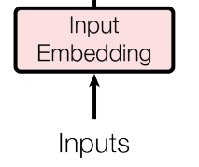

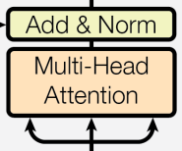
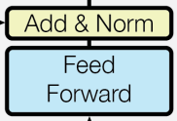
Nr EPOCHS for 100% accuracy
Bes code: >10k epochs
Bes code + PE: 5k epochs
Bes code + PE + Multihead: 1.5k epochs
Bes code + PE + Multihead + RC with Normalization: 420 epochs

Slide 3
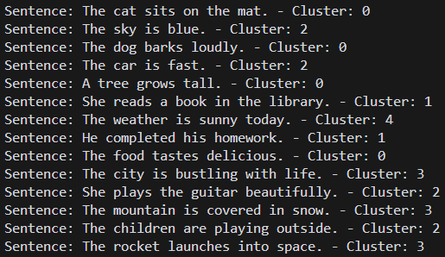

Encoder_magic_4_epoch_500_loss_1.4351_acc_65.6268%_time_32.4519
We need more features!

Slide 4
