Slide 1
Augustan age
(1714-1760)

Slide 2
Literally point of view
The journals, in particular newspaper and periodical, became the principal media of the century because they were inexpensive to produce, quick to read and a great way to influence public opinion
In the XVII century many masterpieces of the novel were born. The most important type of novel in Augustan age were:
Satirical novel: it is a comic story with the hidden purpose of criticizing various aspects of society and making the reader think. The most famous satirist of this period was Johnathan Swift, writer of the famous “Gulliver’s Travels”.
Realistic novel: it’s a novel based on real events. An example of author of realistic novel is Daniel Foe, writer of the famous story of “Robinson Crusoe”, inspired by the story of Scottish sailor Alexander Selkirk who had been stranded on an island in South American for some years.

Slide 3
Literally point of view
Sentimental novel: celebrates the emotional and intellectual concepts of sentiment, sentimentalism, and sensibility. An example is Pamela by Samuel Richardson
Comic novel: it is characterized by the fact that the story is told through drawings with dialogues and the ironical, humoristic and satirical tone. A very famous comic of Augustan age is Tom Jones of Henry Fielding
Experiment novel is a type of novel that introduces new narratives techniques. An example is Tristram Shandy by Laurence Sterne

Slide 4
Literally point of view
The poetry: the poets were divided into two factions: those who regarded the subjective self as a worthy argument and those who they exalted art and poetry as a performance for the benefit of society. However, the most important poet of the time was certainly Alexander Pope, so much so that today many of his jokes have become clichés and proverbs in modern English.

Slide 5
Political point of view
After the exclusion city and glorious revolution in 1688 the king James II had to leave England, replaced by William III.
His successor, the sister-in-law Anne Stuart, was the last sovereign belonging to the Stuart’s dynasty. The throne of England passed to the German Hanover dynasty. In particular, the kings during the Augustan age were George I and his successor George II. They didn’t know English and stayed in England little time, so they left important decision to a group of ministers: the Parliament.
In the parliament there was two principal rival parties: the Whigs and the Tories

Slide 6
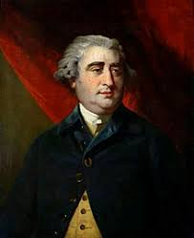
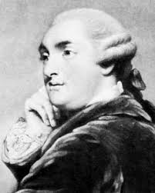
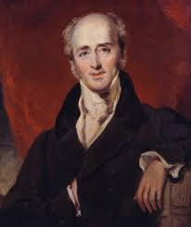
Political point of view: the Whigs
Whigs: they are liberals, so they support the middle class and the workers and favored a strong Parliament. They was against the king and the Catholics. Whigs started as a loose groupings in 1788.
Some famous Whigs are:
Duke of Portland
Administration leader of 1783
Earl Grey: led Constitutional reform
Charles Fox: supported
Parliament reform

Slide 7
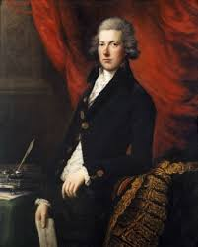
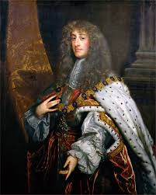
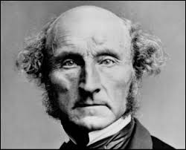
Political point of view: the Tories
Tories: they are conservatories, so they support the aristocracy and the king and was against the Parliament. They believed that God and Religion were on the same level as the king. They emerged in 1678 and fell in 1738. They were succeeded by Conservative party.
Some famous Tories are:
John Stuart: First Tory Prime Minister
William Pitt: the youngest
English Prime Minister
James the Duke of York

Slide 8
Political point of view
Both parties believed that sovereign is indivisible, so or the kings have the absolute power or the parliament have absolute power. However, the kings is technically the sovereign, so the Whigs had to develop the technical concept of “the king in parliament”: the Parliament, with the consent of the king, can do whatever it wants. In this way, they indirectly transform the king into parliament
Inspired by this concept, Blackstone, a preeminent Whigs, establish the doctrine of parliament sovereign: the parliament could pass any laws that not contrary with the laws of nature.

