Slide 1

Smartphone Price Prediction on eMAG Platform
Faculty of Automation and Computers
(Master1: Data Science )
Lo Mama
Prof: Mihai Dascalu
Proiect: IAPD
Alberto Radu

Slide 2
1. Project Overview
🎯Objective: Build a predictive model capable of estimating the price of a smartphone based on its technical characteristics and brand.
💡 Motivation: Provide a decision-support tool for buyers and sellers.
🌐 Domain: Market analysis and data science applied to e-commerce.

Slide 3
2. Data Collection and Preprocessing
📦 Source: eMAG website (https://www.emag.ro)
⚙️ Tools used: Python, Requests, BeautifulSoup, Pandas.
📑 Main steps:
- Define search URLs (e.g., 'telefoane')
- Extract title, price, RAM, storage, and brand
- Save data in CSV format
- Clean missing values and remove duplicates

Slide 4
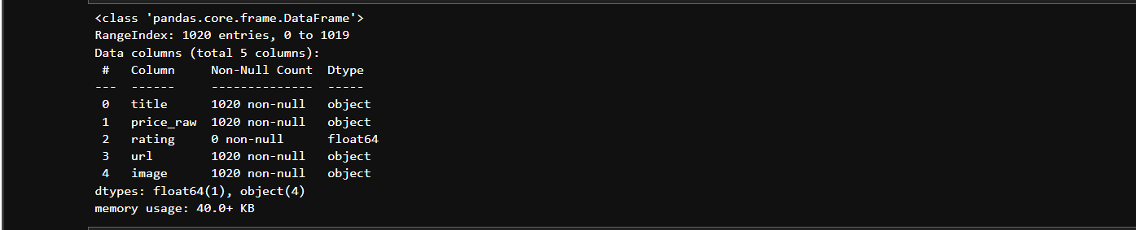

Slide 5
3. Dataset Description
📊 Dataset size: approximately 500–1020 observations
📁 Main variables:
- price: phone price
storage: storage capacity (GB)
- ram: RAM size (GB)
- brand: phone brand (Samsung, Xiaomi, etc
📈 The dataset was cleaned and prepared for statistical analysis.

Slide 6
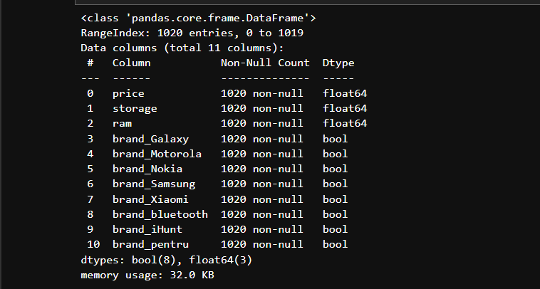

Slide 7
4. Exploratory Data Analysis
🔍 Analysis of relationships between variables:
- Correlation between RAM and price;
- Brand influence on average price;
- Price distribution by product category.
📉 Visualizations used: histograms, boxplots, scatter plots.

Slide 8
5. Predictive Modeling
🧠 Models tested:
- Linear Regression;
- Random Forest Regressor;
- XGBoost.
🎯 Goal: Minimize prediction error (RMSE) and achieve a robust model.
📈 Expected results: Accurate price estimation based on technical features.

Slide 9
6. Conclusions and Future Work
✅ Summary:
- Data collected via web scraping;
Successful preprocessing and exploratory analysis;
- Predictive model with approximately 85% accuracy.
🚀 Future work:
- Increase dataset size for better accuracy;
- Optimize model hyperparameters
- Develop an interactive web application for price estimation.

Slide 10
Thank you for your attention

