Slide 1
SELF DRIVING CARS

Slide 2
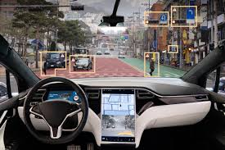
What are self driving cars?
Vehicles able to drive autonomously
Pilotage automated systems and sensors

Slide 3
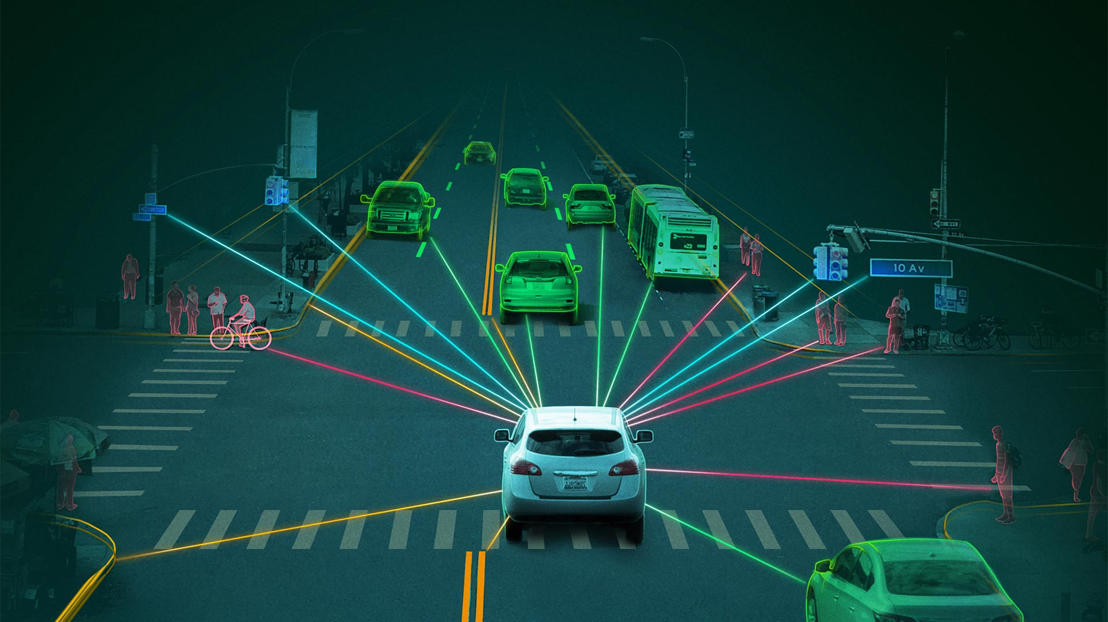
Advantages
Less dangerous journeys
Decrease of traffic
Possibility to spend time differently while travelling

Slide 4
Autonomous driving levels
Level 0: no automation
Level 1: assisted driving
Anti-collision and distance detectors
Level 2: partial automation
Cars able to brake autonomously
Level 3: conditioned automation
Cars can control the traffic and intervene
Level 4: high automation
Cars able to drive autonomously
Level 5: full automation
Cars like the level 4, this time without steering wheels and pedals

