Slide 1
Analysis of leads to increase the efficiency of the sales TEAM
By Alberto Escalante, Data Scientist (Applicant)
alberto.escalante@ini.rub.de
28.08.2018

Slide 2
Challenge faced by THE sales team
Sales Director is interested in increasing efficiency by understanding the leads
23,245 leads, € 18.9 M total contract value
13.5% of them result in a sale
Can we recognize the most promising leads to improve efficiency of the sales team?
How likely is a lead to result in a sale?
In case a lead results in a sale, how high will the sales value be?
How much revenue can be kept by reducing the leads to only 40%?
2/10

Slide 3
DATA and MethodS
23,245 leads, 50 variables per lead
Plus two key variables to be predicted:
Binary variable Target_Sold --> estimated using model 1 (M1)
Real valued variable Target_Sales (if contract) --> estimated using model 2 (M2)
Use M1 and M2 to compute the expected sales value of each lead, defined as:
3/10

Slide 4
First model (M1)
Data --> Training set (60%), validation set (20%), test set (20%). Normalization
Randomized search with 5-fold CV to tune hyperparameters
Handling of missing values: replace by zero / mean. Optional: extend feature vector with Boolean flags that indicate whether a value is missing
Four promising candidates
Algorithm | Classification Rate (Validation)
Logistic regression | 90.88 %
Random forest classifier | 96.00 %
Gradient boosting classifier | 95.85 %
Support vector classifier | 93.93 %
(Chance level) | 86.28 %
4/10

Slide 5
Second model (M2)
Same data pre-processing / splitting
Training data restricted to leads that resulted in a sale
Five promising algorithms (randomized hyperparameter search + 5-fold CV)
Algorithm | Root Mean Square Error (Validation)
Linear regression | € 11,205.7
Ridge regression | € 11,215.2
Random forest regressor | € 8,652.3
Gradient boosting regressor | € 10,231.0
Support vector regression | € 9,339.3
Chance level | € 14,170.8
5/10

Slide 6
Expected revenue (M1 & M2)
Tested all combinations algorithms for m1 and m2
Ordered the leads by expected revenue, kept the most promising 40% leads, computed total sales value for such leads
Validation data € 3,506,349 in total
Percentage of sales kept (40% of leads)
M1 M2 | Logistic regression | Random forest classifier | Gradient boosting classifier | Support vector classifier
Linear regression | 89.87 % | 94.06 % | 93.53 % | 91.90 %
Ridge regression | 90.79 % | 93.31 % | 93.83 % | 92.13 %
Random forest regressor | 98.48 % | 99.72 % | 98.90 % | 97.79 %
Gradient boosting regressor | 98.27 % | 99.34 % | 98.90 % | 95.53 %
Support vector regression | 96.71 % | 99.13 % | 98.71 % | 96.57 %
6/10

Slide 7
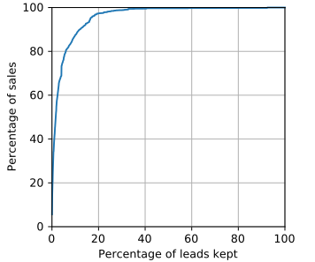
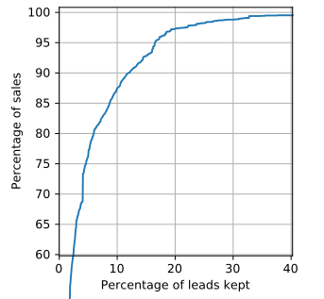
Efficiency given a fraction of leads
Best model: random forest classifier + random forest regression
7/10

Slide 8
variable importance (gini, var) M1 & M2
Cre_Val_6M | 0.116 | Inv_Val_12M | 0.018 | No_List_On_24M | 0.012 | No_Act_WOF_1vs2 | 0.007
No_List_STST_6M | 0.074 | Inv_Days_1M | 0.017 | Inv_Val_1M | 0.011 | No_Act_6M | 0.007
No_Act_Ph_1M | 0.071 | List_STS_Index_12M | 0.017 | AVG_Share_Online | 0.011 | List_STS_T4_12M | 0.007
Cre_Val_12M | 0.053 | Inv_Val_3M | 0.017 | AVG_Refresh_p_Posting | 0.011 | No_Act_Lo_1vs2 | 0.006
MISC_Days_Since_Last_Offer | 0.050 | Offer_days_24M | 0.016 | Count_SIC_3 | 0.011 | List_STS_off_24M | 0.006
Cre_Val_1M | 0.043 | No_Act_3M | 0.016 | Avg_Views_1M | 0.010 | AVG_STF_1M | 0.005
No_List_STST_3M | 0.042 | List_STS_Index_3M | 0.016 | Avg_Views_6M | 0.010 | List_FB_HOM_1M | 0.004
Offer_days_1M | 0.038 | Inv_Days_12M | 0.015 | No_Act_WOS_12M | 0.010 | No_Act_WOF_1M | 0.004
No_list_IND_24M | 0.032 | No_Act_1M | 0.015 | AVG_Renew_p_Posting | 0.009 | Var_04 | 0.004
Avg_OAF_6M | 0.028 | Inv_Days_6M | 0.014 | List_STS_FB_1M | 0.009 | List_FB_off_6M | 0.002
Avg_Views_12M | 0.027 | No_Act_Ph_3M | 0.014 | AVG_STF_12M | 0.008 | No_List_Off_1M | 0.001
MISC_Days_Since_Last_act_noffer | 0.027 | List_STS_Index_1M | 0.013 | No_List_T7_1M | 0.007
No_list_FB_6M | 0.019 | No_Act_Lo_1M | 0.013 | AVG_STF_6M | 0.007
Final evaluation using test data: from €4.299.377 (100% leads), one can keep €4.329.002 (99.78%) by pursuing only 40% of the leads
Variable importance (average of M1, M2, M3) , (using gini/var metrics)
8/10

Slide 9
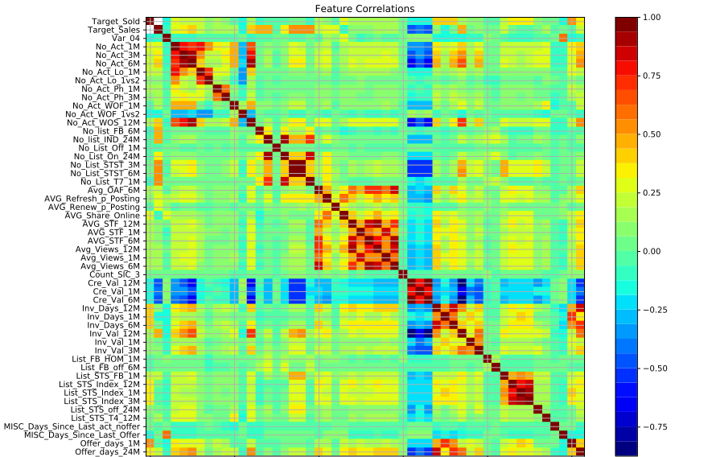
9/10

Slide 10
Recommendations and future work
Final evaluation using test data: € 4,338,430 (100% of leads) --> € 4,329,002 (99.78%) by pursuing only 40% of the leads
Variable importance (average of M1, M2), (using gini/var metrics) is model dependent. Investigate whether important variables can be controlled to improve the expected sales value of a lead
M1 and M2 give useful information to the sales team so that they can focus on the most promising leads
Estimate the cost of pursuing a lead and then use the method to decide if it should be pursued
Main limitation: the method is short sighted. Pursuing a lead (even if not immediate sold) might contribute to a conversion in the future. Care should be taken if the number of pursued leads is reduced
Future work: variable selection, long-term effects, reinforcement learning
10/10

