Slide 1
Anticipated Schedule
10:35 -10:38 (3 mins) Introduction
10:40 - 10:42 (2 mins) q1
10:42 - 10:45 (3 mins) q2
10:45 - 10:48 (3 mins) q3
10:48 - 10:52 (4 mins) q4
10:52 - 10:56 (4 mins) q5
10:56 - 10:58 (2 mins) Tie-Breaker if necessary
10:58 - 11:00 Announce winners, come up and take pictures!!
Notes:
Hey everyone,
My name is Alberto Li, I’m in UIT in the DART team under Platforms & Services and I’ll be running the Code Challenge. The code challenge is on handling data transformations using map, filter, reduce and functional programming techniques such as lambdas, function composition, and currying in Javascript/Typescript.
This is a team-based challenge for groups of 10 or less, conveniently each table has X people so if you want that to be your team that is great, if not feel free to shuffle around.
So, I have written a challenge that includes 5 questions and a tiebreaker. Since this session will run for 25 minutes we may kind of be in a time crunch. Part of the challenge is doing these 5 questions in a timely manner.
The anticipated schedule looks like this:
10:35 -10:38 (3 mins) Introduction
10:40 - 10:42 (2 mins) q1
10:42 - 10:45 (3 mins) q2
10:45 - 10:48 (3 mins) q3
10:48 - 10:52 (4 mins) q4
10:52 - 10:56 (4 mins) q5
10:56 - 10:58 (2 mins) Tie-Breaker if necessary
10:58 - 11:00 Announce winners, come up and take pictures!!
Instructions:
There will be a problem set at each table. You can go at your own pace, however, I recommend that you follow this schedule. When you’ve come to a conclusion to a question. Raise your hand and a Solution Runner (Ryan Ngo, Brett Rowberry, or myself) will come to you and mark your answer as RIGHT OR WRONG with a RED X or a RED Checkmark. You can only SUBMIT once, so please think about your answer before you raise your hand.
Any questions?
Good luck everyone!
Oh, we will send out the GitLab link to the Problem Set, Solution Set, Explanations, and runnable javascript code for each question afterwards?
If we have time we can go over the solutions at the end.

Slide 2
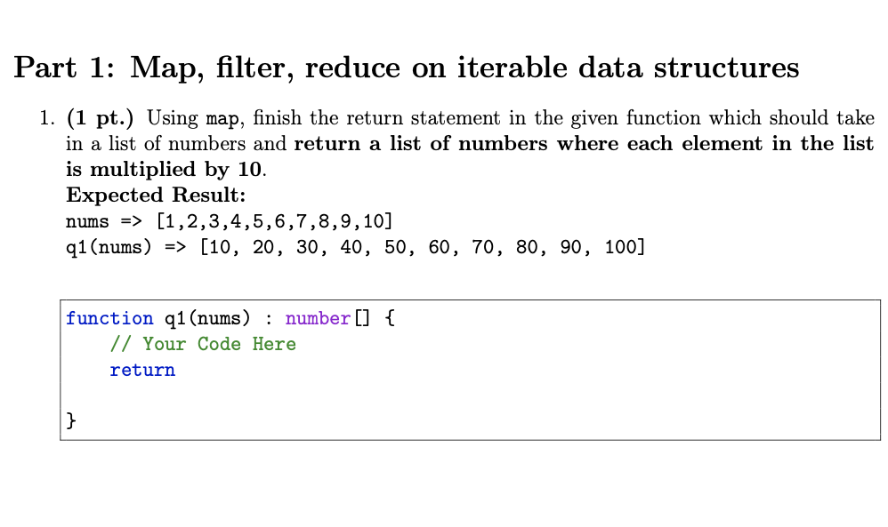
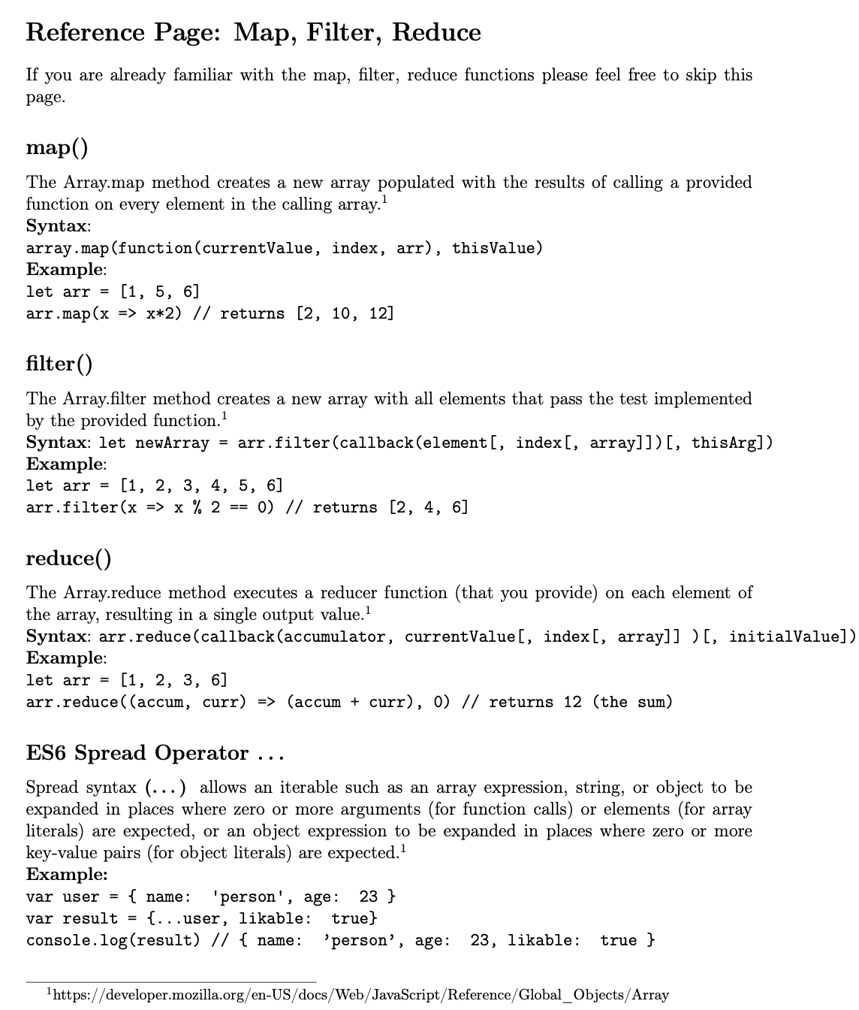
Q1 (10:40 – 10:42)

Slide 3
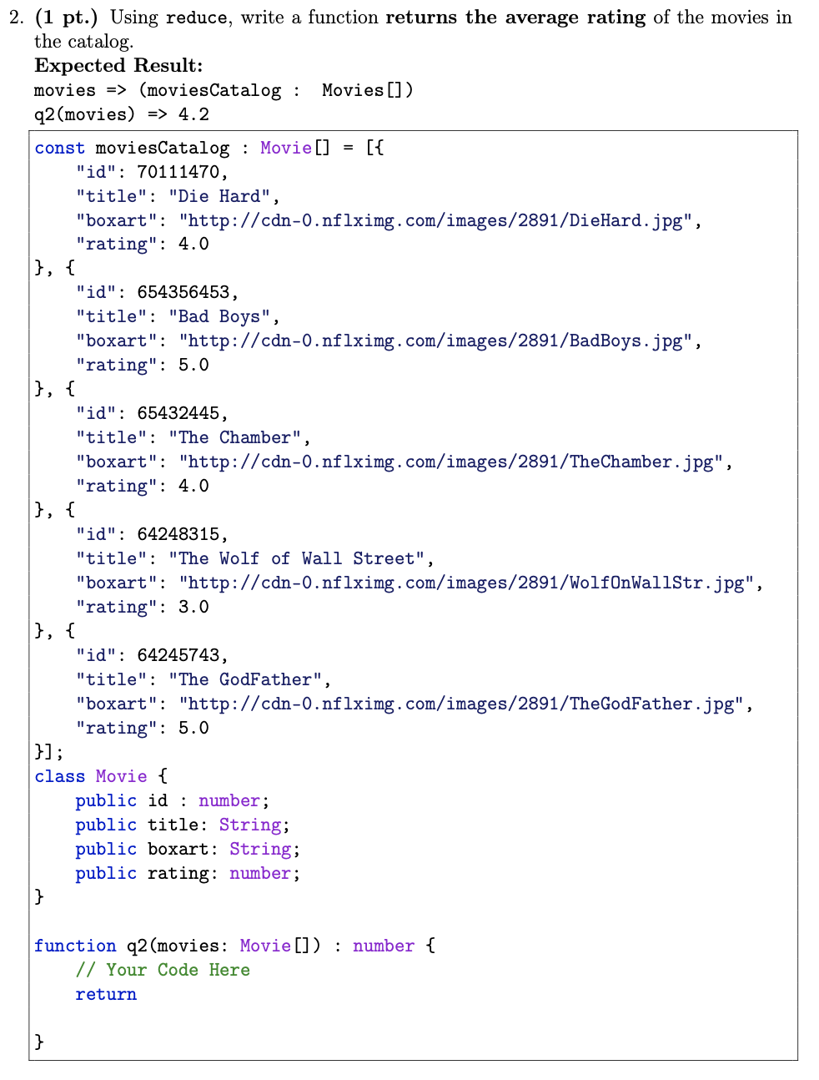
Q2 (10:42 – 10:45)

Slide 4
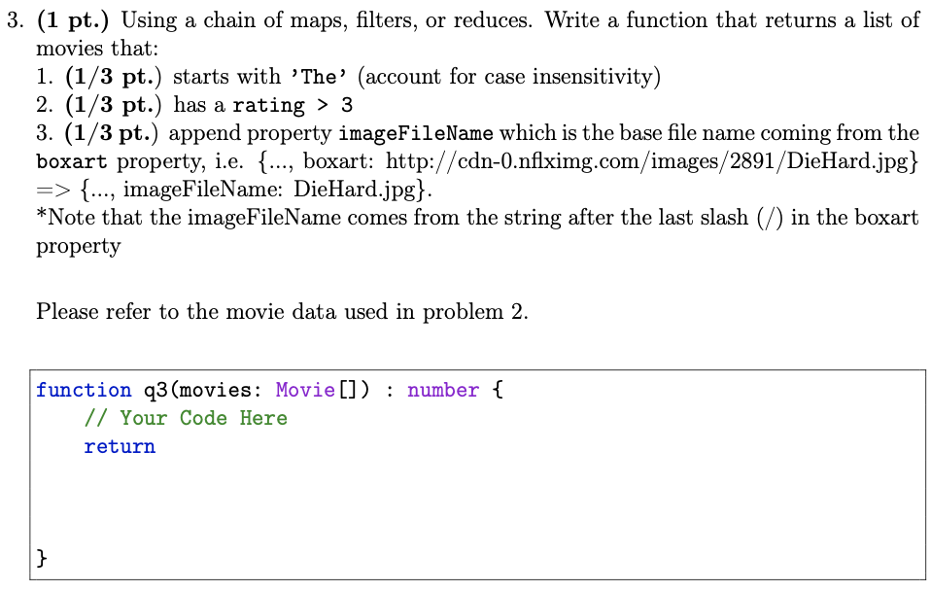
Q3 (10:45 – 10:48)

Slide 5
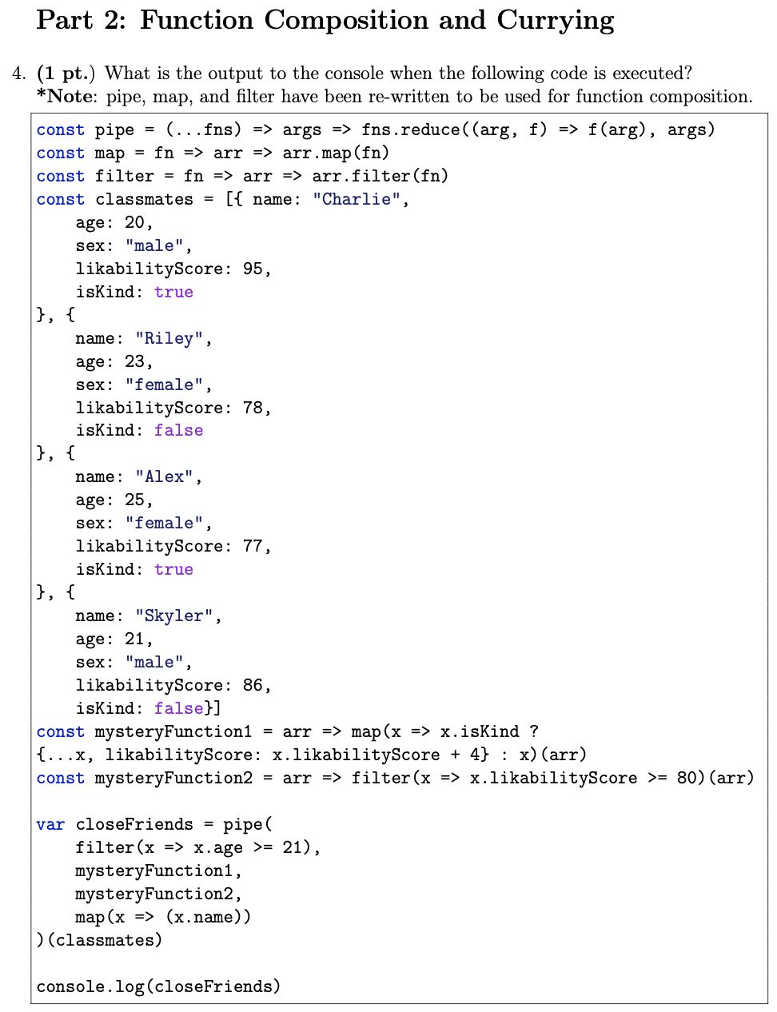
Q4 (10:48 – 10:52)

Slide 6
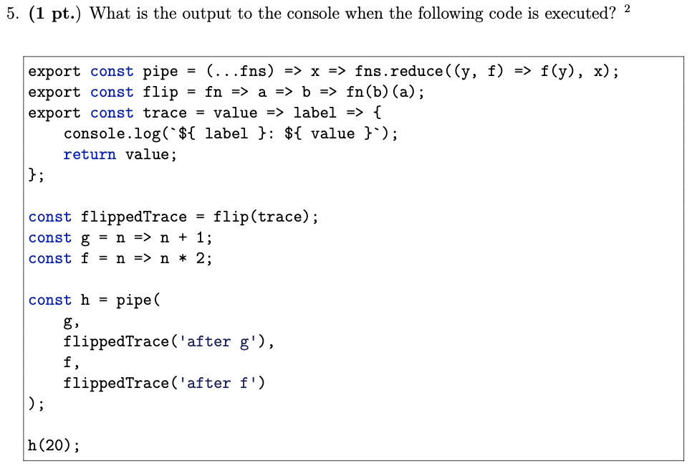
Q5 (10:52 – 10:56)

Slide 7
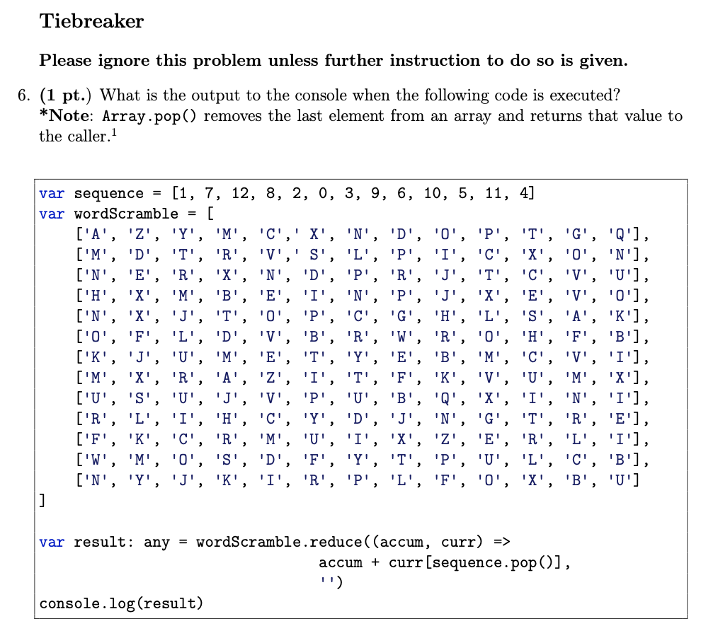
Tiebreaker (10:56 – 10:58)

