Slide 1
CS50 AI IN PYTHON: Crossword
A solution by Alberto Pascal

Slide 2
Background
This problem can be represented as a constraint satisfaction problem. The objective is to find the words the best fit the given crossword layout. For these, the following functions were required:
Enforce_node_consistency
Revise
Ac3
Assignment_complete
Consistent
Order_domain_values
Select_unassigned_variable
backtrack

Slide 3
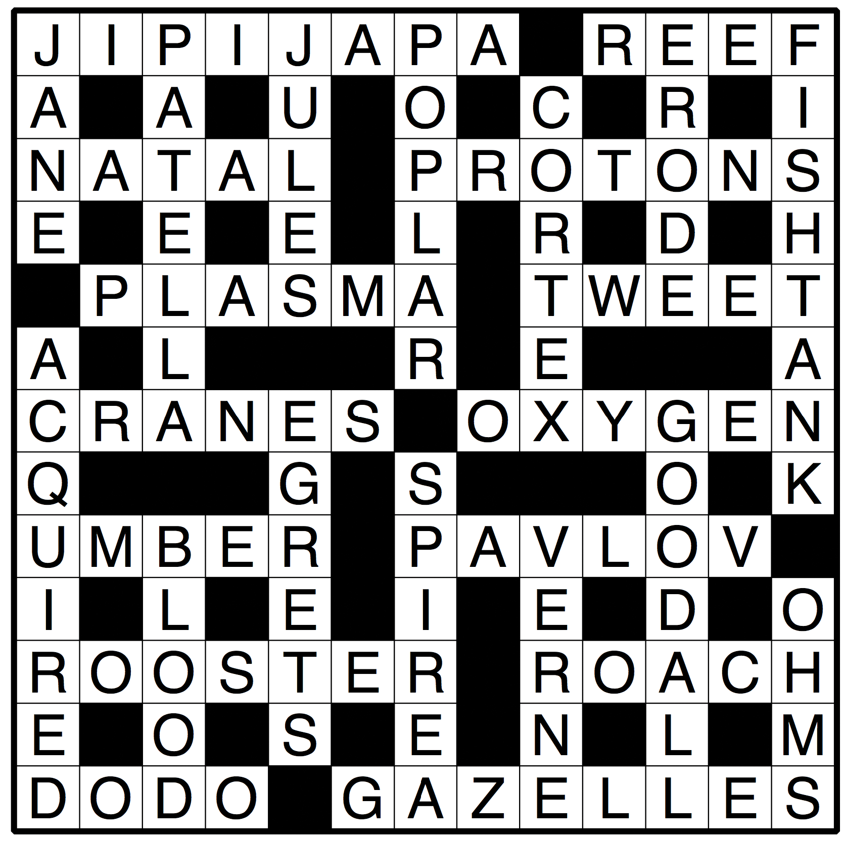
Enforce node consistency
The objective is to make sure that every variable fulfulls all of its unary constraints. These are:
Making sure that every word has the same number of letters as the variable’s length
If a word does not meet the criteria, we remove it from the domain.

Slide 4
revise
The objective is to make sure that, given the variable x, there is always a possible value for variable y. This can be achieved by:
Looking for an overlap. If there is one:
Go through every word of domain X
Try every word of domain Y with the current word of domain X.
If there is at least one option where they can perfectly overlap, we can use that word of domain X
If not, we remove that word from domain X.
If there was no overlap:
We do no updates and return that we did not make any revision

Slide 5
AC3
The objective is to update every domain so that each variable is arc-consistent with one another. We can do this by:
Receiving or creating all possible combination of variables that overlap
This was done using permutations
Iterate through every combination X, Y and revise them.
If any of my domains’s length is 0, we cannot have an arc-consistency.
However, if both have at least 1 element, we add to the arc_list all of the possible neighbors that can be created with that variable to keep searching

Slide 6
Assignment_complete
The objective is to check whether our current assignment is ready to be marked as complete or not. This was done by:
Going through every variable of the crossword puzzle
If the variable is not present in the assignment keys, we are missing assignments
If the variable is present but the value of that assignment is set to None, we are also missing assignments
If none of the conditions were met and we went through all variables, we have completed a valid assignment.

Slide 7
Consistent
The objective is to make sure that, given an assignment, all of the words assigned in their variables meet the requirements. This is done by:
Going through every possible permutation of variables within the assignment
Check for length
Check that one same word is not assigned to two different variables
Check that both words can overlap
If any of the previous conditions is not met, our assignment is not consistent

Slide 8
Order_domain_values
The objective is to make sure that we pick the options that limit our future choices the least. This was done by:
Going through every word for the domain of the given variable
Going through every unassigned neighbor for that variable
Checking for overlap between current variable and the neighboring variable
If there was an overlap, we now need to check every possible word of the neighboring domain and see if it matches all conditions with the first word:
If it does, we add it to the count, mapping it to the current variable
Lastly, we order our resulting dictionary by using the negative value of the count as a criteria (to make sure it is in a descending order)

Slide 9
Select_unassigned_variable
The objective is to make sure that, given a current assignment, we can choose a variable that has not yet been assigned. This is done by:
Going through every variable in the crossword
If the variable is not yet in assignment, store it in a dic1tionary along with the count of words in its domain and the neighbors it has
Sort the values by two criteria:
Count of words in its domain in an ascending manner
Degrees (count of neighbors) in a descending manner

Slide 10
backtrack
The objective is to try and complete an assignment given a partial assignment. This is done by using recursive calls as follow:
If the assignment is complete, we return the assignment. Else, we fetch an unassigned variable
We look for the best domain of variable based on the fetched variable and the current assignment
Go through every word of that domain
Assign the word to the variable
Check for AC3 consistency
If there is AC3 consistency, call our backtracking function to keep assigning and return the current value
If not, we return the assignment of that variable to None and keep looking

