Slide 1
CS50 AI IN PYTHON: Shopping
A solution by Alberto Pascal

Slide 2
Background
The problem tries to predict the behavior of people that go shopping according to the csv data provided. In order to achieve this, we will be making use of:
Sklearn module
Nearest-Neighbor Classification

Slide 3
Background
In order to solve the problem, the following functions required to be modified:
Load Data
Train Model
Evaluate

Slide 4
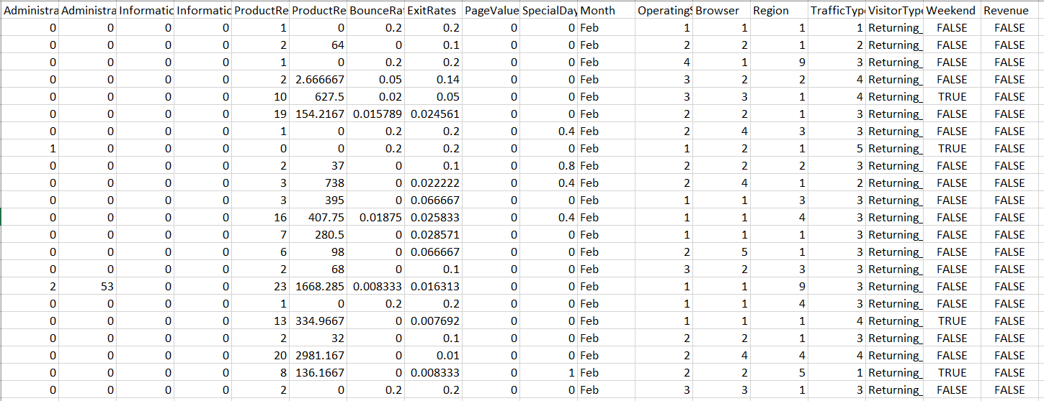
Load_Data

Slide 5
LOAD_DATA
Steps:
Create a flag to skip reading the headers
Create a month list
Prepare the label and evidence lists
Read row by row interpreting the results:
For every row in the first 10 columns, we store data as is
For the 11th column, we interpret the month
For columns 12th to 16th we store data as is
The remaining rows will be interpreted as 0 or 1 depending on their value.

Slide 6
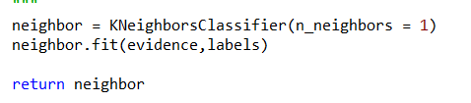
Train_model
Thanks to the sklearning module, this function is pretty straight forward:
We create a KNeighborClassifier with k=1
We fit the model
We return the KNeighborClassifier once it is fit to the evidence and labels

Slide 7
Evaluate
Since we are mainly depending on our testing data, we want to measure both specificity and sensitivity. To achieve this:
We iterate through every label (correct answer) and prediction
We keep track of how many labels are positive and negative
We keep track of how many predicions were accurately assigned
For specificity, we divide our accurately assigned negative descriptions over the total negative labels
For sensitivity, we divide our accurately assigned positive descriptions over the total positive labels

