Slide 1


Heredity
CS50: Python Artificial Intelligence Course
A solution by Alberto Pascal

Slide 2
Outline
In this video we will go through a quick overview of the following approach and functions:
Heredity with father and mother
Joint probability
Update
Normalize

Slide 3
Heredity with father and mother
To make things easier to see, I:
Determined the different possible scenarios for the parents:
They can have 0, 1 or 2 bad genes
Genes can mutate
Calculated the probability of giving a good gene and the probability of giving a bad gene.
Note: If the person has no parents, we use the generic probabilities provided.

Slide 4
Parent’s probabilities:
Having 0 bad genes:
I can give a bad gene only by mutating
Having 1 bad gene:
I can give a bad gene by :
selecting the “good” gene and it mutating OR
Selecting my bad gene
Having 2 bad genes:
I can give a bad gene anytime my gene does not mutate
Bad Genes | Probability
0 | PROBS(“mutation”)
1 | (0.5 * PROBS(”mutation”)) + (0.5 * (1-PROBS(“mutation”))
2 | 1-PROBS(“mutation”)
Note: The probabilities of giving a GOOD gene can be calculated with (1– probability_of_bad_gene) and these calculations apply for both parents.

Slide 5
Joint Probability
In order to calculate the joint probability, we had to consider the different possible scenarios:
If I am to receive 0 “bad” genes
I need to receive a “good” gene from both parents
If i am to receive 1 “bad” gene
I need to reveive either a ”good” gene from Mom and a “bad” gene from Dad
OR
A “good” gene from Dad and a “bad” gene from Mom
If I am to receive 2 “bad” genes:
I need to receive a bad gene from both parents
Finally, I multiply times the probability of showing or not showing the trait according to the situation.

Slide 6
Joint Probability: summing up
Desired Gene’s Probability
Porbability of showing/not showing trait
Joint Probability
Parent’s probability of passing genes
Parent’s probability of passing genes

Slide 7
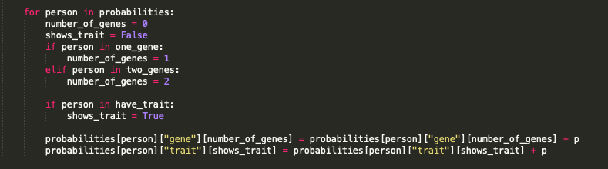
Update Function
In order to create the update function:
We only add probability p to each individual probability.

Slide 8
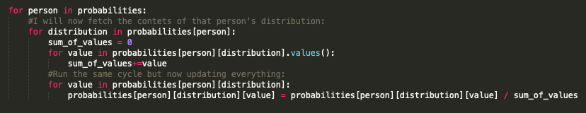
Normalize function
The idea is to make all of the distributions sum 1. Therefore:
For each individual value in a distribution we will divide it into the total sum of the values of that distribution

Slide 9
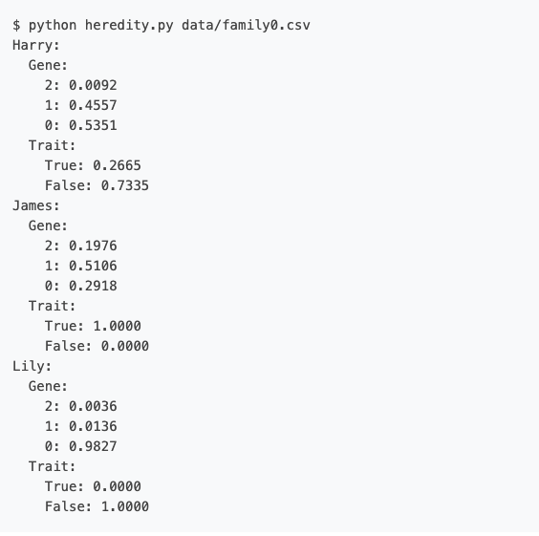
Expected results
According to the project’s description, when running family0.csv we expect the following results:

