Slide 1


Pagerank
CS50: Python Artificial Intelligence Course.
An approach by Alberto Pascal

Slide 2
Outline
In this video we will go through a quick overview of the following approach and functions:
Transition_model
Sample_pagerank
Iterative_pagerank

Slide 3
Transition Model
In order to code the transition model, we need to take into account:
We have a probability of damping_factor of choosing a link within our current page
We have a probability of (1– damping_factor) of choosing a random page from the corpus.

Slide 4
Transition Model
Link 1
1/n
Current Page
1/n
Link 2
Damping Factor
1/n
Link 3
n→ Represents the total number of links withing the page
m→ Represents the total number of pages in the corpus
Probabilities
Page 1
1/m
Random Page
1/m
( 1 - Damping Factor)
Page 2
1/m
Page 3

Slide 5
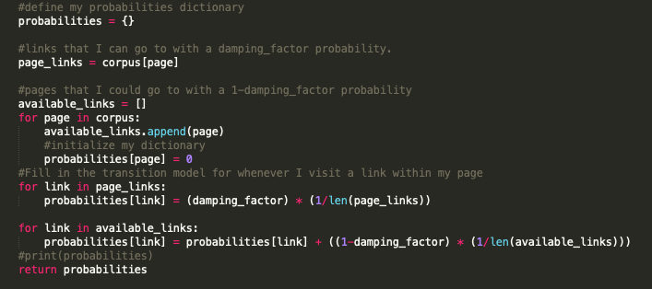
Transition Model
Therefore, we can say that the probability of arriving at a given page is the sum of:
The probability of clicking a link that leads to that page from the current page
The probability of randomly choosing that page.

Slide 6
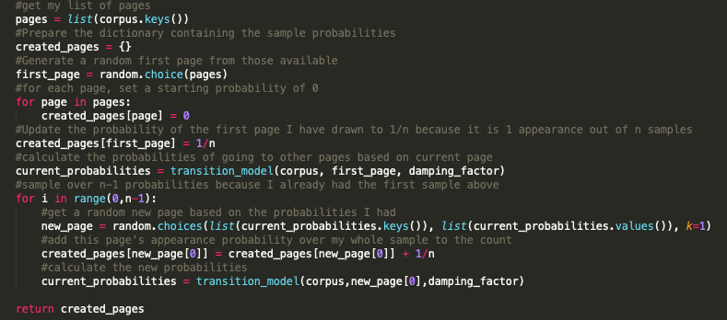
Sample PageRank
To get a first approach of the probabilities, we will need to create N samples and look at the results. Therefore:
I will create N samples of random pages according to the probability distributions from my transition model
Every time a page is generated, a dictionary will update its result’s probability by adding (1/n)

Slide 7
Sample PageRank: Generating a Sample
We randomly generate a page (according to transition probabilities)
We update the generated page’s probability
Page 1
Page 1
1/n
Page 1
1/n
2/n
1/n
Page 2
Random Page
1/n
Random Page
Random Page
1/n
Page 2
Page 2
1/n
1/n
Page 3
1/n
Page 3
1/n
Page 3
Page 1
n→ Represents the total number of pages that we will sample

Slide 8
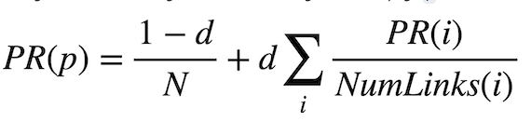
Iterative PageRank
To get a iterative approach of the probabilities, we will need to calculate the new values from the previous values by following a formula:
In order to achieve this, we will need to:
Create a function sum_of_ranks to calculate the sumation part of the formula
Store a copy of my probabilities so I can alter the values without messing with the calculations

Slide 9
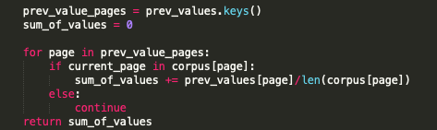
Sum_of_ranks function:
To get a iterative approach of the probabilities, we will need the now “old” values

Slide 10
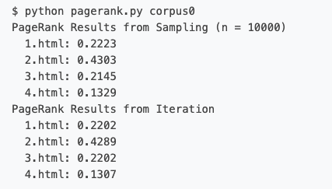
Expected results

