Slide 1
CS50 AI IN PYTHON: Nim
A solution by Alberto Pascal

Slide 2
Background
The objective is to try to teach the AI how to play a game of NIM. For this, we will be making use of Q-learning. The most important functions we will look at are:
Get_q_value
Update_q_value
Best_future_reward
Choose_action

Slide 3
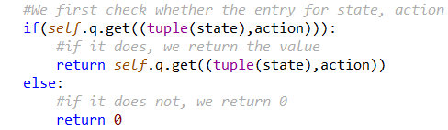
Get_q_value
Steps:
Check if the tuple of state, action values exist in our q dictionary.
If the value exists, return it.
If it doesn’t exist, we return 0

Slide 4
update_q_value
Steps:
In order to update our Q_Value we will be making use of the following formula:
Q(s, a) = old value estimate + alpha * (new value estimate - old value estimate)
Q(s, a) <- old value estimate + learning_rate * ((current_reward + future reward) – old_value_estimate)

Slide 5
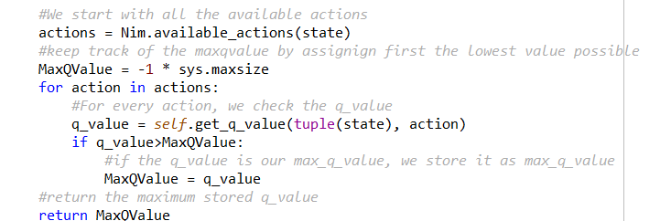
BEST FUTURE REWARD
In order to calculate our best possible future reward, we will:
Start with the universe of all our available actions.
For every action, get the q_value of taking that action.
If our q_value is the greatest known, we store that action until we find a best one.
Return our best possible q_value.

Slide 6
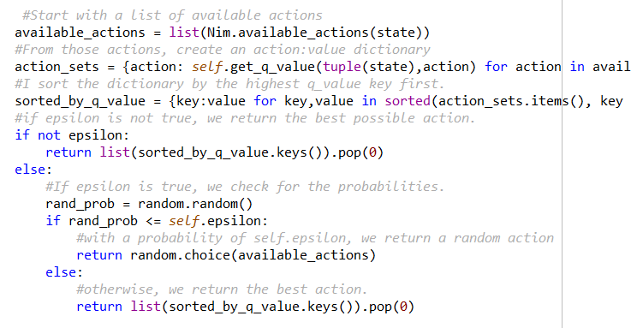
Choose_action
In order to know which action to take, we will:
Get all possible actions
Calculate all the possible q_values from those actions.
Check for epsilon value:
If epsilon is true:
With a probability of self.epsilon we choose a random action
Otherwise, we choose our best available action.
If epsilon is false:
Return our the action that results in our best possible known q_value

Slide 7
Demonstration

