Slide 1
CS50 AI IN PYTHON: parser
A solution by Alberto Pascal

Slide 2
Background
The objective is to try to teach the AI how to interpret sentences. For this, we will be making use the nltk python module. The most important parts we will look at are:
NonTerminals
Preproccess
Np_chunk

Slide 3
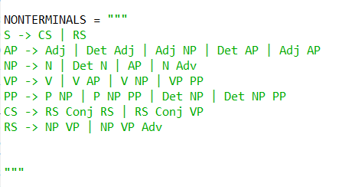
Nonterminals
In order for nltk to be able to determine what a sentence is made, we need to determine the following context-free grammar:

Slide 4
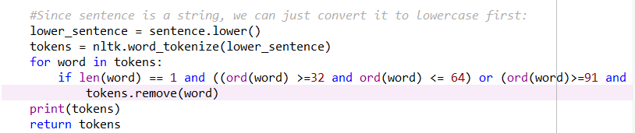
Preproccess
Steps:
Convert sentence into lower case
Tokenize with nltk
Remove all special tokens (ascii)
Return the tokens

Slide 5
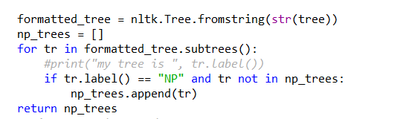
Np_chunk
Steps:
Create an nltk formatted tree from the given tree string input
Create empty list of subtrees.
For each subtree in our tree:
Look for the tree’s label.
If label is NP and the subtree is not already in my list of subtrees:
Add subtree to list of subtrees.

Slide 6
Demonstration

