Slide 1
CS50 AI IN PYTHON: Questions
A solution by Alberto Pascal

Slide 2
Background
The objective is to try to teach the AI how to interpret queries and look for the answer in body of texts. For this we will take a look at:
Load_files
Tokenize
Compute_idfs
Top_files
Top_sentences

Slide 3
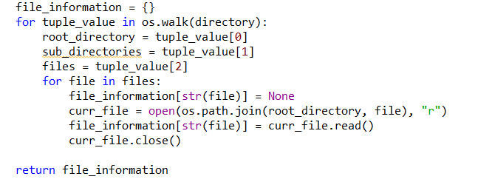
Load_files
Data is given in the form of .txt that contain the body of text from where to extract the answers to the queries.
Steps:
Walk through the directory
Read each file
Map the file’s content to a dictionary with the filename
Return the dictionary

Slide 4
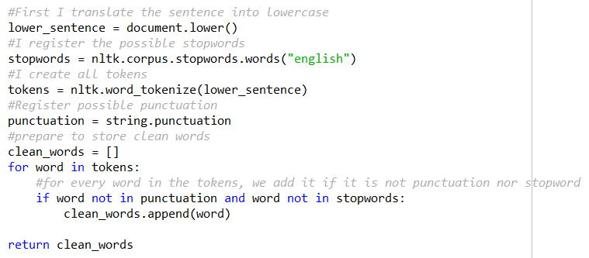
tokenize
Steps:
Convert document to lower case
Fetch the stopwords by using ntlk.corpus.stopwords(“English”)
Fetch punctuation by using string.punctation
Word_tokenize with nltk our document.
For each word of our tokens, we will only keep those that are not in punctuation nor a stopword.

Slide 5
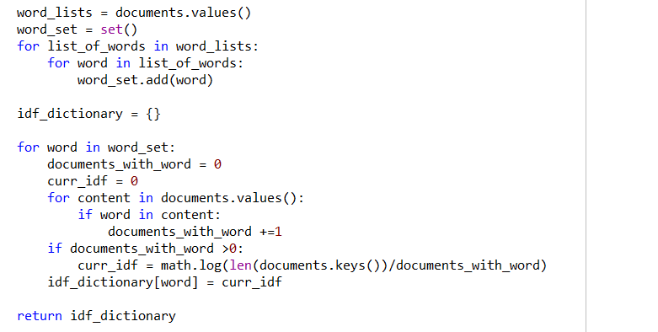
Compute_idfs
Steps:
Remove possible word duplicates in our documents by creating a set
For each word in our set we count the number of documents that contain it
If at least one document contains our word, we calculate idf with the formula:
Math.log(total_documents/documents_with_my_word)
We map our idfs to a each word with a dictionary and return it.

Slide 6
Top_files
Steps:
Map each filename to a dictionary with the count of each of its words.
For each word in our query:
Look in every file:
If that file has a term frequency registered for that word, we fetch it
Otherwise, we set term frequency as 0
We add to the tf-idf calculation of that file term_frequency * inverse_doc_frequency[word]
We sort our tf-idf values descending by the td-idf values.
Return the n best results.

Slide 7
Top_sentences
Steps:
Create a dictionary containing an array of 2, that represents idf and density for each sentence.
For every sentence in sentences given:
Go through each word of our query:
Look for the word in our sentence.
If the word of the query is present in the sentence, we add the idf value of the word to our dictionary in that sentence and increase our counter of query_words_in_sentence
Calculate density of that given word and sentence by adding to our dictionary the value of query_words_in_sentence divided by the length of our sentence.
Finally, order our results descending according to our sum of idf values and density.
Return the n best results.

Slide 8
Demonstration

