Slide 1
CUPID · Pile-up background
Pile-up Background Index
Octopus vs Argonauts cross-check on run m204
Estimating each channel's pile-up BI, understanding why two processing pipelines disagree, and improving the filter.
Progress update Alberto Zanelli · 6 July 2026

Slide 2
How the Background Index is estimated
One independent estimate per channel, run in parallel on the cluster.
1
Inputs per channel
Average pulse (AP) and noise power spectrum (NPS).
THE ESTIMATOR
2
Optimal filter
H = S*/NPS → analytic resolution σₒᵣ and SNR.
BI = Jfinal × K
3
Optimize band filters
Two filters f₁, f₂ trained to minimize the pile-up metric J.
J filter figure of merit
K physics normalization
4
Background Index
BI = J_final × K (K from activity, LMO mass, exposure).
Cluster-parallel: one qsub job per channel (analyze_BI_singlerun.py).

Slide 3
Comparing AP & NPS across pipelines
Same physics, different conventions — they must be aligned before the BI is comparable.
OCTOPUS ROOT histograms
ARGONAUTS .bin binaries
AP: averagepulse_ap_medianAP
NPS: averagepowerspectrum_anps
Normalization applied to NPS:
• one-sided → mirrored to two-sided
• × 5.708
• × window_size²
• × (1 / sampling_time)
AP: *.bin_edmean.bin
NPS: *.bin_spec.bin
Normalization applied to NPS:
• already two-sided
• × 1e−12 (pW² → W²)
• × 8/3 (Hann window)
Once aligned, σₒᵣ and BI from the two pipelines land on the same scale — the comparison becomes meaningful.

Slide 4
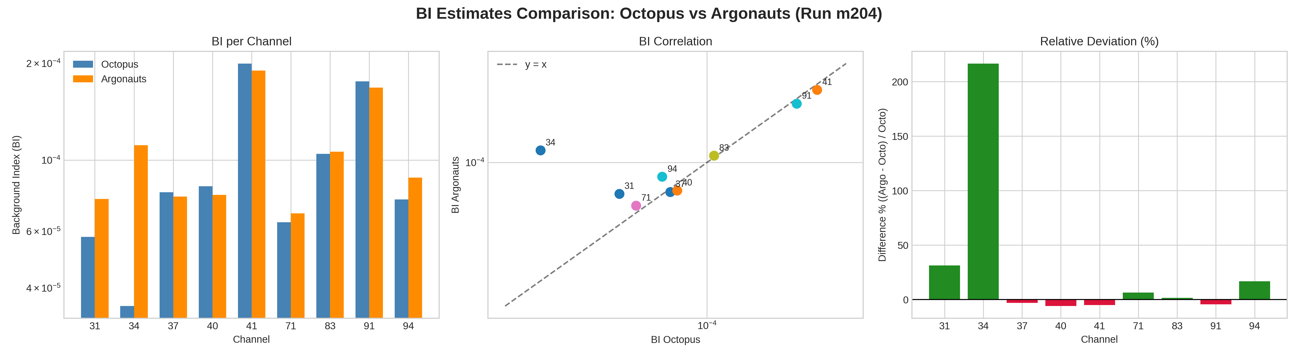
Result: BI agrees on most channels
Agreement within a few percent on 7 of 9 channels (points on the y = x line). Two clear outliers: ch34 (+217%) and ch31 (+31%).
The difference is not driven by the measured signal amplitude — so what causes it?

Slide 5
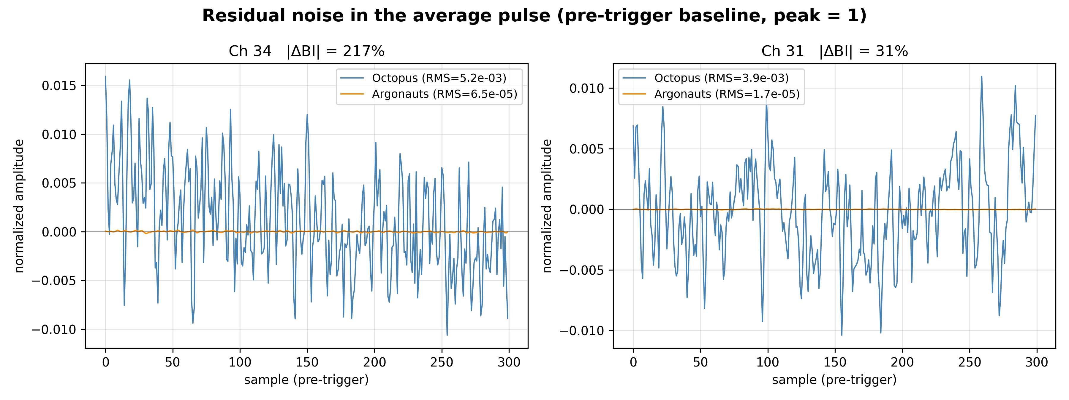
Diagnosis: residual noise in the average pulse
The BI mismatch tracks noise left in the Octopus AP template — not the amplitude.
r = +0.88
ΔBI vs AP high-frequency power
r = −0.59
ΔBI vs amplitude
r = −0.07
ΔBI vs analytic σₒᵣ
AP pre-trigger baseline (peak = 1). Octopus (blue) oscillates at ±10⁻²; Argonauts (orange) is flat (~10⁻⁵). That leaked noise enters S and biases the optimal filter.
All correlations use percentage differences between the pipelines. Amplitude, σ, risetime and SNR do not explain the gap.

Slide 6
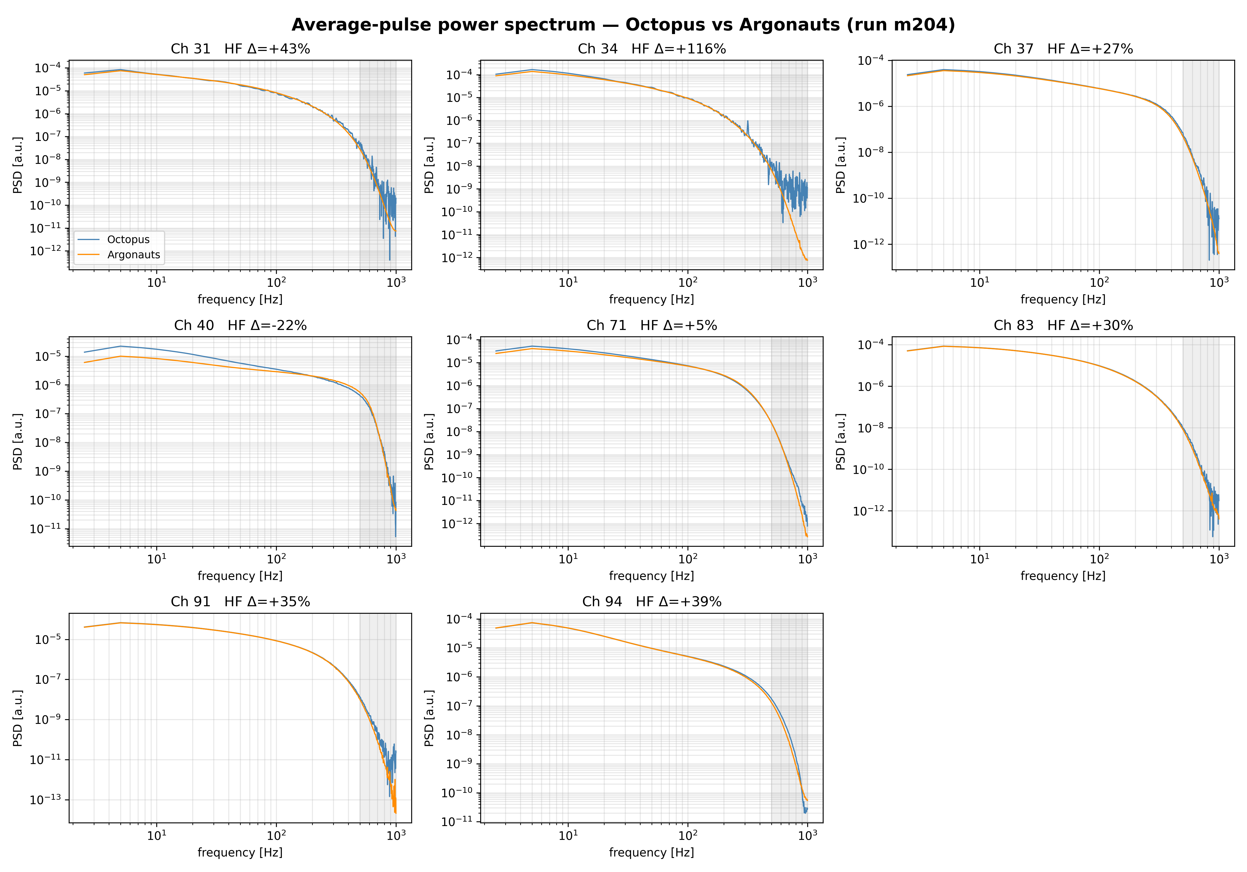
Quantifying the noise in one number
Above ~500 Hz the pulse has no signal — any AP power there is noise. Integrate it.
AP HF-POWER ( >500 Hz )
r = +0.88
vs ΔBI (best of all drivers)
Per channel, the shaded band's power excess (Octopus − Argonauts) is the single number for the leaked noise.
ch34 shows +116% HF excess — exactly the channel with the largest BI gap.

Slide 7
PART 2 · RUN m205
Load-curve measurement
The same detectors swept across many operating points.
Load curve — each channel measured at 15 bias voltages (working points).
WORKING POINTS ( V_bias )
Sampling — 10 kHz, 10 000-sample window (1 s per waveform).
0.6 · 1.0 · 1.4 · 1.8 · 2 · 3 · 4 · 5 · 6 · 8 · 10 · 20 · 26 · 30 · 40 V
Channels — 5 analyzed: 31, 34, 71, 83, 91.
15 WP · 10 kHz · 5 channels
Goal — how the BI depends on the operating point and on the pulse/noise parameters, and where the BI-optimal working point lies.

Slide 8
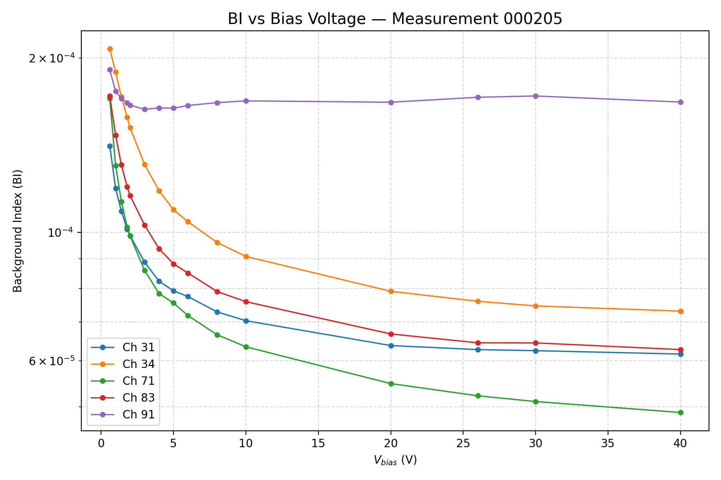
BI vs bias voltage
BI decreases with bias and plateaus above ~20 V.
The BI-optimal working point is at 40 V for most channels.
Ch 91 is anomalous — flat and ~10× higher BI, unresponsive to bias.

Slide 9
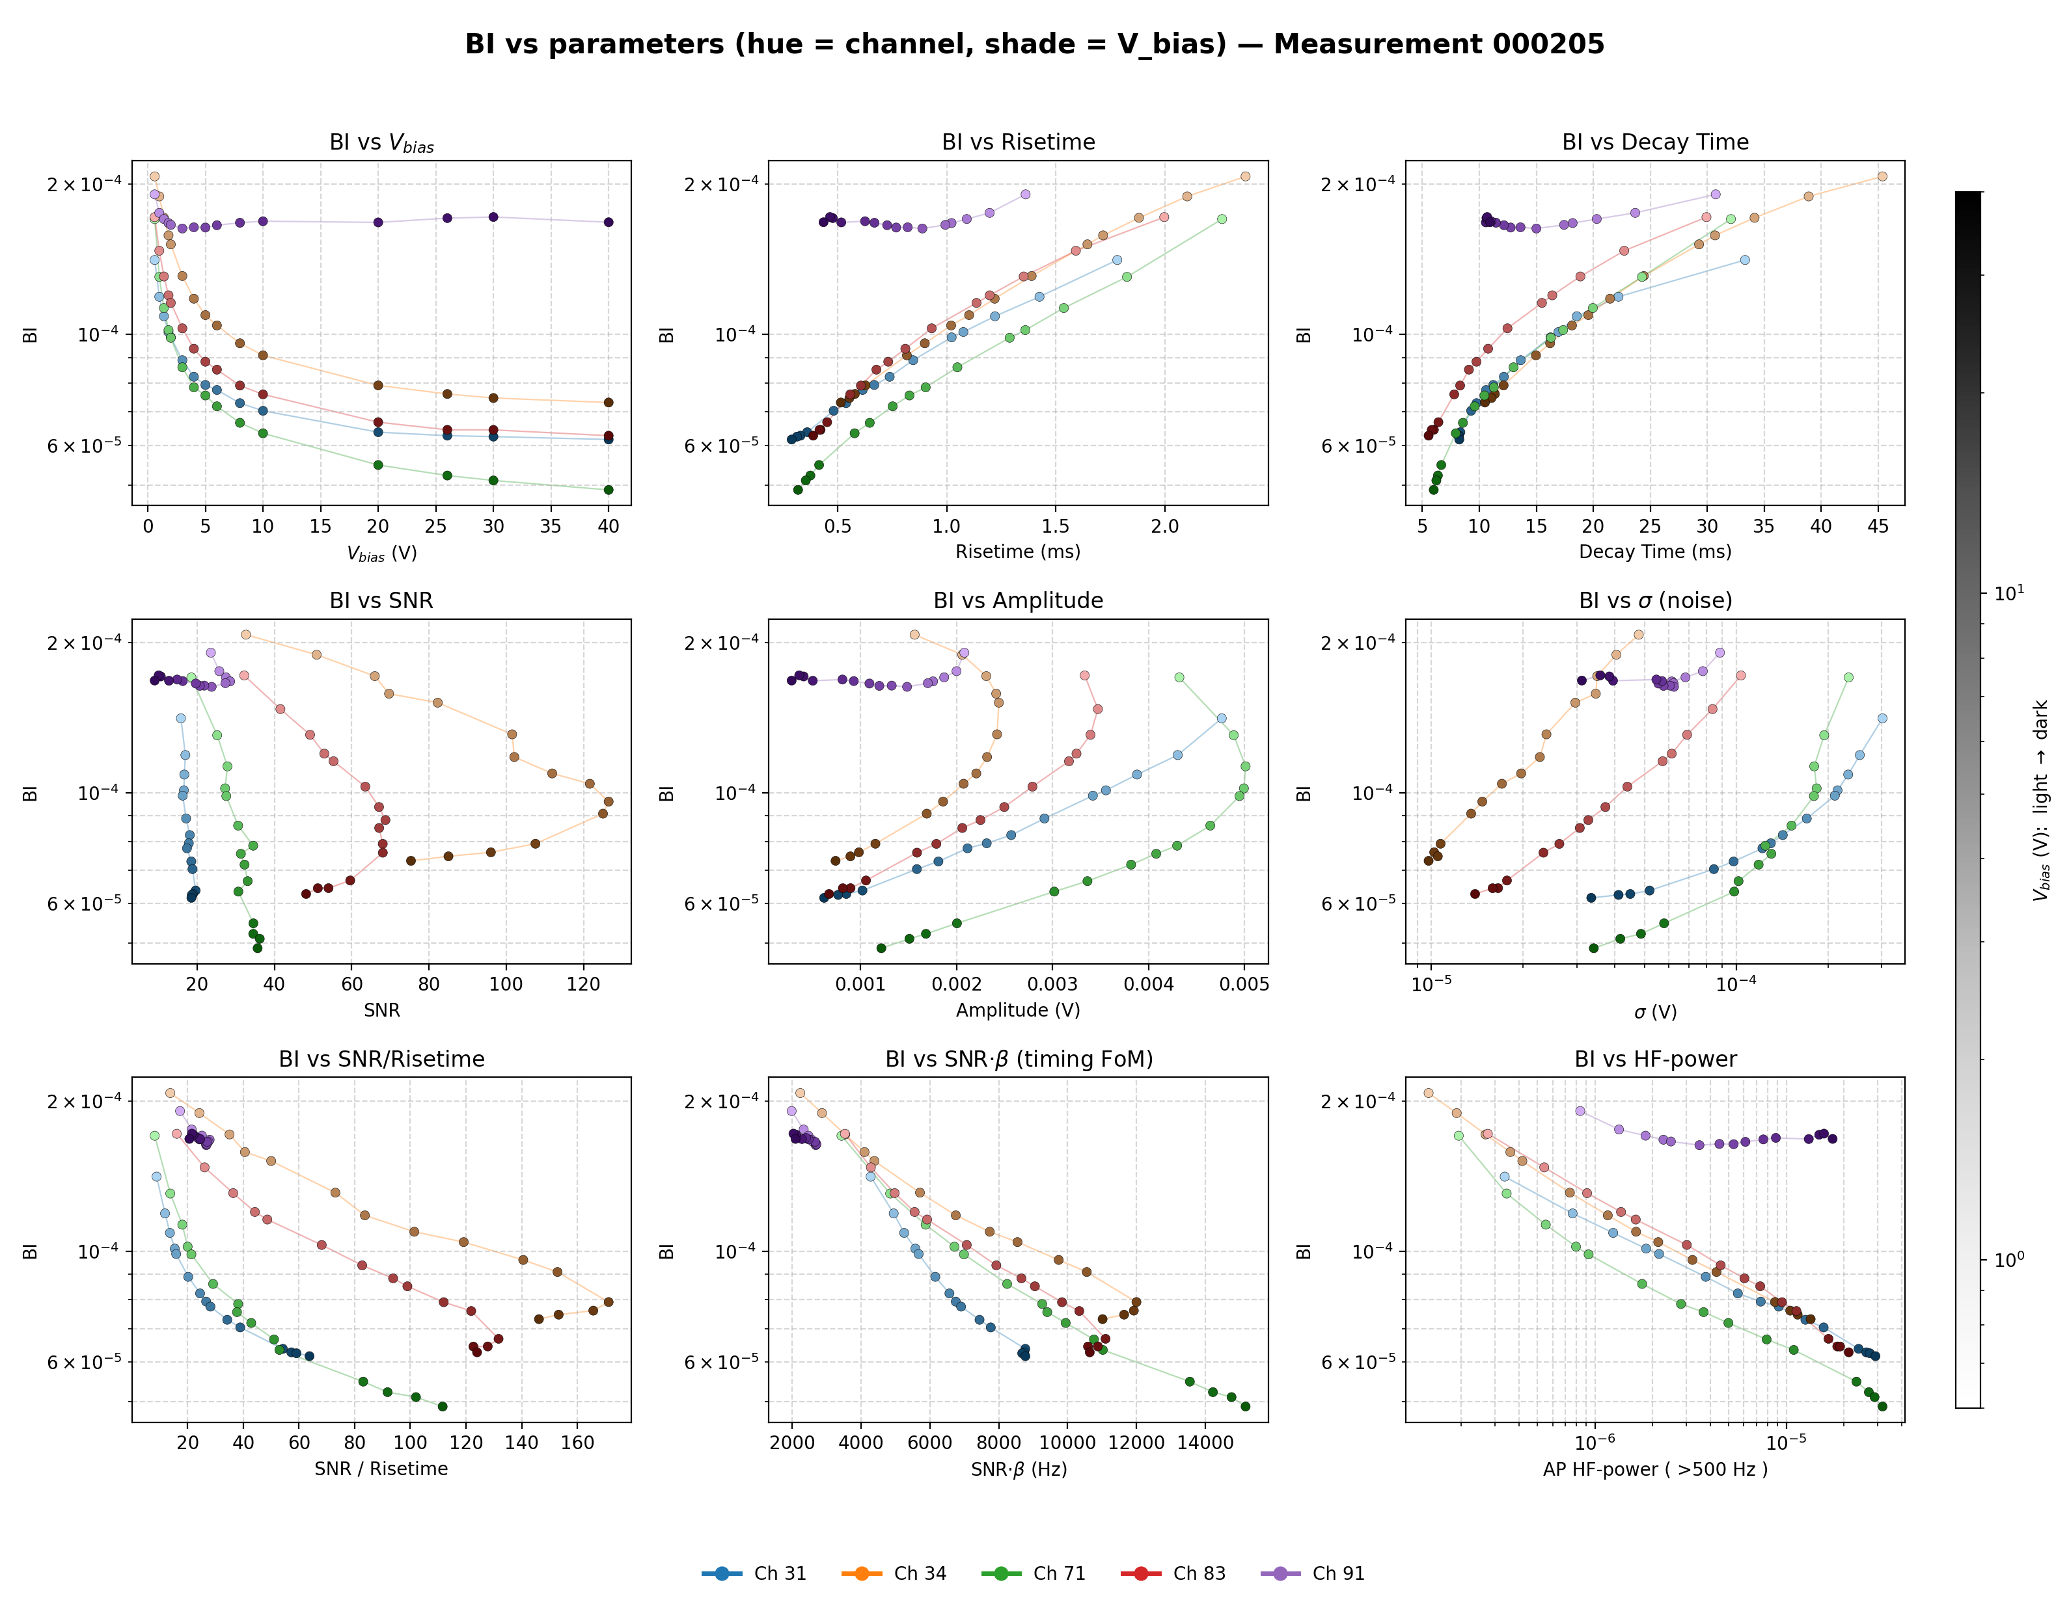
BI vs all parameters
One hue per channel; shade = V_bias (light → dark). Monotonic vs risetime, decaytime, σ, HF-power; folded vs SNR/amplitude — the timing FoM SNR·β restores it.

Slide 10


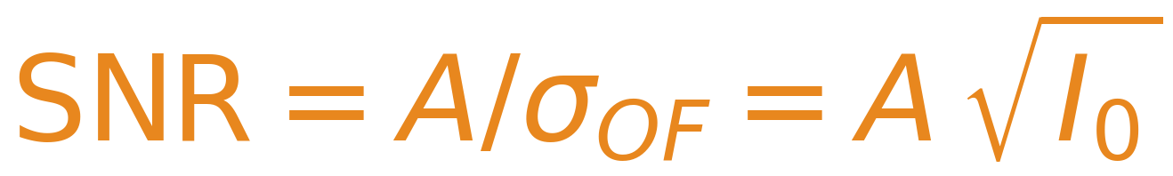
How the SNR is computed
The classic SNR is the optimum-filter amplitude resolution (in the CSV).
S(f) = FFT of the average pulse (its spectrum).
N(f) = noise power spectrum (NPS).
A = signal amplitude.
The filter weights each frequency by |S|²/N and sums over ALL of them. So the SNR is a broadband number — it does not care WHERE, in frequency, signal and noise sit.
OPTIMUM FILTER

Slide 11
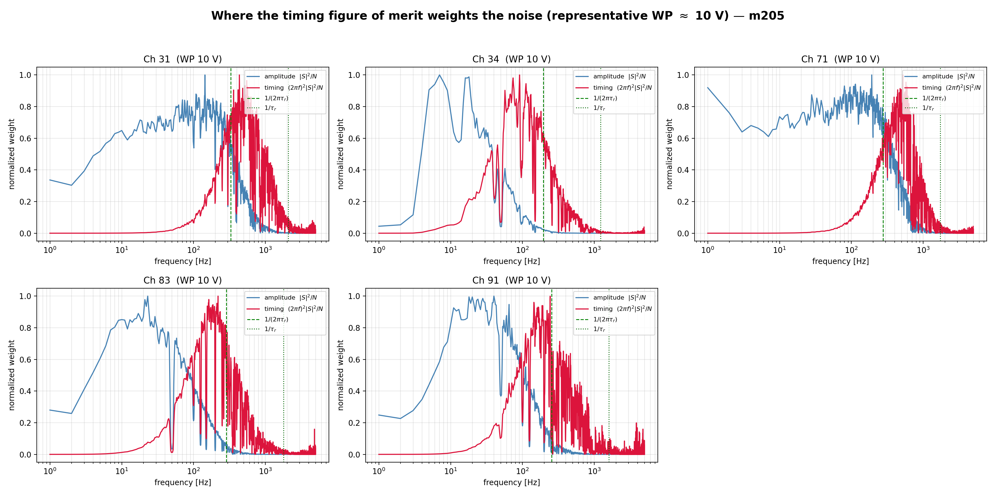



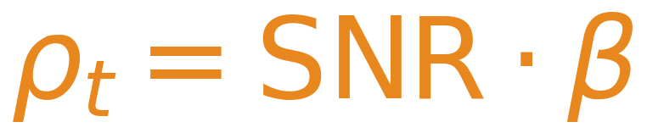
A pile-up figure of merit: SNR · β
Pile-up needs the fast edges → weight the noise by frequency (Cramér–Rao timing bound).
β = pulse bandwidth ≈ 1/risetime. Large ρ_t → lower BI.
Blue = amplitude weight |S|²/N (low-f, what SNR uses). Red = timing weight (2πf)²|S|²/N (near 1/risetime). BI monotonicity: SNR 0.57 → SNR·β 0.96.

Slide 12
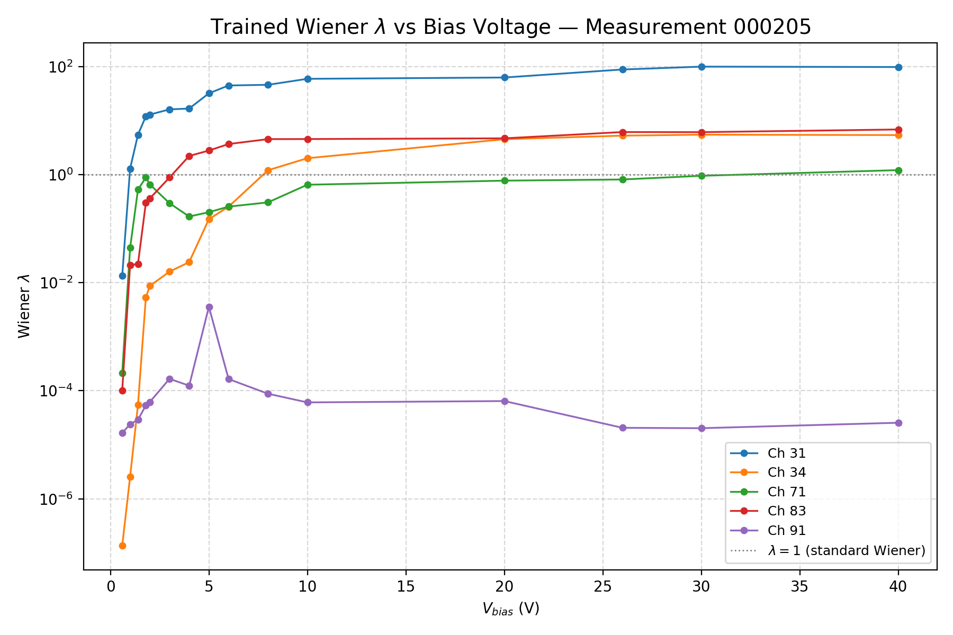
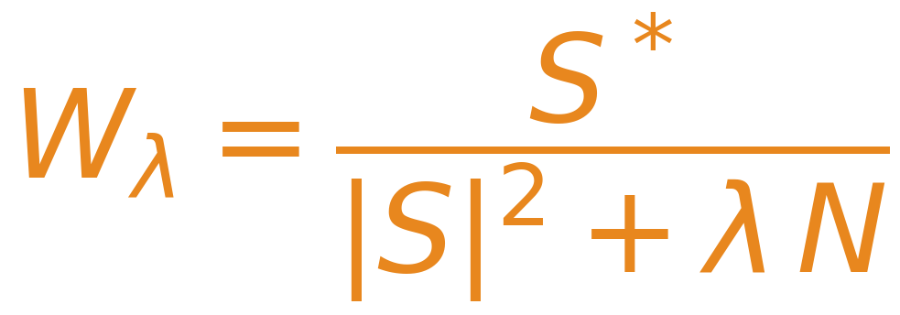
PART 3 · A BETTER FILTER
A trainable Wiener filter
The optimum filter maximizes amplitude SNR; pile-up instead needs sharp, separable pulses. The Wiener filter deconvolves the pulse shape — a trainable λ sets the balance.
TRAINABLE WIENER FILTER
λ → 0 deconvolution: sharpen the edges, separate close pulses.
λ → ∞ recovers the optimum filter.
λ is trained jointly with the band filters f₁, f₂ to minimize the same BI metric J.
λ is learned per channel and working point — not fixed. It spans ~10⁻⁵ (ch91, deconvolution-dominated) to ~10² (ch31, near optimum filter): each detector picks its own noise-vs-deconvolution balance.

Slide 13
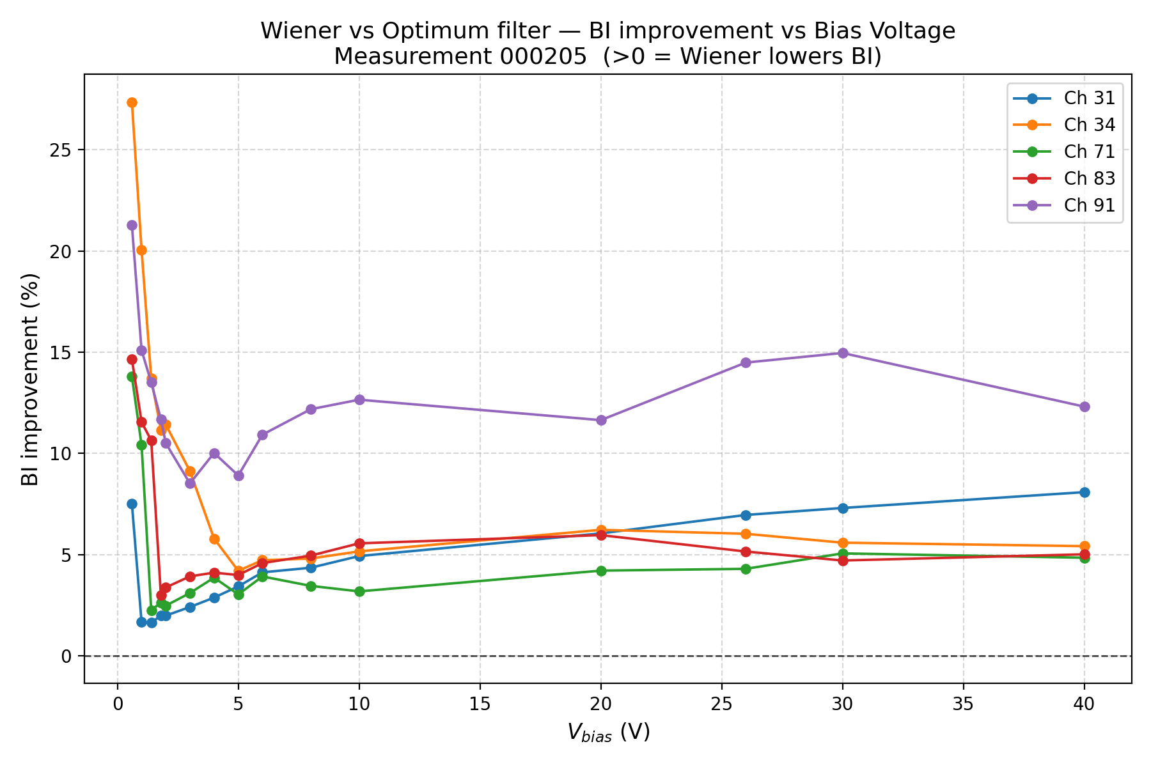
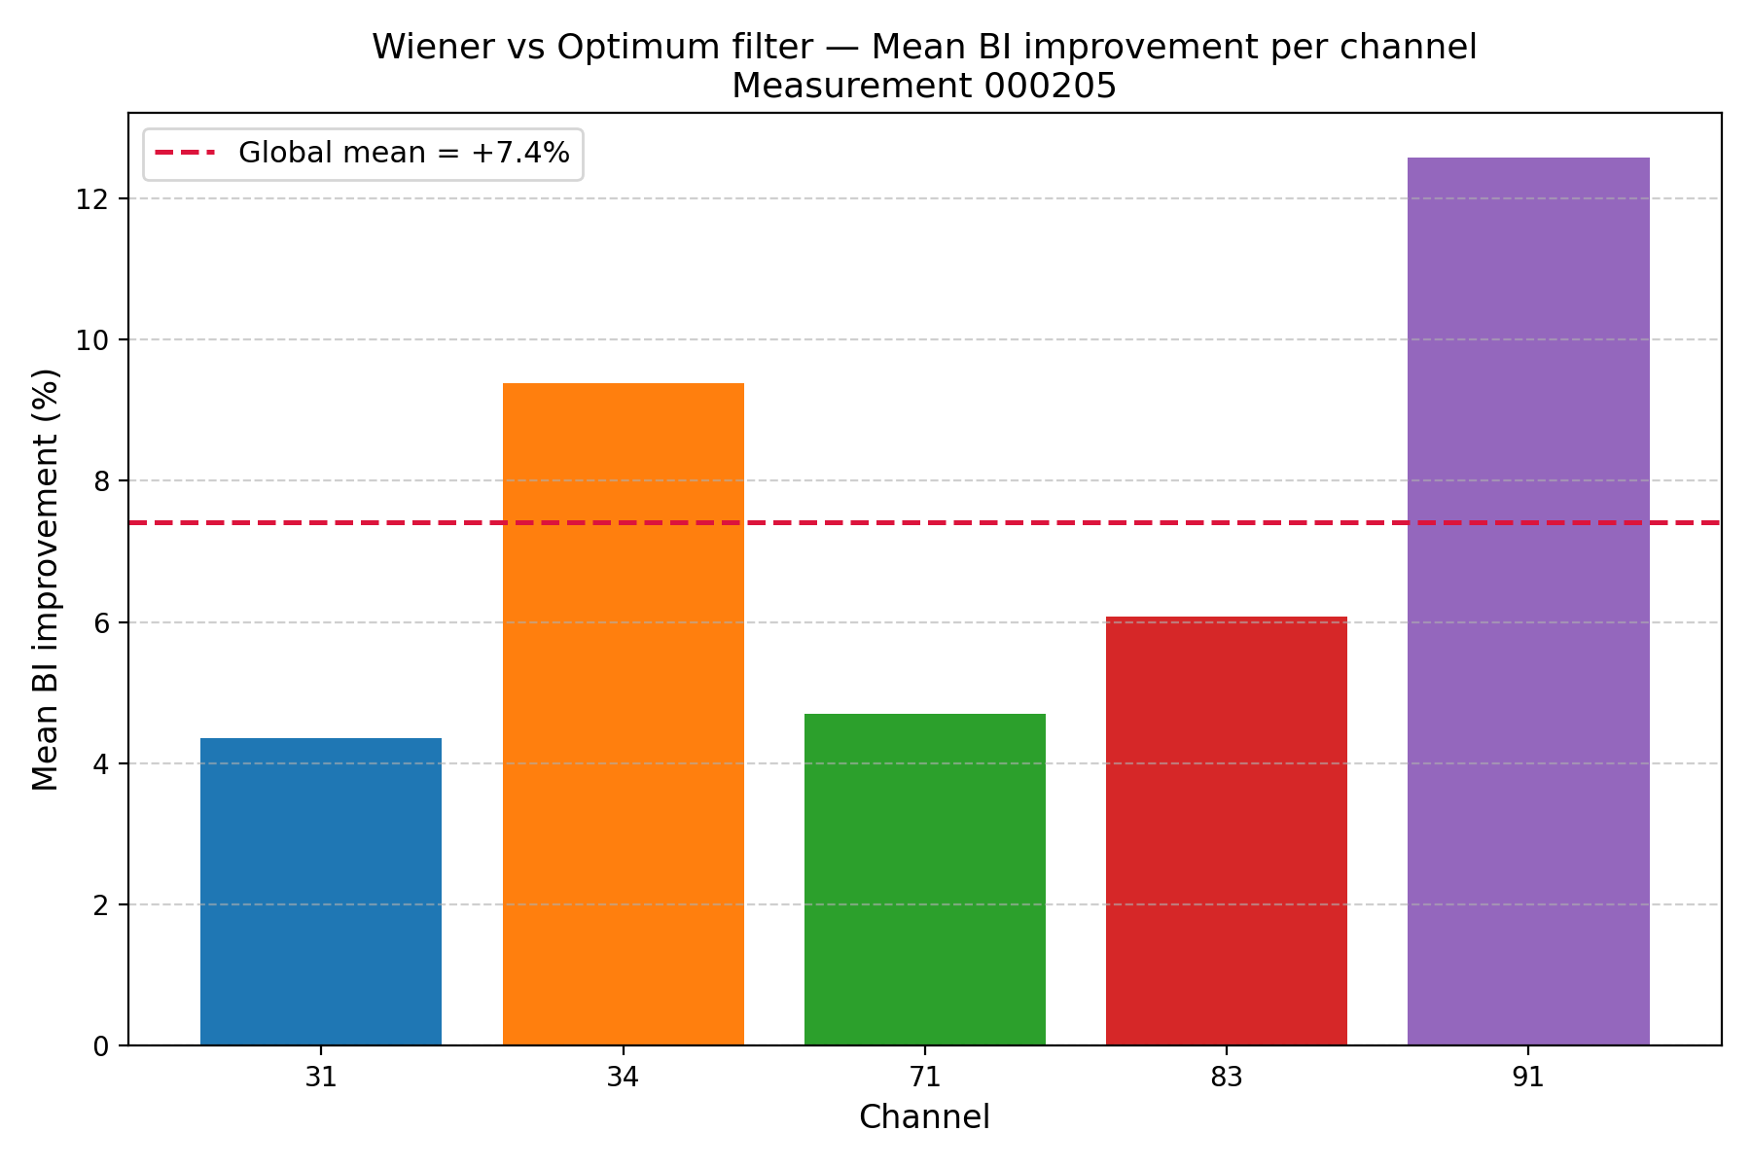
Wiener vs optimum: the BI drops on every channel
Same estimator, same working points — only the filter changes. Improvement = percentage decrease of the BI.
−7.4%
mean BI improvement — the Wiener filter lowers the BI on every channel and every bias point.
Largest on ch91 (+12.6%), the anomalous detector; up to +27% at individual ch34 working points.

