Slide 1
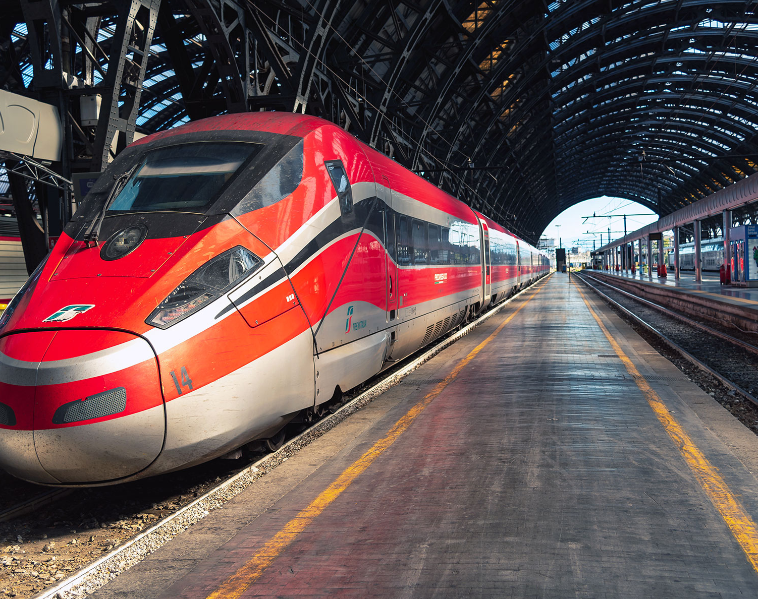
Graph Analysis on Trenord Routes
Alberici Federico - 808058 Gherardi Alessandro - 817084 Locatelli Simone Giuseppe - 816781

Slide 2
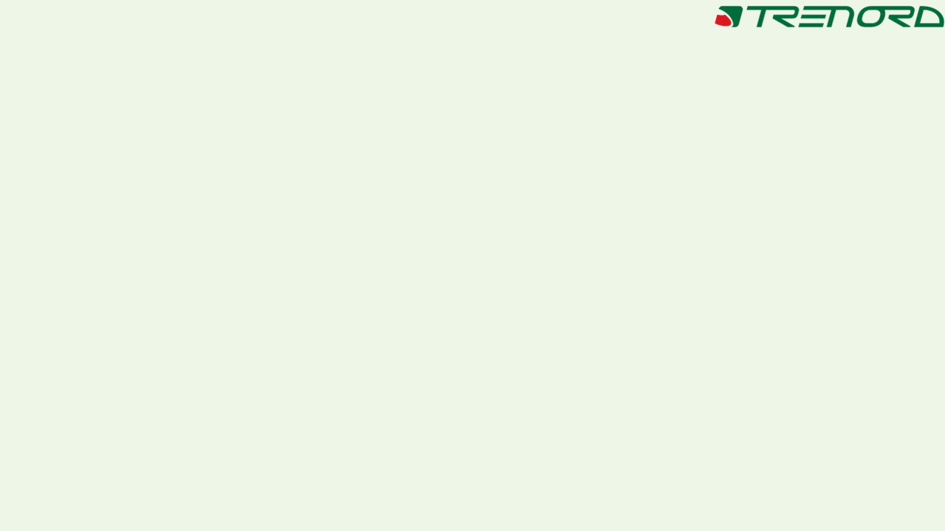
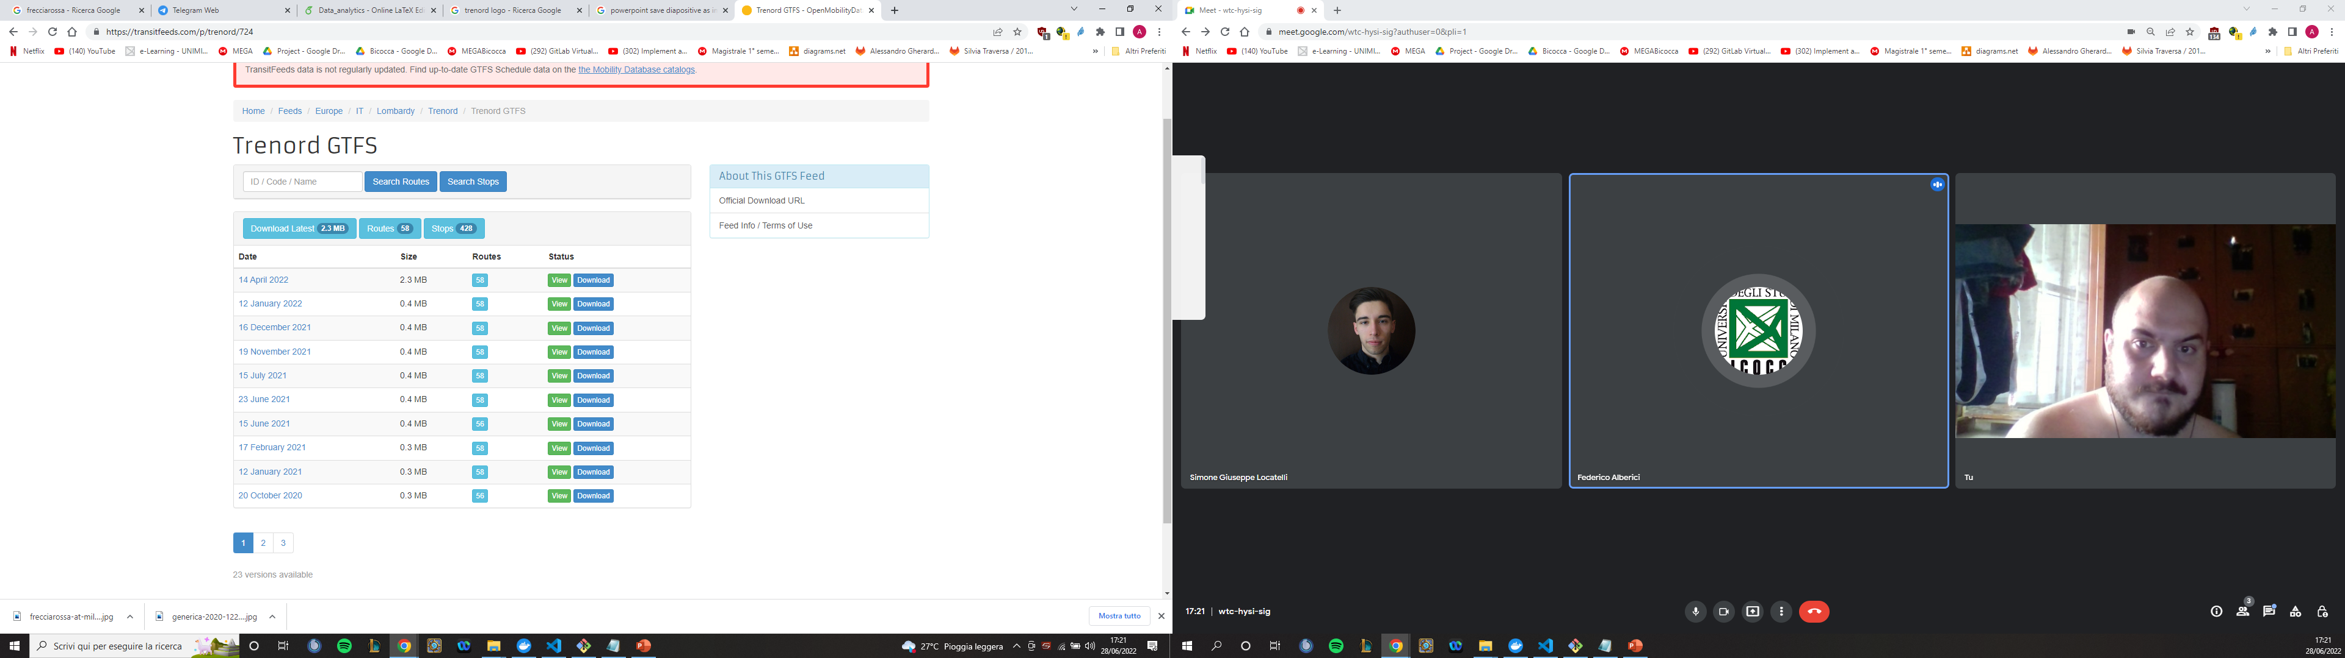
DATASET
Dati su base temporale della programmazione delle tratte
File | Size | Lines
agency.txt | 130 B | 1
calendar.txt | 749.9 KB | 15,997
calendar_dates.txt | 68.8 KB | 2,609
routes.txt | 3.7 KB | 58
stop_times.txt | 8.0 MB | 197,012
stops.txt | 19.4 KB | 428
trips.txt | 668.6 KB | 15,997
https://transitfeeds.com/p/trenord/724

