Slide 1

Starbucks Statistical Learning Project Alberto Calabrese Eleonora Mesaglio Greta d’Amore Grelli

Slide 2
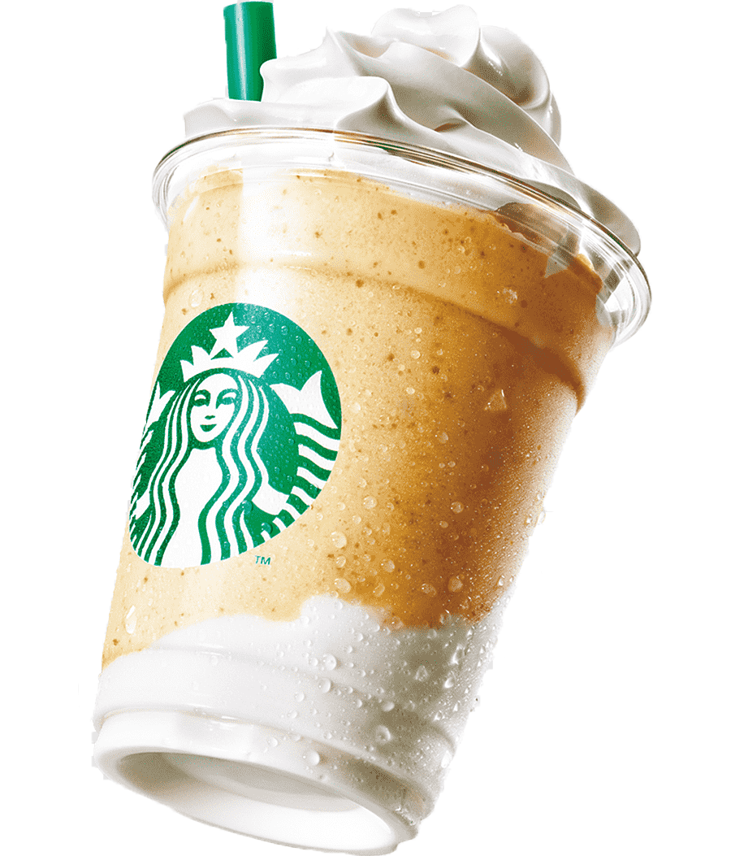
What is Starbucks ?
Global coffeehouse chain known for its specialty coffee drinks, teas, and pastries.
Founded in Seattle in 1971
Noted for its customer-centric approach and ethically sourced coffee beans.

Slide 3
Content
Objective of the analysis
Data cleaning
Correlation analysis
Histograms
Scatterplot
Lasso and Ridge Regression
LDA
Introduction & Data
Explorative Data Analysis
Data Visualization
Model Analysis
Dataset overview
Data preprocessing
Boxplots
Barplot
Linear regression
Logistic Regression

Slide 4
1. Introduction & Data
Objective of the analysis | Data

Slide 5
Objective of the analysis
Introduction & Data
Goal:
Gain a comprehensive understanding of the data;
Build models for accurate predictions and classifications.

Slide 6
Introduction & Data
Dataset
SOURCE
Kaggle
UNIT OF MEASURE
g, mg
242
SAMPLES
18
FEATURES

Slide 7
2. Explorative Data Analysis
Data preprocessing | Correlation Analysis

Slide 8
Problems with the data & data preprocessing
Explorative Data Analysis
Data Cleaning
NA’s
Multicollinearity
Raw data into numeric
23 NA values
High VIF values
Column renamed
Replaced with median
Standardization

Slide 9
Correlation Analysis
Explorative Data Analysis

Slide 10
3. Data Visualization
Histograms | Boxplot | Scatterplot

Slide 11
Histograms
Data Visualization

Slide 12
Boxplot
Data Visualization

Slide 13
Scatterplot
Data Visualization

Slide 14
4. Model Analysis
Regression Analysis | Classification Analysis

Slide 15
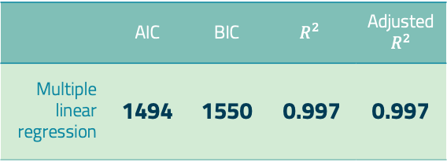
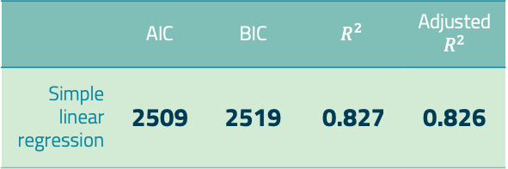
Linear Regression
Regression Analysis
Simple and Multiple
 | AIC | BIC | $$R^{2}$$ | Adjusted $R^{2}$
Simple linear regression | 2509 | 2519 | 0.827 | 0.826
 | AIC | BIC | $$R^{2}$$ | Adjusted $R^{2}$
Multiple linear regression | 1494 | 1550 | 0.997 | 0.997

Slide 16
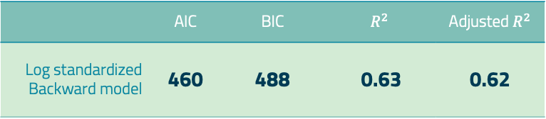
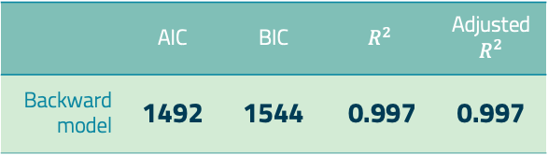
Linear Regression
Regression Analysis
Backward selection | Multicollinearity
High VIF Values
 | AIC | BIC | $$R^{2}$$ | Adjusted $R^{2}$
Backward model | 1492 | 1544 | 0.997 | 0.997
LOG Standardization
 | AIC | BIC | $$R^{2}$$ | Adjusted $R^{2}$
Log standardized Backward model | 460 | 488 | 0.63 | 0.62

Slide 17
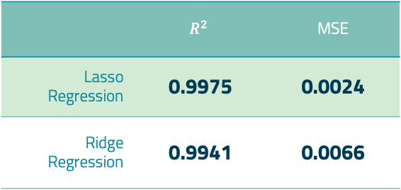
Lasso and Ridge Regression
Regression Analysis
 | $$R^{2}$$ | MSE
Lasso Regression | 0.9975 | 0.0024
Ridge Regression | 0.9941 | 0.0066

Slide 18
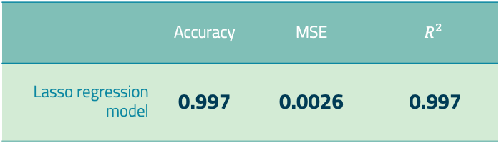
Cross Validation
Regression Analysis
Lasso Regression Model
Training Set
80%
Test Set
20%
 | Accuracy | MSE | $$R^{2}$$
Lasso regression model | 0.997 | 0.0026 | 0.997

Slide 19
Logistic Regression
Classification Analysis
New Categorical Variable: Calories content
Greater than median: High quantity of calories
Lower than median: Low quantity of calories

Slide 20
Logistic Regression
Classification Analysis

Slide 21
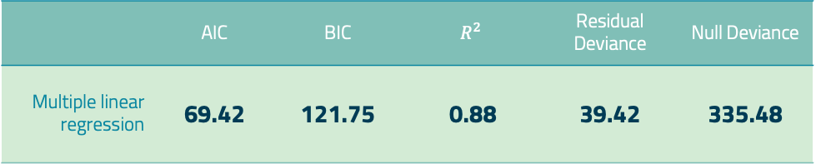
Logistic Regression
Classification Analysis
 | Accuracy | Precision | Recall | F1 Score
Cross Validation | 0.91 | 0.92 | 0.92 | 0.92
 | AIC | BIC | $$R^{2}$$ | Residual Deviance | Null Deviance
Multiple linear regression | 69.42 | 121.75 | 0.88 | 39.42 | 335.48

Slide 22
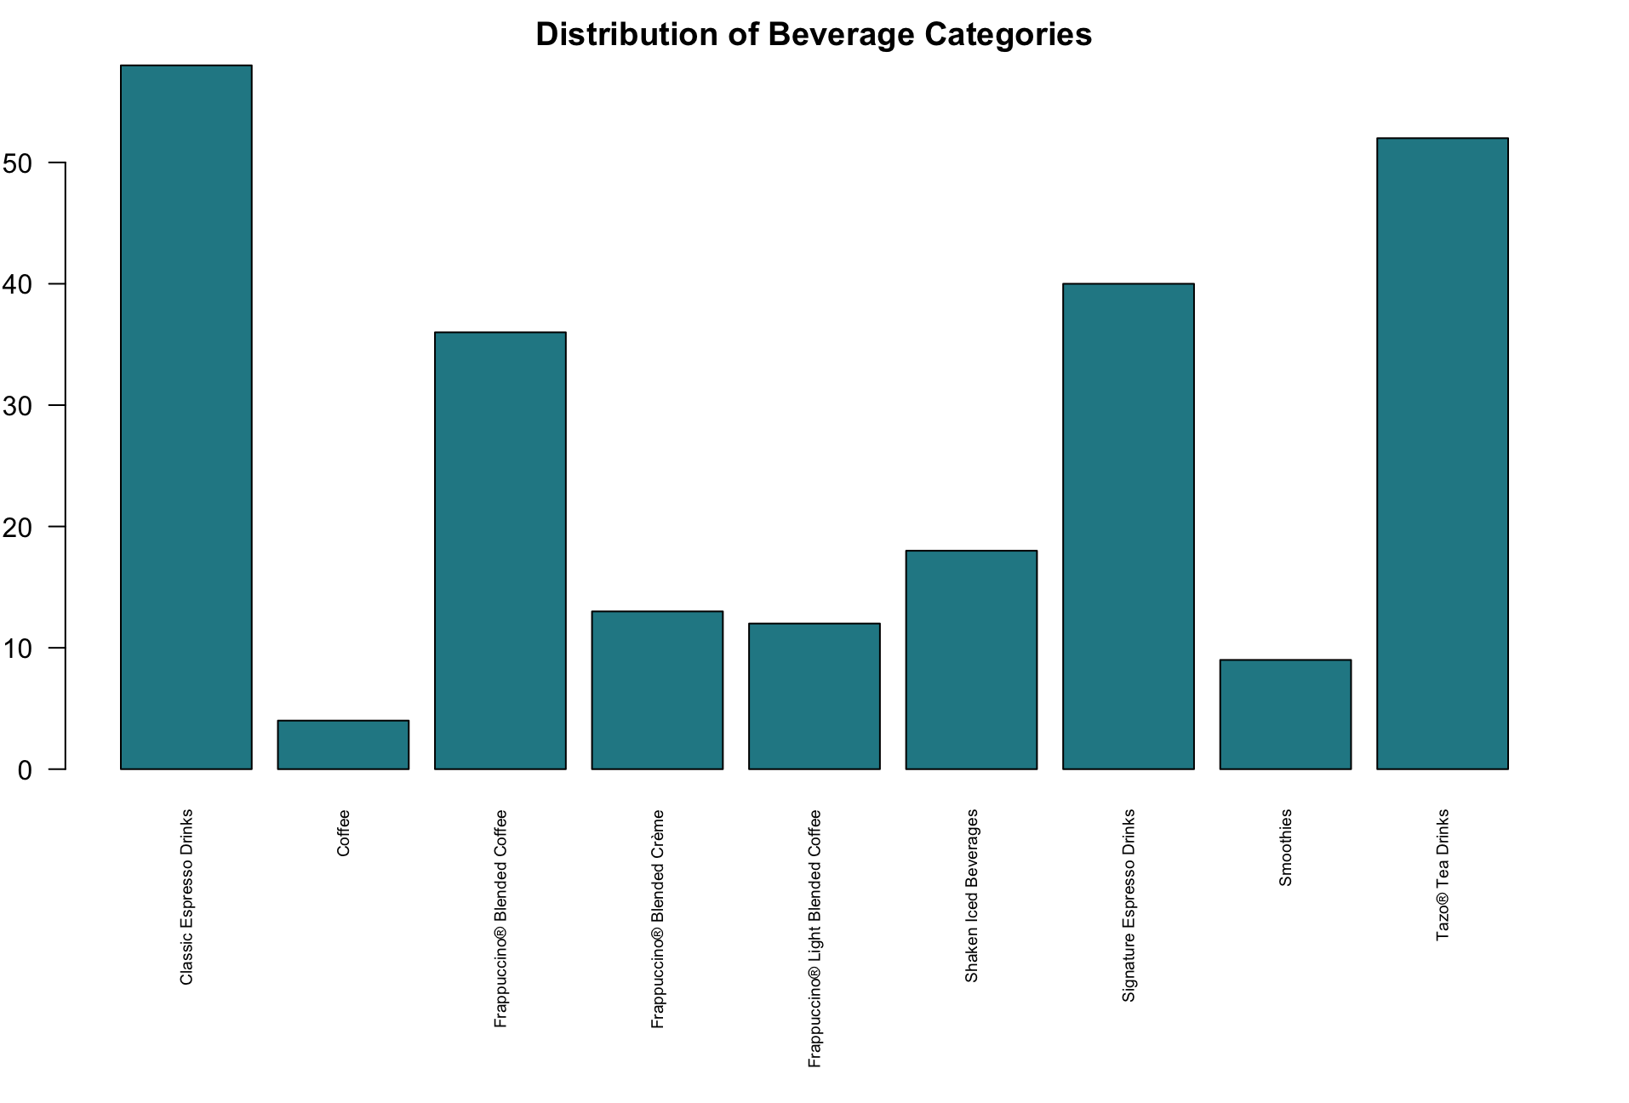
Linear Discriminant Analysis
Classification Analysis
Classification of beverage categories
Accuracy
80%

Slide 23
5. Conclusions
Conclusions | Potential implementations

Slide 24
Conclusions
Conclusions
Lasso Regression Model
Accuracy 99.7%
Useful to predict the amount of calories in a beverage
Logistic Regression Model
Accuracy 91%
Useful to classify a beverage as calorie-dense or calorie-light

Slide 25
Potential Implementations
Conclusions
Propose our model to companies developing new beverages, allowing them to predict calorie content based on other variables.
Especially useful in the US, where obesity is a major issue, this tool can make a significant difference!

Slide 26


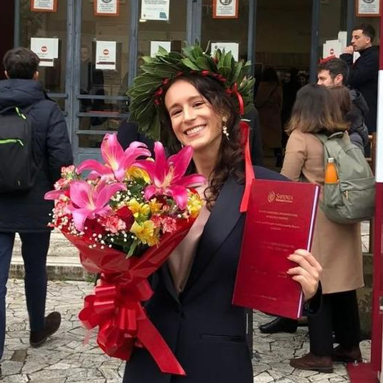
THANKS! Any questions?
Alberto Calabrese
Eleonora Mesaglio
Greta d’Amore Grelli

