Slide 1

Starbucks Statistical Learning Project Alberto Calabrese Eleonora Mesaglio Greta d’Amore Grelli

Slide 2
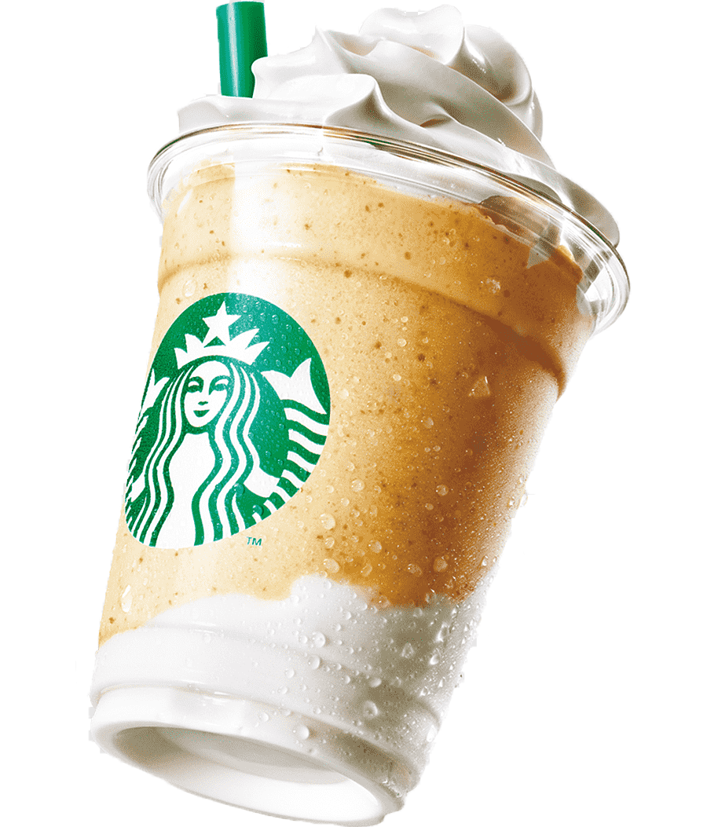
What is Starbucks ?
Starbucks is a global coffeehouse chain known for its specialty coffee drinks, teas, and pastries.
Founded in Seattle in 1971, it has since expanded worldwide, offering a variety of beverages and snacks in a cozy, café-style environment.
Starbucks is also noted for its customer-centric approach and ethically sourced coffee beans.

Slide 3
Content
Objective of the analysis
Data cleaning
Correlation analysis
Histograms
Scatterplot
Lasso and Ridge Regression
Introduction & Data
Explorative Data Analysis
Data Visualization
Regression Analysis
Dataset overview
Data preprocessing
Boxplots
Barplot
Linear regression
Logistic Regression

Slide 4
1. Introduction & Data
Objective of the analysis | Data

Slide 5
Objective of the analysis
Introduction & Data
In this project, we conducted a thorough analysis of the Starbucks Beverage Components dataset, which contains information about the ingredients in Starbucks beverages. Our goal was to gain a comprehensive understanding of the data and build models for accurate predictions.

Slide 6
Dataset
Introduction & Data
The dataset we analyzed is the Starbucks Beverage Components dataset from Kaggle. This dataset provides a comprehensive guide to the nutritional content of beverages available on the Starbucks™ menu.
242
Samples
18
Features

Slide 7
2. Explorative Data Analysis
Data preprocessing | Correlation Analysis

Slide 8
Problems with the data & data preprocessing
Explorative Data Analysis
Data Cleaning
We transformed our raw data into numeric values and renamed the columns to ensure easy comprehension of the variables.
NA’s
We found some NA values in the Caffeine column and replaced these values with the median of the variable to maintain the distribution.
Multicollinearity
We noted a problem with multicollinearity in our data, which we addressed during the regression analysis.

Slide 9
Correlation Analysis
Explorative Data Analysis
We calculated the correlation matrix for our dataset. This computation helps us in comprehending the interrelationships among the dataset’s variables.
In the correlation matrix, a value near to 1 at the ij position indicates a strong positive correlation between the i-th and j-th variables. Conversely, a value close to −1 signifies a strong negative correlation. A value near 0 suggests that the two variables do not significantly influence each other.

Slide 10
3. Data Visualization
Histograms | Boxplot | Scatterplot | Barplot

Slide 11
Histograms
Data Visualization

Slide 12
Boxplot
Data Visualization

Slide 13
Scatterplot
Data Visualization

Slide 14
Barplot
Data Visualization

Slide 15
4. Regression Analysis
Linear Regression | Logistic Regression

Slide 16
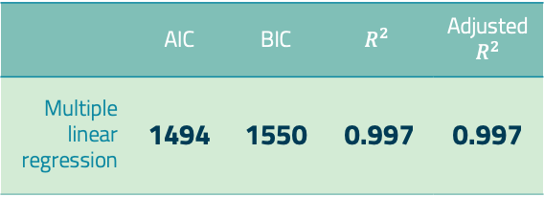
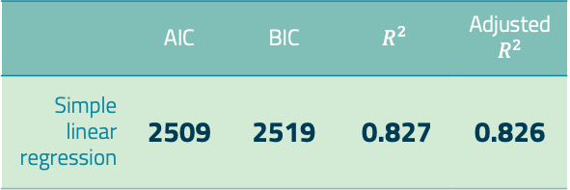
Linear Regression
Regression Analysis
Simple and Multiple
 | AIC | BIC | $$R^{2}$$ | Adjusted $R^{2}$
Simple linear regression | 2509 | 2519 | 0.827 | 0.826
 | AIC | BIC | $$R^{2}$$ | Adjusted $R^{2}$
Multiple linear regression | 1494 | 1550 | 0.997 | 0.997

Slide 17
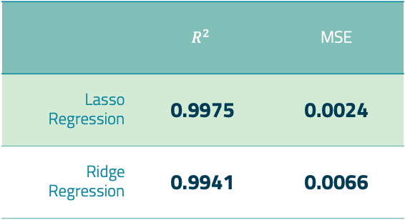
Lasso and Ridge Regression
Regression Analysis
 | $$R^{2}$$ | MSE
Lasso Regression | 0.9975 | 0.0024
Ridge Regression | 0.9941 | 0.0066

Slide 18
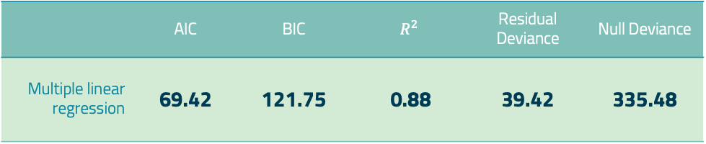
Logistic Regression
Regression Analysis
 | Accuracy | Precision | Recall | F1 Score
Cross Validation | 0.91 | 0.92 | 0.92 | 0.92
 | AIC | BIC | $$R^{2}$$ | Residual Deviance | Null Deviance
Multiple linear regression | 69.42 | 121.75 | 0.88 | 39.42 | 335.48

Slide 19
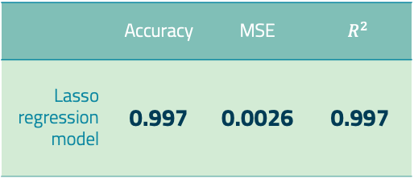
Cross Validation
Regression Analysis
Lasso Regression Model
We decided to split the data, allocating 80% of the examples for training and 20% for testing. We then evaluated the model using the testing set and calculated the mean squared error and the root mean squared error to assess its accuracy.
 | Accuracy | MSE | $$R^{2}$$
Lasso regression model | 0.997 | 0.0026 | 0.997

Slide 20
5. Conclusions
Conclusions | Potential implementations

Slide 21
Conclusions
Conclusions
In this project, we conduct a thorough analysis of the Starbucks™ Beverage Components dataset, which contains information about the ingredients of Starbucks™ beverages. Our goal is to gain a comprehensive understanding of the data and build models for accurate predictions.
The process involves several key steps:
Data Cleaning: We handle missing values and ensure the data is correctly formatted.
Exploratory Data Analysis (EDA): Using visual and quantitative methods, we explore the data structure and the relationships between variables.
Regression Analysis: We analyze the relationship between dependent and independent variables, focusing on predicting and understanding the factors influencing the Calories variable.

Slide 22
Potential Implementations
Conclusions
Here we can write the idea of propose our best model as solution for companies that want to create a new kind of beverage and thanks to our model can predict the amount of calories based on other variables.
This could be useful specially in US where there is an important obesity disease and a tool like this can really make the difference!
Write better of course. ☺

Slide 23



THANKS! Any questions?
Alberto Calabrese
Eleonora Mesaglio
Greta d’Amore Grelli

