Slide 1

PYTHON-BASED
HONEYPOT
BY:
ALBI VARGHESE
22XU1A0587

Slide 2
What is a honeypot?
A honeypot is a security mechanism designed to attract and trap cyber attackers. It acts like a decoy system that looks real but is actually isolated and monitored. When hackers try to break in, the honeypot records their actions — like login attempts, commands, or malware uploads — without exposing the real network..
Why honeypots are used in Cybersecurity:
In cybersecurity, honeypots are used to study attack patterns, detect unauthorized access, and strengthen defenses. They help security teams understand how attackers think and what tools they use, making it easier to prevent real-world attacks.

Slide 3
PROJECT OVERVIEW:
This project is a simple Python-based honeypot that consists of two main components:
1. SSH-Based Honeypot – This module imitates an SSH server to lure attackers trying to gain unauthorized remote access. It records their login attempts, commands, and interaction patterns.
2. Web-Based Honeypot – This part simulates a fake web login page to attract web attack. It captures any credentials entered and monitors the behavior of the intruder.
The honeypot is designed to 'collect key information' about each attack, including:
1. The 'attacker’s IP address', to identify the source of the intrusion.
2. The 'Tactics, Techniques, and Procedures (TTPs)' used by the attacker, helping to analyze their methods and tools.
3. The 'time and nature of the attack', giving insights into when and how the intrusion occurred.
By gathering this data, the honeypot helps in 'understanding attacker behavior' and improving the overall security posture of the system.

Slide 4
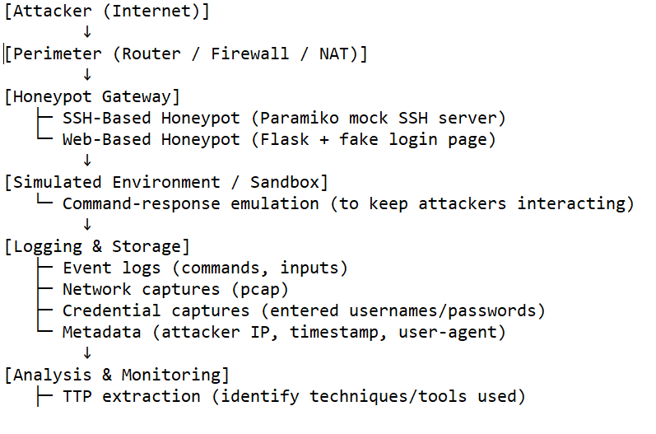
SYSTEM ARCHITECTURE:

Slide 5
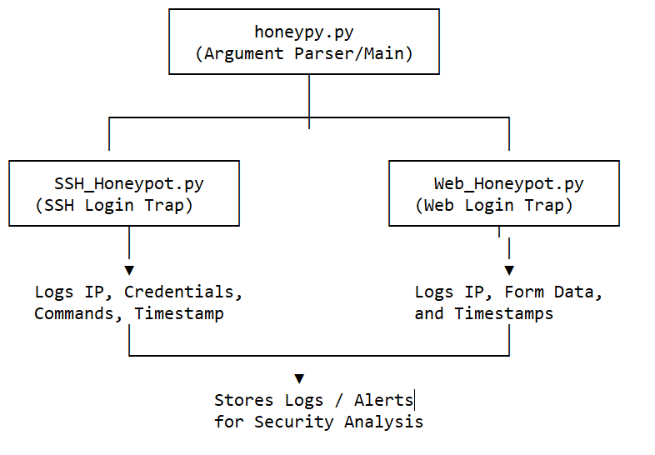
MODULE DESIGN:

Slide 6




TOOLS AND TECHNOLOGIES:
Language : Python
Framework/Libraries : Paramiko, flask, socket, threading and logging
Operating System Used : Windows and Ubuntu
IDE : PyCharm

Slide 7
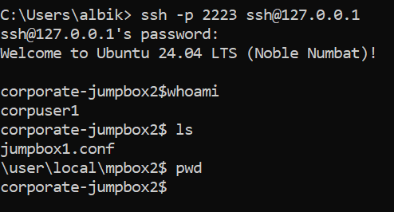
SSH HONEYPOT RUNNING:
To run the SSH Honeypot we run the command in terminal:
‘python honeypy.py -a 127.0.0.1 -p 2223 -u --ssh’
Then open the PowerShell or bash and run a SSH command : ssh –p 2223 ssh@username(which is IP machine)
Created a server and client-handle.

Slide 8
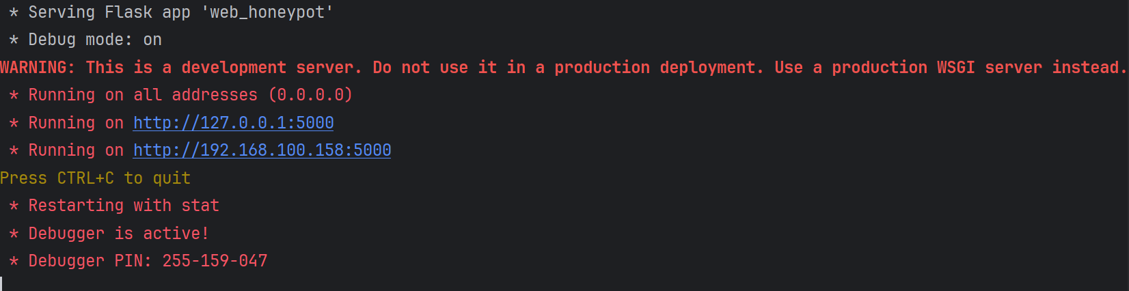
WEB-BASED HONEYPOT:
This web-based honeypot is created using flask and front-end using HTML.
This is the baseline code for the web-based :
Code in python:
def web_honeypot(input_username="admin", input_password='password'):
app = Flask(__name__)
@app.route('/')
def index():
return render_template('wp-admin.html')
After a successful login the page will display a ‘DEEBOODAH’.
Run the module: Check the first link.

Slide 9

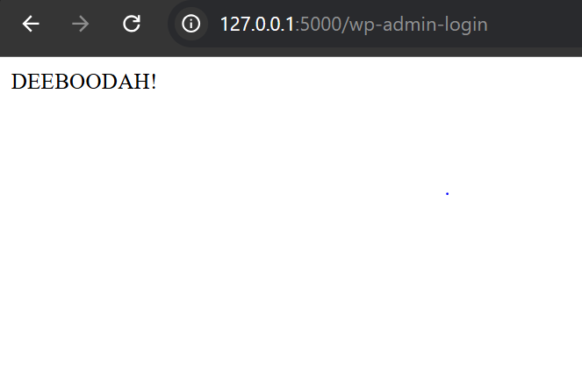
HTML PAGE:
The html page is a login page asking for username and password.
After a successful login , new page with a text: ‘DEEBOODAH’.

Slide 10
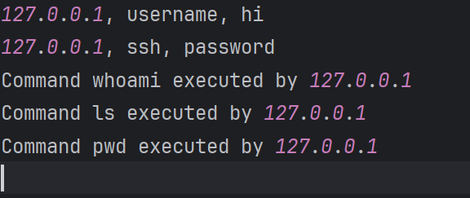
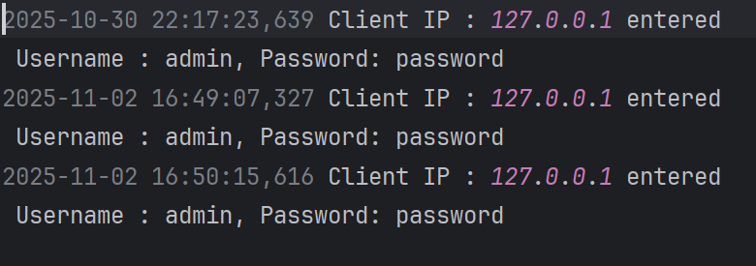
LOGS:
To capture what the attacker has entered, I have created log files:
The honeypot utilizes Python’s built-in logging framework to record all activity logs. The logging system is
implemented using the ‘logging.handlers’ module, specifically the ‘RotatingFileHandler’ class, to efficiently manage
log files by automatically rotating them once they reach a specified size.
Two log files have been created for this honey-based:
cmd_audits(for SSH-based Honeypot)
html_audits(for HTML-based Honeypot)
These are the logs generated:
cmd_audits html_audits

Slide 11
FUTURE IMPROVEMENTS:
Deploy the HoneyPot in a ‘VPS’ .
Create a alert system for suspicious system.
Integrate database for log servers
Add GUI dashboard to visualize a attack.

Slide 12
CONCLUSION:
Honeypots play a crucial role in modern cybersecurity by serving as decoy systems that attract and analyze
malicious activities.
This project demonstrates how honeypots can be effectively used to study attacker behavior, identify intrusion patterns, and strengthen overall network defense through deception techniques.
By observing real-world attack methods in a controlled environment, valuable insights can be gained to enhance
threat detection and improve security strategies.

Slide 13


