Slide 1
DEPARTMENT OF COMPUTER SCIENCE AND ENGINEERING
Combining Demand Classification and Forecasting
Models in Spare Parts Inventory Management
for the Energy Sector
A Seminar Presentation based on Research Paper By:
L.F Da Silva, E.S Christp, K.A Costa, H.P Tavares (2026). The International Journal of Advanced Manufacturing Technology, 144, 355–366.
Presented by: Albin Joseph
Department: Computer Science and Engineering
Institution: Amal Jyothi College of Engineering (Autonomous)
Date: 6 August 2026

Slide 2
Contents
1
Introduction
5
Results and Discussion
2
Literature Survey
6
Conclusion and Future Work
3
Objectives
7
References
4
Methodology / Work Carried Out
2

Slide 3
Introduction
Why inventory forecasting matters ?
20–40%
Inventory holding costs represent 20–40% of item value — accurate demand forecasts directly reduce fixed capital costs.
Spare parts in energy companies show irregular, sparse, and highly variable consumption — traditional models often fail.
The paper studies a large energy company in Minas Gerais, Brazil, with 2,244 historical spare-part consumption series (Jan/2020–Dec/2024).
Goal: identify whether classical statistical models or Machine Learning models forecast better — and whether the best model depends on demand type.
of item value tied up as inventory holding cost
2,244
historical spare-part series analyzed (60 months)
13,464
total forecasting iterations (6 models × 2,244 items)
3

Slide 4
Literature Survey (1/2) — Base Paper
PRIMARY / BASE PAPER
Combining demand classification and forecasting models in spare
parts inventory management for the energy sector.
L.F Da Silva et al. (2026). The International Journal of Advanced Manufacturing Technology, 144, 355–366.
Contribution:
Analyzed a full population of 2,244 spare-part consumption series (60 months, Jan/2020–Dec/2024) from a large Brazilian energy utility, executing 13,464 forecasting iterations.
Combines demand-behavior classification (ADI, CV²) with ABC value classification, then compares six forecasting models — Random Forest, XGBoost, Exp. Smoothing, Holt, Holt-Winters, SARIMA — across the full population of 2,244 spare-part series from an energy company.
Limitation: Stops at forecast model selection, does not compute downstream inventory parameters (safety stock, reorder points)
Relevance: This is the methodological foundation for both this seminar and my final-year project, NexusERP.
This seminar is built primarily on the paper above. The studies on the next slide are supporting literature only — included to situate the base paper's approach within the broader field of AI-driven demand forecasting.
4

Slide 5
Literature Survey (2/2) — Supporting Studies
Predictive models for inventory
optimization
Contribution: Deployed cloud AutoML (AWS Forecast/SageMaker) for demand forecasting at an SME. Limitation: Contribution is architectural, not algorithmic; no baseline comparison; single case study. Relevance: Shows SME-scale forecasting is feasible without a data-science team — directly relevant to Nexus ERP's target users.
Goulart et al. (2026) — Future Business Journal
Construction supplies distributor, Brazil (SME)
Developing a demand planning strategy for joint forecasting
Contribution: Demand planning framework combining statistical forecasts with customer-collaborative inputs; root-cause analysis of forecast deviation (MAPE90). Limitation: Enterprise-scale, tool-heavy (JDA/ERP); not focused on model accuracy. Relevance: Reinforces that forecasting must feed a planning process, not stop at the number — informs Nexus ERP's reorder-recommendation feature.
Basavaraju & Fatahi Valilai (2025) — Discover Applied Sciences
FMCG multinational, EMEA region
Machine Learning and Deep Learning Models for Demand
Forecasting in Supply Chain Management
Contribution: Bibliometric review of ML/DL demand-forecasting methods; benchmarks LSTM, Random Forest, XGBoost, SARIMA-hybrids across the field. Limitation: Descriptive review; no new model or case implementation. Relevance: Confirms Random Forest and XGBoost — the base paper's ML models — remain field-standard choices.
Douaioui et al. (2024) — Applied System Innovation
Critical review, 119 papers (2015–2024)
Read together: an SME implementation case, an enterprise planning-process case, and a field-wide review — each supports a different facet of the base paper's approach, from small-scale feasibility to model choice to process integration.
5

Slide 6
Objectives
1
Classify demand behavior
2
Classify by financial value
Segment 2,244 items into Erratic, Irregular, Intermittent, and Regular categories using ADI and CV² statistics.
Apply ABC (Pareto) classification to identify the small subset of items carrying most of the consumption value.
3
Compare six forecasting models
4
Identify the best model per demand type
Evaluate Random Forest, XGBoost, Exponential Smoothing, Holt, Holt-Winters, and SARIMA on the full item population.
Use the CRITIC multicriteria method on MAE, MAPE, sMAPE, and RMSE to recommend a specific model for each demand category.
These findings from the base paper directly inform my final year project — NexusERP, a lightweight inventory system with AI demand forecasting for small businesses.
6

Slide 7
Methodology (1/2) — Research Pipeline
Data
Extraction
Data
Classification
Model
Processing
Accuracy
Calculation
Error
Consolidation
Analysis &
Best Model
▶
▶
▶
▶
▶
Eight-stage process defined in the base paper, from literature review to final conclusions (Fig. 1).
Data Source & Scope
Demand Classification (Syntetos–Boylan)
Company: Large energy company, SE Brazil
Source: SAP R/3 ERP materials management module
Scope: 2,244 stockable SKUs, 60 months of consumption (Jan/2020–Dec/2024)
Novelty: Full population used, not a sample — avoids selection bias
ADI = average inter-demand interval
CV² = squared coefficient of variation of demand size
Cutoffs: ADI = 1.32, CV² = 0.49
4 groups: Erratic • Intermittent • Irregular • Regular
7

Slide 8
Methodology (2/2) — Models & Validation
Six Forecasting Models
Train / Test Split
Machine Learning: Random Forest, XGBoost
Classical / Exp. Smoothing:
Simple Exp. Smoothing, Holt, Holt-Winters, SARIMA
Training: Jan 2020 – Dec 2023
Test: Jan 2024 – Dec 2024
Forecast horizon: 12 steps ahead
Platform: Spyder (Python 3.11), 13,464 iterations
Error Measures & Model Selection
Error metrics: MAE, MAPE, sMAPE, RMSE (computed per item, per model)
Stationarity checks: Augmented Dickey-Fuller (ADF), Kwiatkowski-Phillips-Schmidt-Shin KPSS
Model-fit checks: Akaike Information Criterion (AIC), Bayesian Information Criterion (BIC)
Model selection: CRITIC method — objective, data-driven weighting of error metrics (no subjective cutoffs)
8

Slide 9
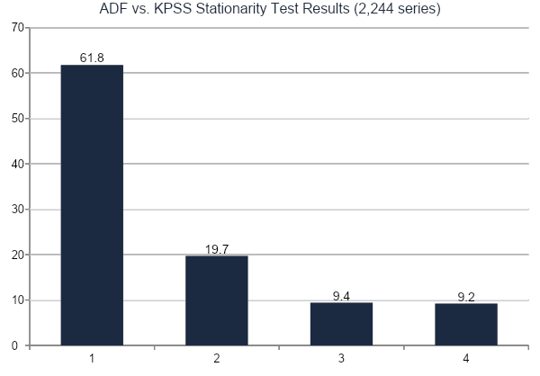
Historical Series Behavior & Stationarity
What This Tells Us
61.8% of series are stationary by both tests — high reliability for classical models like SARIMA.
19.7% pass neither test, suggesting non-stationary behavior that is harder to forecast.
AIC and BIC values were strongly correlated across models, reinforcing robust model selection.
One extreme AIC outlier (≈ −750) was flagged for review — illustrates the value of automated diagnostics on large datasets.
9

Slide 10
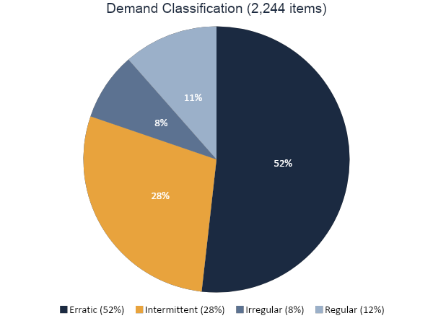
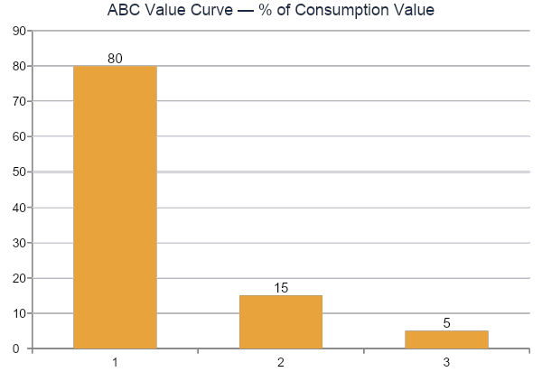
Results — Demand & Value Classification
Only 82 items (4% of SKUs) account for 80% of consumption value — these Class A items justify closer forecasting scrutiny. Meanwhile, 52% of all items show erratic demand, the hardest pattern to forecast accurately.
10

Slide 11
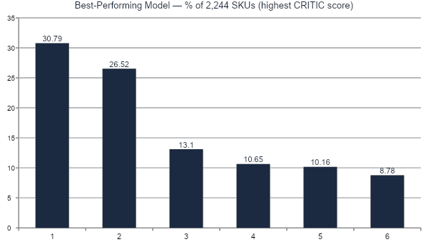
Results — Overall Model Performance (CRITIC Score)
#1 Random Forest
Best for 691 SKUs (30.8%). Strongest on Erratic, Intermittent, and Irregular demand — handles high variability well.
#2 Exp. Smoothing
Best for 595 SKUs (26.5%). Second-best for Intermittent and Erratic demand, close to Random Forest on those groups.
11

Slide 12
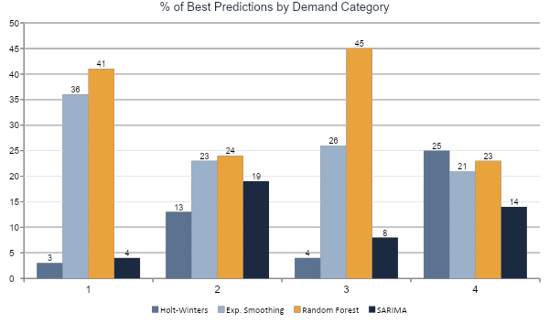
Results — Best Model by Demand Type
Key Takeaway
Irregular & Intermittent → Random Forest (41–45%)
Regular → Holt-Winters (25%)
Erratic → No model dominates (Random Forest & Exp. Smoothing close, ~23–24%)
Class A items (80% of value) → Holt-Winters performed best overall
12

Slide 13
Relevance to My Final Year Project
This seminar is based on the energy-sector base paper above. My own final year project applies the same core ideas to a different, smaller-scale context.
Base Paper (this seminar)
My Project — NexusERP
Domain: Large energy company, Brazil
Scale: 2,244 SKUs, enterprise ERP (SAP R/3)
Models: Random Forest, XGBoost, Exp. Smoothing, Holt, Holt-Winters, SARIMA
Goal: Identify the best forecasting model per demand type
Domain: Small businesses
Scale: Lightweight web-based ERP (FastAPI, PostgreSQL, React)
Forecasting: AI-driven demand forecasting module using Facebook Prophet
Goal: Bring the same demand-aware forecasting principles to businesses too small for enterprise ERP systems
13

Slide 14
Results Summary — Table 3 (Base Paper)
Model
SKUs Won
% of Total
Random Forest
691
30.79%
Exp. Smoothing
595
26.52%
SARIMA
294
13.10%
Holt-Winters
239
10.65%
Holt
228
10.16%
XGBoost
197
8.78%
Total base: 2,244 items — Random Forest and Exponential Smoothing together account for over 57% of best-fit predictions across the entire dataset.
14

Slide 15
Conclusion and Future Work
Summary of Findings
Future Work
No single model is ideal for all series — model choice should follow demand type.
Random Forest is superior for irregular and intermittent demand (ensemble methods excel with high variability).
Holt-Winters remains the most reliable for regular, seasonal demand.
Erratic demand (52% of items) resists all six models — an open forecasting challenge.
The joint use of behavioral classification (ADI/CV²) and ABC value classification lets managers focus rigorous analysis on the 82 Class A items driving 80% of value.
Extend forecasts into inventory sizing: safety stock, reorder point calculations.
Explore hybrid / deep-learning models for erratic demand.
Continuously re-evaluate model choice as new data and scenarios emerge — no model stays optimal indefinitely.
Limitation: applying these results in practice requires additional inventory-planning calculations (safety stock, order point) beyond forecast accuracy alone.
15

Slide 16
Limitations of the Base Paper's Approach
Forecast accuracy ≠ inventory policy
Erratic demand remains unsolved
The study evaluates statistical metrics (MAE, RMSE, MAPE) but does not translate forecasts into decision variables like safety stock level, reorder point (ROP), or economic order quantity (EOQ).
Over 52% of all spare parts exhibited erratic behavior, yet no evaluated model achieved dominant accuracy, leaving a significant performance gap.
Static evaluation window
Enterprise-scale tooling assumed
Relies on a single 80/20 temporal split (2020–2023 vs. 2024); model rankings could fluctuate under expanding rolling-origin evaluations
Assumes access to SAP R/3 ERP data lakes and local Python/Spyder scripting environments — creating adoption barriers for small businesses.
16

Slide 17
References
Silva, L.F. et al. (2026). Combining demand classification and forecasting models in spare parts inventory management for the energy sector. Int J Adv Manuf Technol, 144, 355–366. https://doi.org/10.1007/s00170-026-17483-1
Da Silva, L.F. et al. (2024). Demand Forecasting for Steel Company Spare Items with Time Series Templates. Procedia Computer Science, 57–64.
Diakoulaki, D., Mavrotas, G., Papayannakis, L. (1995). Determining objective weights in multiple criteria problems: the CRITIC method.
Kramar, V., Alchakov, V. (2023). Time-series forecasting of seasonal data using machine learning methods. Algorithms.
Barbosa, N., Christo, E.S., Costa, K.A. (2015). Demand forecasting for production planning in a food company.
Syntetos, A.A., Boylan, J.E. (2001). On the bias of intermittent demand estimates. Int J Prod Econ, 71(1–3), 457–466.
Holt, C.C. (2004). Forecasting seasonals and trends by exponentially weighted moving averages. Int J Forecast, 20(1), 5–10.
Winters, P.R. Forecasting sales by exponentially weighted moving averages. JSTOR.
17

Slide 18
Acknowledgements
I sincerely thank my Seminar Guide and the Department of Computer Science and Engineering, Amal Jyothi College of Engineering, for their guidance and support throughout this seminar.
18

Slide 19
Questions?
Thank you for your attention
This work informs my final year project, NexusERP — an AI-powered inventory forecasting system for small businesses.
19

