Slide 1
MICRO PROJECT
Notes:
3/30/2020
1
1

Slide 2
INDEX
● Topic
● Group Members
● DESCRIPTION
● Design
● Implementation
a)Source Code
b)Output
Notes:
3/30/2020
2
2

Slide 3
TOPIC
Display the boot options passed to the kernal
with short Description of each
Notes:
3/30/2020
3
3

Slide 4
Group Members
● AJIL VARGHESE - FIT18CS009
● AKHIL ANTHONY- FIT18CS010
● ALBIN JOHNSON - FIT18CS011
● ALLEN K PRINCE - FIT18CS012
Notes:
3/30/2020
4
4

Slide 5
DESCRIPTION
bootparam - introduction to boot time parameters of the Linux kernel
The Linux kernel accepts certain 'command-line options' or 'boot time parameters‘
at the moment it is started. In general, this is used to supply the kernel with information
about hardware parameters that the kernel would not be able to determine on its own,
or to avoid/override the values that the kernel would otherwise detect.
When the kernel is booted directly by the BIOS, you have no opportunity to specify
any parameters. So, in order to take advantage of this possibility you have to use
a boot loader that is able to pass parameters, such as GRUB.
Notes:
3/30/2020
5
5

Slide 6
DESIGN
The program is coded using python language. Graphical User Interface(GUI) is
designed using PyQt
Building GUI applications using PYQT designer tool is comparatively less time consu
ming than code the widgets. It is one of the fastest and easiest ways to create GUI’s.
The normal approach is to write the code even for the widgets and for the functionalities
as well. But using Qt-designer, one can simply drag and drop the widgets, which
comes very useful while developing big-scale applications.
Notes:
3/30/2020
6
6

Slide 7
Prerequisites
To start with this tutorial you need these installed:
Python
PyQt
Qt Designer
You will need Python 3 or above, because the others are out dated.
If you don’t have PyQt, install PyQt.
You can install Designer (Ubuntu Linux) with:
sudo apt-get install qttools5-dev-tools
sudo apt-get install qttools5-dev
Notes:
3/30/2020
7
7

Slide 8
Reference:PyQT_Tutorial-link ()
PyQT is a Python wrapper around the QT framework for
creating graphical user interfaces
GUI’s
PyQt - Tutorial - Link
Learn PyQt using the tutorials given .
Click link to open resource
https://pythonprogramming.net/basic-gui-pyqt-tutorial/
.
Notes:
3/30/2020
8
8

Slide 9
IMPLEMENTATION
Source code:
import os
import sys
from PyQt4.QtCore import *
from PyQt4.QtGui import *
def main():
app = QApplication(sys.argv)
w = MyWindow()
w.show()
sys.exit(app.exec_())
class MyWindow(QWidget):
def __init__(self, *args):
QWidget.__init__(self, *args)
label = QLabel(self.tr("Enter the key to display boot options passed to the kernel with short description of each"))
self.le = QLineEdit()
self.te = QTextEdit()
Notes:
3/30/2020
9
9

Slide 10
layout = QVBoxLayout(self)
layout.addWidget(label)
layout.addWidget(self.le)
layout.addWidget(self.te)
self.setLayout(layout)
self.connect(self.le,SIGNAL("returnPressed(void)"),
self.run_command)
def run_command(self):
cmd = 'cat /proc/cmdline'
stdouterr = os.popen4(cmd)[1].read()
self.te.setText(stdouterr)
#def home(self):
# btn =QtGui.QPushButton("Quit", self)
# btn.clicked.connect(self.close_application)
#btn.resize(btn.minimumSizeHint())
#btn.move(0,0)
#self.show()
#def close_application(self): #if QWidget install in PyQt4 exit button from elearn reference
# print("thank you!!!")
Exit button
# sys.exit()
if __name__ == "__main__":
main()
Notes:
3/30/2020
10
10

Slide 11
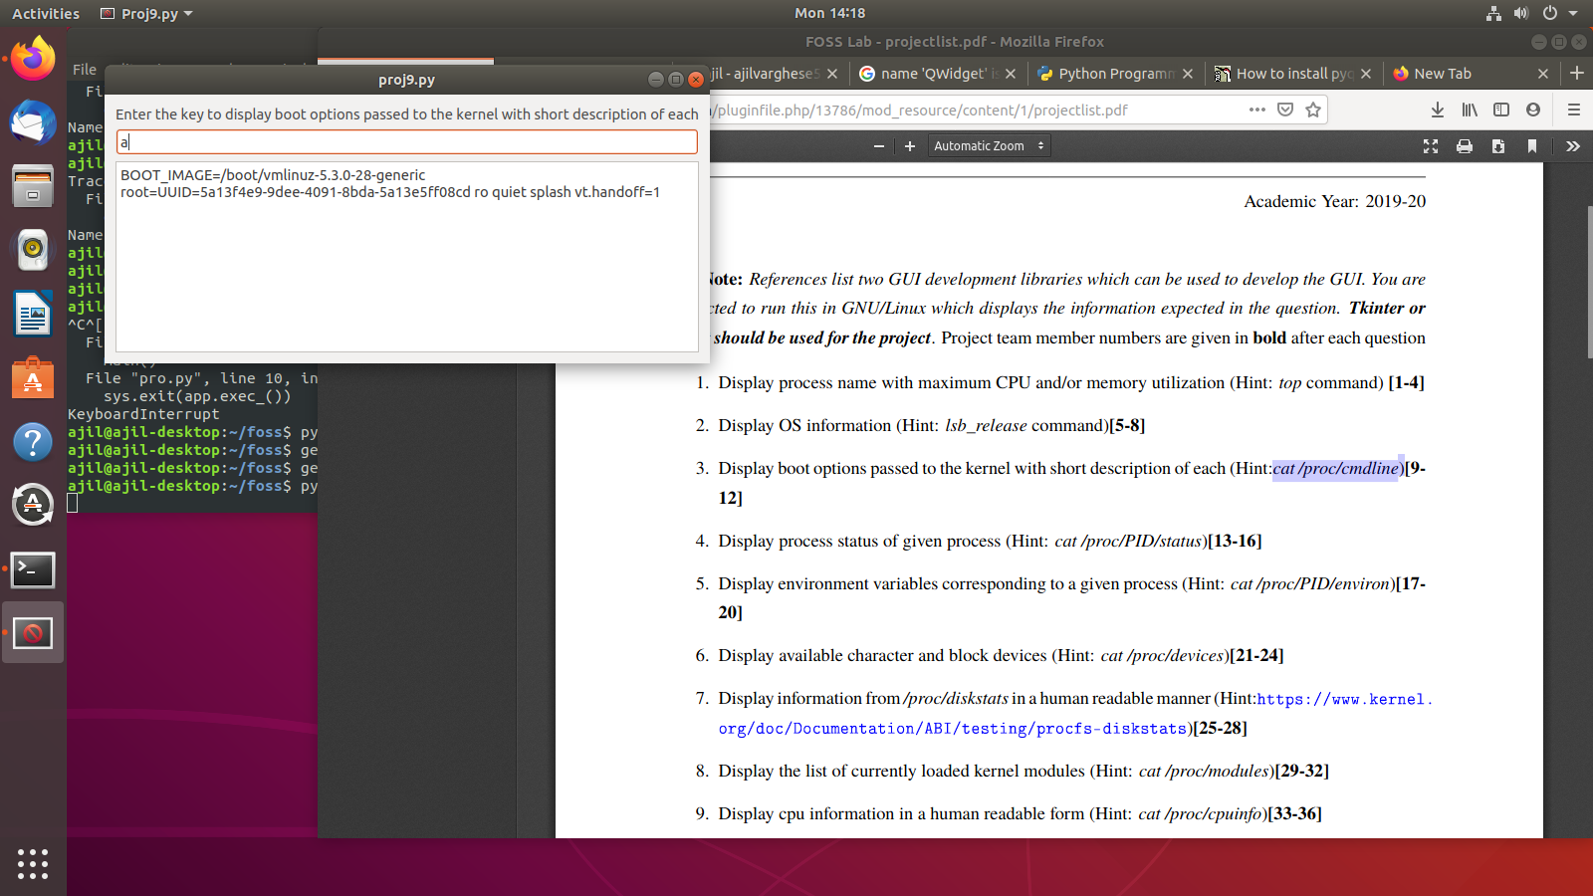
Notes:
3/30/2020
11
11

Slide 12
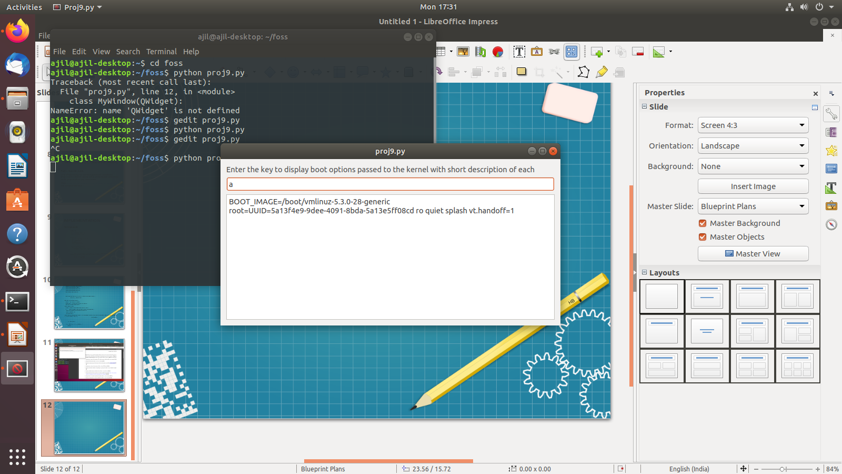
Output
Notes:
3/30/2020
12
12

Slide 13
THANK YOU
Notes:
3/30/2020
13
13

