Slide 1

Legal Case Query System: Case Study and Differentiation
Comparison with Existing Legal Research Tools

Slide 2

Introduction
This presentation provides a comparison between our legal case query system and existing legal research tools by highlight the unique features and advantages of our system.
Our Product: An AI-powered legal case query system designed to enhance the efficiency of legal research. It leverages advanced semantic search to understand the context and nuances of queries and provides precise results. Additionally, it incorporates conversational AI to facilitate dynamic and interactive querying, allowing users to retrieve relevant information through an intuitive chat interface.

Slide 3

LexisNexis
What is LexisNexis?
- A comprehensive legal research tool with extensive databases.
Key Features:
- Advanced search with NLP
- AI-driven legal research
How We Differ:
- Focus on semantic search and interactive queries using AI.

Slide 4

Westlaw
What is Westlaw?
- Westlaw is an online legal research service and proprietary database for lawyers and legal professionals available in over 60 countries by Thomson Reuters.
Key Features:
- Natural language search
- KeyCite for citation checking
- AI-enhanced search
How We Differ:
- Our tool integrates conversational AI for dynamic interactions.

Slide 5
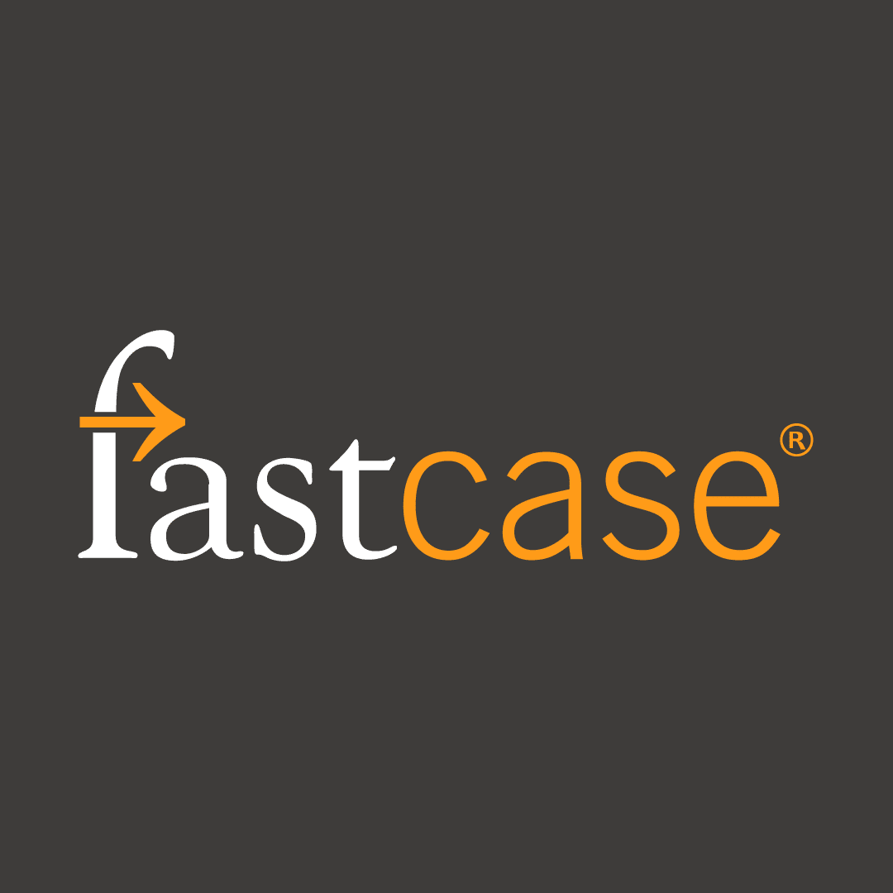
Fastcase
What is Fastcase?
- Fastcase provides industry-leading tools to make legal research easier and more intuitive; helping forward-thinking lawyers navigate the law faster and smarter.
- An affordable legal research service with a large database.
Key Features:
- AI-driven search
- Data visualization tools
- Integration with legal organizations
How We Differ:
- We use semantic search and generative AI for context-aware conversations.

Slide 6
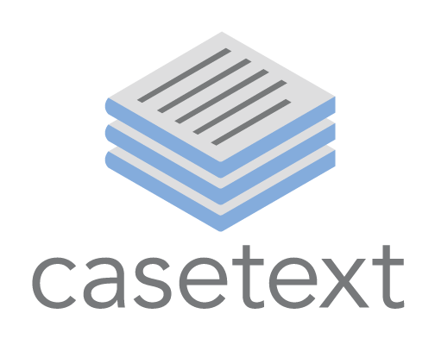
Casetext
What is Casetext?
- Casetext is the modern legal platform that combines AI-powered search technology with premier content to help lawyers streamline critical elements of legal practice, from research and drafting to discovery and more.
- A legal research tool using advanced AI (CARATM).
Key Features:
- AI-powered research assistant
- Advanced search capabilities
- Comprehensive legal database
How We Differ:
- Our tool leverages generative AI for personalized responses.

Slide 7

Our Unique Features
Conversational AI:
- Interactive querying with AI (Google's Gemini).
Semantic Search:
- Uses sentence-transformers for nuanced search results.
User Experience:
- Simple, intuitive UI for easy searching and interaction.

Slide 8

Conclusion
Summary of Key Differences:
- Unique blend of conversational AI and semantic search.
Benefits of Our Tool:
- Enhanced efficiency in legal research.
- Personalized and context-specific information retrieval.

