Slide 1
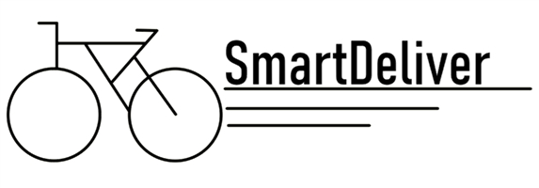
Work less for more

Slide 2
Goal
Build a delivery platform which connects package suppliers with delivery drivers and mainly focuses on the deliverers interests

Slide 3
Organization
Client
Backend
Driver

Slide 4
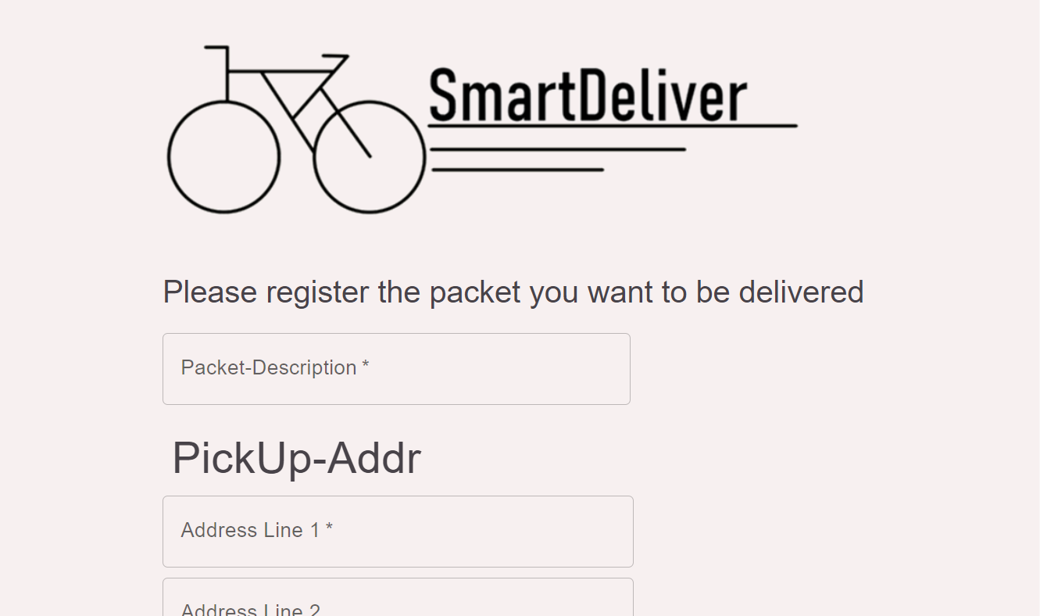
Package Supplier – Build a Website
Features
Log new orders
What we used
NextJs

Slide 5
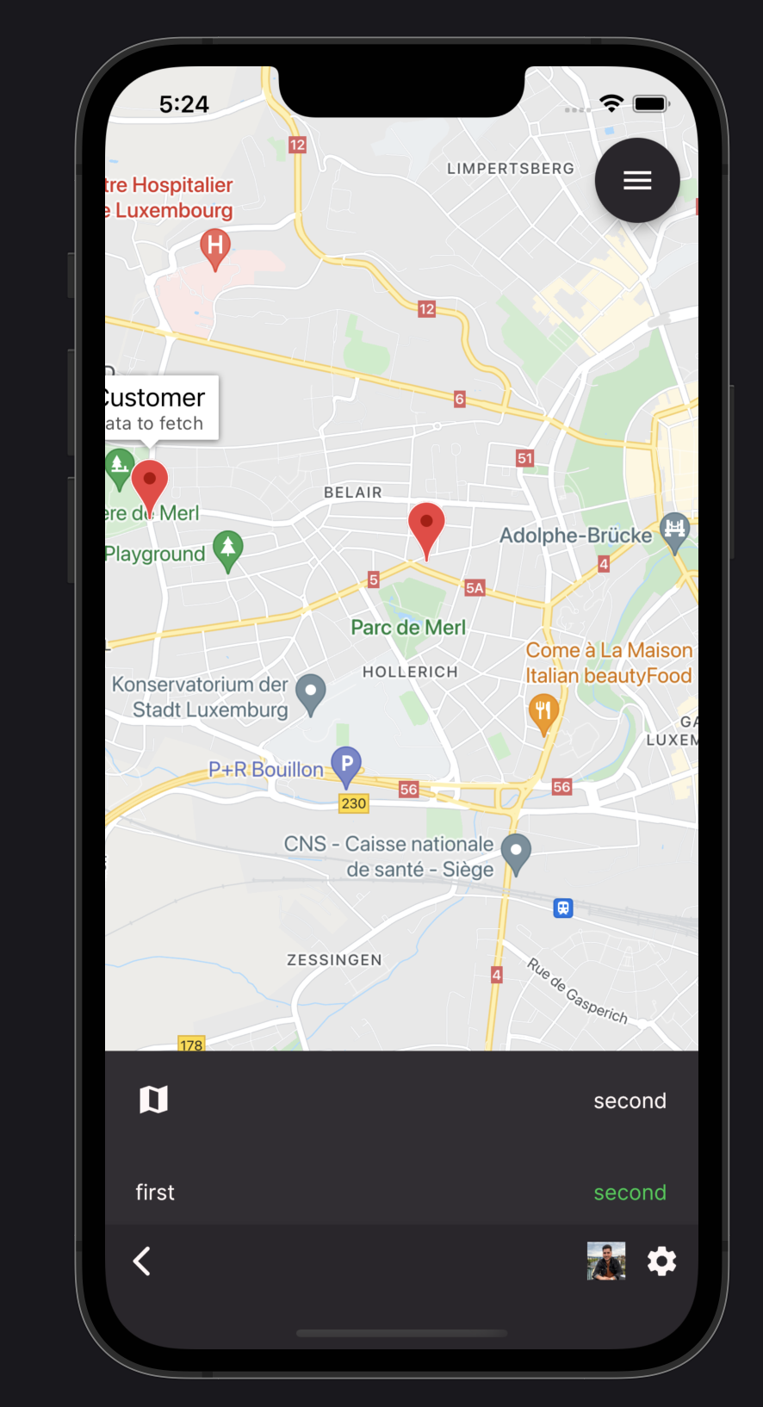
Driver – Build an App
Features
See optimal delivery route on map
Live update route based on incoming orders
Live tracking data
Overview of stats e.g. Money earned, Kilometres driven, etc.
What we used
Flutter

Slide 6
Backend – Providing Services
Features
Manage Data
Calculate optimal distribution of orders among deliverers
Is he close to the orders pickup-address?
How much money has the driver earned yet?
What distance has he covered so far?
Does the new order fit into the current route?
What we used
Firebase

Slide 7
Demo ☺

Slide 8
Look into the Future
Premium subscription model for deliverers to have a better chance to get good orders
“Share your day”-Button to share covered distance, number of orders executed, etc. on social media
Implement rankings in different areas such as covered distance

