Slide 1
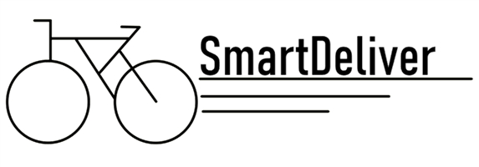
Work less for more

Slide 2
Goal
Build a delivery platform which connects package suppliers with delivery drivers and mainly focuses on the deliverers interests

Slide 3
Organization
Client
Backend
Driver

Slide 4
Client – Build a Website
Features
Log in new orders
What we used
NextJs

Slide 5
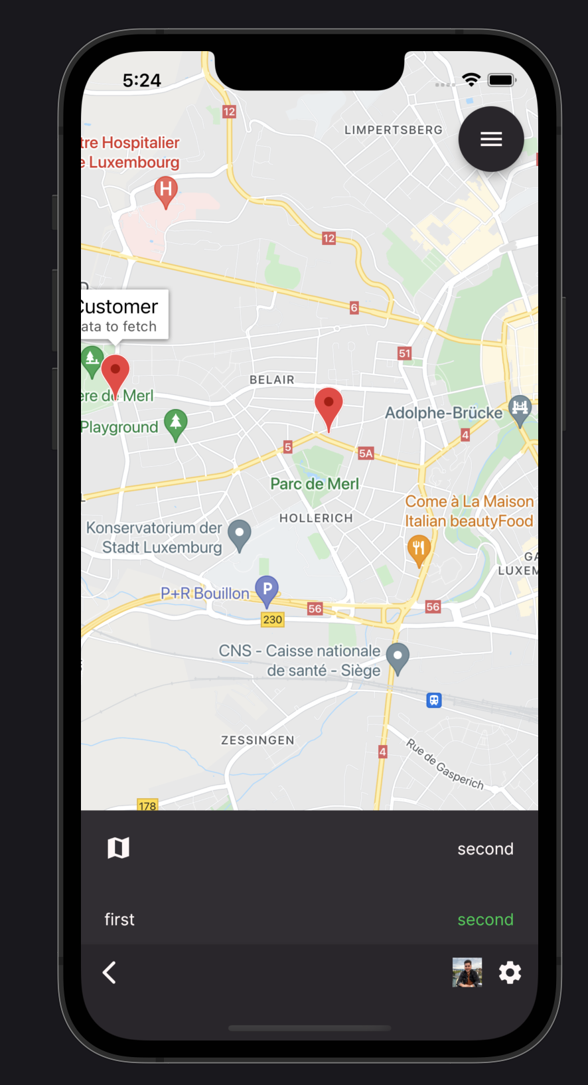
Driver – Build an App
Features
Accept/Reject orders
See optimal delivery route on map
Overview of stats e.g. Money earned, Kilometres driven, etc.
What we used
Flutter

Slide 6
Backend – Providing Services
Features
Manage Data
Calculate optimal distribution of orders among deliverers
Is he close to the orders pickup-address?
How much money has the driver earned yet?
What distance has he covered so far?
Does the new order fit into the current route?
What we used
Firebase

Slide 7
Demo ☺

Slide 8
Look into the Future
Premium subscription model for deliverers to have a better chance to get good orders
“Share your day”-Button to share covered distance, number of orders executed, etc. on social media
Implement rankings in different areas such as covered distance

