Slide 1
Identify IP Addresses via Fine-Tuned AI Models
https://github.com/frankwxu/digital-forensics-lab/tree/main/AI4Forensics/IP_Identifier_Fine_Tuning
Notes:
http://xmlstar.sourceforge.net/doc/UG/

Slide 2
Overview
IP addresses as digital forensic evidence
Background
Problem
Proposed approach
Introduction to object identification with AI
Object classification
Fine-tunning
Identify IP Addresses via Fine-tuned Models
Data processing, training, testing, and validation
Summary

Slide 3
IP addresses as digital forensic evidence

Slide 4
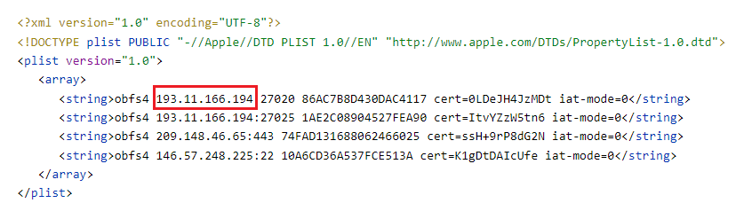
Motivation
Mobile devices contain multiple configuration files
e.g., xxx.plist (an iOS configuration file)
A configuration file contains lots of potential digital evidence
IP of a server, Geolocation, Name, Address,
port number
Notes:
<?xml version="1.0" encoding="UTF-8"?> <!DOCTYPE plist PUBLIC "-//Apple//DTD PLIST 1.0//EN" "http://www.apple.com/DTDs/PropertyList-1.0.dtd"> <plist version="1.0"> <array> <string>obfs4 193.11.166.194:27020 86AC7B8D430DAC4117 cert=0LDeJH4JzMDt iat-mode=0</string> <string>obfs4 193.11.166.194:27025 1AE2C08904527FEA90 cert=ItvYZzW5tn6 iat-mode=0</string> <string>obfs4 209.148.46.65:443 74FAD131688062466025 cert=ssH+9rP8dG2N iat-mode=0</string> <string>obfs4 146.57.248.225:22 10A6CD36A537FCE513A cert=K1gDtDAIcUfe iat-mode=0</string> </array> </plist>

Slide 5
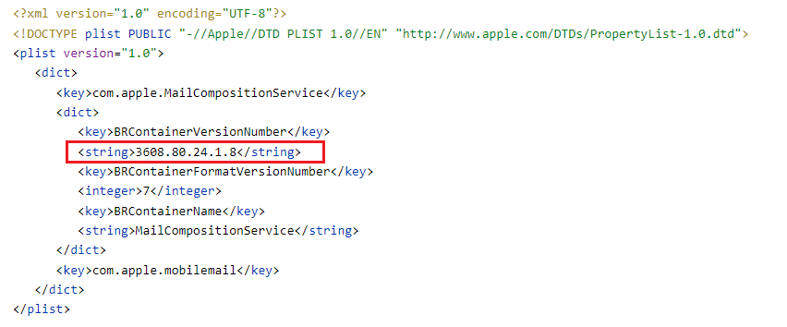
Problem
Identifying the correct IP address is not an easy task. Why?
Not the correct IP, it is the container’s version number!
Notes:
<?xml version="1.0" encoding="UTF-8"?>
<!DOCTYPE plist PUBLIC "-//Apple//DTD PLIST 1.0//EN" "http://www.apple.com/DTDs/PropertyList-1.0.dtd">
<plist version="1.0">
<dict>
<key>com.apple.MailCompositionService</key>
<dict>
<key>BRContainerVersionNumber</key>
<string>3608.80.24.1.8</string>
<key>BRContainerFormatVersionNumber</key>
<integer>7</integer>
<key>BRContainerName</key>
<string>MailCompositionService</string>
</dict>
<key>com.apple.mobilemail</key>
</dict>
</plist>

Slide 6
Goal
Utilizing AI techniques to identify correct IP addresses from iOS configuration files.
Fine-tuning pre-trained language models
pre-trained language models are provided by openAI
Note
Other approaches may solve the problem, e.g., regular expression

Slide 7
Approach
Use regular expressions to identify possible IPs
Inputs: a text line from a configuration file contains all possible IPs
output: all possible IPs (positive or negative)
false positives are included intentionally
Utilize OpenAI language model to identify if the IP is correct
Binary classification
Inputs: the text line + IPs identified with regular expression
Output: the possible IP a real IP or not (positive or negative)

Slide 8
Introduction to Object Identification with AI

Slide 9




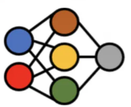
How does AI identify if a fruit is an apple?
Input Dataset
Training Process
This is an apple.
This is not an apple.
Model
Trained Model
Label/Truth/Annotation
It is an apple
Testing Process
Test Data
Trained Model

Slide 10




Fine-tuning a model to identify objects
Trained Model
Fine-Tuning Process
Classifier
Fine-tuned Model
Additional Domain Specific Data
Testing Process
It is valid IP
Test Data
Fine-tuned Model

Slide 11
Identify IP Addresses via Fine-tuned Models

Slide 12
Approach
Prepare a dataset
Train a specified model
Test a fine-tuned model
Evaluate model performance

Slide 13
A. Preparing a dataset

Slide 14


training dataset (80%)
preprocessing
test dataset (20%)
Prepare Dataset Overview
Should be training/validation/test. We simplify the data

Slide 15
Preparing dataset steps
Label IP addresses in a single line
Convert the single line with the label to prompt-completion pair
Save multiple prompt-completion pairs to a file (.jsonl)
i.e., JSON Lines text
e.g., dataset.jsonl (openAI format)
Split dataset.jsonl to training and testing datasets

Slide 16
1. Label IP addresses (positive or negative)
,
# | Text Line | IP from Regx | Label (Truth)
1 | <string>obfs4 193.11.166.194:27025 1AE2C08904527FEA90 cert=ItvYZzW5tn6 iat-mode=0</string> | 93.11.166.194 | Positive
2 | <string>3608.80.24.1.8</string> | 80.24.1.8 | Negative
We included IP from regular expression to help us to label (pos or neg) the IP address
False Positive: because it is a container version, not an IP address

Slide 17
2. Convert the single line
Convert the single line with the label to prompt-completion pair
Key words
{"prompt": "prompt text", "completion": “ ideal generated text"}
,
# | Text Line | IP from Regx | Label
1 | <string>obfs4 193.11.166.194:27025 1AE2C08904527FEA90 cert=ItvYZzW5tn6 iat-mode=0</string> | 193.11.166.194 | Positive

Slide 18
Best practice for prompt-completion formatting
{"prompt": "prompt text ->", “completion": “_xxx \n"}
Each prompt should end with a fixed separator
The separator informs the model when the prompt ends and the completion begins.
The separator should not appear elsewhere in any prompt.
\n\n###\n\n, ->
Each completion should start with a whitespace
Model tokenization tokenizes most words with a preceding whitespace.
Each completion should end with a fixed stop sequence
inform the model when the completion ends.
A stop sequence could be any other token that does not appear in any completion.
\n, ###, END

Slide 19
prompt-completion pair example with the best practice
,
# | Text Line | IP from Regx | Label
1 | <string>obfs4 193.11.166.194:27025 1AE2C08904527FEA90 cert=ItvYZzW5tn6 iat-mode=0</string> | 93.11.166.194 | Positive
Convert to a prompt-completion pair
added new annotation
{
"prompt": " <string>obfs4 193.11.166.194:27025 1AE2C08904527FEA90 cert=ItvYZzW5tn6 iat-mode=0</string>
; 193.11.166.194 ->",
"completion": “ Positive END“
}
a fixed separator
a white space
END: optional stop sequence

Slide 20
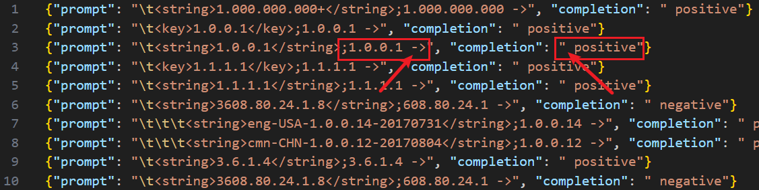
3. Save multiple p&c pairs to a file (dataset.jsonl)
we don’t use a stop token

Slide 21
4. Split dataset.jsonl to training and test datasets
dataset_train.jsonl
dataset_test.jsonl

Slide 22
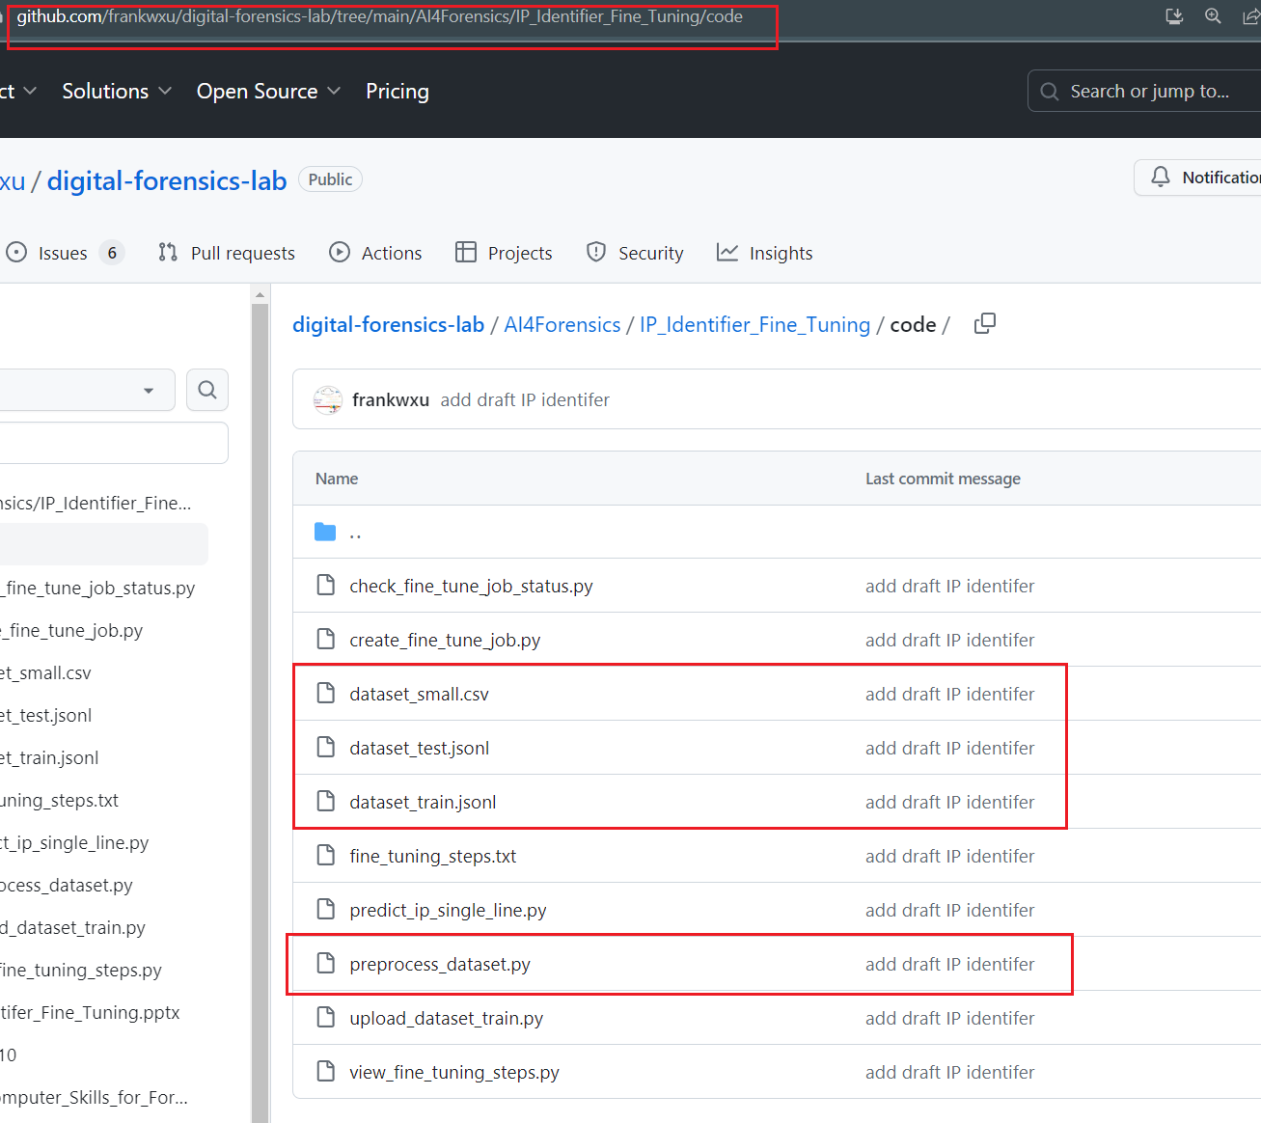

https://github.com/frankwxu/digital-forensics-lab/tree/main/AI4Forensics/IP_Identifier_Fine_Tuning/code
Input labeled dataset
Output of the preprocessing
Preprocess input dataset

Slide 23
B. Train a specified model

Slide 24


Training steps
3. check job info
4. view training progress
1. Upload a training dataset
2. Create a fine-tunning job
openAI trains
Training dataset
job ID
fine-tuned model ID
file ID

Slide 25
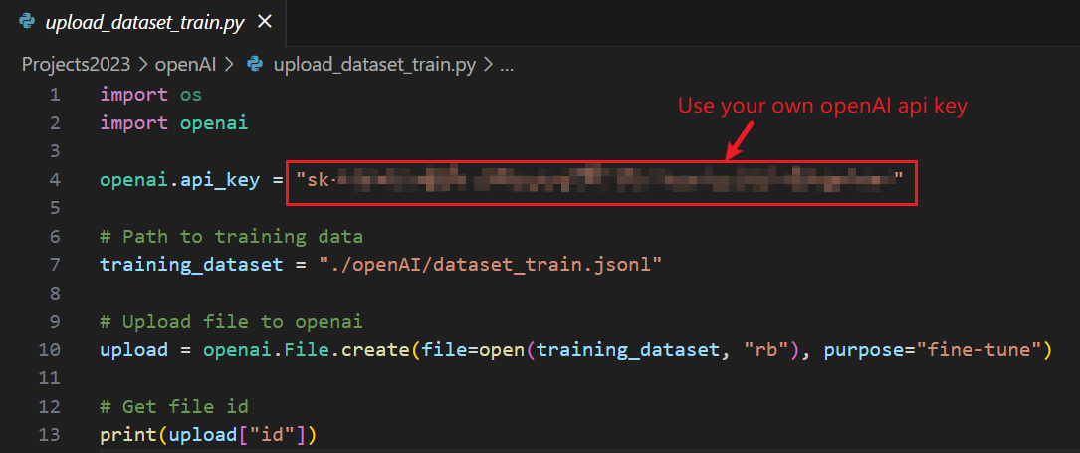
1. Upload the training dataset to openAI
https://raw.githubusercontent.com/frankwxu/digital-forensics-lab/main/AI4Forensics/IP_Identifier_Fine_Tuning/code/upload_dataset_train.py
pip install --upgrade openai
Execution results which shows the uploaded dataset ID
uploaded file ID
Notes:
file-1kZdBPJtBAHOehkHuhc8z5N1
pip install --upgrade openai

Slide 26
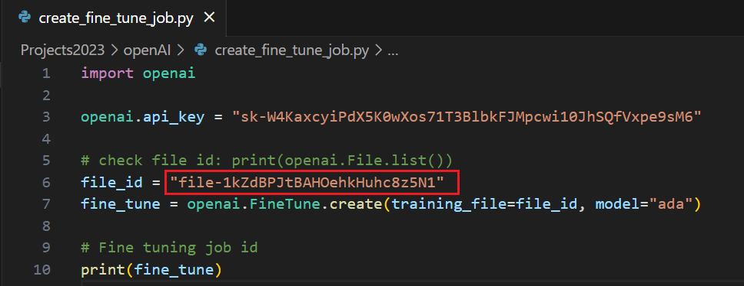
2. Create a fine-tuning job
https://raw.githubusercontent.com/frankwxu/digital-forensics-lab/main/AI4Forensics/IP_Identifier_Fine_Tuning/code/create_fine_tune_job.py
Creates a job that fine-tunes a specified model from a given dataset
Input: file (id) that contains the training data
output: fine-tune job object with ID

Slide 27
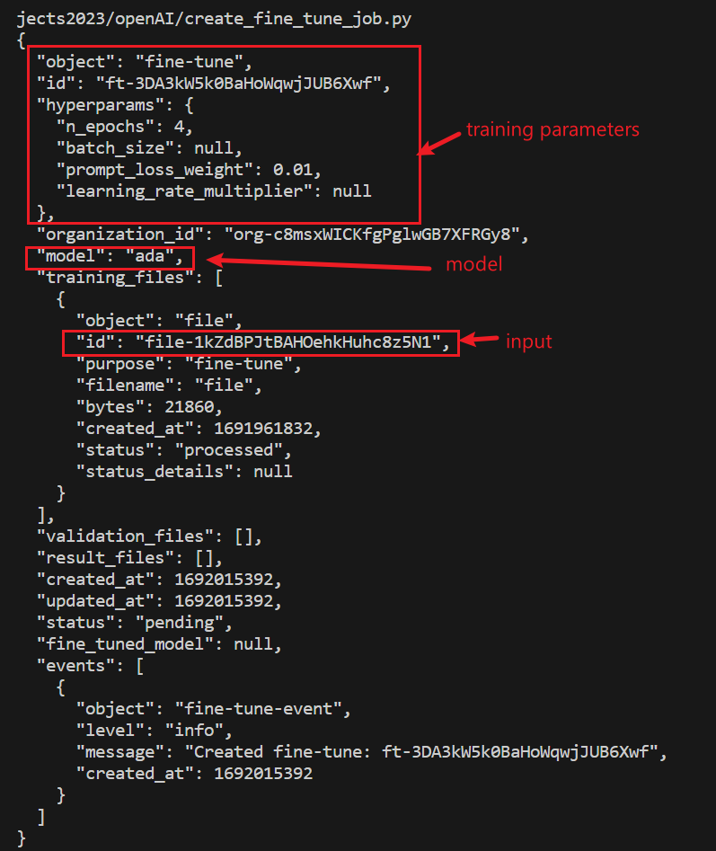
Output: Fine-tune object description
fine-tuning job ID
job status
Notes:
{
"object": "fine-tune",
"id": "ft-3DA3kW5k0BaHoWqwjJUB6Xwf",
"hyperparams": {
"n_epochs": 4,
"batch_size": null,
"prompt_loss_weight": 0.01,
"learning_rate_multiplier": null
},
"organization_id": "org-c8msxWICKfgPglwGB7XFRGy8",
"model": "ada",
"training_files": [
{
"object": "file",
"id": "file-1kZdBPJtBAHOehkHuhc8z5N1",
"purpose": "fine-tune",
"filename": "file",
"bytes": 21860,
"created_at": 1691961832,
"status": "processed",
"status_details": null
}
],
"validation_files": [],
"result_files": [],
"created_at": 1692015392,
"updated_at": 1692015392,
"status": "pending",
"fine_tuned_model": null,
"events": [
{
"object": "fine-tune-event",
"level": "info",
"message": "Created fine-tune: ft-3DA3kW5k0BaHoWqwjJUB6Xwf",
"created_at": 1692015392
}
]
}

Slide 28
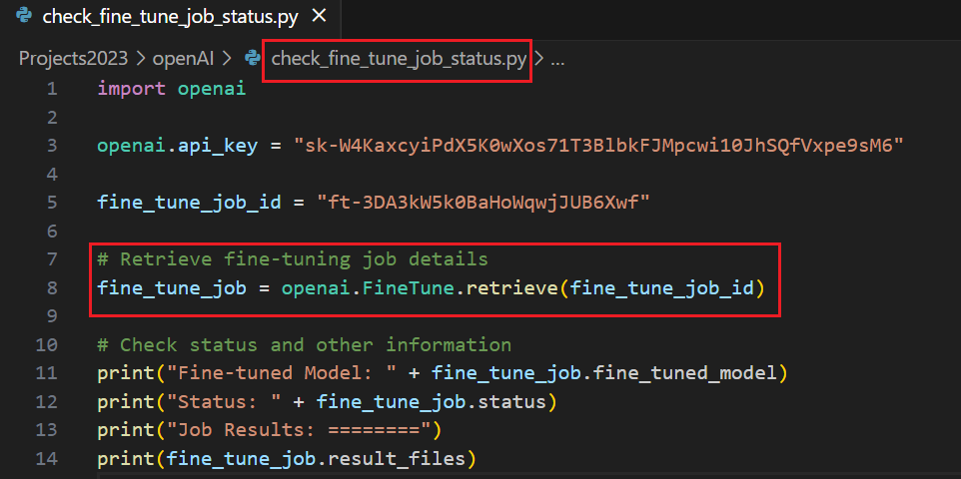
3. Check fine-tune job info (model, status, progress)
https://raw.githubusercontent.com/frankwxu/digital-forensics-lab/main/AI4Forensics/IP_Identifier_Fine_Tuning/code/check_fine_tune_job_status.py
Train model, training status, and training process information
Input: fine-tune job (id)
output: fine-tune job info
output 1: fine-tune model
output 2: fine-tune status
output 3: fine-tune progress file info
Notes:
Fine-tuned Model: ada:ft-university-of-baltimore-2023-08-14-12-39-06
Status: succeeded
Job Results: ========
[<File file id=file-ngHRotibSy82Mr55IjsPP2uK at 0x1c1873fa7c0> JSON: {
"object": "file",
"id": "file-ngHRotibSy82Mr55IjsPP2uK",
"purpose": "fine-tune-results",
"filename": "compiled_results.csv",
"bytes": 31134,
"created_at": 1692016747,
"status": "processed",
"status_details": null
}]

Slide 29
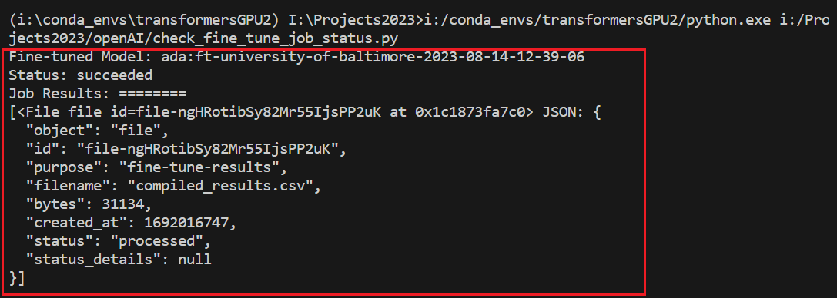
Outputs: (1) model: ada:ft-university-of-baltimore-2023-08-14-12-39-06
(2) fine-tune steps: "file-ngHRotibSy82Mr55IjsPP2uK”
training completed!
we can view fine-tune steps, e.g., training_loss
Notes:
Fine-tuned Model: ada:ft-university-of-baltimore-2023-08-14-12-39-06
Status: succeeded
Job Results: ========
[<File file id=file-ngHRotibSy82Mr55IjsPP2uK at 0x1c1873fa7c0> JSON: {
"object": "file",
"id": "file-ngHRotibSy82Mr55IjsPP2uK",
"purpose": "fine-tune-results",
"filename": "compiled_results.csv",
"bytes": 31134,
"created_at": 1692016747,
"status": "processed",
"status_details": null
}]

Slide 30
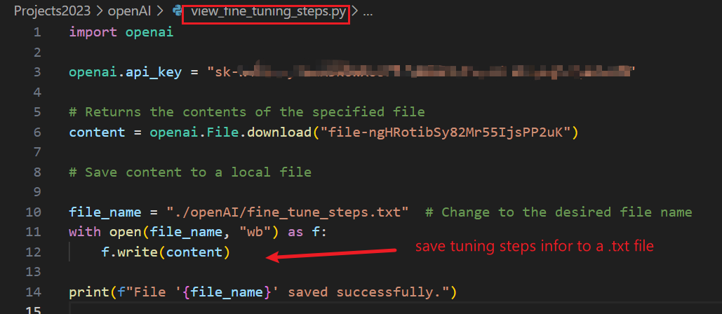
4. View fine-tuning progress information
https://raw.githubusercontent.com/frankwxu/digital-forensics-lab/main/AI4Forensics/IP_Identifier_Fine_Tuning/code/view_fine_tuning_steps.py
Download fine-tunning steps information
Input: file (id) that saves the training progress info

Slide 31
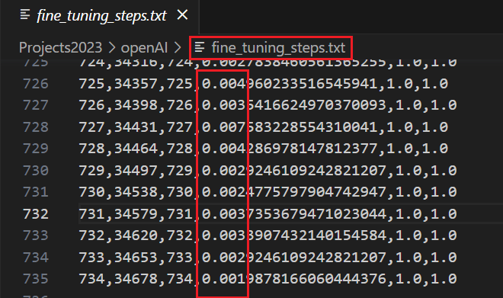
Running result
View fine-tuning steps information
training_loss should decrease

Slide 32
C. Test a fine-tuned model

Slide 33
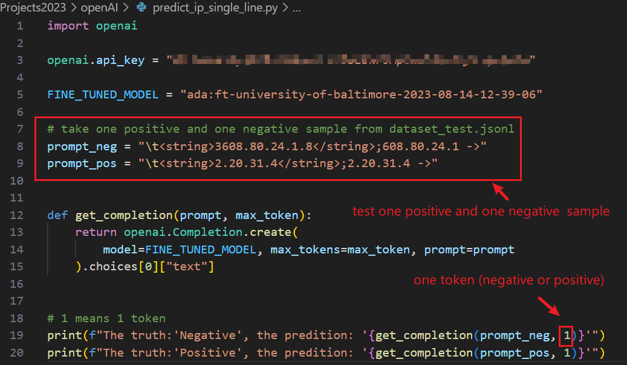
Identify IP from a single text line
https://raw.githubusercontent.com/frankwxu/digital-forensics-lab/main/AI4Forensics/IP_Identifier_Fine_Tuning/code/predict_ip_single_line.py
Only test one negative and one positive samples
Input: trained model (ID)

Slide 34
Execution results

Slide 35
D. Evaluate model performance

Slide 36
Goal
Evaluate the fine-tuned model performance on the provided validation set
dataset_test.jsonl
We use the testing dataset as the validation set for the demonstration purpose

Slide 37
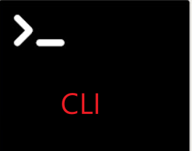



training dataset (80%)
test dataset (20%)
1. Run command line
2. Download the accuracy of each training step
3. Show or visualization accuracy

Slide 38
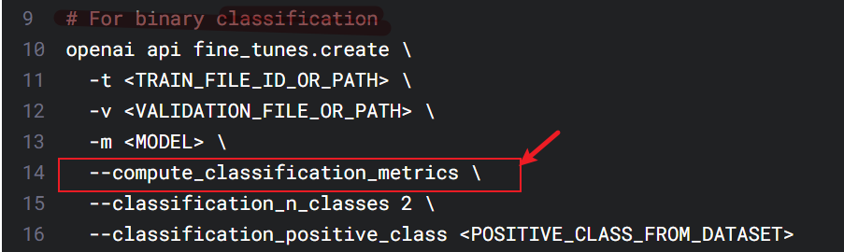
classification/accuracy
classification/precision
classification/recall
classification/f{beta}
classification/auroc - AUROC
classification/auprc - AUPRC
1. One Windows CLI
save the above classification performance data to a result file

Slide 39
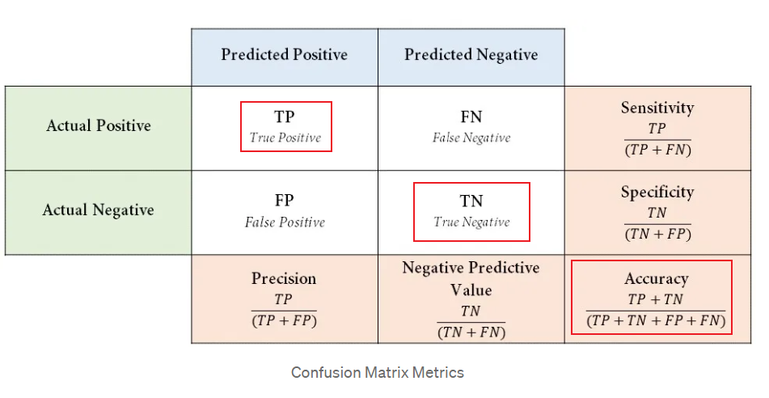
https://medium.com/@danyal.wainstein1/understanding-the-confusion-matrix-b9bc45ba2679

Slide 40
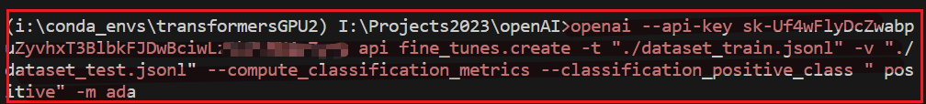
The CLI to evaluate our trained model
openai --api-key sk-Uf4wFlyDcZwabpuZyvhxT3BlbkFJDwBciwLz1hBcxxxx
api fine_tunes.create
-t "./dataset_train.jsonl"
-v "./dataset_test.jsonl"
--compute_classification_metrics
--classification_positive_class " positive"
-m ada

Slide 41
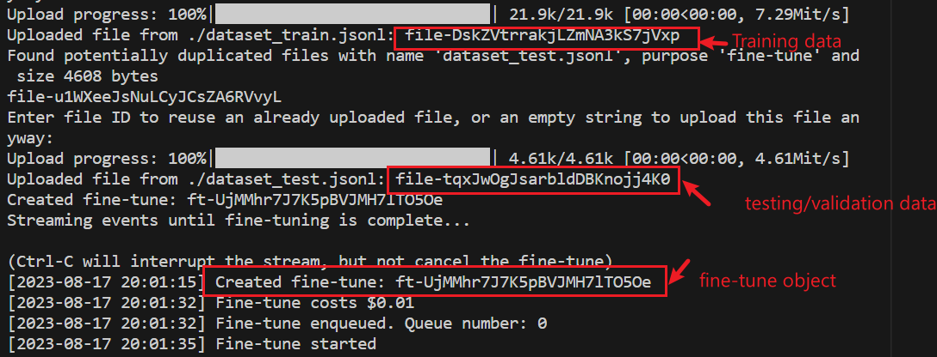
Execution information
(job id)
ft-UjMMhr7J7K5pBVJMH7lTO5Oe
Notes:
Upload progress: 100%|█████████████████████████████| 21.9k/21.9k [00:00<00:00, 7.29Mit/s]
Uploaded file from ./dataset_train.jsonl: file-DskZVtrrakjLZmNA3kS7jVxp
Found potentially duplicated files with name 'dataset_test.jsonl', purpose 'fine-tune' and size 4608 bytes
file-u1WXeeJsNuLCyJCsZA6RVvyL
Enter file ID to reuse an already uploaded file, or an empty string to upload this file anyway:
Upload progress: 100%|█████████████████████████████| 4.61k/4.61k [00:00<00:00, 4.61Mit/s]
Uploaded file from ./dataset_test.jsonl: file-tqxJwOgJsarbldDBKnojj4K0
Created fine-tune: ft-UjMMhr7J7K5pBVJMH7lTO5Oe
Streaming events until fine-tuning is complete...
(Ctrl-C will interrupt the stream, but not cancel the fine-tune)
[2023-08-17 20:01:15] Created fine-tune: ft-UjMMhr7J7K5pBVJMH7lTO5Oe
[2023-08-17 20:01:32] Fine-tune costs $0.01
[2023-08-17 20:01:32] Fine-tune enqueued. Queue number: 0
[2023-08-17 20:01:35] Fine-tune started

Slide 42
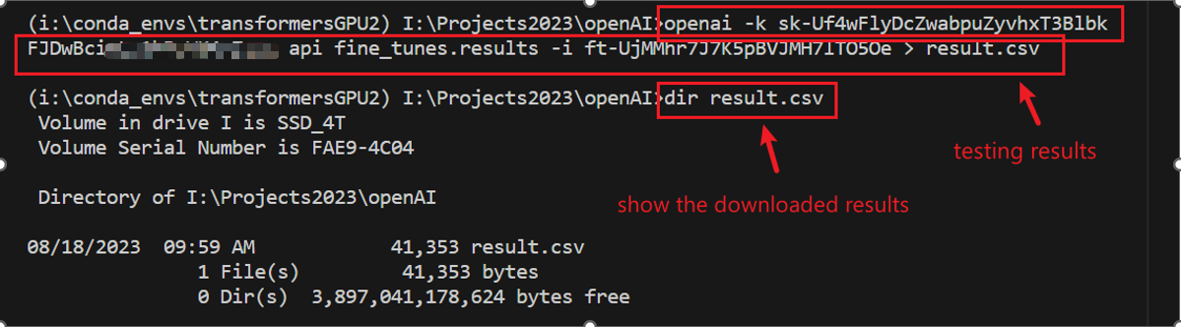
2. Download the fine-tuned (based on job id) metrics of each training step to a text file for further analysis
Notes:
openai -k sk-Uf4wFlyDcZwabpuZyvhxT3BlbkFJDwBciwLz1xxxxx api fine_tunes.results -i ft-UjMMhr7J7K5pBVJMH7lTO5Oe > result.csv

Slide 43
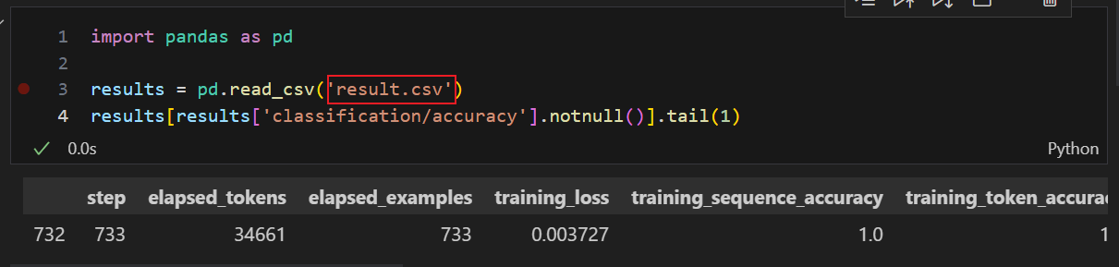
https://raw.githubusercontent.com/frankwxu/digital-forensics-lab/main/AI4Forensics/compute_classification_metrics/ipynb
3. Read metrics accuracy information using pandas
Notes:
import pandas as pd
results = pd.read_csv('result.csv')
results[results['classification/accuracy'].notnull()].tail(1)

Slide 44
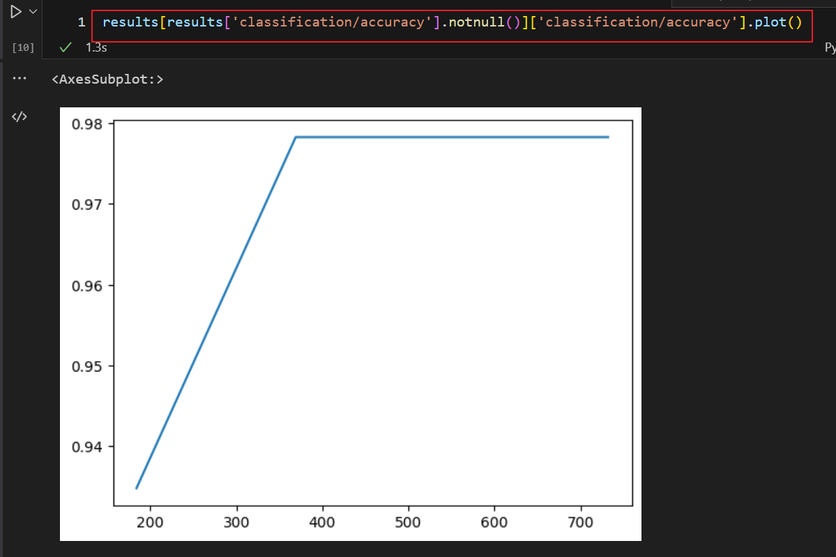
How accuracy increases with training steps

Slide 45
Summary 1
Fine-tuning refers to the process of taking a pre-trained model and further training it on a smaller, domain-specific dataset to adapt it to a specific task or domain.
The pre-trained model has already learned general patterns and features from a large dataset, often resulting in better initial performance than training from scratch.

Slide 46
Summary 2
Select a Pre-trained Model:
Prepare Domain-specific Data:
Fine-tuning:
Adjust Hyperparameters:
Evaluation and Iteration:
Deployment

Slide 47
Appendix
set up openAI api key

Slide 48
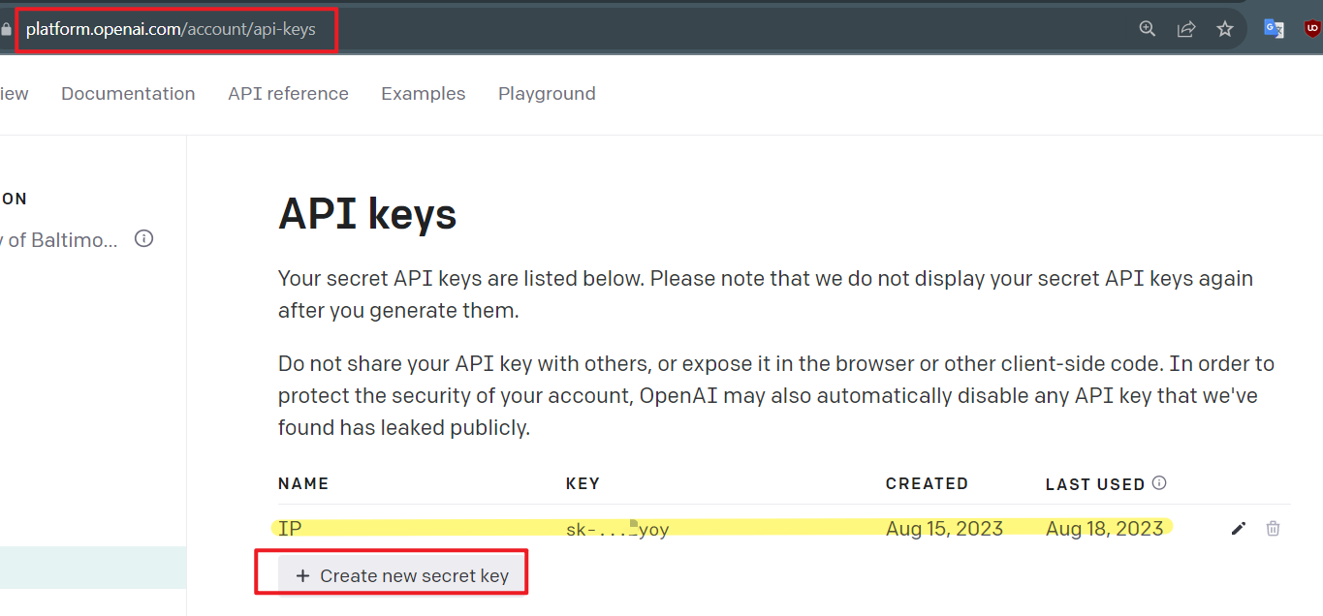
Set up API keys

Slide 49
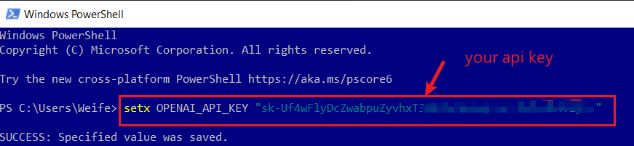
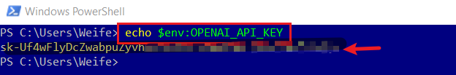
set up openAI api keys in Windows
Notes:
setx OPENAI_API_KEY "sk-Uf4wFlyDcZwabpuZyvhxT3BlbkFJ….“
echo $env:OPENAI_API_KEY
https://github.com/openai/openai-cookbook/blob/main/examples/Fine-tuned_classification.ipynb

Slide 50
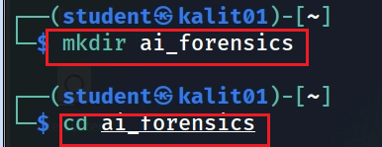
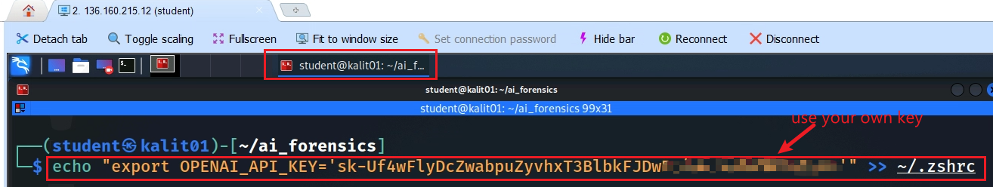

set up openAI api keys in Linux
Notes:
echo "export OPENAI_API_KEY='sk-Uf4wFlyDcZwabpuZyvhxT3BlbkFJDwBciwLz1hBcWK4vZ'" >> ~/.zshrc
source ~/.zshrc
echo $OPENAI_API_KEY

Slide 51
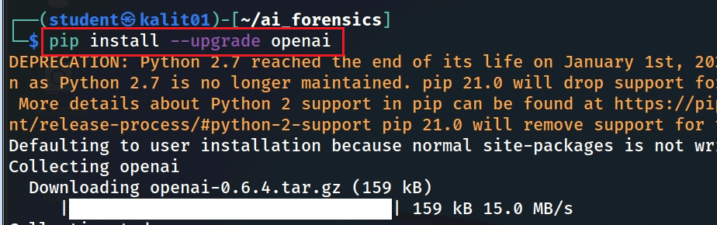
install openAI library

Slide 52
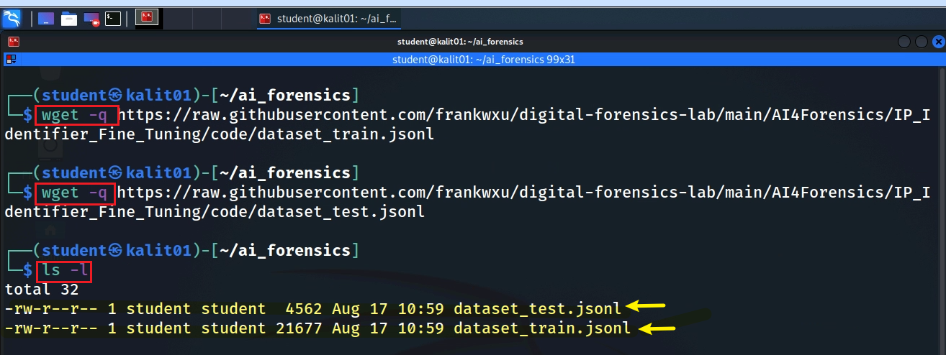
Download files in Linux
Notes:
wget –q https://raw.githubusercontent.com/frankwxu/digital-forensics-lab/main/AI4Forensics/IP_Identifier_Fine_Tuning/code/dataset_train.jsonl
wget –q https://raw.githubusercontent.com/frankwxu/digital-forensics-lab/main/AI4Forensics/IP_Identifier_Fine_Tuning/code/dataset_test.jsonl

