Slide 1
Investigate Data Leakage Case
Keywords: Windows Security Event Logs, XML
Notes:
http://xmlstar.sourceforge.net/doc/UG/

Slide 2
Goals
Understand evidence generated by OS
Understand XML format
Know how to extract information from XML files

Slide 3
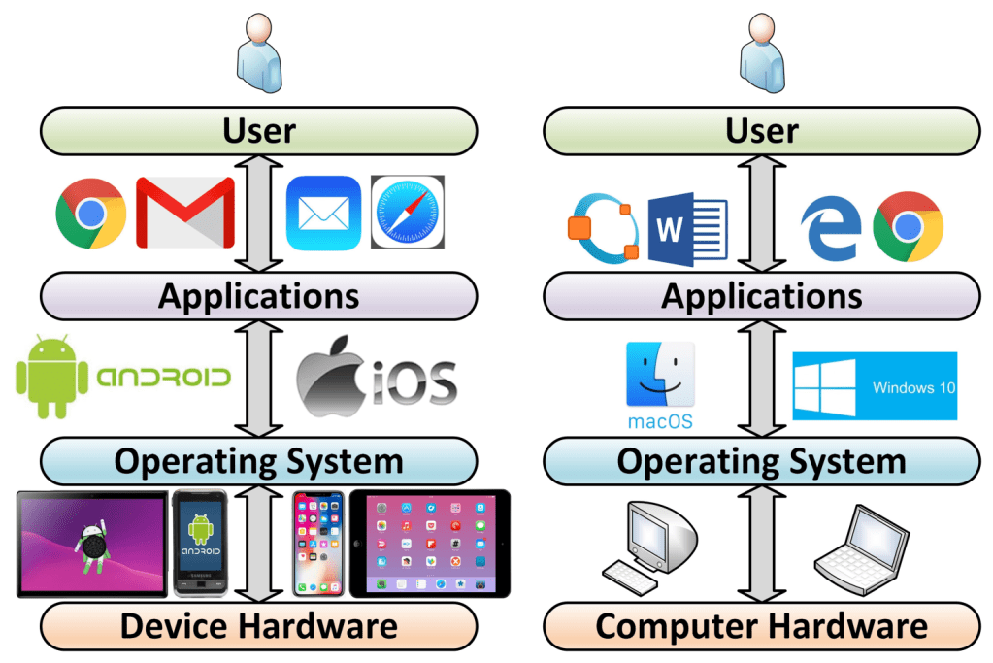
Layers of a computer system
Evidence is generated from each layer
User activities= Applications+ OS+ Disk/Memory
https://windsongtraining.ca/the-technology-layer-cake-users-apps-os-and-hardware/

Slide 4
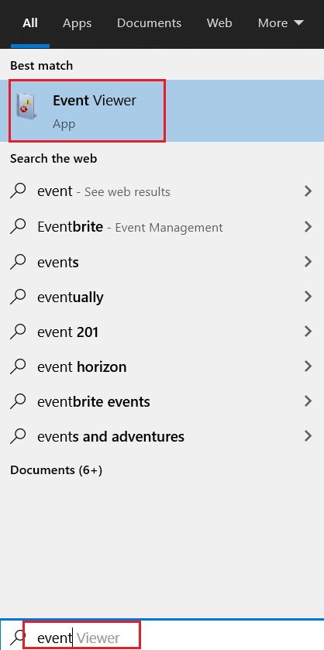
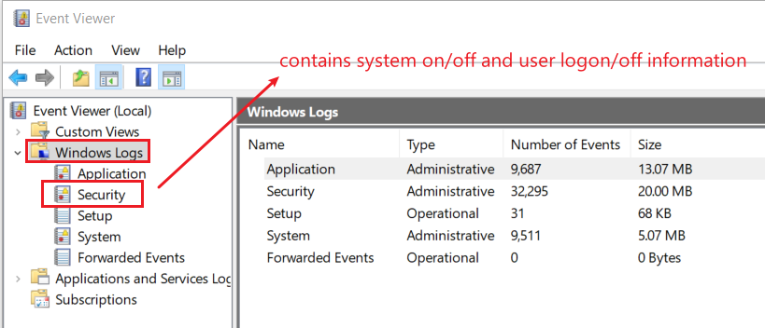
12. List all traces about the system on/off and the user logon/logoff (It should be considered only during a time range between 09:00 and 18:00 in the timezone (Eastern Time) from Question 4.
The Windows event log is a detailed record of system, security and application notifications stored by the Windows
It’s a useful tool for
troubleshooting all kinds of different Windows problems
forensics analysis
Notes:
evtx_dump.py Security.evtx > SecurityEvt.xml

Slide 5
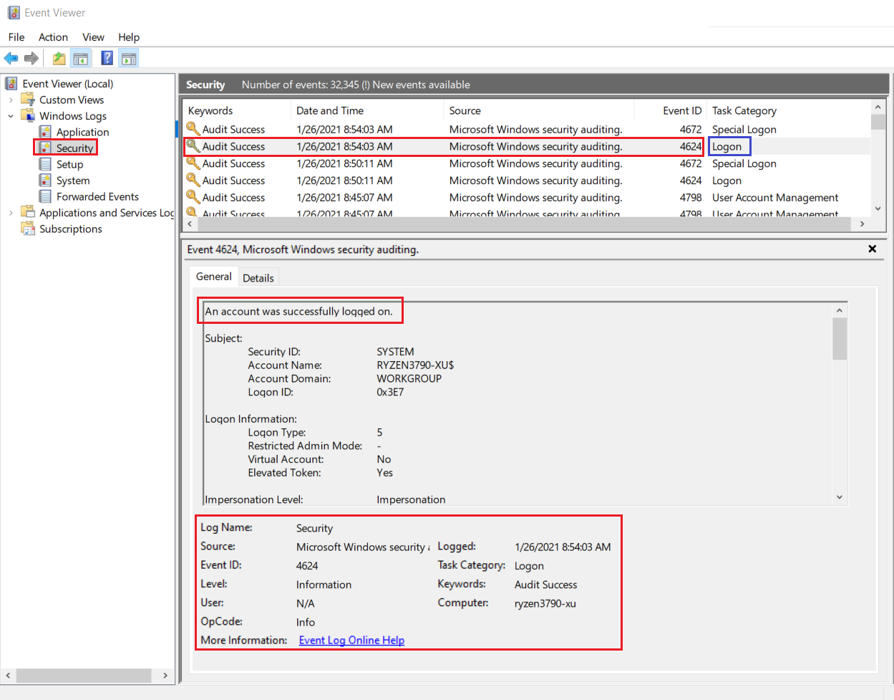
Logon event 4624

Slide 6
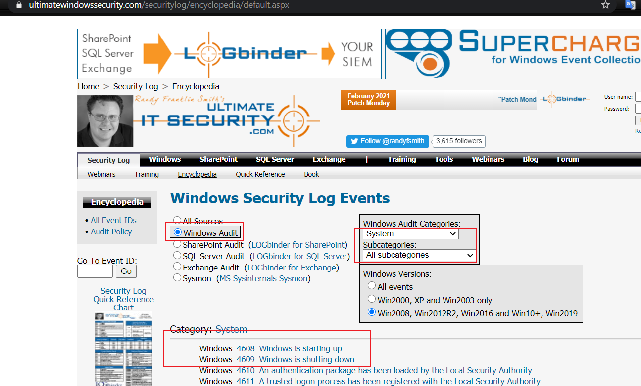
How to search events?
https://www.ultimatewindowssecurity.com/securitylog/encyclopedia/default.aspx

Slide 7
Overview approach
Get a copy of security event log
Analyze the event log
Install XML parser (xmlstarlet)
Validating Security Event Log XML documents
Display element structure of XML document
Format XML document
Query XML documents
Modify or edit XML documents

Slide 8
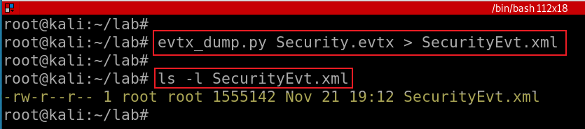
Get a copy of security event log
Exam security event logs for logon/logoff
Notes: If you are not in root, you will see an error message. You need to check the permission of the lab folder
See next slide debugs error messages if you see any.
Notes:
evtx_dump.py Security.evtx > SecurityEvt.xml

Slide 9
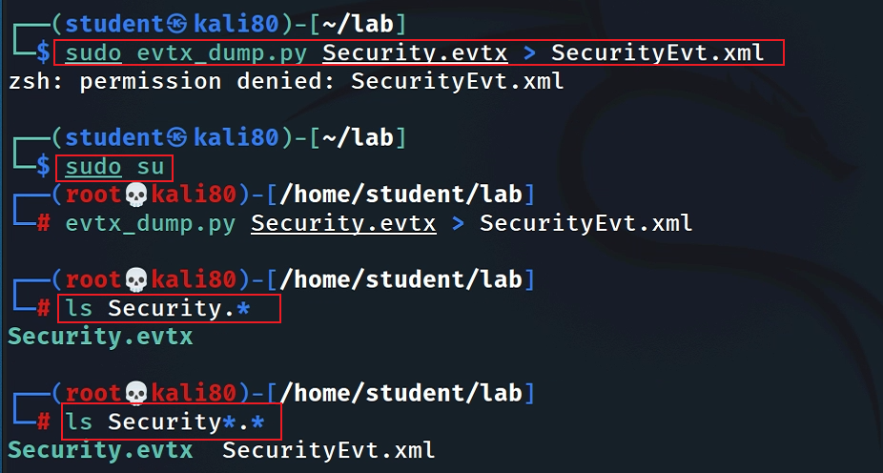
switch to root if there is a permission problem

Slide 10
What is XML
An XML file is an eXtensible Markup Language file that structures data for storage and transport.
XML files can be used for various purposes
Data transfer: XML files can store and retrieve data for different applications.
Formatting documents: XML files can define how web pages or other documents are displayed.
Web searching: XML files can help search engines index and rank web pages
Creating layouts: XML files can design the user interface of mobile applications.
Storing configuration data: XML files can store the settings and preferences of an application.

Slide 11
Install XML parser

Slide 12
xmlstarlet
Is a set of command line utilities (tools)
transform, query, validate, and edit XML documents and files
Using simple set of shell commands
Similar to grep, sed, awk
http://xmlstar.sourceforge.net/doc

Slide 13
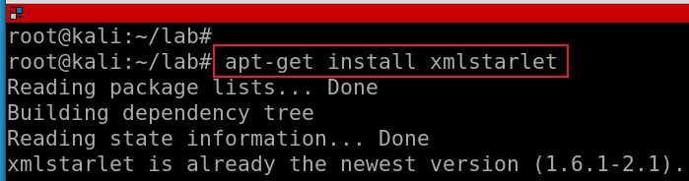
Install xmlstartlet
Notes:
apt-get install xmlstarlet

Slide 14
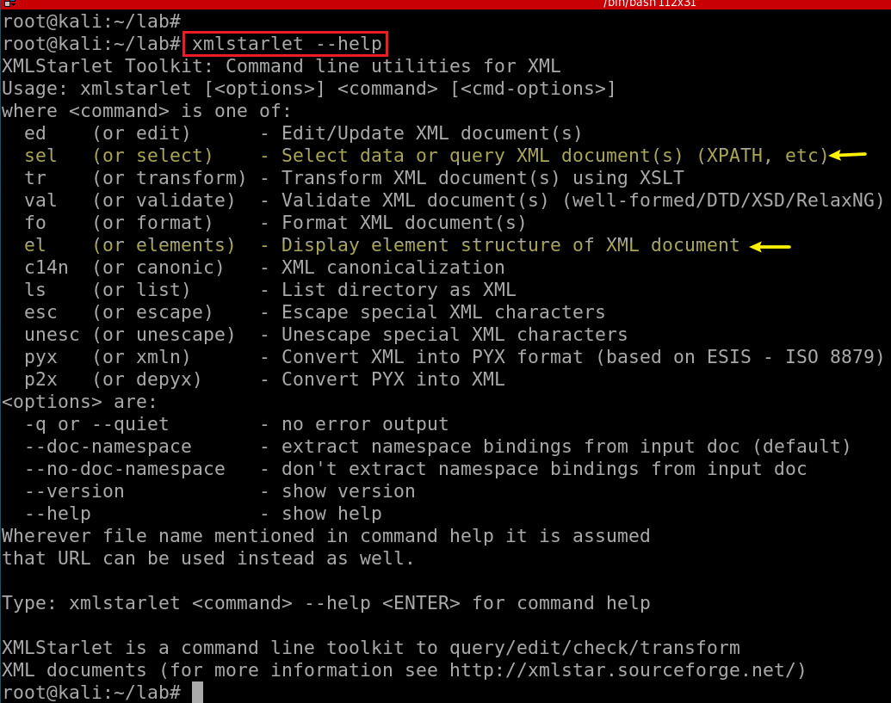

Slide 15
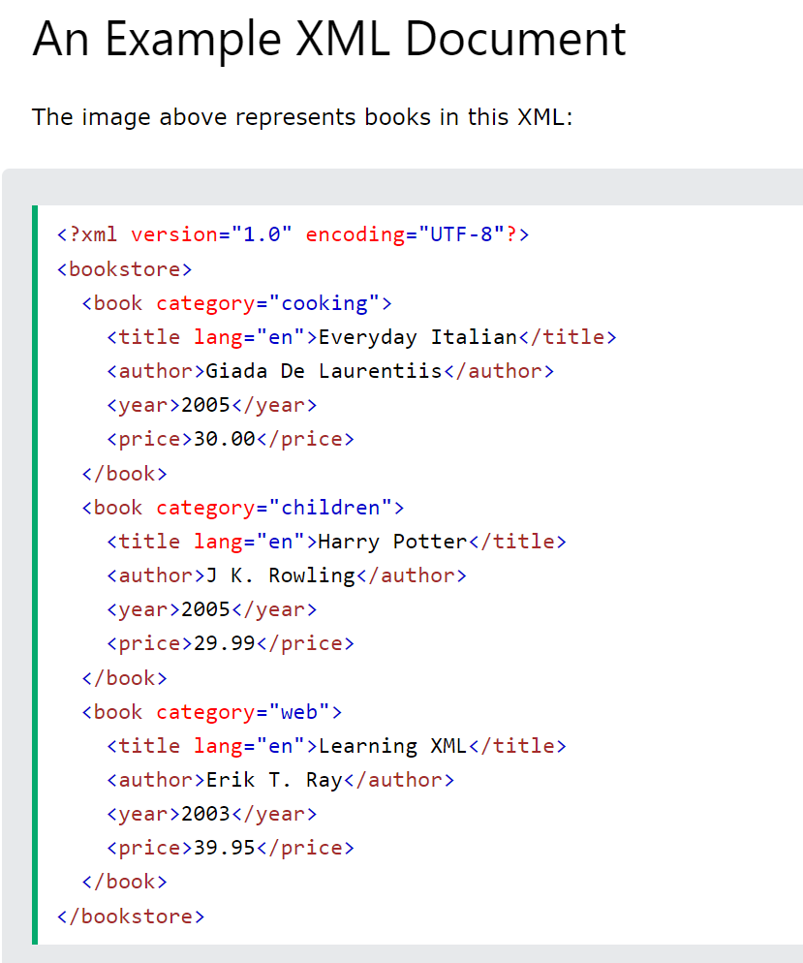
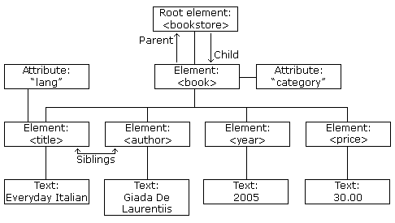
UTF-8 is capable of encoding all 1,112,064 characters using one to four one-byte (8-bit) code units.
https://www.w3schools.com/xml/xml_tree.asp
Notes:
<?xml version="1.0" encoding="UTF-8"?> <bookstore> <book category="cooking"> <title lang="en">Everyday Italian</title> <author>Giada De Laurentiis</author> <year>2005</year> <price>30.00</price> </book> <book category="children"> <title lang="en">Harry Potter</title> <author>J K. Rowling</author> <year>2005</year> <price>29.99</price> </book> <book category="web"> <title lang="en">Learning XML</title> <author>Erik T. Ray</author> <year>2003</year> <price>39.95</price> </book> </bookstore>

Slide 16
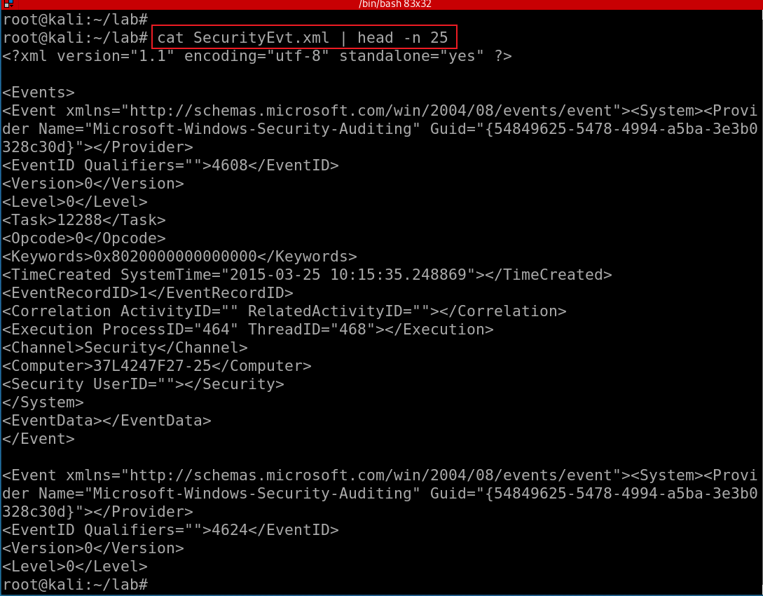
Show SecurityEvt.xml
XML Namespaces provide a method to avoid element name conflicts.
defined by an xmlns attribute in the start tag of an element.
xmlns:prefix="URI".
which table?
<table> <tr> <td>Apples</td> <td>Bananas</td> </tr> </table>
<table> <name>African Coffee Table</name> <width>80</width> <length>120</length> </table
Notes:
https://www.w3schools.com/xml/xml_namespaces.asp

Slide 17
validating XML documents

Slide 18
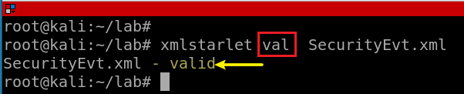
Notes:
xmlstarlet val SecurityEvt.xml

Slide 19
Display element structure of XML document
or elements

Slide 20
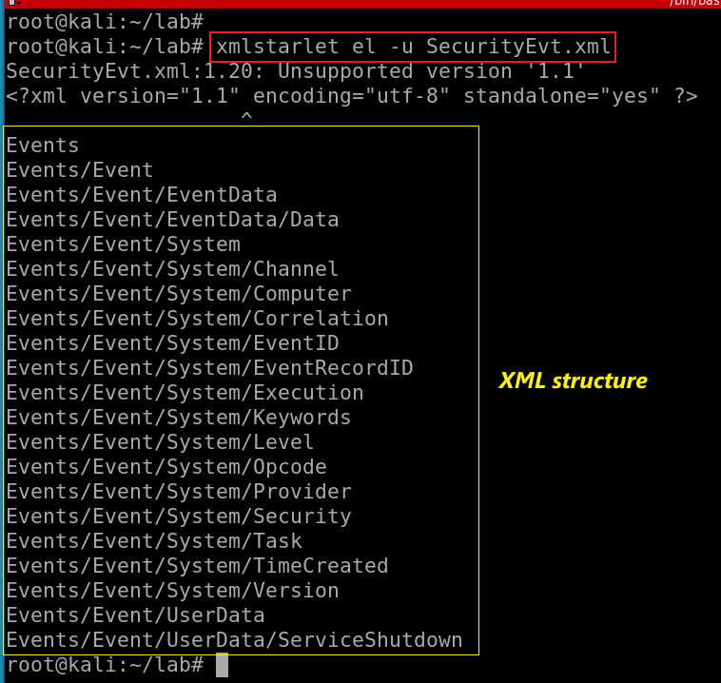
Show the element structure of SecurityEvt.xml
el: Display element structure of XML document
-u: print out sorted unique lines
Notes:
xmlstarlet el -u SecurityEvt.xml
xmlstarlet el -u SecurityEvt.xml 2>/dev/null

Slide 21
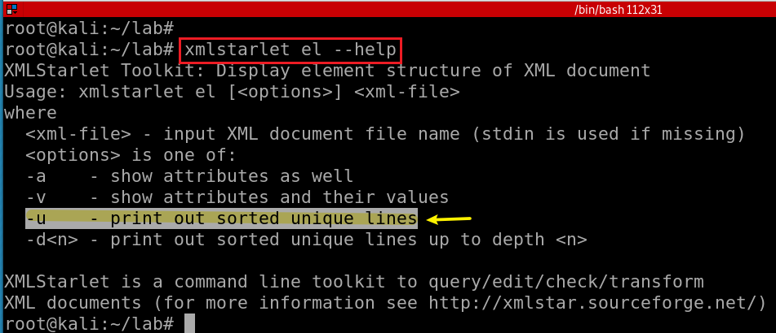
Notes:
xmlstarlet el --help

Slide 22
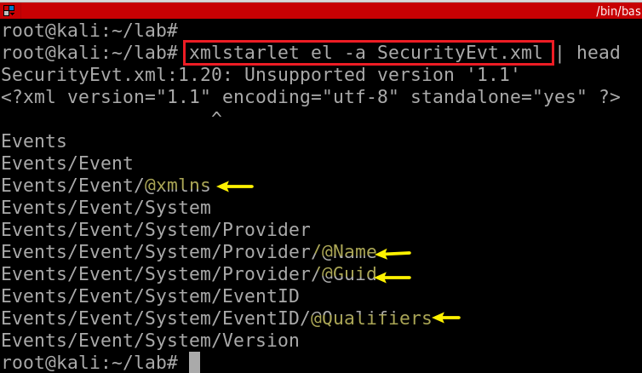
Show the element (attributes) structure of SecurityEvt.xml
-a: show attributes

Slide 23
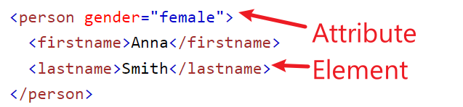
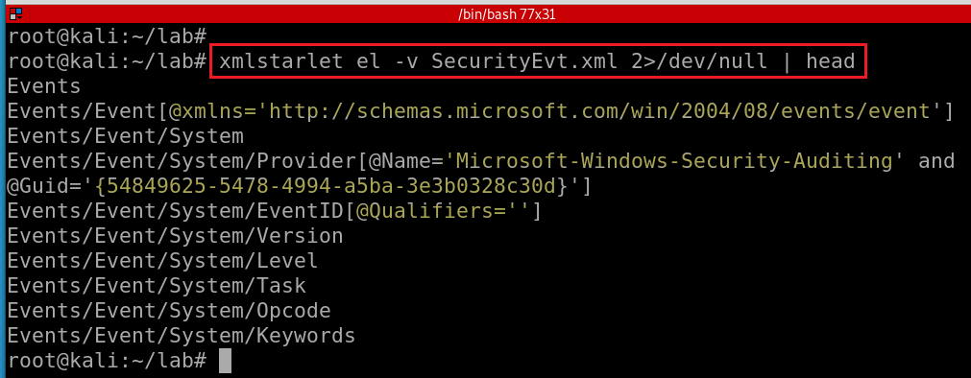
Show element attributes and their values
-v : show attributes and their values
Notes:
xmlstarlet el -v SecurityEvt.xml 2>/dev/null | head

Slide 24
format XML document

Slide 25
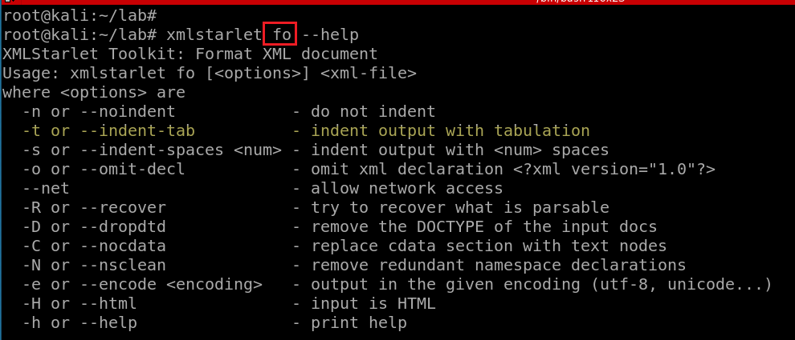

Slide 26
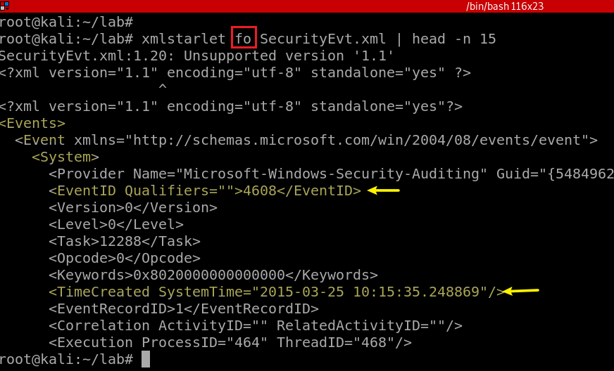
Notes:
xmlstarlet fo -n SecurityEvt.xml | head -n 15

Slide 27
select data or query XML document(s) (XPATH, etc)

Slide 28
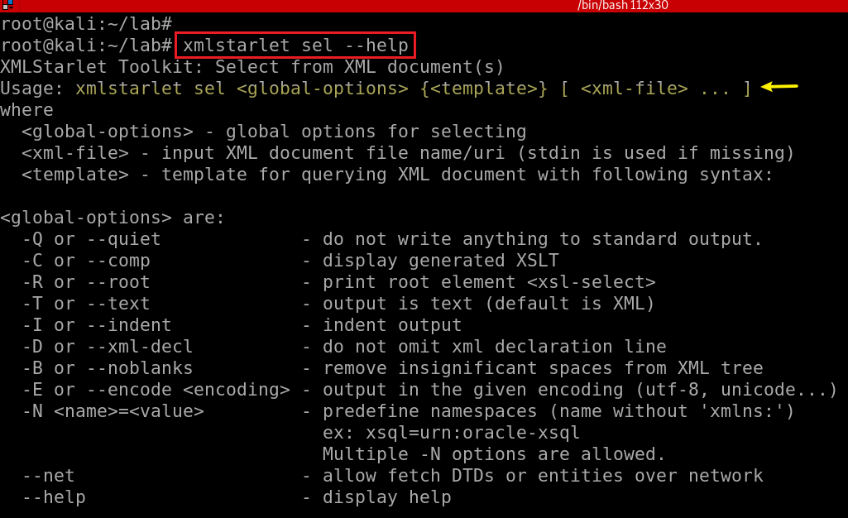

Slide 29
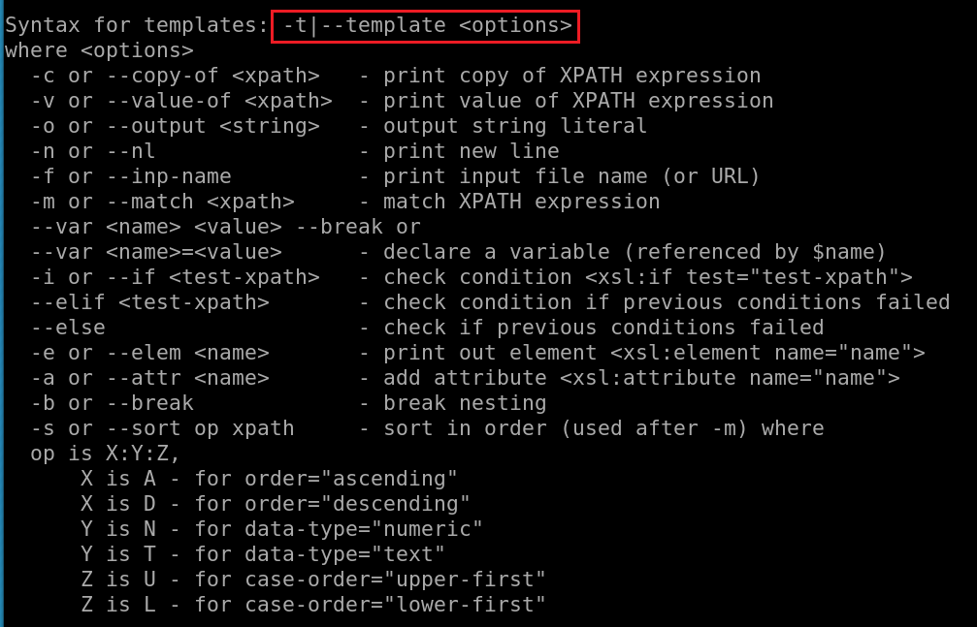
What is XPATH expression?

Slide 30
Xpath expressions
Xpath uses path expressions to select nodes or node-sets in an XML document.
Xpath expressions look very much like the expressions you see when you work with a traditional computer file system.
Must provide XML namespace for queuing data

Slide 31
Xpath expressions
“//” operator, a convenient shorthand for selecting nodes at any level in a document.
x: namespace variable, e.g., x=http://schemas.microsoft.com/win/2004/08/events/event
First Event node
//x:Event[1]
Last event
//x:Event[last()]
First two events
//x:Event[position()<3]
EventID with an attribute named Qualifiers
//x:EventID[@Qualifiers]
Notes:
https://www.marklogic.com/blog/xpath-punctuation-part-1/

Slide 32
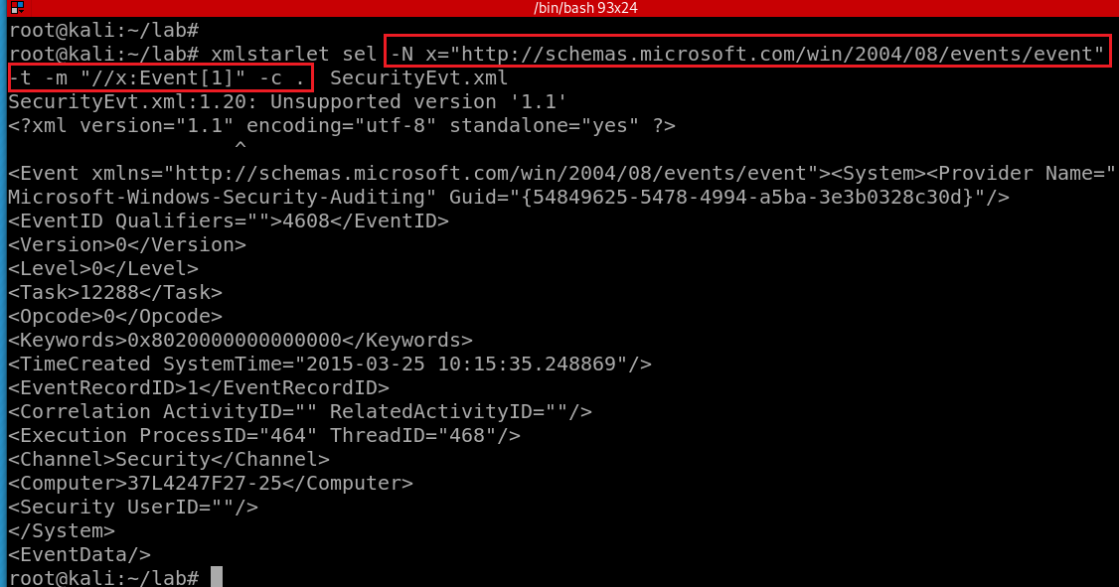
Select the first event by using template to match the xpath and print the copy of the context node
-N: namespace
x: namespace variable
The dot (“.”) : the “context item expression” because it refers to the context item.
This could be a node (such as an element, attribute, or text node), or an atomic value (such as a string, number, or boolean).
When it’s a node, it’s also called the context node.
-c or --copy-of <xpath>: print copy of XPATH expression
options
-m: match XPATH expression
-t|--template <options>
Notes:
xmlstarlet sel -N x="http://schemas.microsoft.com/win/2004/08/events/event" -t -m "//x:Event[1]" -c . SecurityEvt.xml

Slide 33
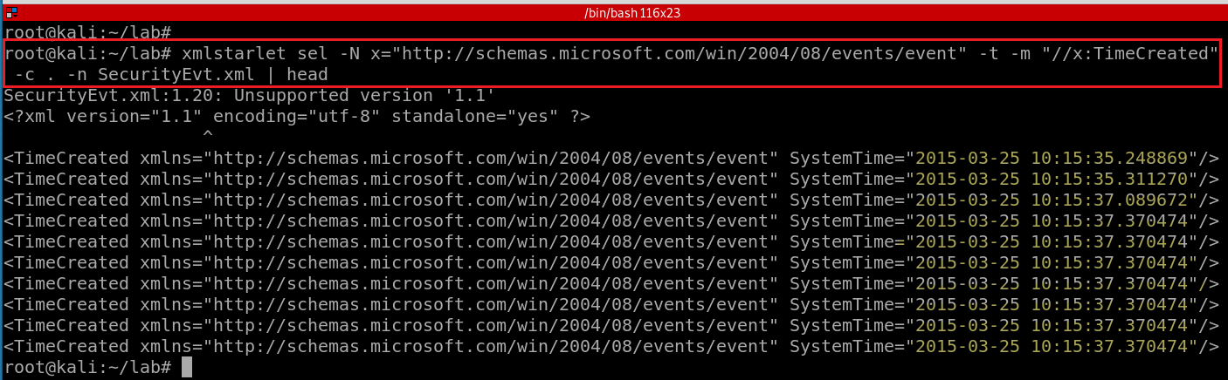
Select TimeCreated of events and print the context node
-n: print new line
Notes:
xmlstarlet sel -N x="http://schemas.microsoft.com/win/2004/08/events/event" -t -m "//x:TimeCreated" -c . -n SecurityEvt.xml
http://xmlstar.sourceforge.net/doc/UG/xmlstarlet-ug.html#idm47077139523728

Slide 34
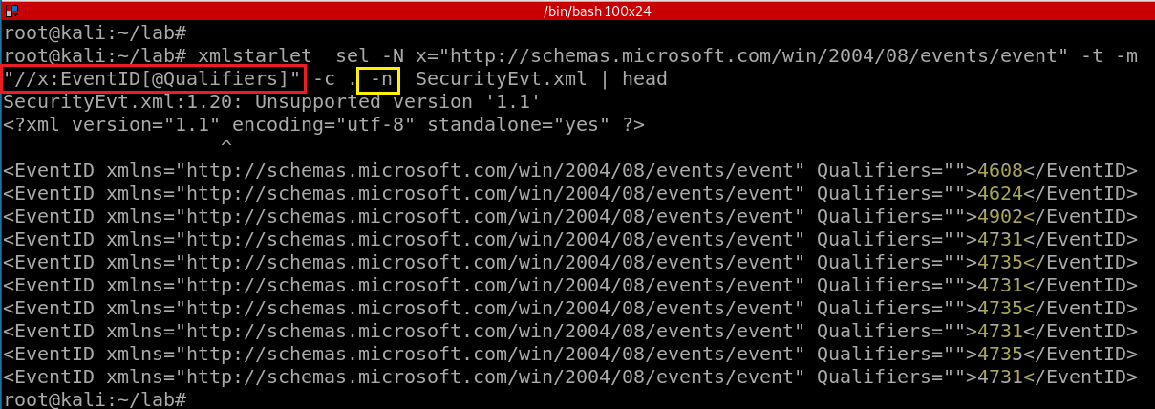
4608 (Windows is starting up)
1100 (service shutdown)
4624 (successful logon)
4634 (logoff)
4625 (logon failure)
4647 (a user initiated the logoff process)...
Select a property of EventID and print the context node
-n: print new line
Notes:
xmlstarlet sel -N x="http://schemas.microsoft.com/win/2004/08/events/event" -t -m "//x:EventID[@Qualifiers]" -c . -n SecurityEvt.xml | head

Slide 35
Substitute xmlstarlet sel results using sed
Notes:
https://www.grymoire.com/Unix/Sed.html#uh-1

Slide 36
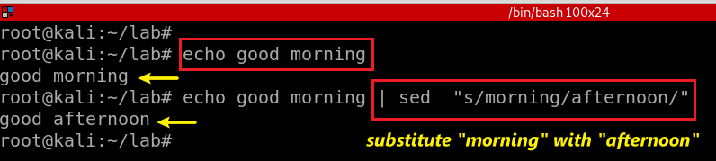
stream editor
Used to perform basic text transformations on an input stream (a file or input from a pipeline).
Can apply regular expression
Substitute morning in text stream with afternoon
Notes:
echo good morning | sed "s/morning/afternoon/"

Slide 37
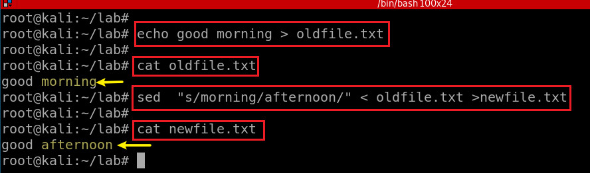
Substitute morning in text stream with afternoon

Slide 38
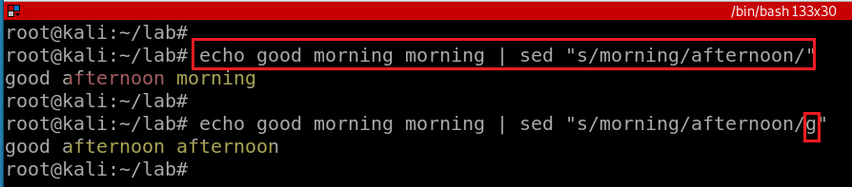
/g - Global replacement

Slide 39
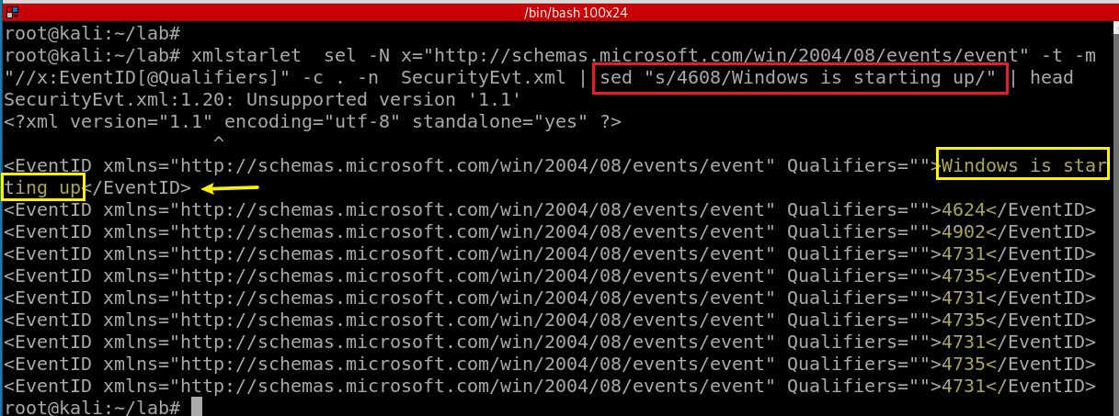
4608 (Windows is starting up)
1100 (service shutdown)
4624 (successful logon)
4634 (logoff)
4625 (logon failure)
4647 (a user initiated the logoff process)...
Notes:
https://www.grymoire.com/Unix/Sed.html
xmlstarlet sel -N x="http://schemas.microsoft.com/win/2004/08/events/event" -t -m "//x:EventID[@Qualifiers]" -c . -n SecurityEvt.xml | head

Slide 40
edit XML document(s)

Slide 41
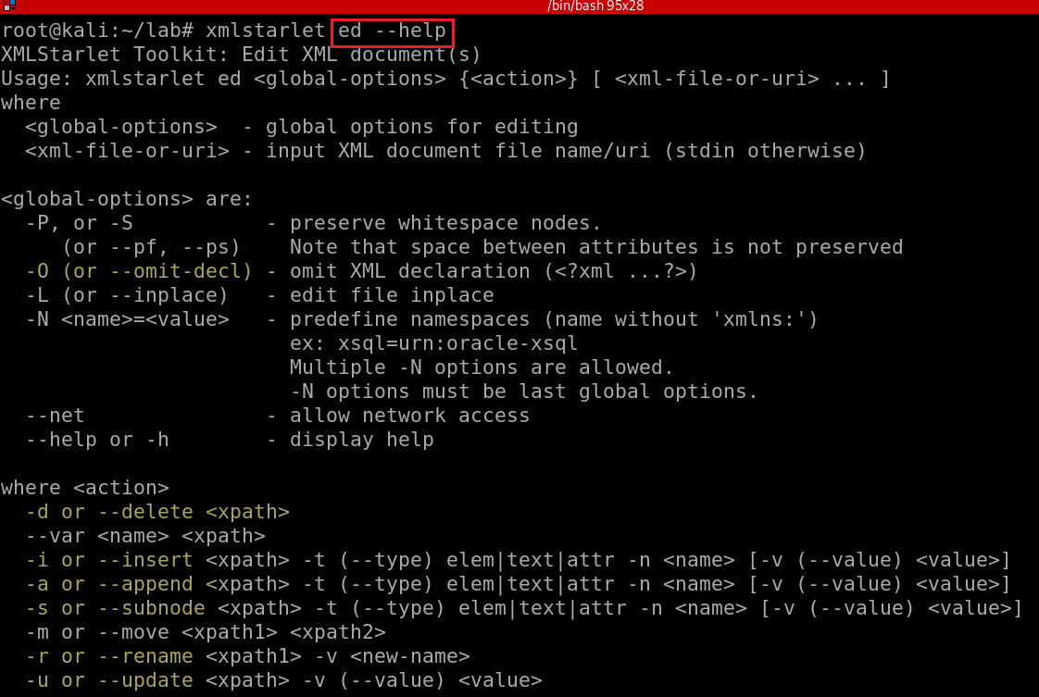
Notes:
xmlstarlet ed --help

Slide 42
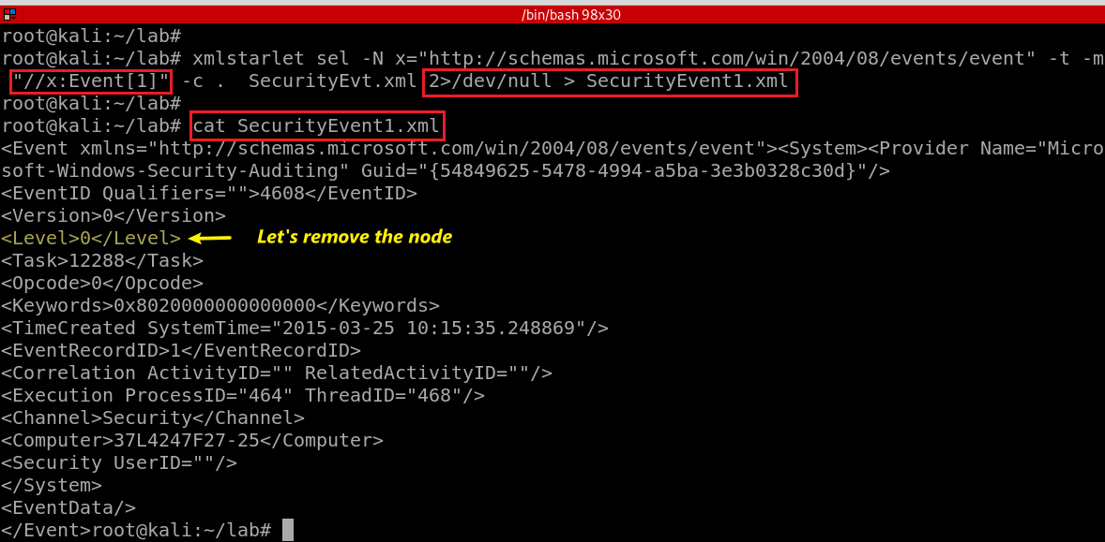
Show the first event and we will make change the event
Notes:
xmlstarlet sel -N x="http://schemas.microsoft.com/win/2004/08/events/event" -t -m "//x:Event[1]" -c . SecurityEvt.xml 2>/dev/null > SecurityEvent1.xml

Slide 43
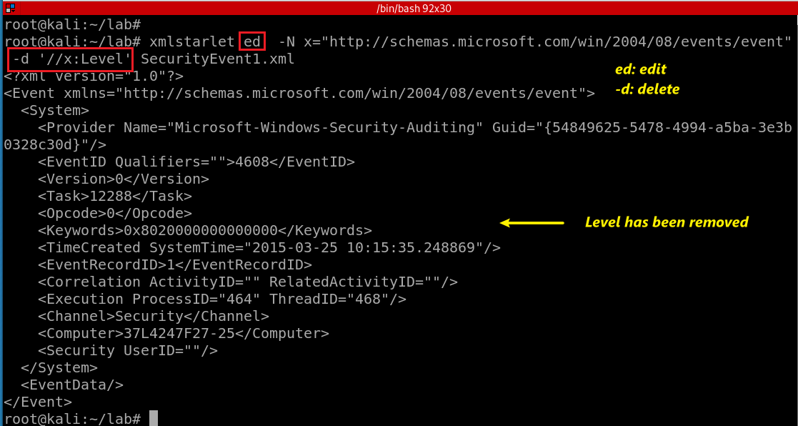
“delete/hide” the node <Level></Level>
Notes:
xmlstarlet ed -N x="http://schemas.microsoft.com/win/2004/08/events/event" -d '//x:Level' SecurityEvent1.xml

Slide 44
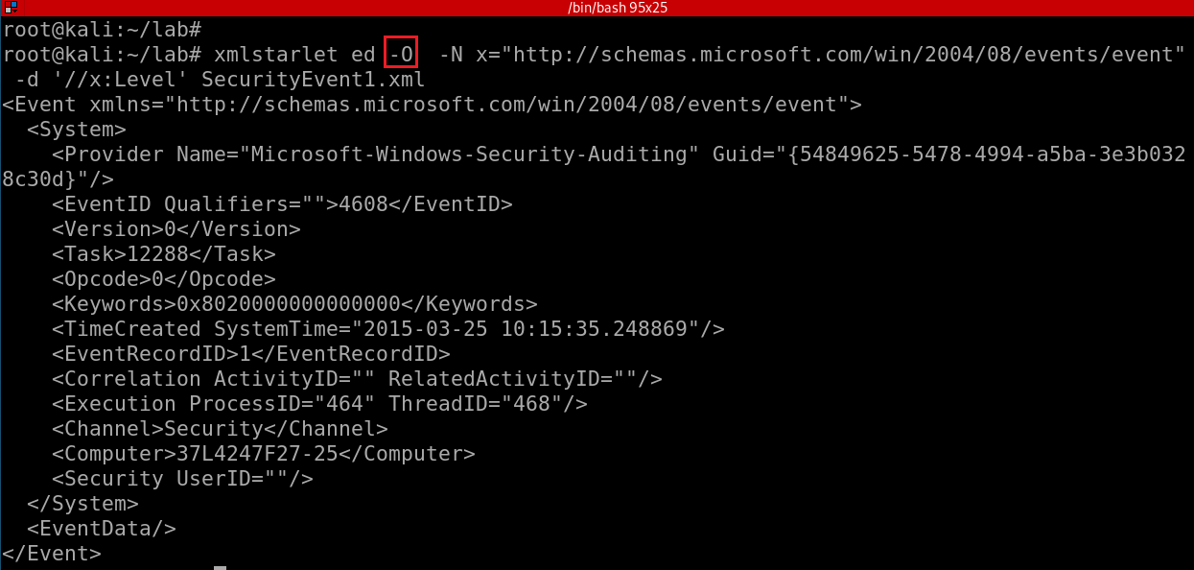
Omit XML declaration (<?xml ...?>) and “delete” the node <Level></Level>
-d: is not actually deleting the note,
only show deleted stream
How to actually delete a node?
Notes:
xmlstarlet ed -O -N x="http://schemas.microsoft.com/win/2004/08/events/event" -d '//x:Level' SecurityEvent1.xml

Slide 45
Deleting namespace declarations
Notes:
http://xmlstar.sourceforge.net/doc/UG/xmlstarlet-ug.html#idm47077139529952
xml ed -N N="http://www.c.com/xyz" -d '//N:*' ns2.xml | \ sed -e 's/ xmlns.*=".*"//g'

Slide 46
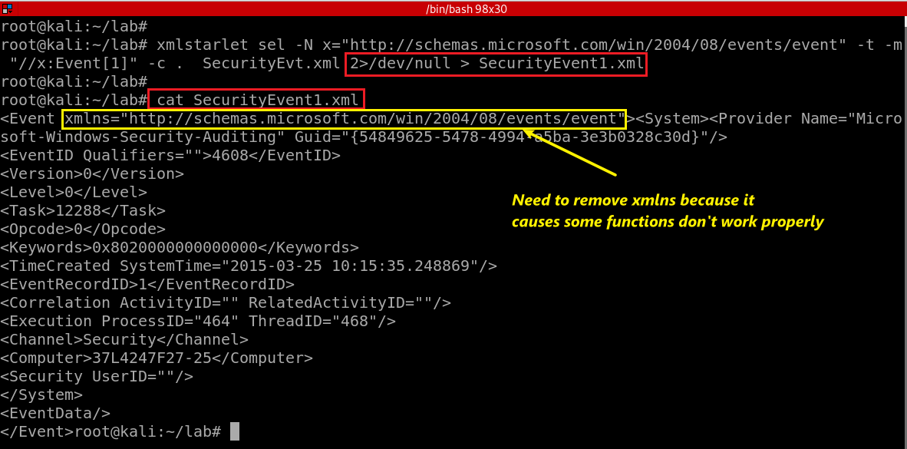
Show the first event and remove error messages
Notes:
xmlstarlet sel -N x="http://schemas.microsoft.com/win/2004/08/events/event" -t -m "//x:Event[1]" -c . SecurityEvt.xml 2>/dev/null > SecurityEvent1.xml

Slide 47
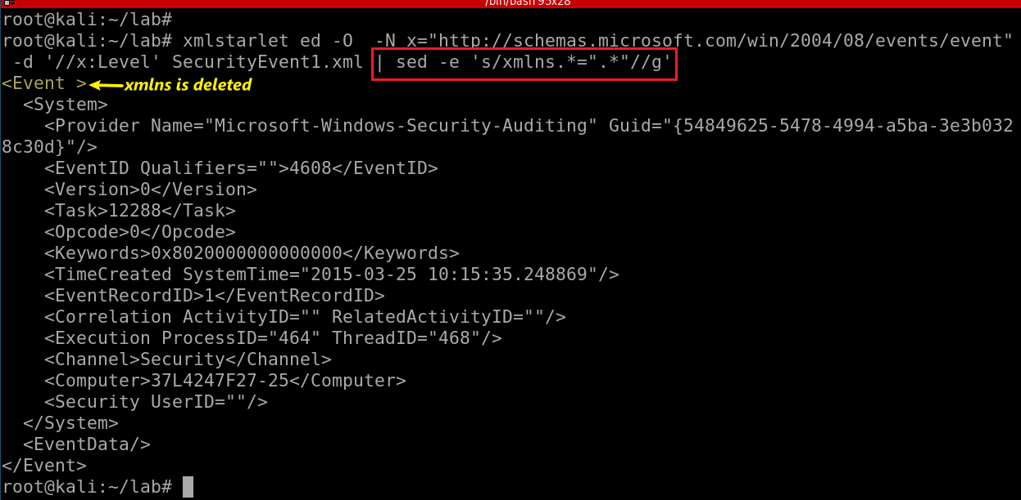
Substitute xmlns with nothing (remove xmlns)
-e: regular expression
s/e1/e2/g:
s: substitute
e1: regex
e2: regex
g: globe
Notes:
xmlstarlet ed -O -N x="http://schemas.microsoft.com/win/2004/08/events/event" -d '//x:Level' SecurityEvent1.xml | sed -e 's/xmlns.*=".*"//g'
http://xmlstar.sourceforge.net/doc/UG/xmlstarlet-ug.html#idm47077139529952

Slide 48
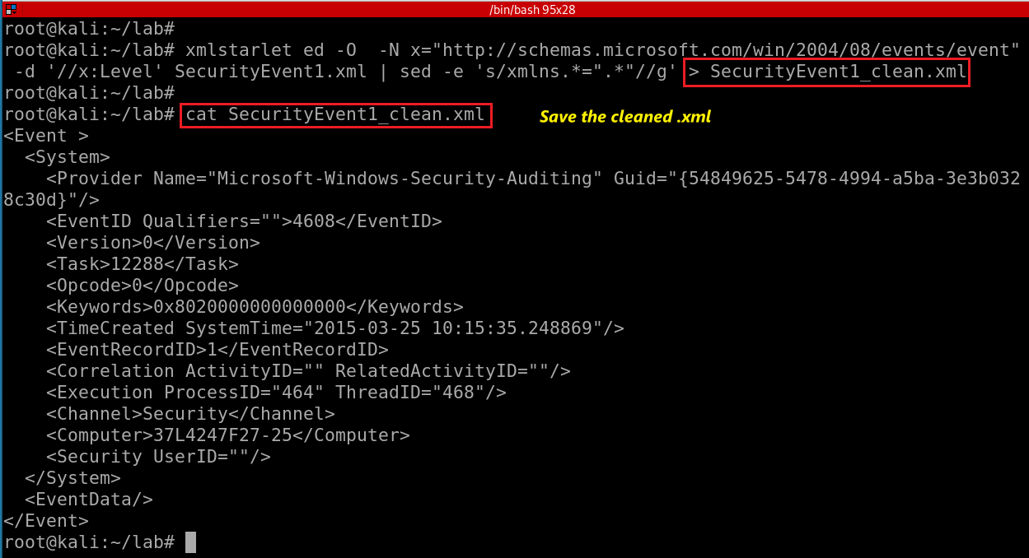
Notes:
xmlstarlet sel -N x="http://schemas.microsoft.com/win/2004/08/events/event" -t -m "//x:Event[1]" -c . SecurityEvt.xml 2>/dev/null > SecurityEvent1.xml
xmlstarlet ed -O -N x="http://schemas.microsoft.com/win/2004/08/events/event" -d '//x:Level' SecurityEvent1.xml | sed -e 's/xmlns.*=".*"//g' > SecurityEvent1_clean.xml

Slide 49
Transforming an XML Document into a CSV

Slide 50
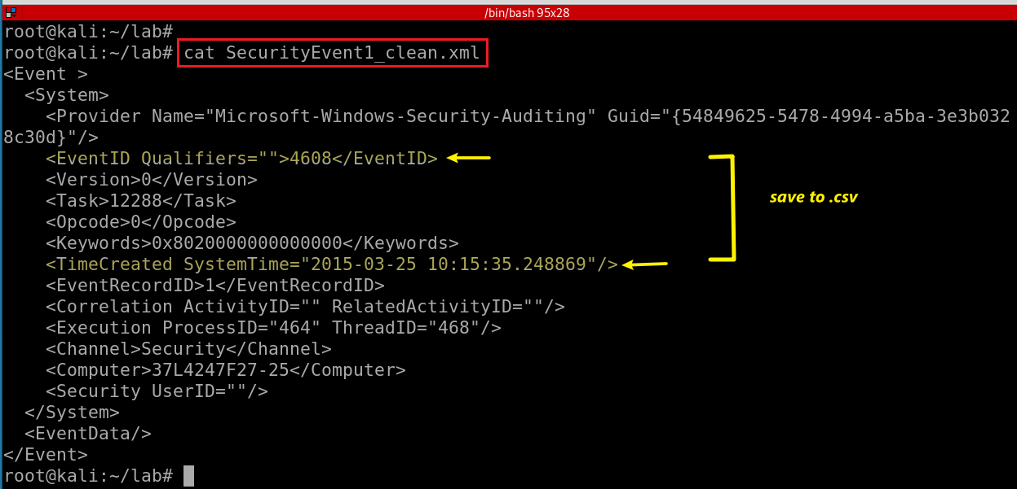
We want to save EventID and ItemCreated to .csv
UTC

Slide 51
<Event><System><Provider Name="Microsoft-Windows-Security-Auditing" Guid="{54849625-5478-4994-a5ba-3e3b0328c30d}"></Provider>
<EventID Qualifiers="">4608</EventID>
<Version>0</Version>
<Level>0</Level>
<Task>12288</Task>
<Opcode>0</Opcode>
<Keywords>0x8020000000000000</Keywords>
<TimeCreated SystemTime="2015-03-25 10:15:35.248869"></TimeCreated>
<EventRecordID>1</EventRecordID>
<Correlation ActivityID="" RelatedActivityID=""></Correlation>
<Execution ProcessID="464" ThreadID="468"></Execution>
<Channel>Security</Channel>
<Computer>37L4247F27-25</Computer>
<Security UserID=""></Security>
</System>
<EventData></EventData>
</Event>
Notes:
https://www.joyofdata.de/blog/transforming-xml-document-into-csv-using-xmlstarlet/

Slide 52
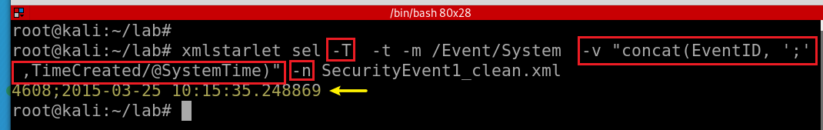
-T: output is text
-t: template
-m: template
-v: print value of xpath
-n: new line
Display EventID and ItemCreated in text
Notes:
xmlstarlet sel -T -t -m /Event/System -v "concat(EventID, ';' ,TimeCreated/@SystemTime)" -n SecurityEvent1_clean.xml

Slide 53
Assignments

Slide 54
Assignments
Repeat PPTs
Find system on/off timestamp using XMLstartlet
Substitute eventid “4634” with “logoff”

