Slide 1
Investigate Data Leakage Case
Supplementary materials for Email Forensics
Notes:
http://xmlstar.sourceforge.net/doc/UG/

Slide 2
Objectives
Email forensics with command line tools (review PPTs)
Email forensics with Python

Slide 3
Email forensics with command line tools
Review PPTs

Slide 4
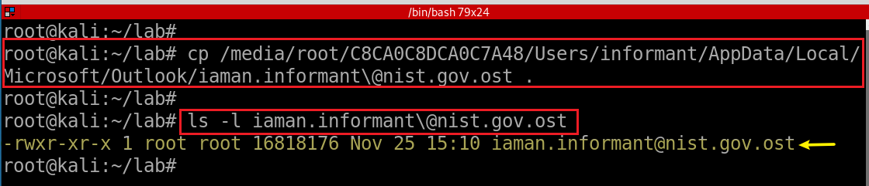
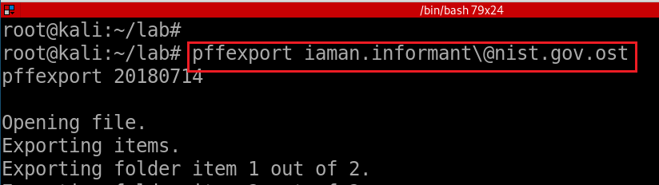
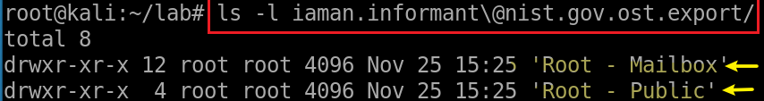
Copy email to current directory
-t: specify the basename of the target directory to export to
Extract emails via pffexport
Verify the default output directory
Notes:
losetup --partscan --find --show --read-only
cp /media/root/C8CA0C8DCA0C7A48/Users/informant/AppData/Local/Microsoft/Outlook/iaman.informant\@nist.gov.ost .
ls -l iaman.informant\@nist.gov.ost

Slide 5
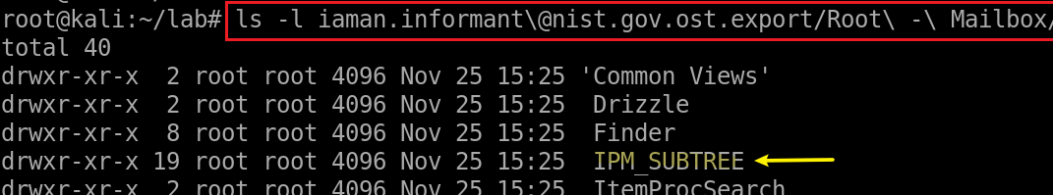
Access a message in suspect’s Mailbox
IPM_SUBTREE
Inbox
Outbox
Sent Items
Deleted Items
interpersonal message, or IPM, subtree. Created by MAPI
Messaging Application Programming Interface (MAPI) creates a tree of folders beneath the root folder of a message store for all clients that send messages to and receive messages from human, rather than computer, recipients.
Notes:
ls -l iaman.informant\@nist.gov.ost.export/Root\ -\ Mailbox/

Slide 6
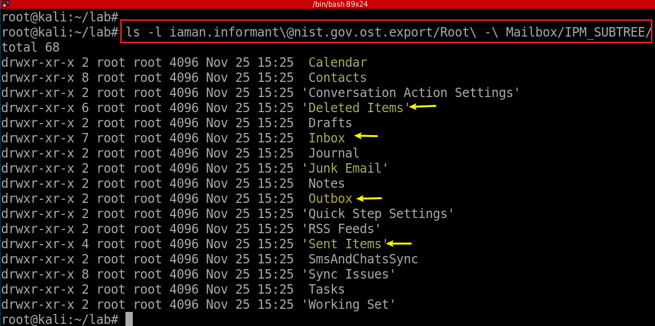
Access a message in suspect’s IPM_SUBTREE

Slide 7
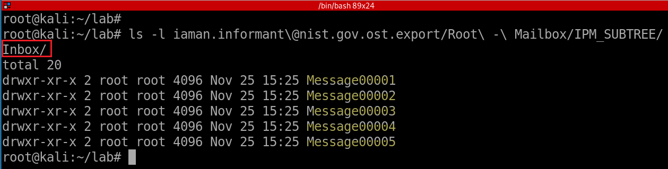
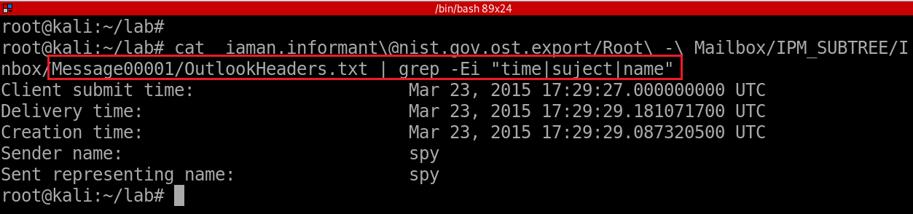
Notes:
ls -l iaman.informant\@nist.gov.ost.export/Root\ -\ Mailbox/IPM_SUBTREE/Inbox/
cat iaman.informant\@nist.gov.ost.export/Root\ -\ Mailbox/IPM_SUBTREE/Inbox/Message00001/OutlookHeaders.txt | grep -Ei "time|suject|name“
grep -E ‘strings’ Message*

Slide 8
Email forensics with Python

Slide 9
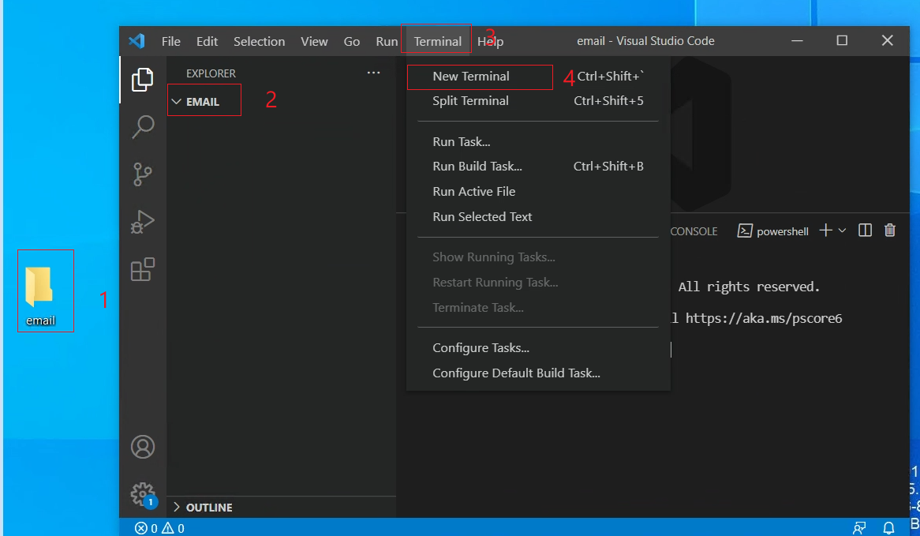
Choose a working folder in VSCode

Slide 10
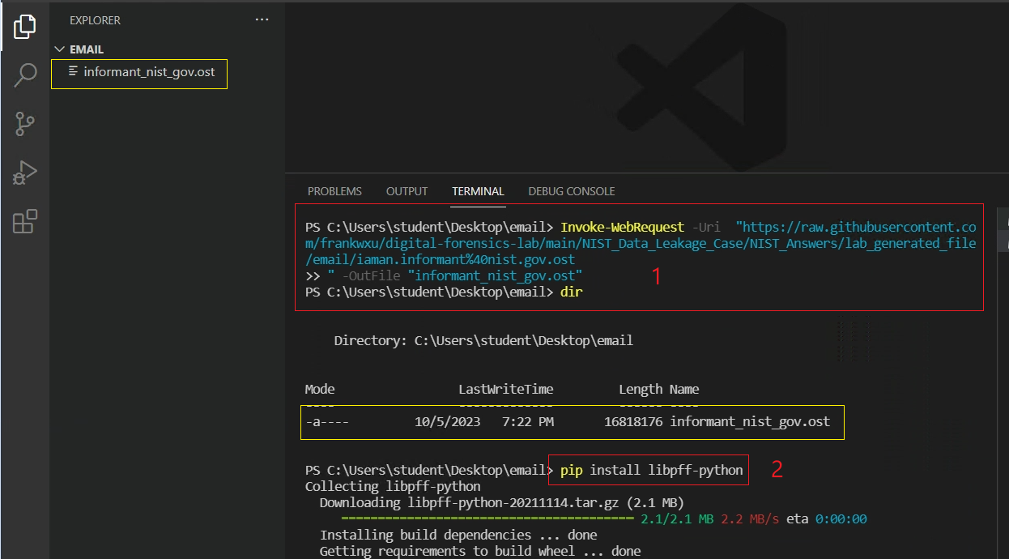

Download .ost email file and libpff-python
Notes:
Invoke-WebRequest –Uri “https://raw.githubusercontent.com/frankwxu/digital-forensics-lab/main/NIST_Data_Leakage_Case/NIST_Answers/lab_generated_file/email/iaman.informant%40nist.gov.ost
” -OutFile “informant_nist_gov.ost"
pip install libpff-python

Slide 11
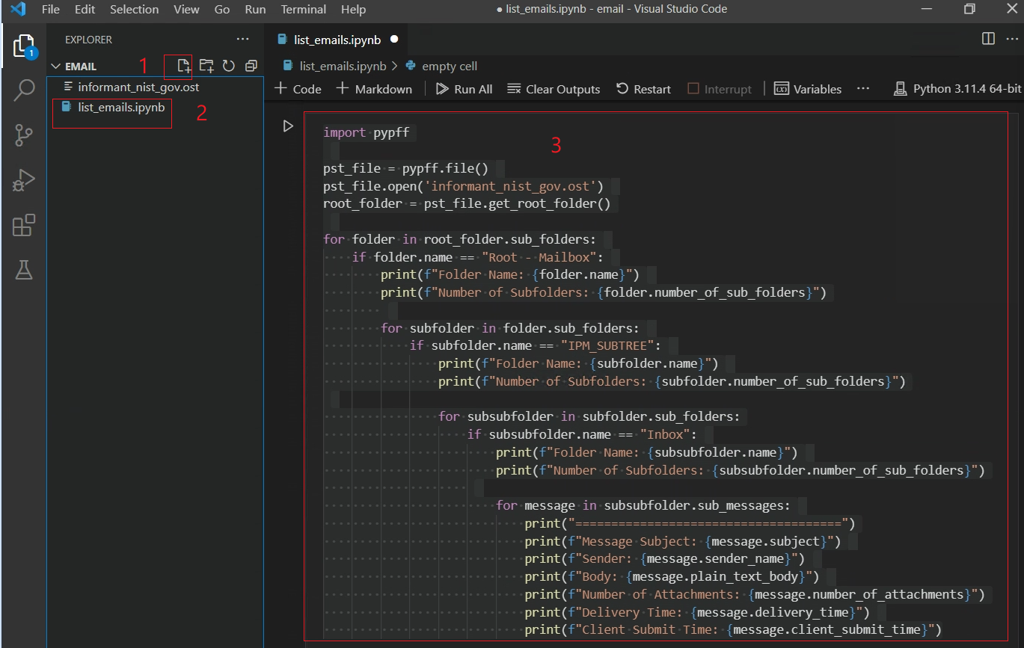
Navigating folders to Inbox:
Root-Mailbox\IPM_SUBTREE\Inbox
Notes:
import pypff
pst_file = pypff.file()
pst_file.open('informant_nist_gov.ost')
root_folder = pst_file.get_root_folder()
for folder in root_folder.sub_folders:
if folder.name == "Root - Mailbox":
print(f"Folder Name: {folder.name}")
print(f"Number of Subfolders: {folder.number_of_sub_folders}")
for subfolder in folder.sub_folders:
if subfolder.name == "IPM_SUBTREE":
print(f"Folder Name: {subfolder.name}")
print(f"Number of Subfolders: {subfolder.number_of_sub_folders}")
for subsubfolder in subfolder.sub_folders:
if subsubfolder.name == "Inbox":
print(f"Folder Name: {subsubfolder.name}")
print(f"Number of Subfolders: {subsubfolder.number_of_sub_folders}")
for message in subsubfolder.sub_messages:
print("=====================================")
print(f"Message Subject: {message.subject}")
print(f"Sender: {message.sender_name}")
print(f"Body: {message.plain_text_body}")
print(f"Number of Attachments: {message.number_of_attachments}")
print(f"Delivery Time: {message.delivery_time}")
print(f"Client Submit Time: {message.client_submit_time}")

Slide 12
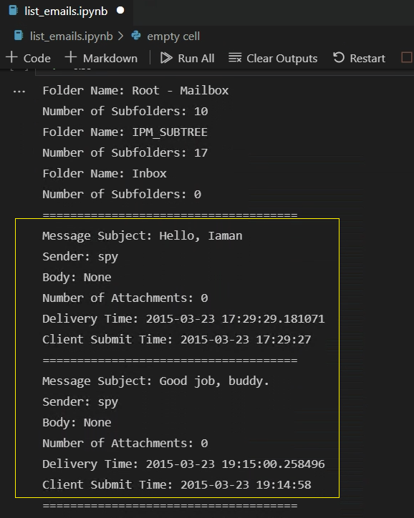
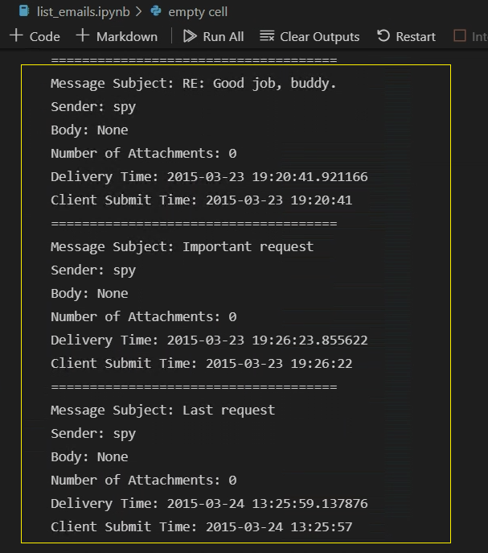
Results: 5 emails
Notes:
https://raw.githubusercontent.com/frankwxu/digital-forensics-lab/main/NIST_Data_Leakage_Case/py_version/pycode/email/list_emails.ipynb

