Slide 1
Docker for Digital Forensic Investigation

Slide 2
Problem Statement
Digital forensic Investigation uses open-source tools
Tools are used to extract and analyze evidence and artifacts from electronic devices.
Installing and maintaining open-source tools are challenging
Many tools
Each tool has different versions
Tools may rely on specific platforms and configurations
Tools may depend on other libraries

Slide 3
Goal
Build a forensic investigation environment
Basic digital forensics tools are pre-installed
The environment is cross-platform
Solution
Using Docker (lightweight VM)

Slide 4
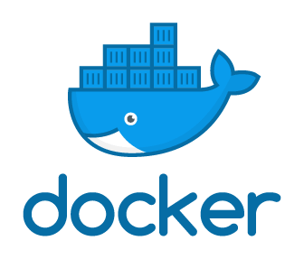
Introduction to Docker

Slide 5
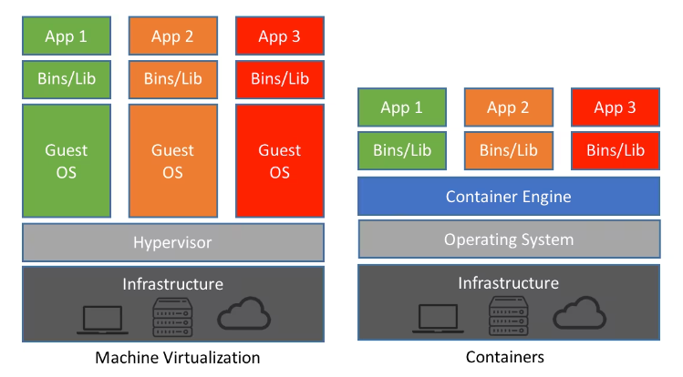
What is Docker?
Docker is a popular virtualization tool
it replicates a specific operating environment on top of a host OS.
Docker is used by development teams
to ensure consistency across different machines.
Docker is a platform
it allows you to package, distribute, and run applications and their dependencies in isolated containers.
https://www.netapp.com/blog/containers-vs-vms/

Slide 6
Leverage Docker for Digital Forensic Education
Consistent Environments
Isolation and Security
Portability
Version Control
Hands-on Experience
Quick Setup
Scalability
Notes:
Consistent Environments: Digital forensics often involves using specific tools and software. With Docker, you can create containers that include all the necessary tools, libraries, and configurations. This ensures that every student has a consistent and reproducible environment, reducing compatibility issues and saving time during setup.
Isolation and Security: Docker containers provide isolation between the host system and the containerized environment. This is crucial in digital forensics to prevent contamination of evidence or interference with the host system. Students can work with potentially malicious files or software without risking their own machines.
Portability: Docker containers can be easily shared and deployed across different platforms and operating systems. This is particularly useful for students who might be using various systems for their coursework. They can simply pull the Docker image and start working, regardless of their underlying OS.
Version Control: Docker images can be versioned, allowing you to create different images for different exercises or lessons. This helps maintain consistency over time and allows instructors to provide updates or improvements to the environment.
Hands-on Experience: Digital forensics education is best learned through hands-on experience. Docker makes it easy for students to interact with real-world tools and scenarios in a controlled environment. They can practice acquiring, analyzing, and preserving digital evidence.
Scalability: Instructors can set up a Docker-based environment that supports multiple students simultaneously. Each student can have their own instance of the container, ensuring that resource constraints don't hinder the learning experience.
Quick Setup: Setting up a digital forensic environment can sometimes be time-consuming. Docker simplifies this process by encapsulating the required software and configurations into a container. Students can start working on assignments without spending hours setting up their environment.
Exercises and Challenges: Instructors can design specific exercises and challenges that involve using various forensic tools. By providing Docker containers with pre-configured environments, students can focus on solving the problem at hand rather than dealing with technical setup.
Collaboration: Docker makes it easy to share work among students and instructors. Containers can be exported and imported, allowing students to share their work, collaborate on investigations, and learn from each other's approaches.
Resource Management: Docker provides control over resource allocation for containers. Instructors can configure resource limits to ensure fair usage among students and to prevent resource-hungry tasks from affecting other containers or the host system.

Slide 7
Key Docker concepts
Docker container
Docker Engine manages containers

Slide 8
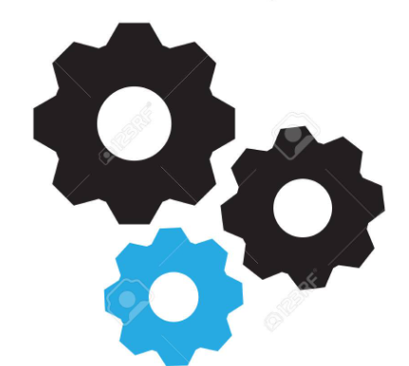
How to run a Docker container?
executable software package
a running instance of a Docker image
script file
Docker Container
Dockerfile
Docker Image
Build
Run
manages
Docker Engine

Slide 9
What is Dockerfile?
Dockerfile is a script/text file
it is a specification for creating a containerized investigation environment.
It contains a set of instructions for building a Docker image.
it contains a set of instructions for installing investigation tools.
Example?

Slide 10
What is a Docker image?
A Docker image is a lightweight, standalone, and executable software package
the package contains everything needed to run a piece of software, including the code, runtime, system tools, system libraries, and settings.
Docker image provides a consistent and isolated environment
for applications to run, making it easier to develop, deploy, and manage software across different environments.

Slide 11
What is a Docker container?
A Docker container is a running instance of a Docker image.
It encapsulates an application along with its runtime environment, system tools, libraries, and configurations.
Dynamic
Containers can be created, started, and stopped dynamically. They are well-suited for microservices architecture and rapid scaling.
Usage
Containers are where your application runs, and they are the units that you manage and interact with during runtime.

Slide 12
What is Docker engine?
The Docker Engine manages containers and their lifecycle
It is the core component of the Docker platform.
It provides a runtime environment for executing Docker containers
The Docker Engine allows users to interact with containers and images.
By providing a command-line interface (CLI) and a REST API

Slide 13
Lab

Slide 14
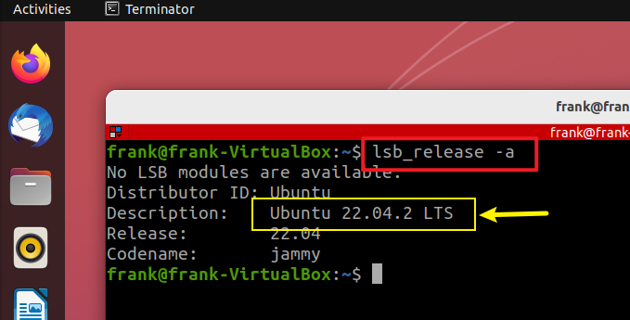
Lab environment setup (OS, Docker engine)
Install/check operating system Ubuntu 22.04 LTS
Notes:
lsb_release -a

Slide 15
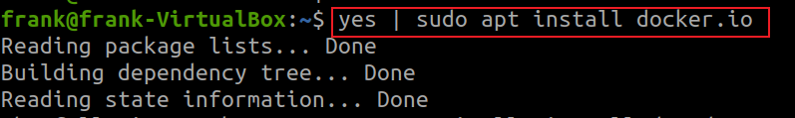

Install Docker Engine
Verify Docker Engine installation
Notes:
yes | sudo apt install docker.io
docker --version

Slide 16
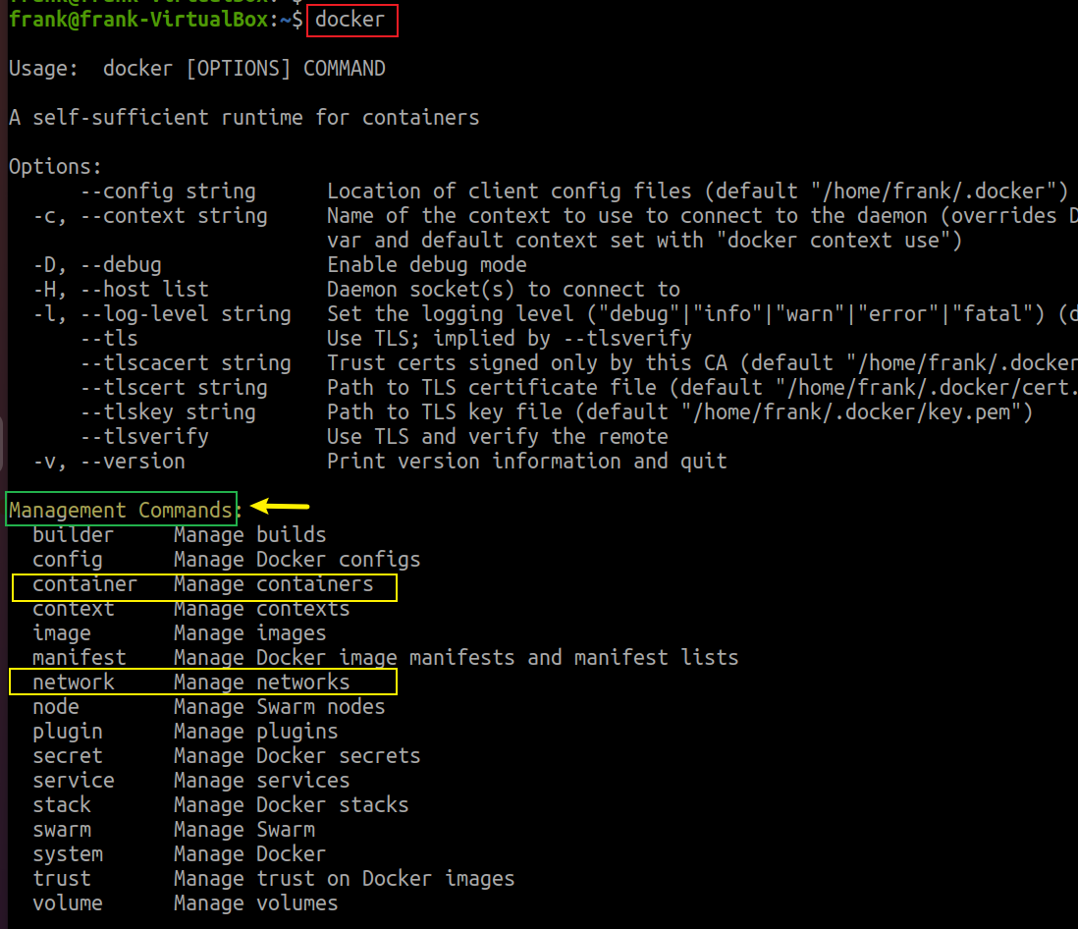
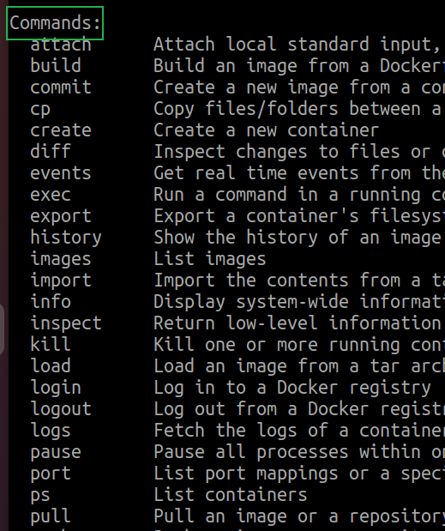
Docker engine commands overview

Slide 17
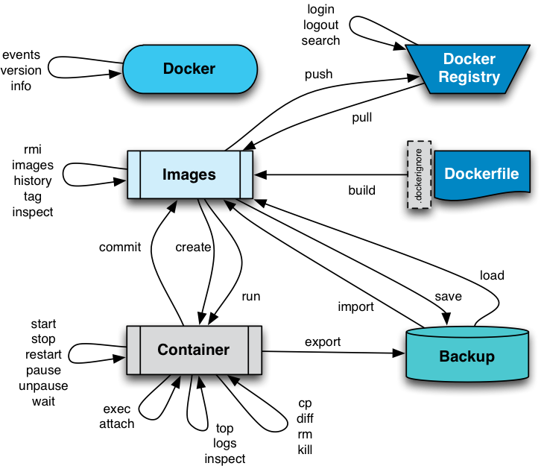



Organized Docker engine commands
We start from here
Container
Management
Notes:
https://github.com/Haufe-Lexware/docker-style-guide/blob/master/DockerImage.md

Slide 18
Create a Docker container for digital forensics
Write/Download Dockerfile
A script file with instructions for installing tools
Build Docker images
Get anything needed to run a piece of software from Dockerfile
Run a Docker container from a Docker image
Create and start an instance of a Docker image
Test tools on the container
with Tools’ help commands

Slide 19



1. Write/Download Dockerfile
Create a working folder
Change current folder to the working folder, Docker
Download (wget) a Dockerfile from GitHub repository
Verify the Dockerfile has been download to the current folder
Notes:
mkdir Docker
wget https://raw.githubusercontent.com/frankwxu/digital-forensics-lab/main/Help/scripts/docker/Dockerfile

Slide 20
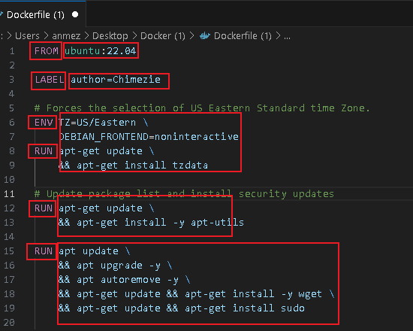
Example of a Dockerfile
We want to build a new container based on Ubuntu 22.04
Docker file commands
Linux commands will be executed on TOP of the new container

Slide 21
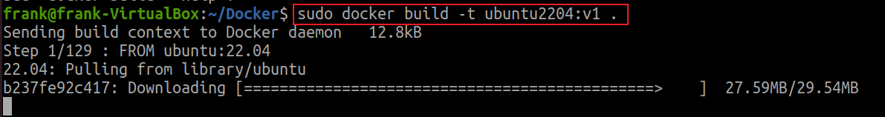
2. Build Docker images
Build a Docker image from Dockerfile
-t tag the image that will be created. A tag contains a version number, such as v1.
. a build context. the Dockerfile is expected to be located in the current directory
Notes:
sudo docker build –t ubuntu2204LTS:v1 .

Slide 22
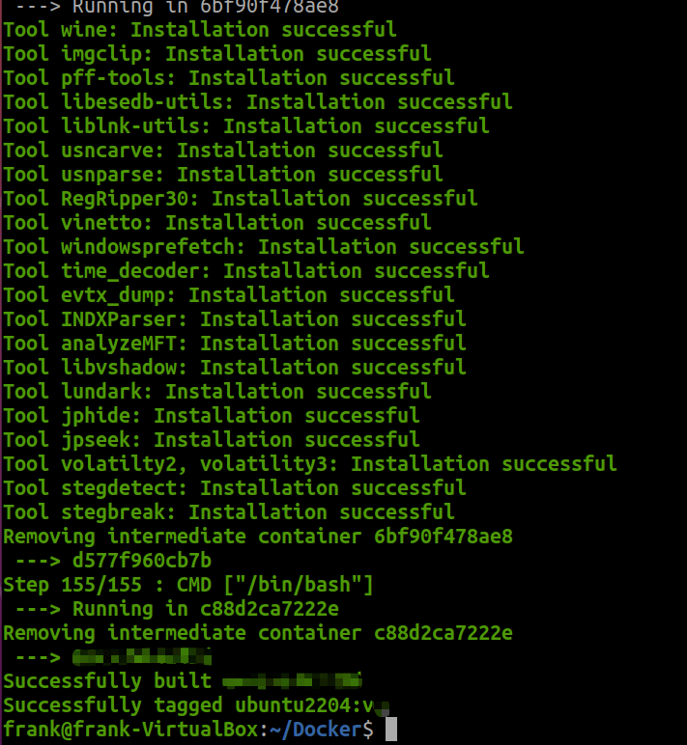
Successful installation message

Slide 23
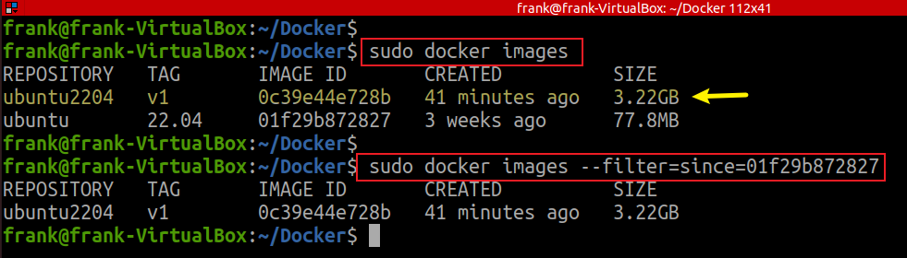


List all images and check image dependency
Base Image
0c39e44e728b
depends on
01f29b872827
Notes:
sudo docker images
sudo docker images --filter=since=01f29b872827
ubuntu2204 v1 0c39e44e728b 41 minutes ago 3.22GB
ubuntu 22.04 01f29b872827 3 weeks ago 77.8MB

Slide 24
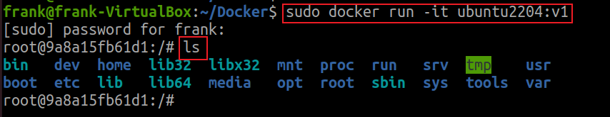
3. Run (create and start) a Docker container
List all images and check image dependency
-i or --interactive: keeps STDIN (standard input) open even if not attached, allowing you to interact with the container.
-t or --tty: allocates a pseudo-TTY (terminal) for the container, which enables you to interact with the container using a shell.
-it: opens an interactive session with the container.
Notes:
sudo docker run -it ubuntu2204:v1

Slide 25
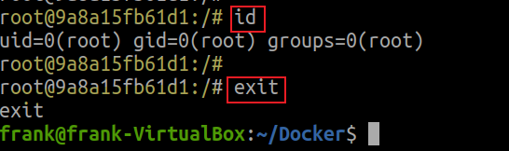
execute Linux command in a container
exit from the container
list all containers, including both running and stopped ones
Container ID: A unique identifier for each container.
Image: The image used to create the container.
Command: The command that was executed when the container was started.
Created: The timestamp indicating when the container was created.
Status: The current status of the container (e.g., running, exited).
Ports: Information about port mapping between the container and the host.
Names: A user-assigned name for the container.
it was stopped
Notes:
sudo docker ps -a

Slide 26
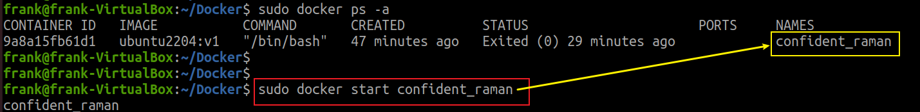
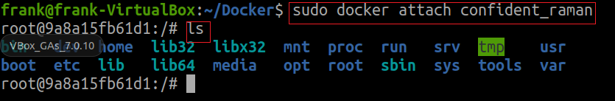
Start a container using its name
List containers
Attach terminal
attach: attach your terminal's standard input, output, and error (stdin, stdout, stderr) streams to an already running container. This allows you to interact with the container as if you were directly connected to its terminal.

Slide 27
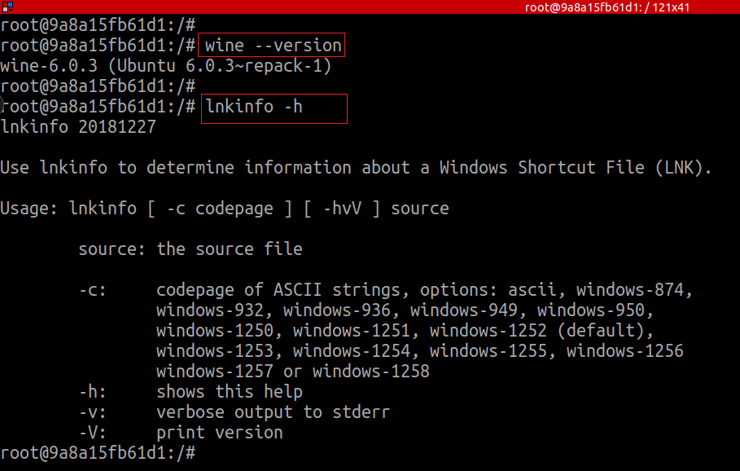
4. Test tools on the container

Slide 28
Table Showing the Help Commands Results (part1)
Tools | Help Commands | Results
wine64, win32 | wine --version | Success
pff-tools | pffexport -h | Success
libesedb-utils | esedbexport -h | Success
liblnk-utils | lnkinfo -h | Success
usncarve | usncarve.py -h | Success
usnparser | usn.py -h | Success
RegRipper30 | rip.pl -h | Success
Vinetto for Thumbcache | vinetto -h | Success
time_decode | time_decode.py -h | Success
windowsprefetch | prefetch.py -h | Success
evtx_dump | evtx_dump.py -h | Success
INDXParse | INDXParse.py -h | Success

Slide 29
Table Showing the Help Commands Results (part2)
Tools | Help Commands | Results
analyzeMFT | analyzeMFT.py -h | Success
imgclip | imgclip -h | Success
libvshadow-alpha-20210425 | vshadowinfo -h | Success
undark | undark -h | Success
stegdetect | stegdetect –V, stegbreak -V | Success
stego-toolkit | jpseek, jphide | Success
volatility-2, volatility3 | vol.py -h | Success

Slide 30
Summary
Docker
A platform for developing, shipping, and running applications in containers.
Advantages for digital investigation
Consistency: Develop in the same environment as production.
Portability: Run anywhere with the same behavior.
Efficiency: Share resources without virtualization overhead.
Components
Images: Templates for containers, containing app code and dependencies.
Containers: Instances of images, isolated and runnable.
Docker Engine: Software managing images and containers

Slide 31
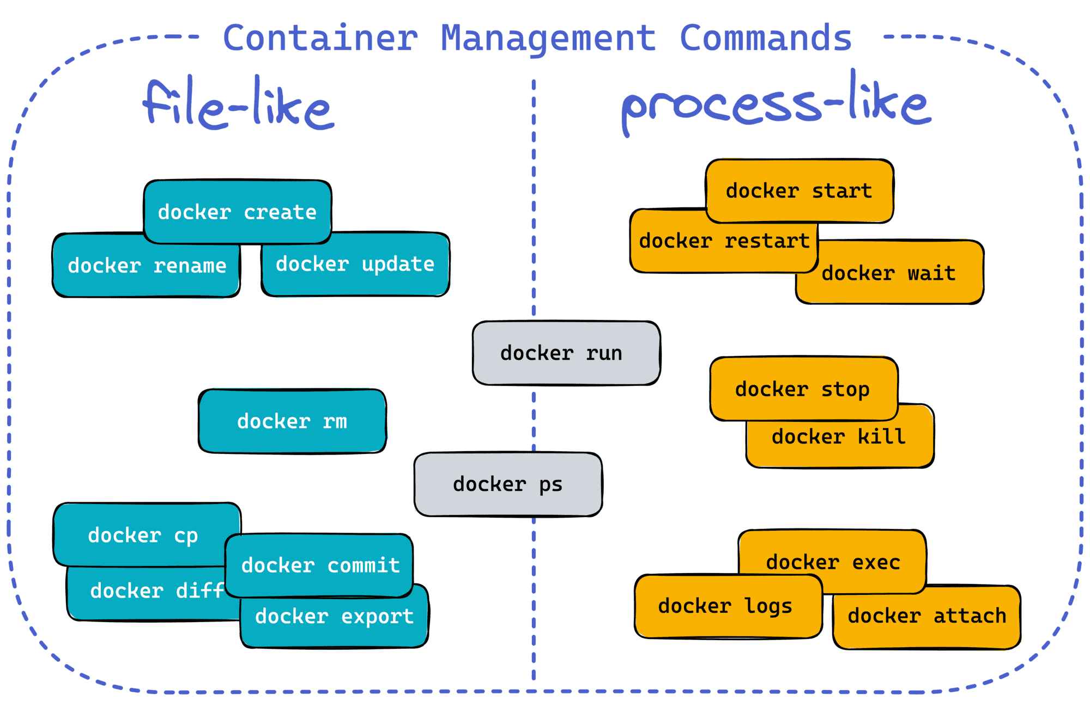
The Docker engine views containers as Linux files and process
Notes:
https://iximiuz.com/en/posts/containers-101-container-mgmt-commands/

