Slide 1
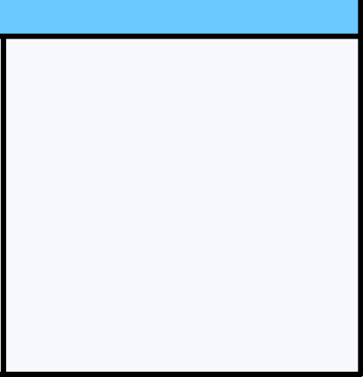

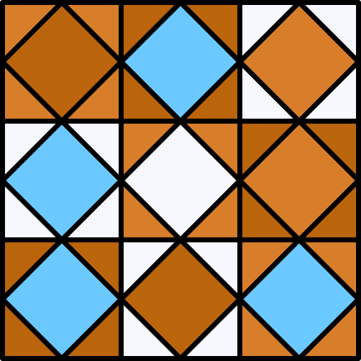
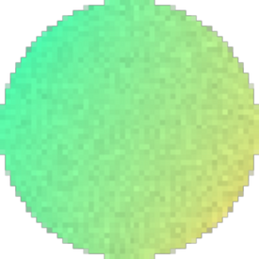
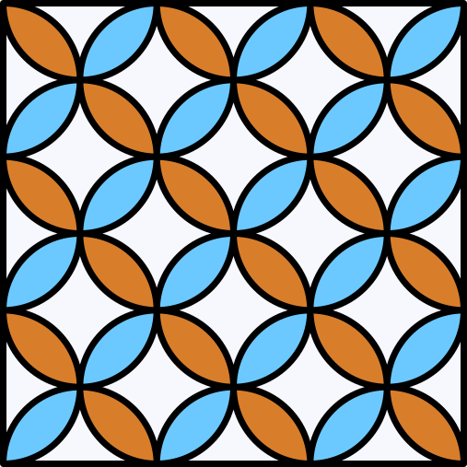
4
CONNECT
Members:
Albino, Warren I.
Mirabueno, Lanz Manuel A. III
Peñaflor, Jose Manuel G.
Zarate, John Leenard B.
SUBMITTED TO:
Mr. Regie C. Ellana, DIT*, MIT

Slide 2
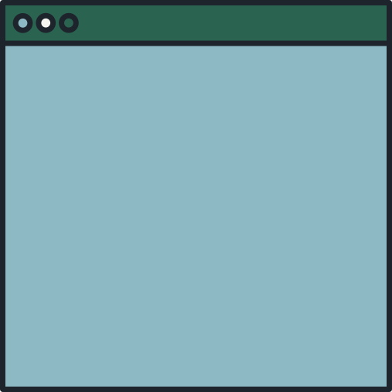
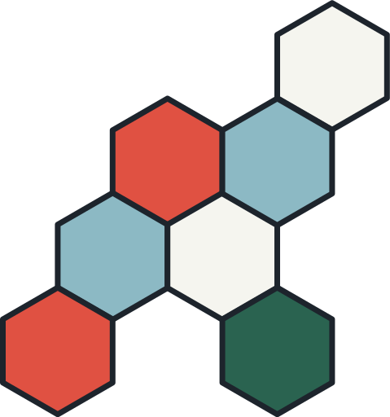

OUTLINE
INTRODUCTION
AIM OF THE PROJECT
FLOWCHART
HOW TO PLAY
RULES
FUNCTIONS USED
SOURCE CODE

Slide 3



INTRODUCTION
The name of the project is Connect 4, a two-player 2D board game, in which the players take turns dropping colored tokens into a seven-column, six-row vertically suspended grid. Written in C++ using Dev-C++ IDE with the help of Borland Graphics Interface (BGI).

Slide 4

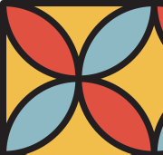
AIM OF THE PROJECT
The project was aimed at making the students familiar with the use of programming language in a practical manner using a graphics library. We used Borland Graphics Interface (also known as BGI) for graphics to create a game and use our understanding of programming concepts.

Slide 5

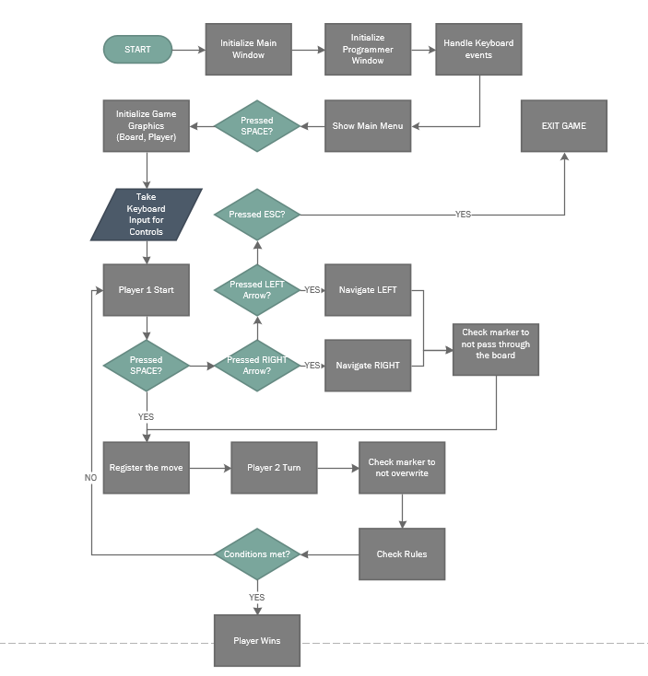


FLOWCHART

Slide 6
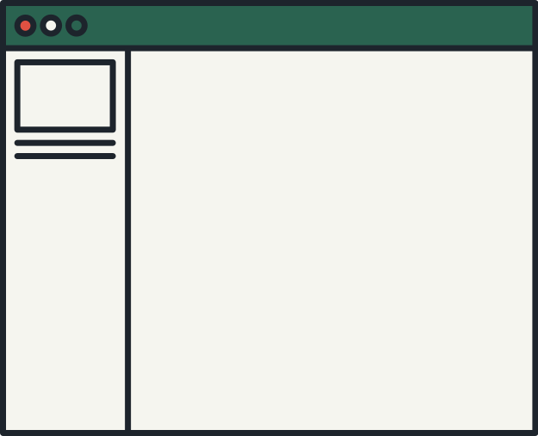




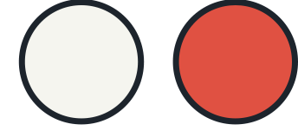
HOW TO PLAY
CONTROLS:
LEFT ARROW KEY - TO MOVE LEFT
RIGHT ARROW KEY - TO MOVE RIGHT
SPACEBAR - TO DRAW MOVE
ESC - TO EXIT GAME

Slide 7
RULES:
The first to get four of their pieces in a straight line wins. A line can be horizontal, vertical or diagonal.

Slide 8
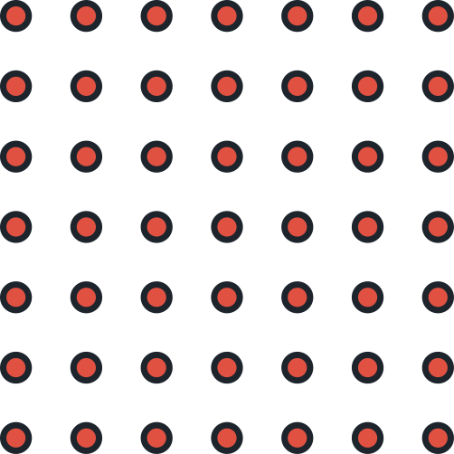
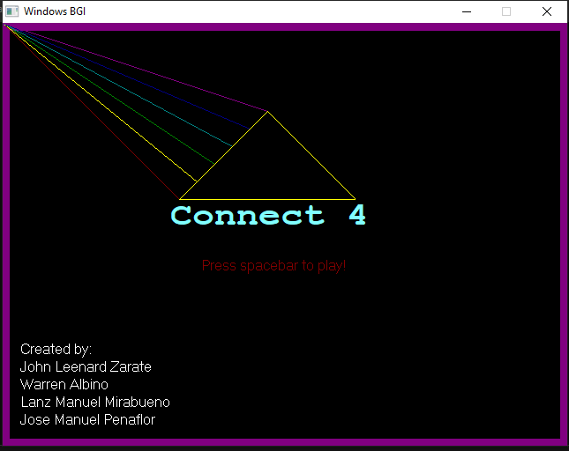

MAIN MENU
The Main Menu contains the title of the game and its creators.

Slide 9
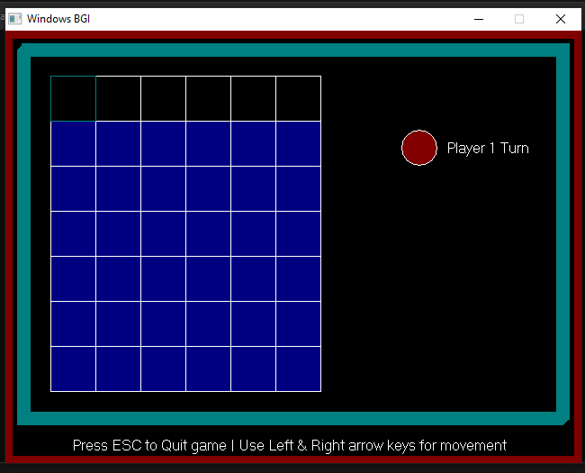
BOARD
This is where the game takes place

Slide 10
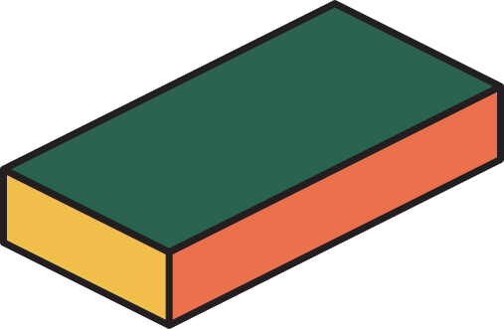
FUNCTIONS USED
initgraph(&gd, &gm, "");
circle();
To initialize the program to enable graphic mode.
x,y is the center of the circle. r is the radius to determine the size of the circle.
setcolor();
floodfill();
To change text color
To fill the enclosed area of the drawing.
settextstyle();
setfillstyle();
To change characteristics of text
To set the fill pattern and color.
outtextxy();
bar();
To display a text string in x,y coordinate.
similar to a rectangle function. It provides shading inside the rectangle.
line();
To draw a line in x,y coordinate.
rectangle();
To draw a rectangle in x,y coordinate.

Slide 11
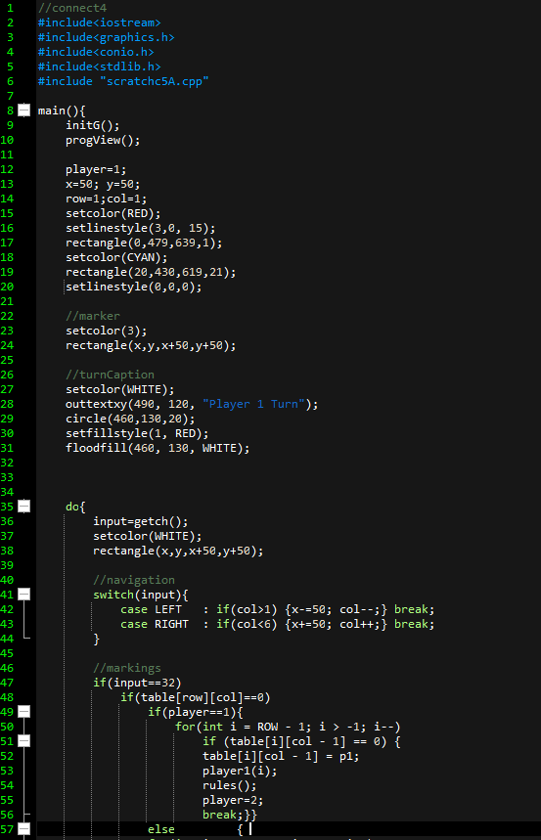
SOURCE CODE

Slide 12
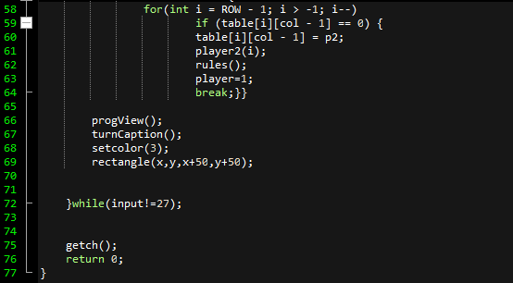
SOURCE CODE

Slide 13
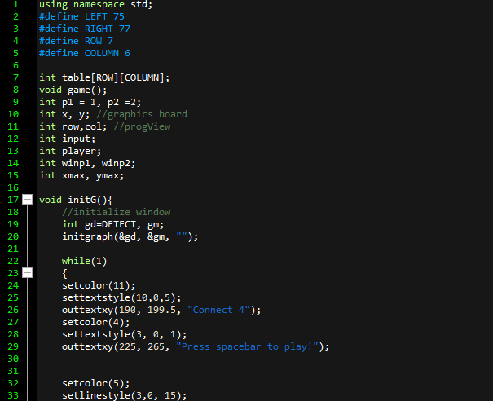
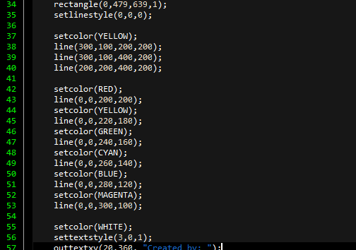
SOURCE CODE

Slide 14
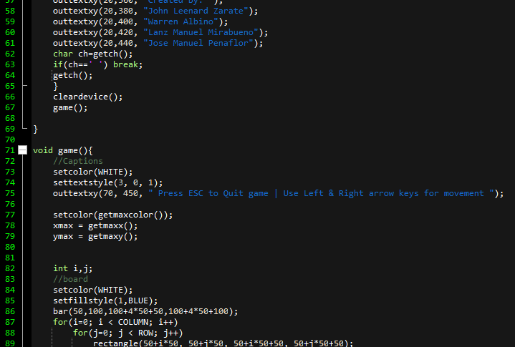
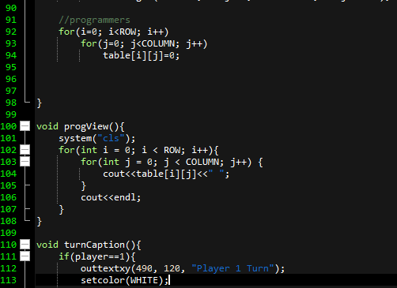
SOURCE CODE

Slide 15
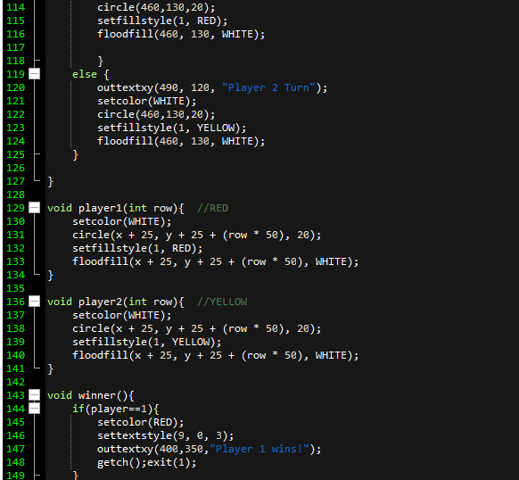
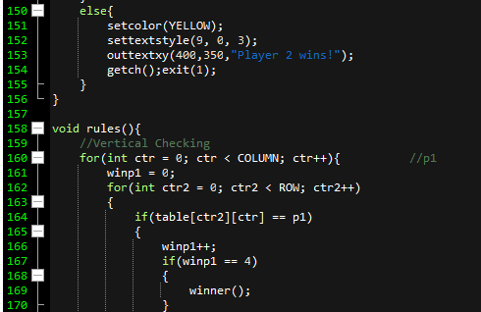
SOURCE CODE

Slide 16
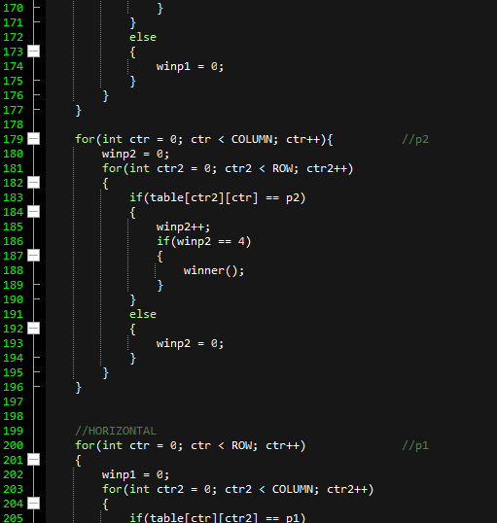
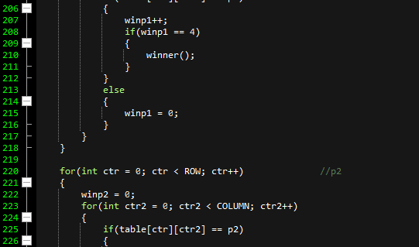
SOURCE CODE

Slide 17
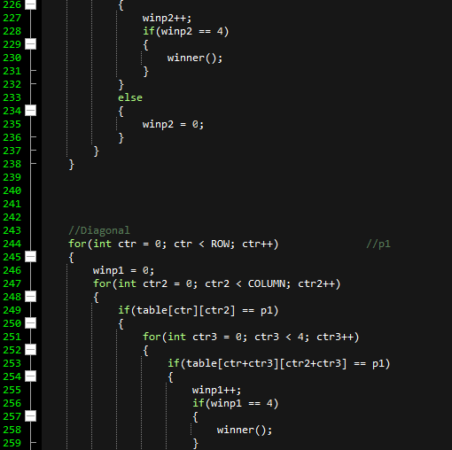
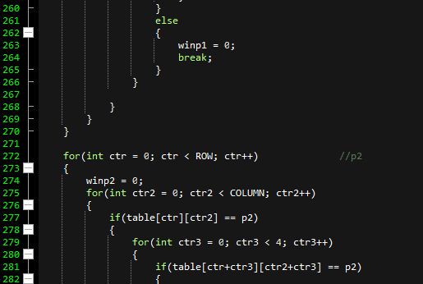
SOURCE CODE

Slide 18
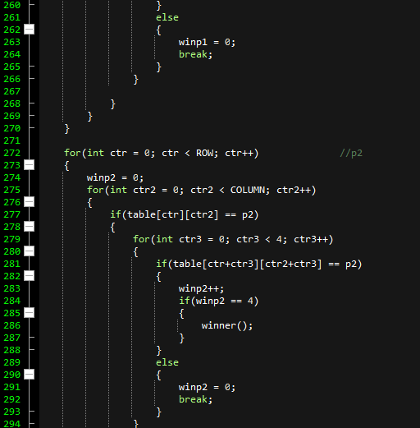
SOURCE CODE

Slide 19
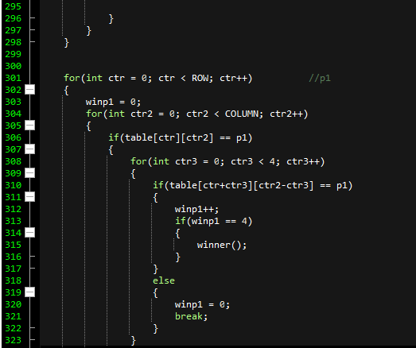
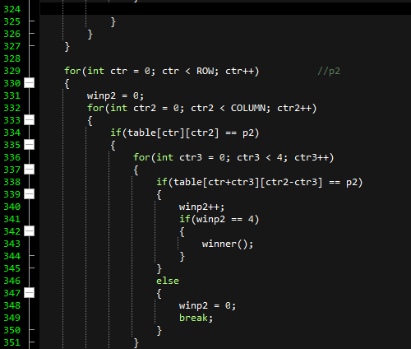
SOURCE CODE

Slide 20
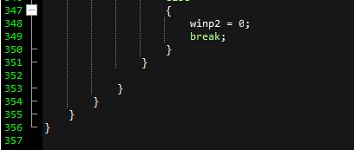
SOURCE CODE

Slide 21
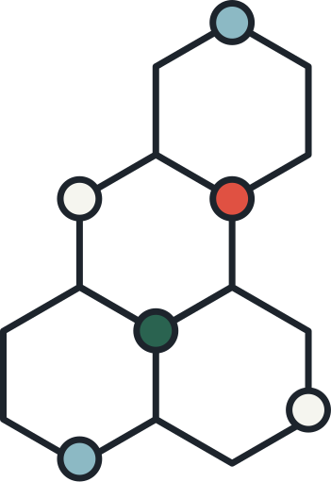

CONCLUSION
The project was a good way to encourage young students to develop their skills and make something useful with their knowledge. This project is a perfect example of all the exceptional things that can be done with some basic C++ programming. We encounter many challenges in creating this project as we spend a long time on our initial project (maze). Lastly, we thank our professor, Mr. Regie C. Ellana, DIT*, MIT for assisting us.

Slide 22
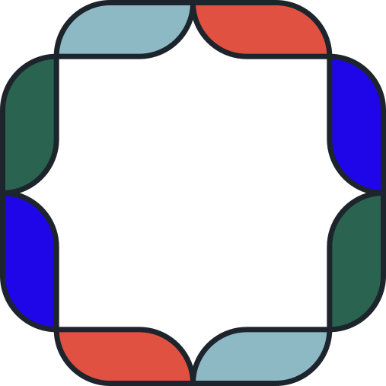
THANK YOU!

