Slide 1

Budget Text Analysis
- Datatopian Visionaries
Akash Meghani,
Miguel Gaspar Utrera,
Naseeb Thapaliya,
Sultan Al Bogami,
Unnati Khivasara
Mentors: Dr. Soumya Mohanty
Jason Jones (Guilford County)

Slide 2
Overview of the Project
Budget text Analysis for counties and cities:
Guilford County
Wake County
Mecklenburg County
Durham County
City of Charlotte
City of Durham
City of Raleigh

Slide 3
Goals
Understand the data
Data Cleaning/Pre-processing
Topic Modelling of the textual data
Emotion and Sentiment Analysis of the budget texts to draw up public’s emotional engagement.
Next work recommender for the texts in budget.

Slide 4
Team Structure
All the individuals will work on preparing data i.e. Perform Data cleaning and Data preprocessing.
Team will be divided into 2 groups to perform different tasks:
Team 1: Topic Modelling Members: 1. Naseeb Thapaliya 2. Miguel Gasper Utrera 3. Sultan Al Bogami
Team 2: Emotion and Sentiment Analysis Members: 1. Akash Meghani 2. Unnati Khivasara

Slide 5
Data Overview
Primarily, 7 pdf files ranging from 400-500 pages long for each.
Each pdf is converted to csv files by extracting all the relevant budget texts(words) from the pdf file.
So, there are total of 638131 total words extracted from the budget files.

Slide 6
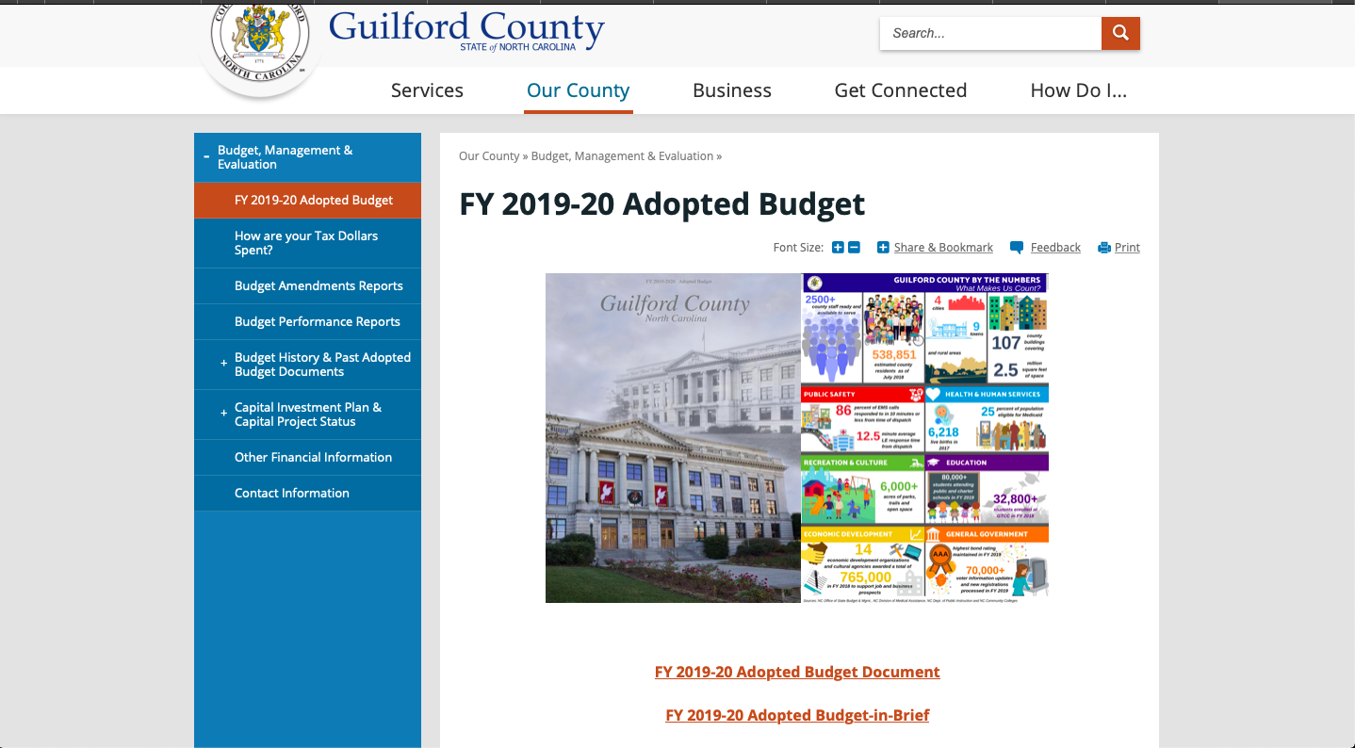
Data Source

Slide 7
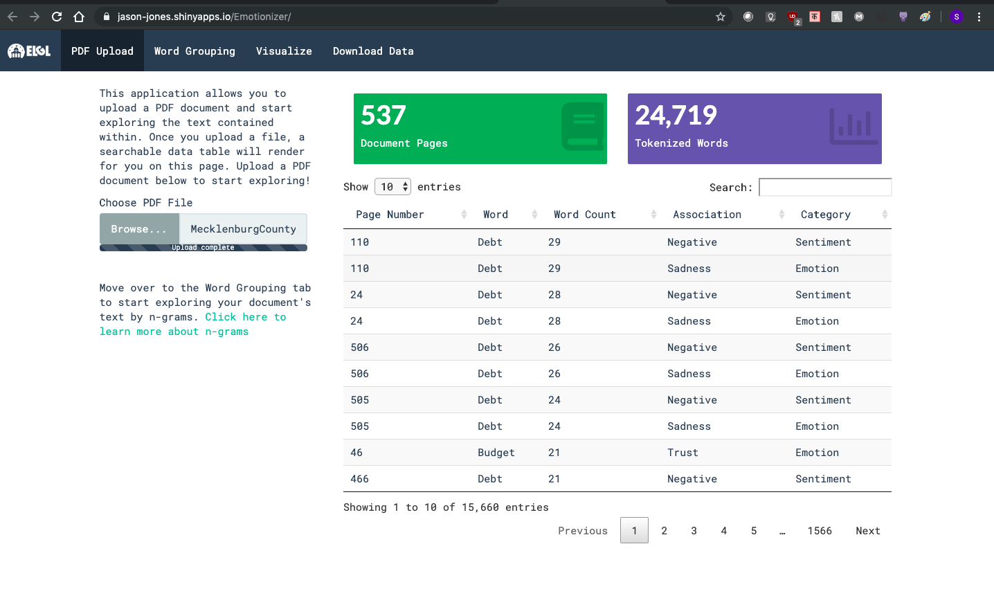
Data Conversion

Slide 8
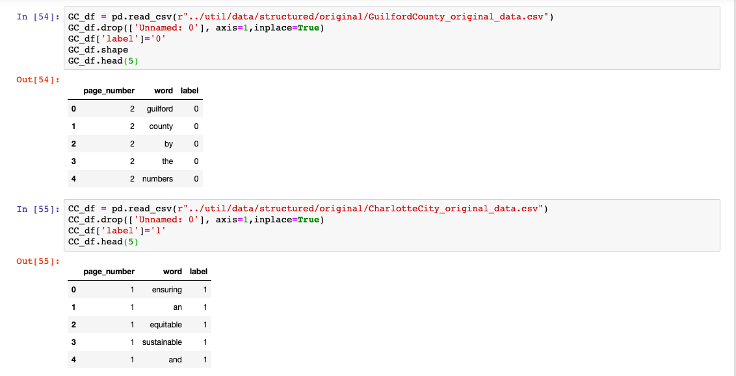
Data Transformation

Slide 9
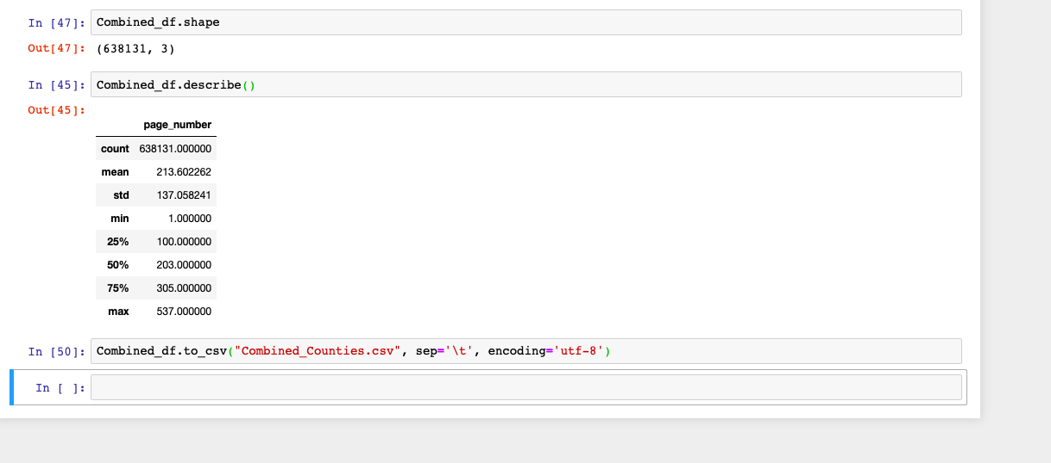
Data Analysis

Slide 10
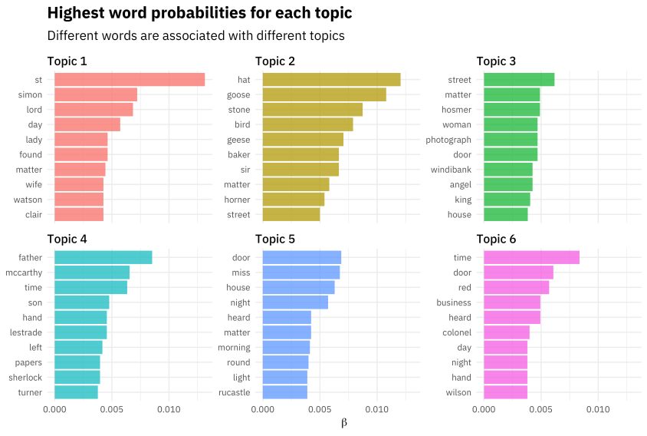
Topic Modelling
Finding a group of words (i.e topic) from a collection of documents that best represents the information in the collection.

Slide 11

Emotion And Sentiment Analysis
Sentiment analysis and emotional analysis are two key methods experts use to quantify audiences’ emotional engagement.

Slide 12
Emotion And Sentiment Analysis
1) Tokenization
2) Cleaning the data
3) Removing stop words
4) Normalization
5) Supervised learning/Lexicon based approach

Slide 13
Emotion And Sentiment Analysis
1) Text classification using spacy python package
2) Number of stop words in the list : 326
3) First ten stop words in Spacy:

Slide 14
Next Word Recommender(optional)
Whenever a user tries to enter a word/s suggest the next word based on combination of words used as input in previous searches.

Slide 15
Relevant Work
Emotion Sentiment Extraction Website by Jason.(https://jason-jones.shinyapps.io/Emotionizer/)
“Peoples Opinion on Indian Budget Using Sentiment Analysis” ^{-Varat Nayak}

