Slide 1

Budget Text Analysis
- Datatopian Visionaries
Akash Meghani,
Miguel Gaspar Utrera,
Naseeb Thapaliya,
Sultan Al Bogami,
Unnati Khivasara
Mentors: Dr. Soumya Mohanty
Jason Jones (Guilford County)

Slide 2
Overview of the Project
Budget text Analysis for counties and cities:
Guilford County
Wake County
Mecklenburg County
Durham County
City of Charlotte
City of Durham
City of Raleigh

Slide 3
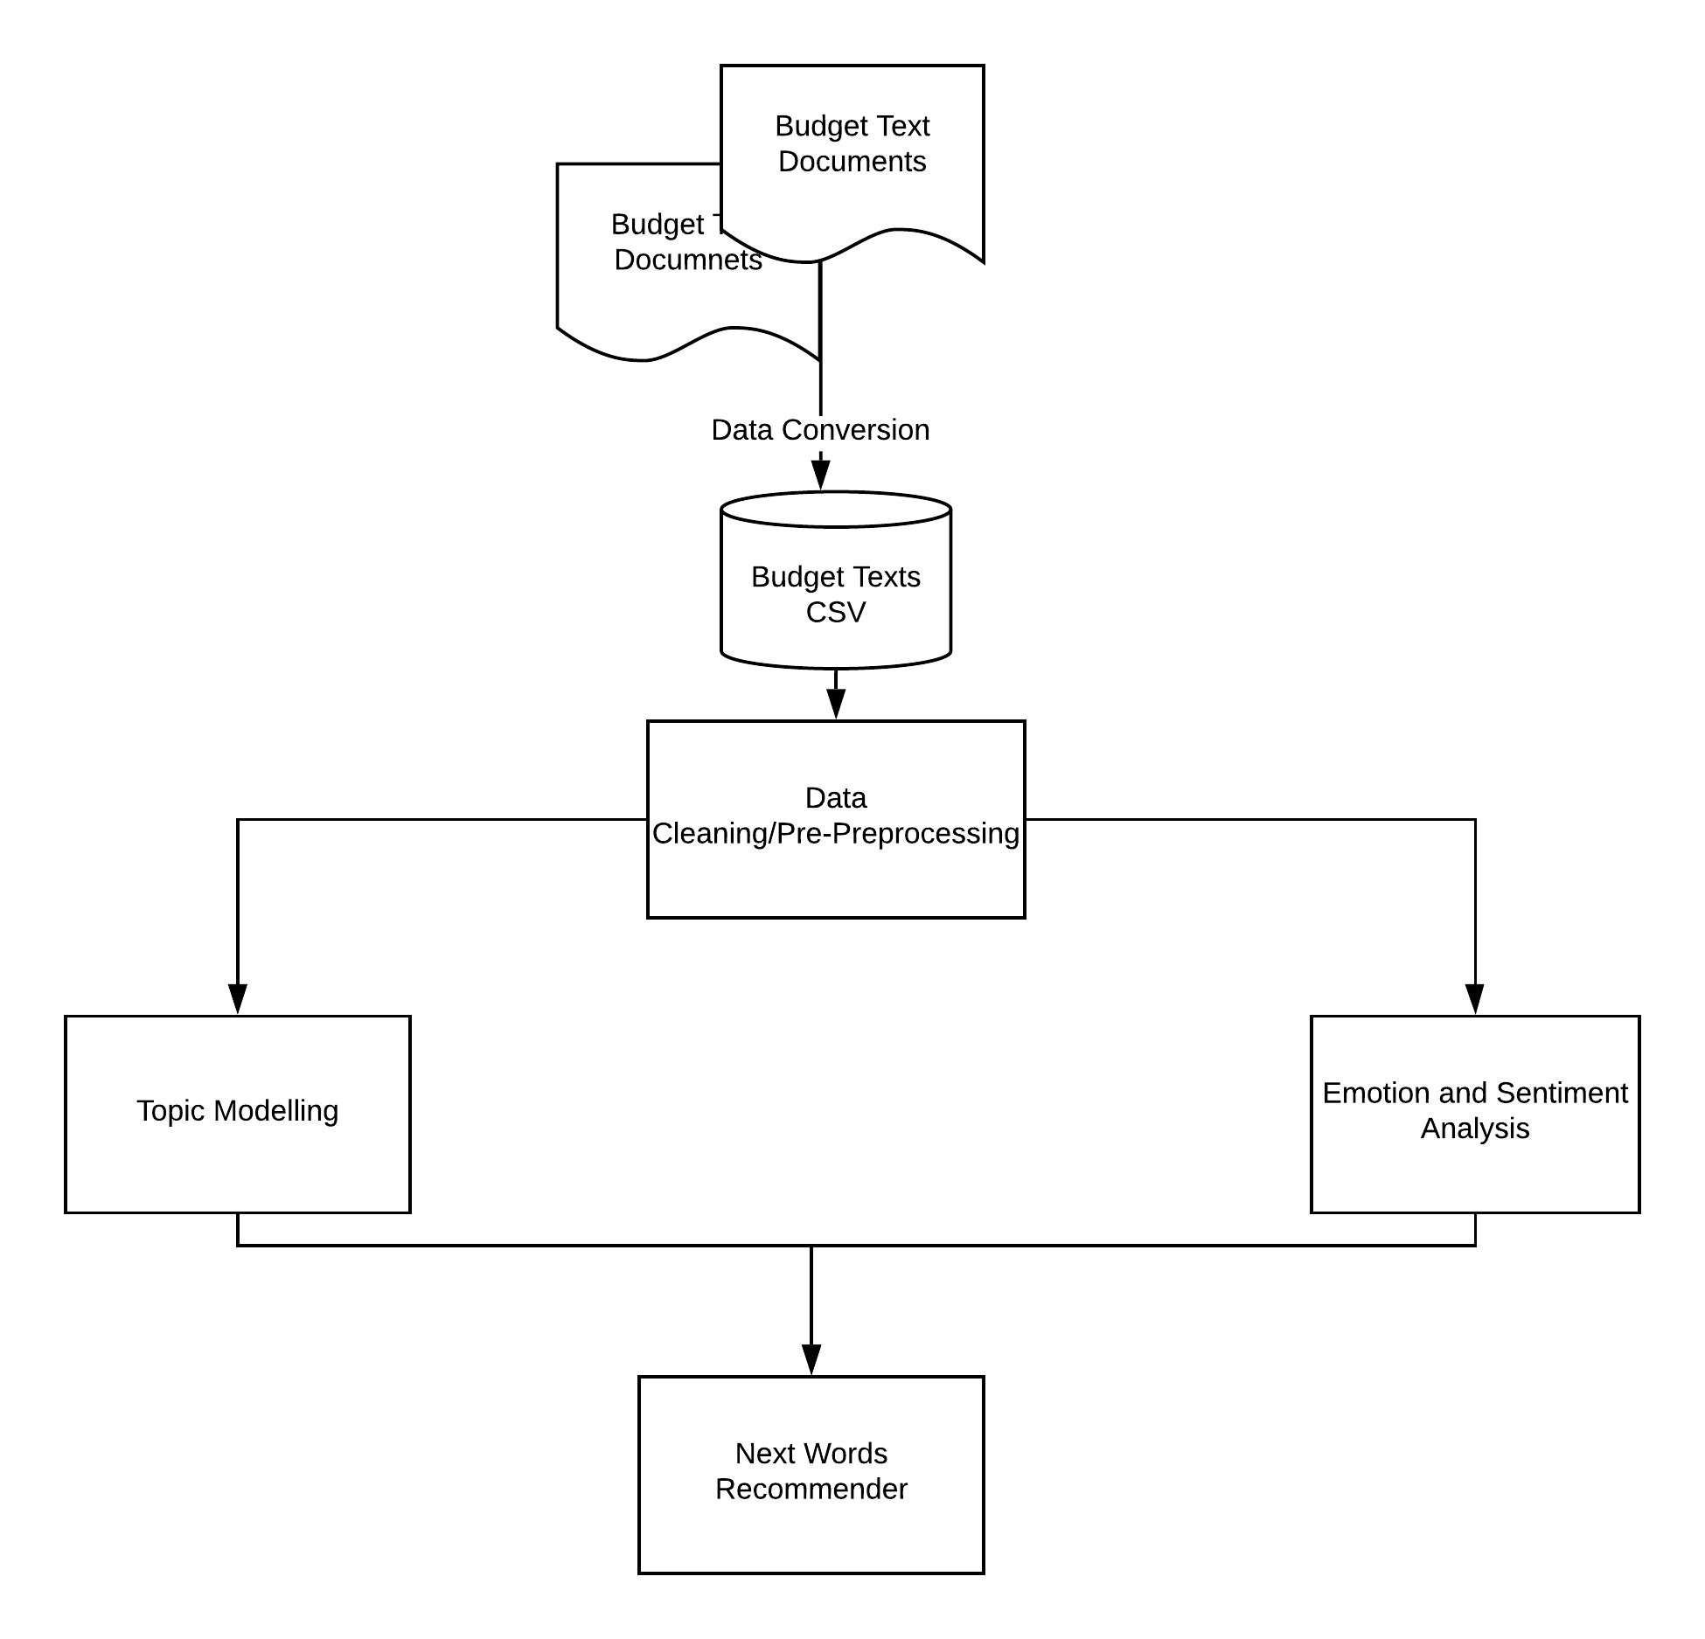
Overview of the Project

Slide 4
Goals
Understand the budget text data according to different counties, and their relationships, similarities/dissimilarities.
Data Cleaning/Pre-processing: Removing stopwords, unwanted words, and lemmatizing the texts for further analysis.
Topic Modelling of the textual data. Compare how the important topics in budget documents has changed with time (From 2009 to 2019).
Emotion and Sentiment Analysis of the budget texts to draw up public’s emotional engagement over the years.
Next words recommender for the texts in budget when searching.

Slide 5
Team Structure
All the individuals will work on preparing data i.e. Perform Data cleaning and Data preprocessing.
Team will be divided into 2 groups to perform different tasks:
Team 1: Topic Modelling Members: 1. Naseeb Thapaliya 2. Miguel Gasper Utrera 3. Sultan Al Bogami
Team 2: Emotion and Sentiment Analysis Members: 1. Akash Meghani 2. Unnati Khivasara

Slide 6
Individual Tasks Done
Sultan Al Bogami 1. Collected Budget Documents from all the different Counties websites and other sources. 2. Converted the pdf documents to csv formats. Extract words from the documents using online tool, and classify them for further processing.
Naseeb Thapaliya 1. Combine all the csv datasets from all the counties, and assign labels to identify the counties. 3. Analyze the combined data sets to identify data dictionaries and volume.
Miguel Gasper Utrera 1. Analyze the Datasets individually and keep the consistent data structure for all the counties. 2. Started looking into how topic modelling works, and find resources for topic modelling.
Unnati Khivasera 1. Organize and Coordinate data and documents for all the team members to access them when required. 2. Research on finalizing suitable approach /techniques used for Emotion and Sentiment analysis:
Akash Meghani 1. Collect Emotions csv data from the budget text documents. 2. Carry out individual analysis of the county documents to discover emotions in words.

Slide 7
Data Overview
Primarily, 7 pdf files ranging from 400-500 pages long for each.
Each pdf is converted to csv files by extracting all the relevant budget texts(words) from the pdf file.
So, there are total of 638131 total words extracted from the budget files.

Slide 8
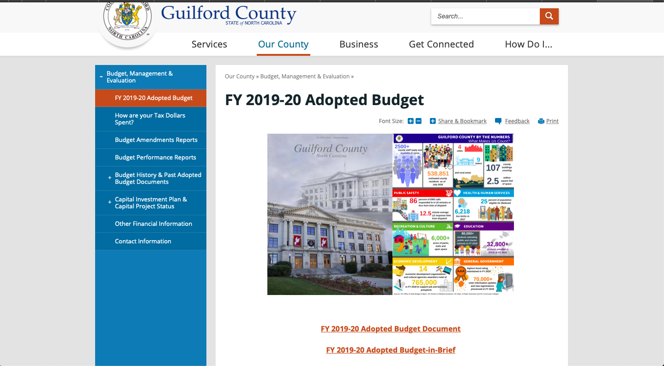
Data Source

Slide 9
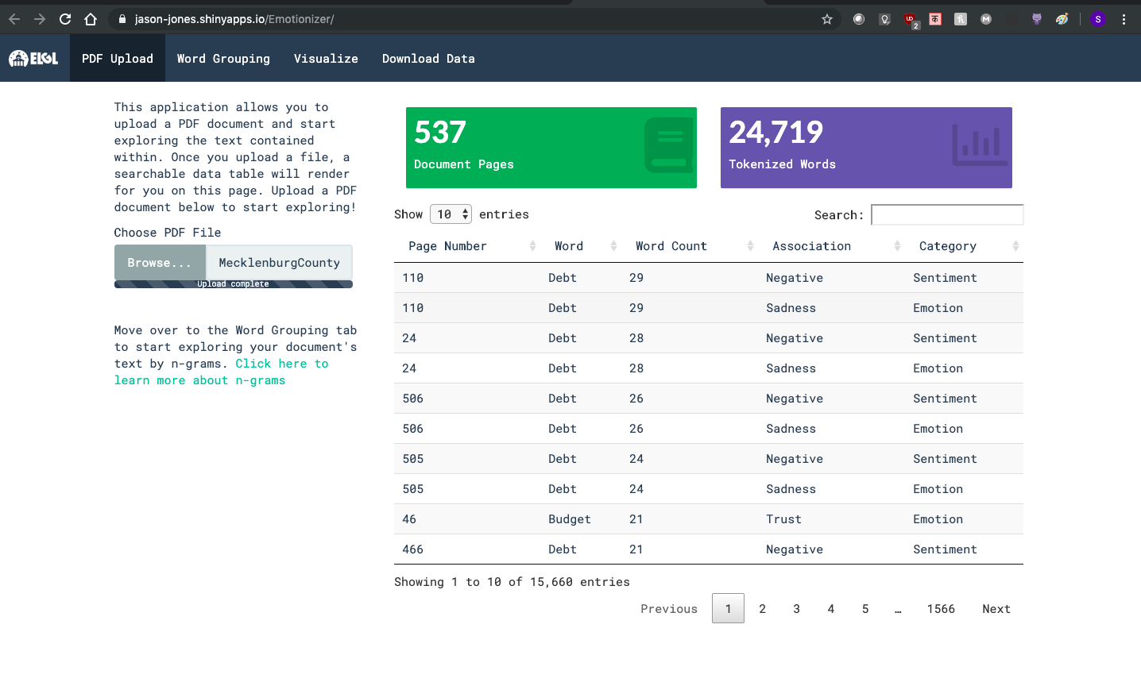
Data Conversion

Slide 10
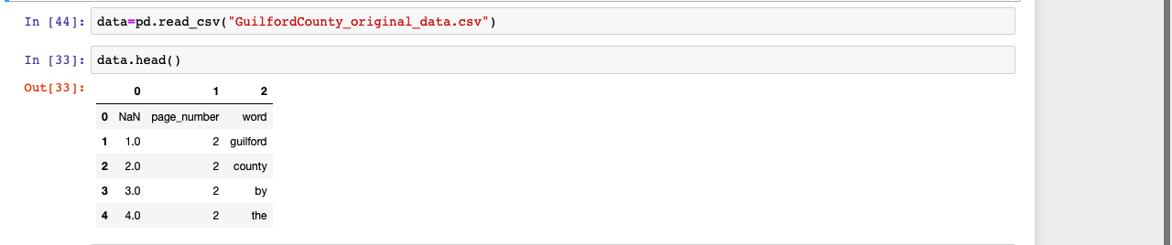
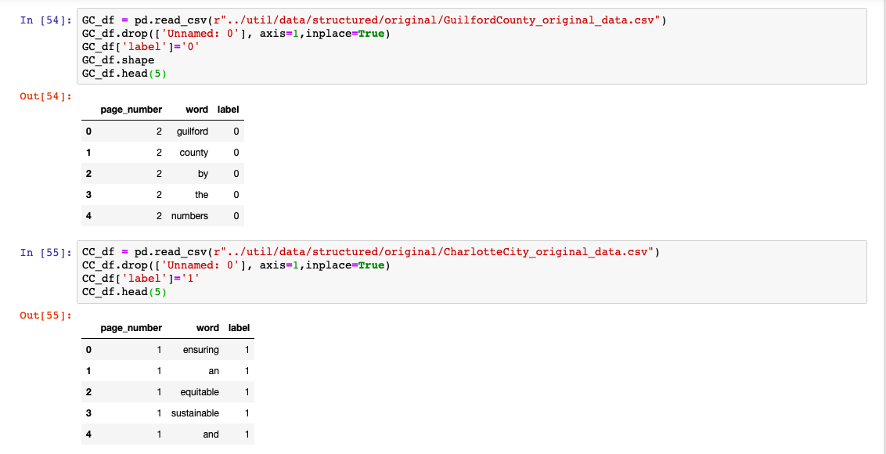
Data Transformation

Slide 11
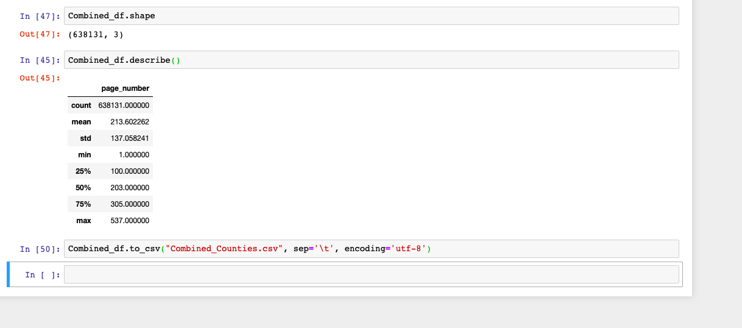
Data Analysis

Slide 12
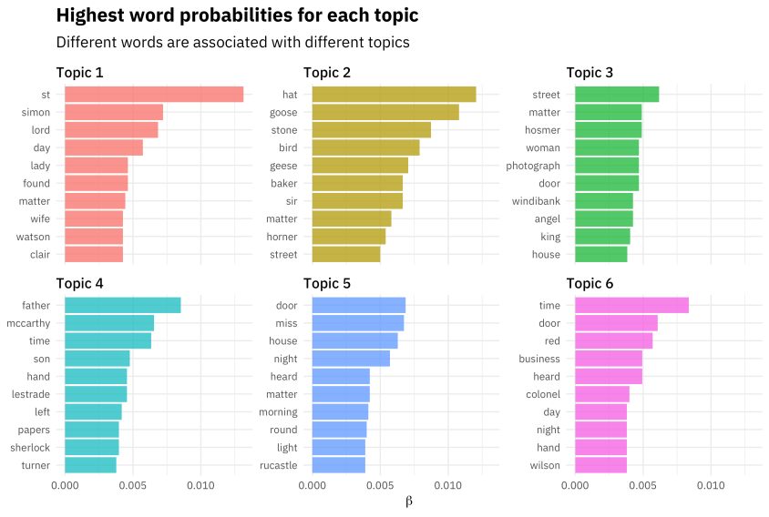
Topic Modelling
Finding a group of words (i.e topic) from a collection of documents that best represents the information in the collection.

Slide 13

Emotion And Sentiment Analysis
Sentiment analysis and emotional analysis are two key methods experts use to quantify audiences’ emotional engagement.

Slide 14
Emotion And Sentiment Analysis
1) Tokenization
2) Cleaning the data
3) Removing stop words
4) Normalization
5) Supervised learning/Lexicon based approach

Slide 15
Emotion And Sentiment Analysis
1) Text classification using spacy python package
2) Number of stop words in the list : 326
3) First ten stop words in Spacy:

Slide 16
Next Word Recommender
Whenever a user tries to enter a word/s suggest the next word based on combination of words used as input in previous searches.
Use results from Topic modeling to predict the recommended word/topic which are important.

Slide 17
Relevant Work
Emotion Sentiment Extraction Website by Jason.(https://jason-jones.shinyapps.io/Emotionizer/)
“Peoples Opinion on Indian Budget Using Sentiment Analysis” ^{-Varat Nayak}

