Slide 1

Budget Text Analysis
- Datatopian Visionaries
Akash Meghani,
Miguel Gaspar Utrera,
Naseeb Thapaliya,
Sultan Al Bogami,
Unnati Khivasara
Mentors: Dr. Soumya Mohanty
Jason Jones (Guilford County)

Slide 2
Hypothesis Testing:
H0 -> The sentiments remain same for service part from 2008 and 2020.
H1 -> Sentiment changes for service part from 2008 to 2020.
To prove this Hypothesis two sample is performed and p-value threshold is p = 0.05
P-Value is greater than threshold (0.56) therefore we were failed to reject null hypothesis.

Slide 3
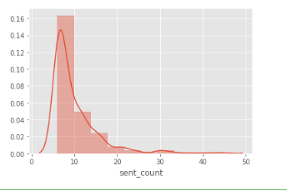
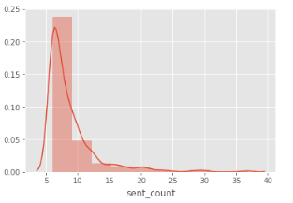
Probability Distribution:
I have concatenated Guilford county, Durham county, Durham city, charlotte city, Raleigh city :
Took negative sentiment counts (at least more than 5 times).
Took positive sentiment counts (at least more than 5 times):

Slide 4
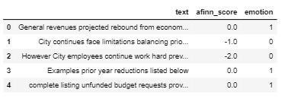
Machine Learning:
Changed the whole data :
1) Parsed the pdf file.
2) Converted the string
3) Converted it into sentences
4) Data cleaning
5) Dropped the rows which are empty
6) Used Affin library from python to assign affin values
7) Assigned the sentiments accordingly

Slide 5
Machine Learning:
X is text and Y is emotions.
Used This vectorizer which breaks text into single words and bi-grams and then calculates the TF-IDF representation.
Accuracy: 91.67
RMSE: 0.28867

Slide 6
Tasks - Sultan
Statistical Text Analysis:
Frequency distributions.
Mean, Variance, Standard deviations.
Hypothesis, and Hypothesis testing.
Machine Learning:
Semantic and linear relationship between words.

Slide 7
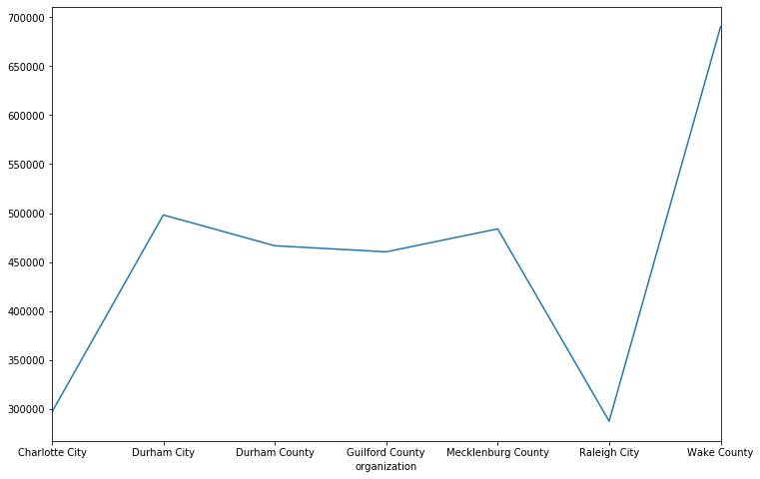
Tasks - Sultan
Count of words grouped by organization.

Slide 8
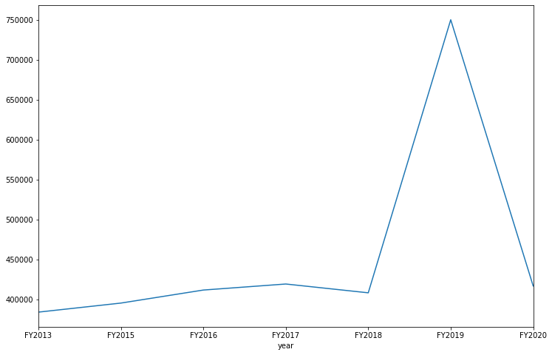
Tasks - Sultan
Count of words grouped by year.

Slide 9
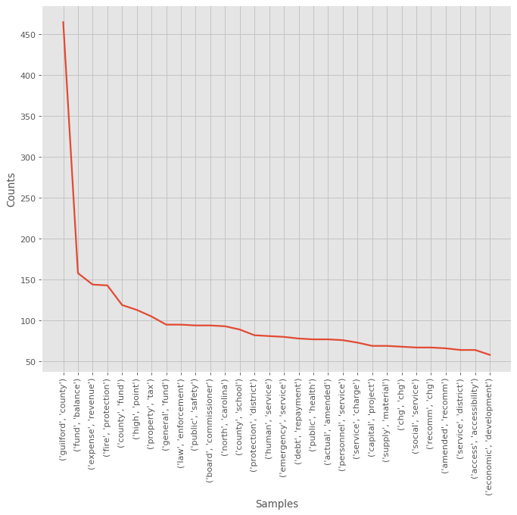
Tasks - Sultan
Most Frequent bigrams in Guilford County budget document
From 2020

Slide 10
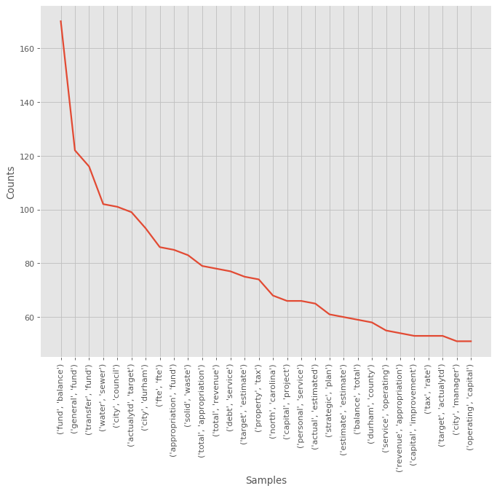
Tasks - Sultan
Most Frequent bigrams in Durham budget document From 2020

Slide 11
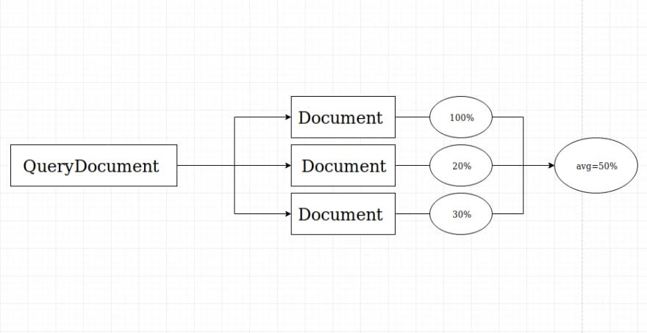
Tasks - Sultan
Is Guilford County talking about the same things as the other organizations?

Slide 12
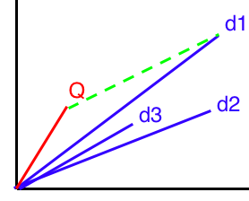
Q = Query Document.
D = budget documents
Each line represents a doc.
Task: Convert to vectors, and compute cosine similarity.

Slide 13
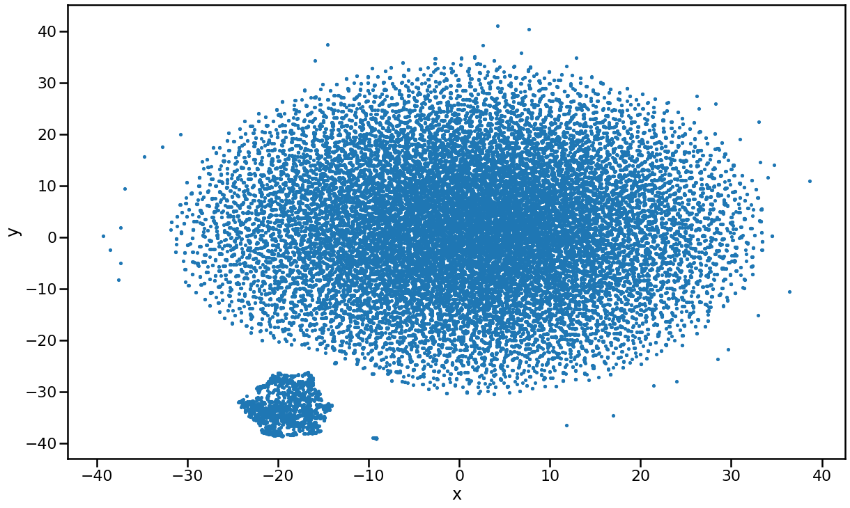
Tasks – Sultan
Cluster of words from 2013-2020 documents combined.

Slide 14
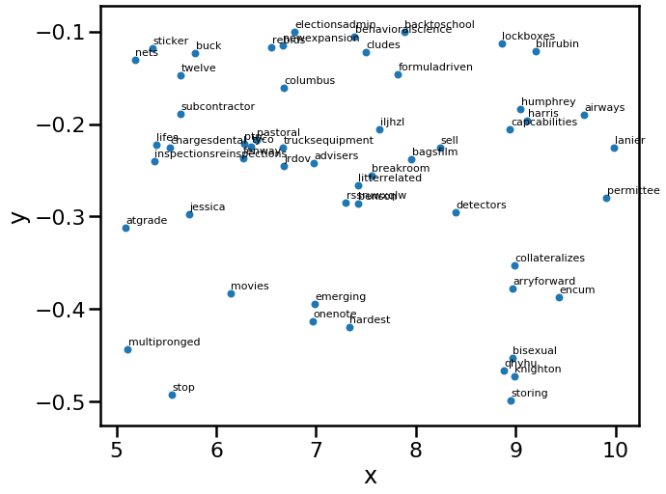
Tasks – Sultan
Zoom in to find how close are the words

Slide 15
THE QUESTION ?
“ Does a topic model for one year can identify the latent semantic structure that persists over time in this budget text domain ?

Slide 16
Tasks
Train LDA Model on the budget texts from 2019.
Grab Topic distributions for every budget texts using the LDA Model
Use Topic Distributions directly as feature vectors in supervised classification models (Logistic Regression, SVM, etc) and get F1-score.
Use the same 2019 LDA model to get topic distributions from 2018 and 2020 (the LDA model did not see this data!)
Run supervised classification models again on the 2018 and 2020 vectors and see if this generalizes.

Slide 17
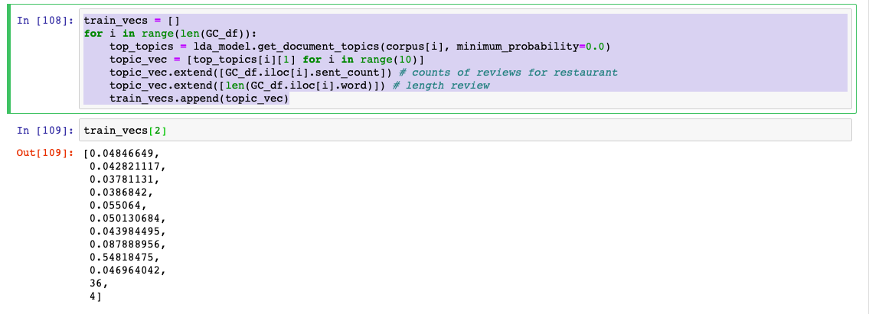
Converting Topics to Feature Vectors for Machine Learning

Slide 18
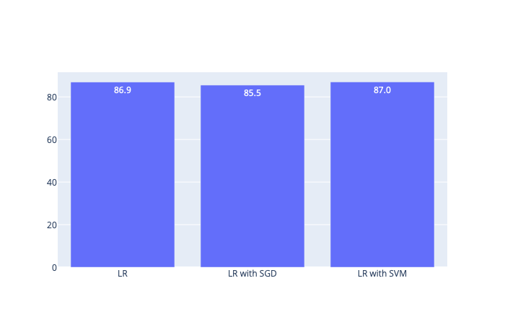

Supervised Classification (Training Data Result)
X = [train_vecs];
Y = [predicted_labels];
Result:

Slide 19


Supervised Classification (Testing on Unseen Data
For 2018:
For 2020:

Slide 20
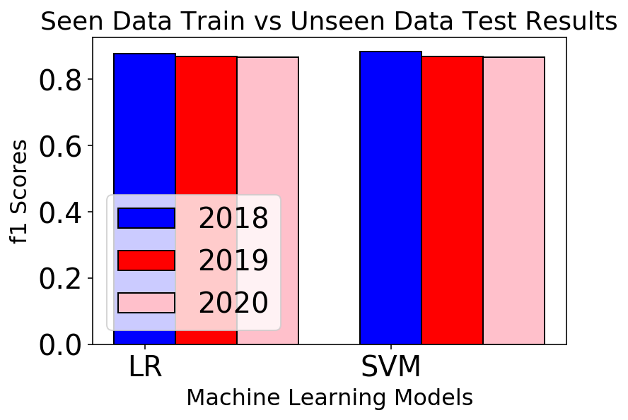
Supervised Classification (On Test Data)

Slide 21

Hypothesis Testing
H0(null hypothesis) -> The ML models are similar and perform for all the year .
H1 -> The ML models are truly different and perform differently.
Condition for Hypothesis taken such that p-value threshold is p = 0.05
Hence, the null hypothesis was rejected, as the models were completely different.

Slide 22
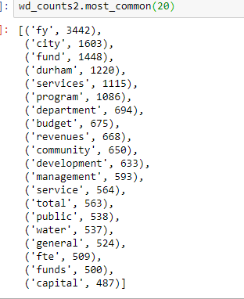
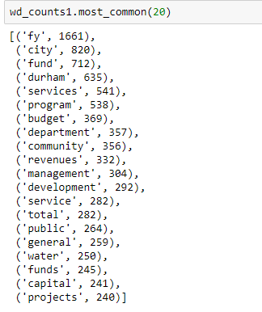
The budget documents are roughly 55% similar

Slide 23
Hypothesis Testing
H0 : The sentiments for Charlotte Document 2008 and 2020 are same
H1 : The sentiments for Charlotte Document 2008 and 2020 are not same
p-value = 0.28
Result : Accept Null Hypothesis
H0 : The sentiments for Raleigh Document 2014 and 2015 are same
H1 : The sentiments for Raleigh Document 2014 and 2015 are not same
p-value = 0.98
Result : Accept Null Hypothesis

Slide 24
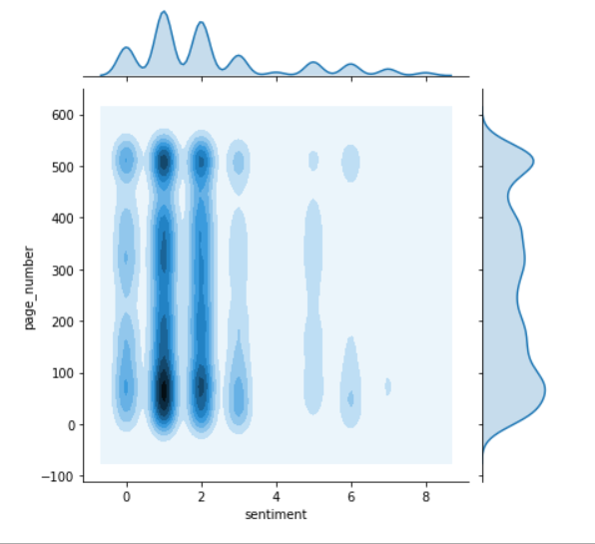
Sentiments over Sections

Slide 25
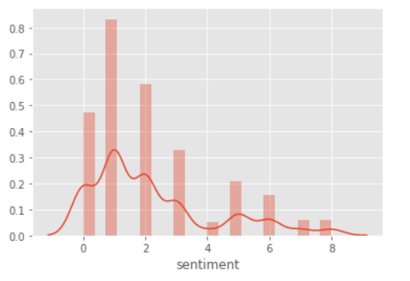
Gillford County Budget Document of 2008 Sentiments Distribution

Slide 26
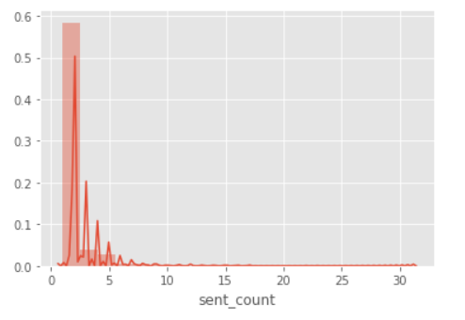
Charlotte Sentiments for 2008 Budget Document

Slide 27
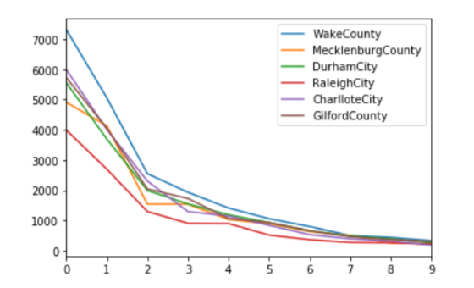
Frequency Distribution of sentiment for Counties and cities

Slide 28
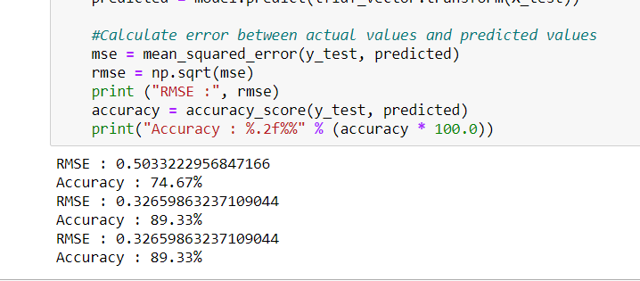
Classification of Sentiments using Logistic Regression, Random Forest Classifier and Linear SVC

