Slide 1



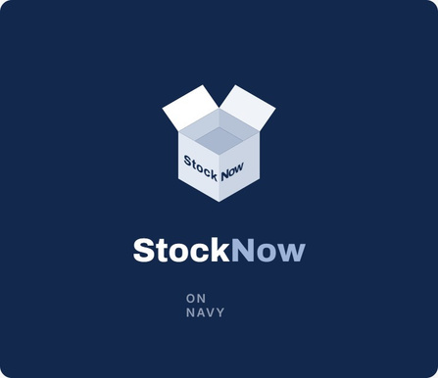


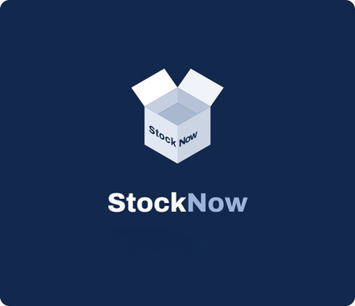


Stocknow
STOCKNOW
PITCH DECK
Presented by : Kita Akan Lawan

Slide 2

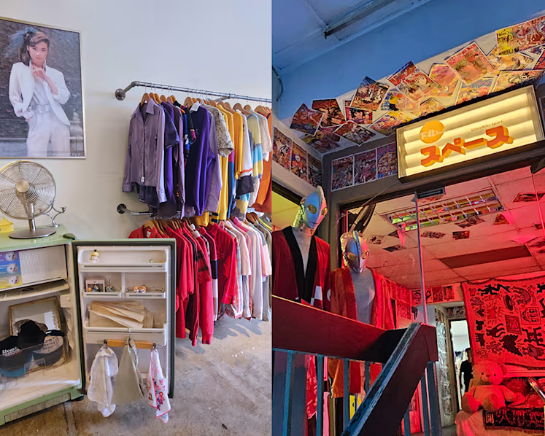

Stocknow
PROBLEM STATEMENT
SMEs tie up limited cash in slow-moving products while struggling to reconcile fragmented records.
When sales records, stock counts, and purchasing decisions are managed separately, owners must manually calculate orders. Making it difficult to see what purchase fits the budget.
  Missing Records
  Budget Blindspots

Slide 3
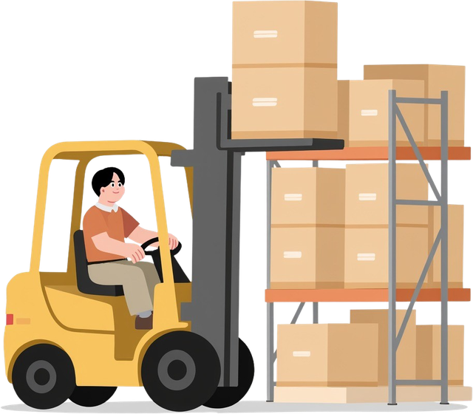

Stocknow
SOLUTION
STOCKNOW
Inventory Management System integrated with Orbyte ecosystem.

Slide 4

Stocknow
OPERATIONAL COSTS
Gemini Job | Input tokens | Output tokens | Cost per call
Plan summary | ~300 | ~160 | US$0.0019
Supplier WhatsApp message | ~150 | ~90 | US$0.0010
Forecast settings suggestion | ~1,040 | ~140 | US$0.0028
Forecast and restock maths | 0 | 0 | Free
Job | Cost | Cost
Plan summaries (4 plans × 5 rewrites) | 20 | US$0.038
Supplier orders and reminders | 12 | US$0.012
Settings suggestion | 1 | US$0.003
GEMINI COST PER CALL ON STOCKNOW
GEMINI FOR ONE SHOP/ 1 MONTH

Slide 5


Stocknow
FULL MONTHLY RUNNING COST
Item | Pilot (10 shops) | 100 shops
Hosting: Vercel Pro (1 seat) | US$20 | US$20
Database: Supabase Pro | US$25 | US$25
Gemini API | US$0.53 | US$5.30
Total per month | ≈ RM 185 | ≈ RM 204
Per shop per month | ≈ RM 18.50 | ≈ RM 2.04

Slide 6
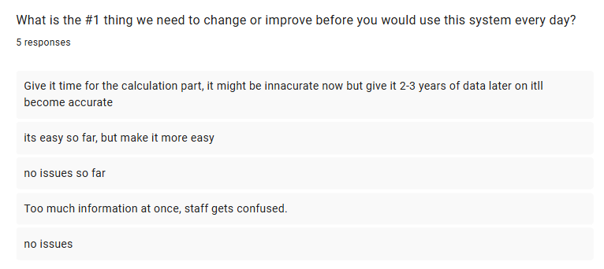
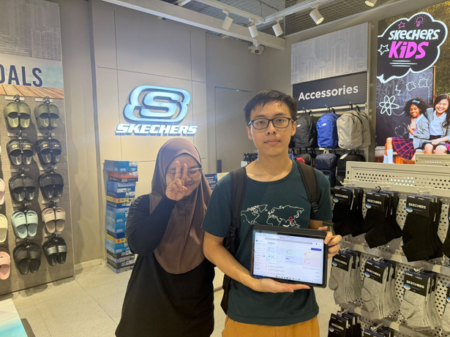
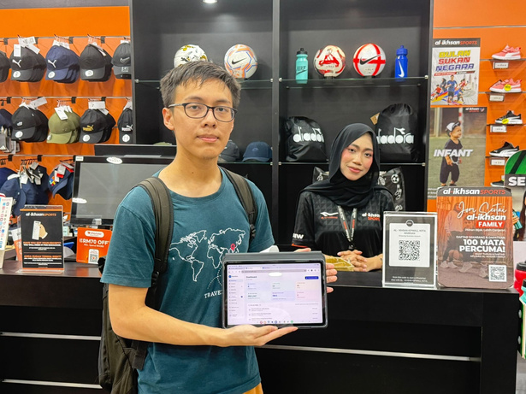
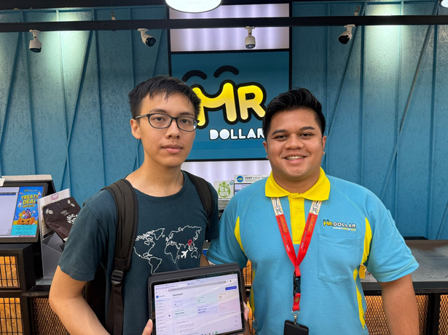
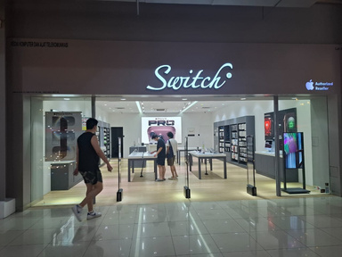

Stocknow
(Adain foto-foto interview, dan data yang dapet dari google form)
REAL WORLD VALIDATION

Slide 7
Stocknow
SUSTAINABLE DEVELOPMENT GOALS
SDG
8
DECENT WORK AND ECONOMIC GROWTH
SDG
9
INDUSTRY, INNOVATION AND INFRASTRUCTURE
Frees up cash stuck in slow-moving stock so SMEs stay profitable, grow, and keep their staff employed.
Brings affordable, AI-assisted inventory tools to small retailers, digitising how SMEs plan and buy stock.

Slide 8



Stocknow
THANK YOU
__________________________________________
FEEL FREE TO ASK ANY QUESTIONS

