Slide 1


MoonLAIT – Leng Lab
Interview for Research Data Analyst
Alice Albrecht
February 4th, 2025

Slide 2

Dataset Presentation
For Each Subject:
EDF File: Contains full Polysomnography (PSG) recordings, from which we will extract key biosignals:
Electrocardiogram (ECG) – Heart activity
Electroencephalogram (EEG) – Brain activity
Electrooculogram (EOG): Eye movement
Electromyogram (EMG) – Muscle activity
XML File: Includes annotated sleep data, providing:
Sleep stages (e.g., Stage1, REM)
Respiratory events (e.g., apneas, hypopneas)
Arousals and other relevant physiological events
Subject Information: Includes demographic and physiological data such as age, gender, BMI, and other relevant characteristics.
Outcome: Contains follow-up data, including vital status (alive or dead) and time since the most recent contact, which can be used for survival analysis.
Dataset: Sleep Heart Health Study – Visit 1 (SHHS1)
Number of Subjects: Subsample of 50
Alice ALBRECHT
Interview for Research Data Analyst
February 4th, 2025

Slide 3
Assignment Task 1
HRV Metrics Calculation and Survival
Analysis for Mortality Prediction
Alice ALBRECHT
Interview for Research Data Analyst
February 4th, 2025

Slide 4
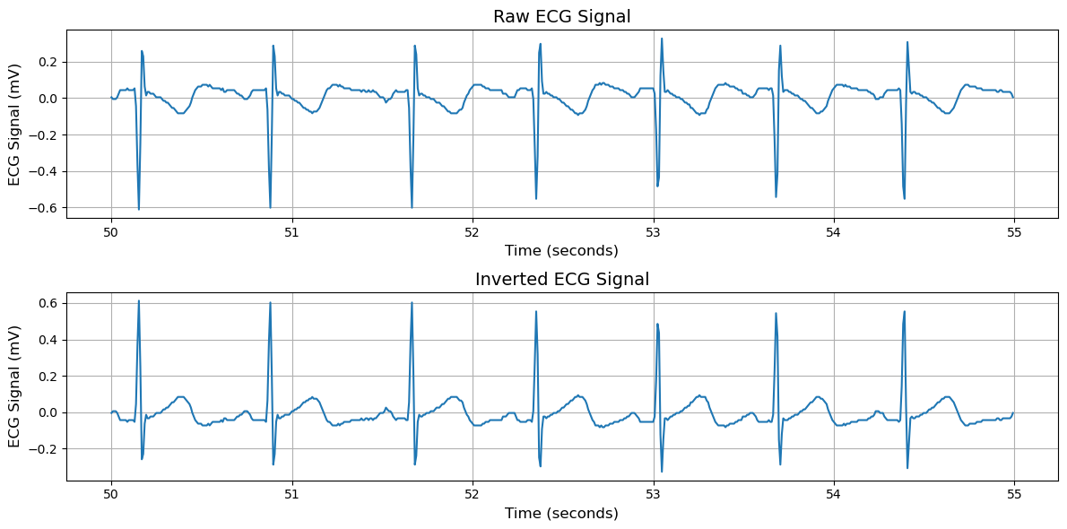
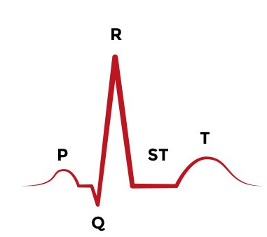
Extraction of ECG signal
Task 1
PSG signals inside EDF file
Conventional ECG waveform orientation (where the P-wave has an upward deflection)
Alice ALBRECHT
Interview for Research Data Analyst
February 4th, 2025

Slide 5
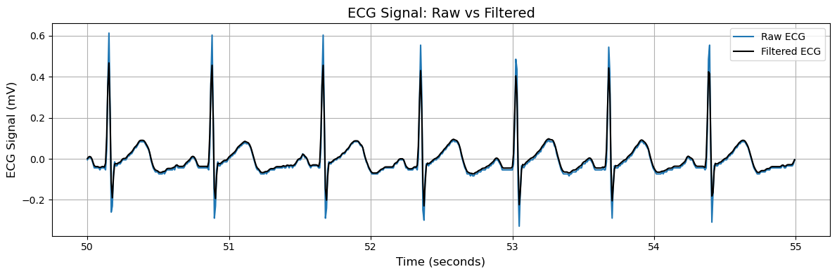
Filtering of ECG signal
Task 1
Cleaning applied: NeuroKit ecg_clean function includes:
Muscle artifact noise removal
Baseline drift correction
General signal enhancement for analysis
Alice ALBRECHT
Interview for Research Data Analyst
February 4th, 2025

Slide 6
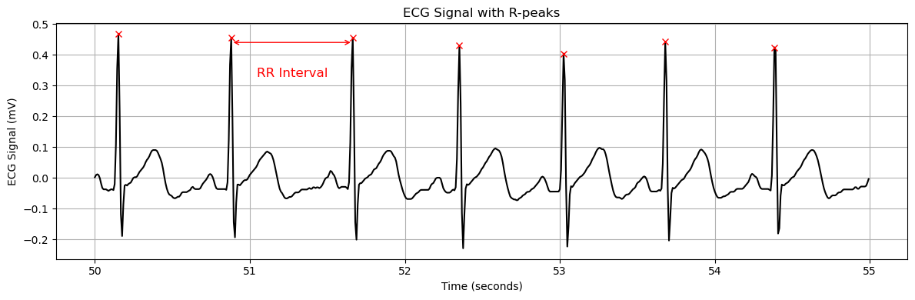
R-Peak Detection and RR-intervals
Task 1
R-peak Detection : NeuroKit ecg_findpeak function based on Probabilistic Methods-Agreement via Convolution (ProMAC)
RR-intervals: Time differences between successive R-peaks.
NN-intervals: after abnormal RR intervals (> 2.5s) removed
Alice ALBRECHT
Interview for Research Data Analyst
February 4th, 2025

Slide 7
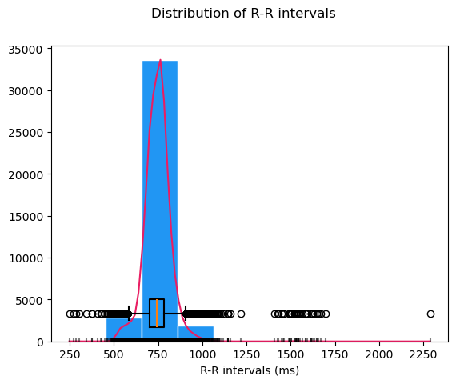
Temporal Analysis for HRV Metrics
Task 1
AVNN (Average NN Interval)
Mean time in ms between successive normal R-peaks (NN intervals)
SDNN(Standard Deviation
of NN Intervals)
Measures overall HRV by quantifying beat-to-beat variability over a period.
RMSSD (Root Mean Square of Successive Differences) Reflects short-term HRV by measuring rapid fluctuations in heart rate.
pNN50 (Percentage of NN50) Percentage of consecutive NN intervals that differ by more than 50 ms, indicating parasympathetic activity
Alice ALBRECHT
Interview for Research Data Analyst
February 4th, 2025
Notes:
The autonomic nervous system (ANS) is responsible for regulating involuntary body functions = SNS + PNS
The sympathetic nervous system (SNS) prepares the body for stress (fight or flight).
The parasympathetic nervous system (PNS) helps the body recover and relax (rest and digest).
The somatic nervous system (SNS) is responsible for voluntary control of body movements via skeletal muscles so opposite of ANS

Slide 8
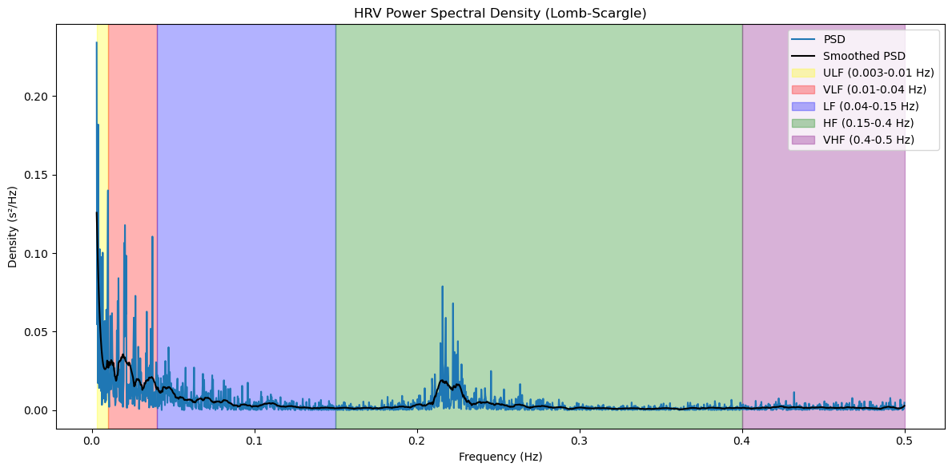
Frequency Analysis for HRV Metrics
Task 1
NN intervals are transformed to the frequency domain using the Lomb-Scargle Periodogram, ideal for unevenly spaced data like RR intervals.
The resulting Power Spectral Density (PSD) reveals how signal power is distributed, allowing calculation of HRV metrics to assess autonomic heart rate regulation.
Alice ALBRECHT
Interview for Research Data Analyst
February 4th, 2025
Notes:
The Lomb-Scargle method doesn’t assume that the data is regularly spaced, and instead, it adjusts the Fourier components to account for the uneven sampling. This makes interpolation unnecessary because the method can directly handle the uneven time intervals.

Slide 9
Frequency Analysis for HRV Metrics
Task 1
ULF (Ultra-Low Frequency, <0.003 Hz) Very slow HRV changes, linked to long-term circadian and metabolic regulation.
HF (High Frequency, 0.15–0.4 Hz) Represents parasympathetic (vagal) activity, closely tied to breathing rate.
VLF (Very-Low Frequency, 0.003–0.04 Hz) Associated with thermoregulation, hormonal activity, and vagal tone.
VHF (Very-High Frequency, >0.4 Hz) Less commonly analyzed, potentially related to mechanical cardiac processes.
LF (Low Frequency, 0.04–0.15 Hz) Reflects a mix of sympathetic and parasympathetic activity; often linked to blood pressure regulation.
LF/HF Ratio Balance between sympathetic and parasympathetic activity, used as indicator of autonomic nervous system modulation.
Alice ALBRECHT
Interview for Research Data Analyst
February 4th, 2025
Notes:
The autonomic nervous system (ANS) is responsible for regulating involuntary body functions = SNS + PNS
The sympathetic nervous system (SNS) prepares the body for stress (fight or flight).
The parasympathetic nervous system (PNS) helps the body recover and relax (rest and digest).
The somatic nervous system (SNS) is responsible for voluntary control of body movements via skeletal muscles so opposite of ANS

Slide 10
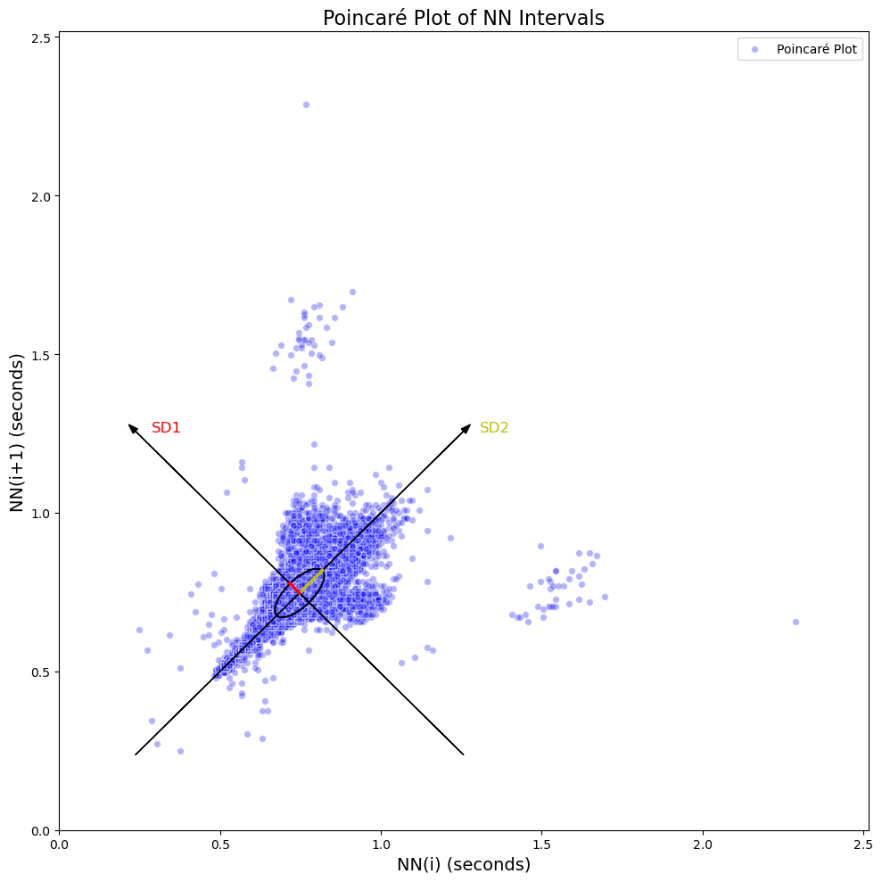
Poincaré Plot and Non-Linear HRV Metrics
Task 1
The Poincaré plot visualizes the relationship between successive NN intervals, showing nonlinear HRV patterns not captured by linear methods.
The ellipse illustrate the direction and strength of these HRV components.
SD1 (Short-Term HRV) Reflects short-term variability and parasympathetic activity.
SD2 (Long-Term HRV) Represents both sympathetic and parasympathetic influences over longer time scales.
Alice ALBRECHT
Interview for Research Data Analyst
February 4th, 2025

Slide 11
All metrics used for Survival Analysis
Task 1
ULF (Ultra-Low Frequency, <0.003 Hz) Very slow HRV changes, linked to long-term circadian and metabolic regulation.
HF (High Frequency, 0.15–0.4 Hz) Represents parasympathetic (vagal) activity, closely tied to breathing rate.
AVNN (Average NN Interval)
Mean time in ms between successive normal R-peaks (NN intervals)
SDNN(Standard Deviation
of NN Intervals)
Measures overall HRV by quantifying beat-to-beat variability over a period.
VLF (Very-Low Frequency, 0.003–0.04 Hz) Associated with thermoregulation, hormonal activity, and vagal tone.
VHF (Very-High Frequency, >0.4 Hz) Less commonly analyzed, potentially related to mechanical cardiac processes.
RMSSD (Root Mean Square of Successive Differences) Reflects short-term HRV by measuring rapid fluctuations in heart rate.
pNN50 (Percentage of NN50) Percentage of consecutive NN intervals that differ by more than 50 ms, indicating parasympathetic activity
HRV METRCIS
LF (Low Frequency, 0.04–0.15 Hz) Reflects a mix of sympathetic and parasympathetic activity; often linked to blood pressure regulation.
LF/HF Ratio Balance between sympathetic and parasympathetic activity, used as indicator of autonomic nervous system modulation.
SD1 (Short-Term HRV) Reflects short-term variability and parasympathetic activity.
SD2 (Long-Term HRV) Represents both sympathetic and parasympathetic influences over longer time scales.
AGE
GENDER
BODY MASS INDEX (BMI)
CHOLESTEROL
HYPERTENSION
COVARIATES
Alice ALBRECHT
Interview for Research Data Analyst
February 4th, 2025

Slide 12
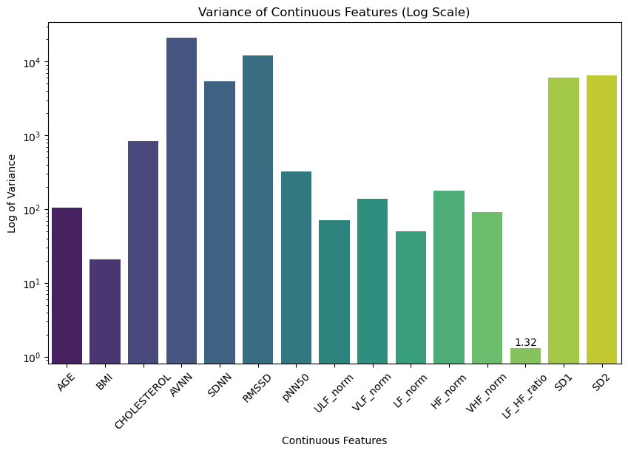
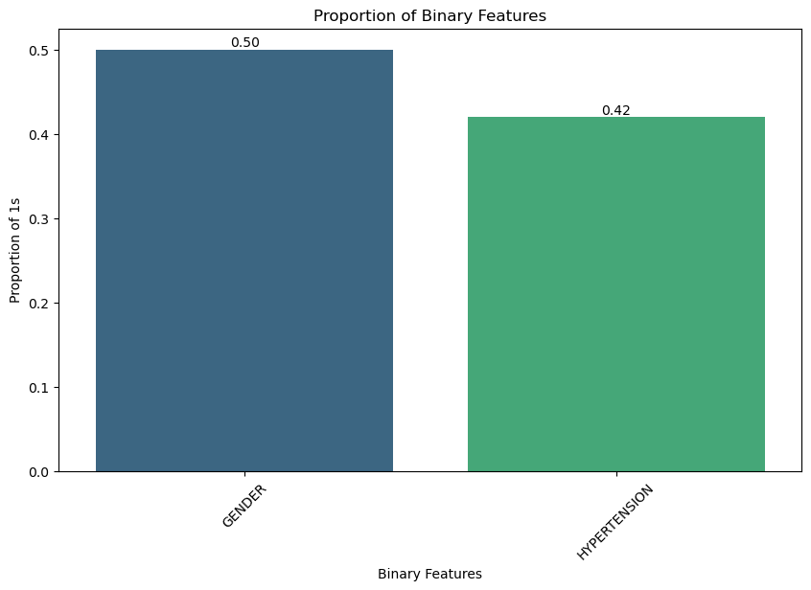
Data Preprocessing: Variance and Balance
Task 1
High variance for the continuous variable
Good balance for binary features
Alice ALBRECHT
Interview for Research Data Analyst
February 4th, 2025

Slide 13
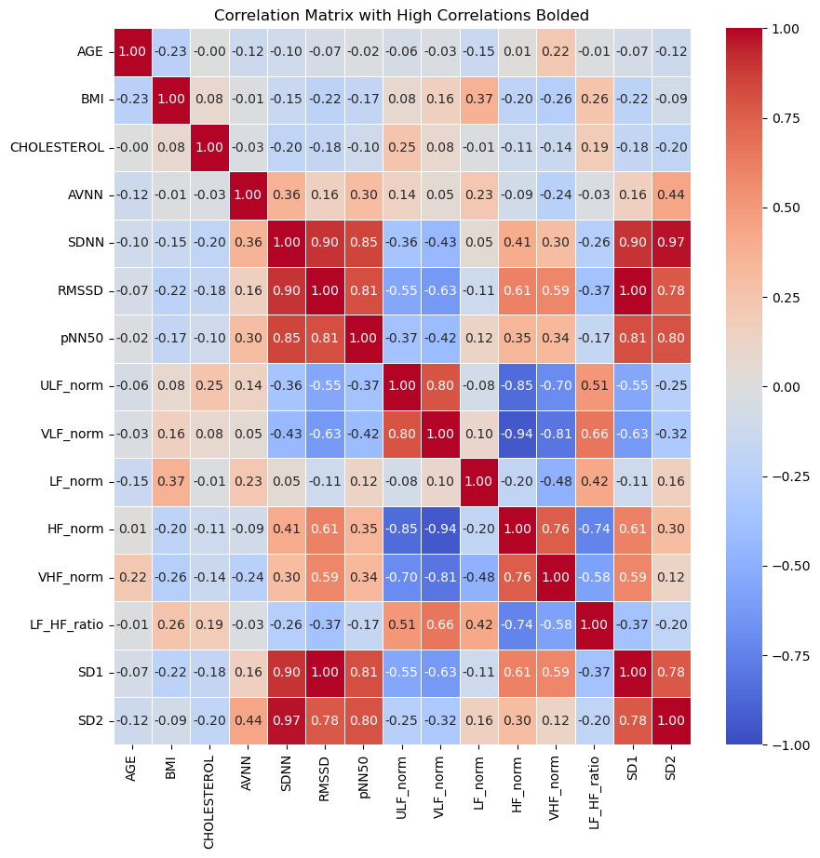
Data Preprocessing: Correlation
Task 1
Features to drop to
avoid correlation (threshold=0.9)
Note: Cox Proportional Hazards is highly sensitive to correlations between features
Alice ALBRECHT
Interview for Research Data Analyst
February 4th, 2025

Slide 14
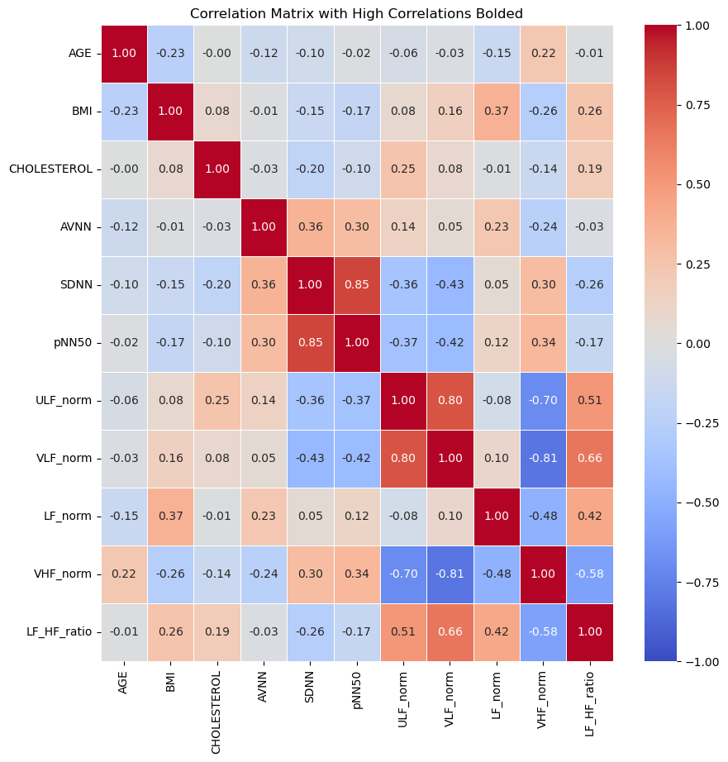
Data Preprocessing: Correlation
Task 1
Less Correlated Dataset
Alice ALBRECHT
Interview for Research Data Analyst
February 4th, 2025

Slide 15
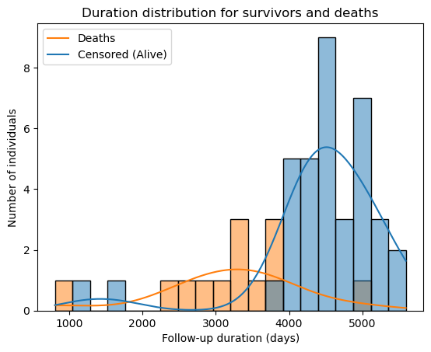
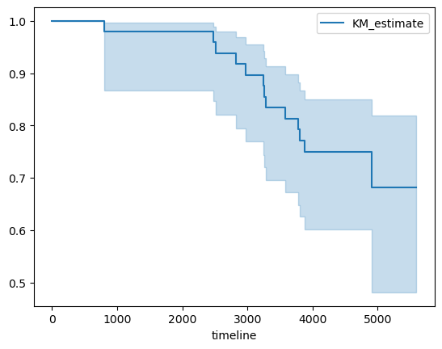
Survival Analysis Outcomes
Task 1
Kaplan-Meier Survival Curve: Survival Function Over Time
Survival Probability
Alice ALBRECHT
Interview for Research Data Analyst
February 4th, 2025

Slide 16
Multivariate Survival Analysis – Statistical Metrics
Task 1
C-index (Concordance Index): Measures the model’s discriminatory power. A higher C-index indicates better ability to differentiate between individuals at different risk levels.
AIC (Akaike Information Criterion): A measure of the model’s goodness of fit, balancing model fit and complexity. Lower AIC values indicate a better-fitting model.
The Cox Proportional Hazards model estimates the relationship between features and the risk of an event.
p-value > 0.05 → Feature is not significant, suggesting it doesn’t impact survival.
p-value <= 0.05 → Feature is significant, indicating it affects survival.”
The Schoenfeld Residuals test checks the proportional hazards assumption for each feature.
p-value > 0.05 → No violation of the proportional hazards assumption, should be constant over time.
p-value <= 0.05 → There is a potential violation of the proportional hazards assumption, meaning its effect on hazard may not be constant over time.
Alice ALBRECHT
Interview for Research Data Analyst
February 4th, 2025

Slide 17
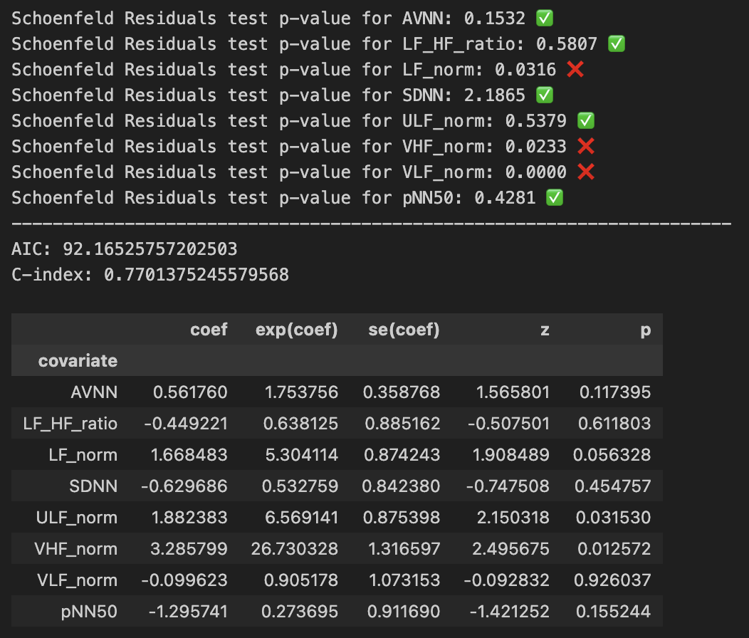
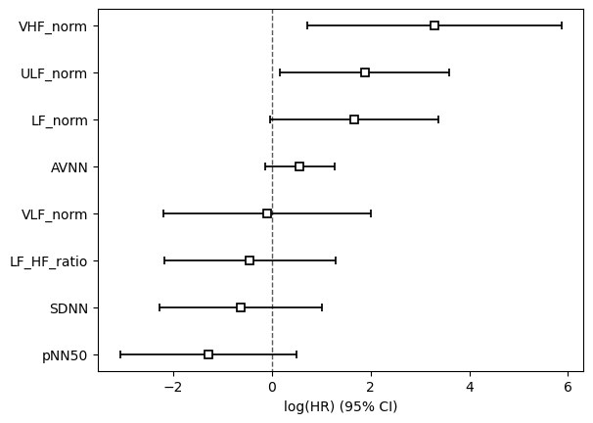
Multivariate Survival Analysis – HRV metrics
Task 1
Hazard Ratios for Predictors of Mortality
Positive coef expected: VHF
Negative coef expected : AVNN, SDNN, pNN50, ULF, LF/HF ratio
Context dependent: LF, VLF
Alice ALBRECHT
Interview for Research Data Analyst
February 4th, 2025
Notes:
If we examine the Cox Proportional Hazards model, we notice 3 interesting p-values: ULF and VHF are significant, while LF is very close to the significance threshold.
However, when checking the Schoenfeld Residuals test, both LF and VHF potentially violate the proportional hazards assumption, meaning their effects on survival are not constant over time.
This suggests that ULF is the only HRV metric that remains valid under this assumption.
Yet, when looking at the hazard ratio plot, ULF has a positive coefficient (1.88), implying that a higher ULF percentage is associated with an increased risk of death. This contradicts physiological expectations, as higher ULF is typically linked to better autonomic balance and lower mortality risk.
Thus, this model does not seem reliable. The AIC (92) is high, indicating a less optimal fit, while the C-index (0.77) is decent but could be improved.

Slide 18
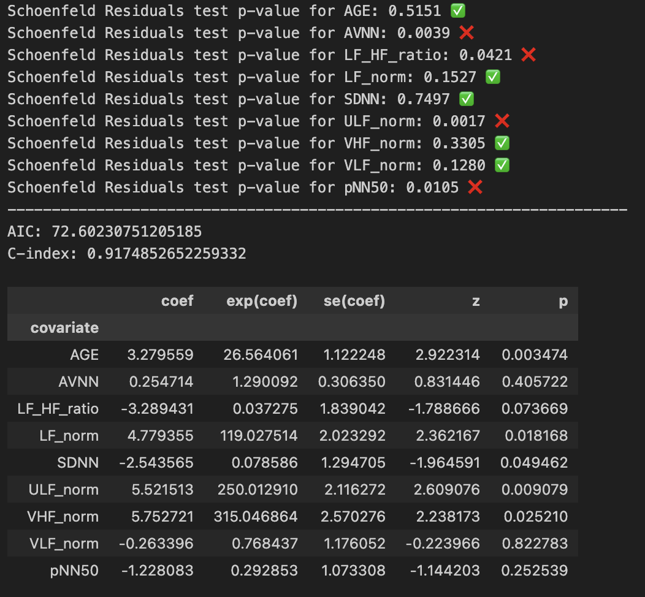
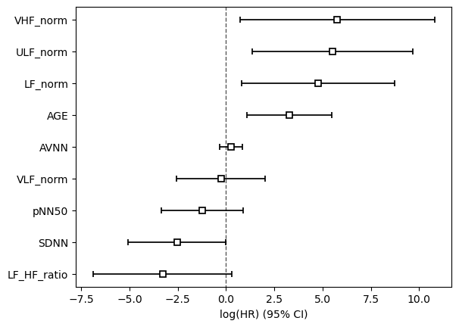
Multivariate Survival Analysis – HRV metrics with AGE
Task 1
Hazard Ratios for Predictors of Mortality
Positive coef expected: AGE, VHF
Negative coef expected : AVNN, SDNN, pNN50, ULF, LF/HF ratio
Context dependent: LF, VLF
Alice ALBRECHT
Interview for Research Data Analyst
February 4th, 2025
Notes:
One key covariate that must be included in our model is Age. It is an obvious and well-established factor influencing mortality, so incorporating it into our model is essential.
Results
When examining the Cox Proportional Hazards model, we observe five significant p-values:
• Age, confirming that our data and model make sense.
• LF, ULF, and VHF, which were already significant in the previous model.
• SDNN, which now appears significant as well.
However, checking the Schoenfeld Residuals test, we find that ULF violates the proportional hazards assumption, meaning its effect on survival is not constant over time. On the other hand, Age, LF, VHF, and SDNN pass the test, making them valid and significant predictors in this updated model.
So, these results suggest that Age is a confounder in the relationship between HRV metrics and survival. By including Age, the most important HRV metrics shift—previously, ULF was a key predictor, but now SDNN, LF, and VHF take precedence.
We also observe a clear improvement over the previous model, as seen in the decrease in AIC (from 92 to 72) and increase in C-index (from 0.77 to 0.91), both showing a much better fit and predictive performance.
Looking at the hazard ratio plot:
• Age has a positive coefficient, as expected—older individuals have a higher risk of mortality.
• VHF also has a positive coefficient, which aligns with literature expectation.
• SDNN has a negative coefficient, which is expected—lower SDNN indicates better HRV and autonomic function, which correlates with improved survival and lower mortality risk.
• LF has a large positive coefficient, which may depend on the context but can be physiologically plausible.
Conclusion
By adding Age as a confounding variable, our model has improved significantly. Three HRV metrics (SDNN, LF, VHF) remain significant, and all pass the proportional hazards assumption check.
The AIC and C-index confirm this is a much stronger and more reliable model, demonstrating the importance of accounting for Age when analyzing HRV and survival.

Slide 19
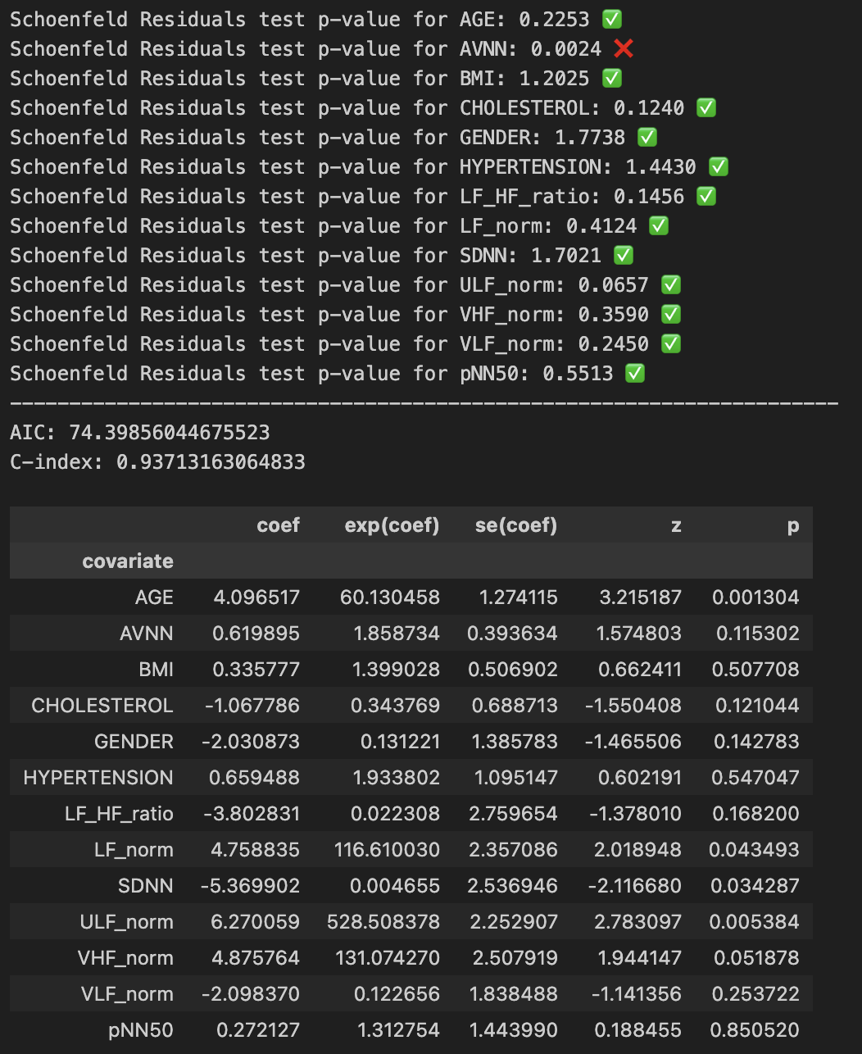
Multivariate Survival Analysis – HRV metrics with all covariates
Task 1
Alice ALBRECHT
Interview for Research Data Analyst
February 4th, 2025
Notes:
Since Age improved our model significantly, let’s now include multiple covariates: Age, Gender, Cholesterol, and Hypertension.
We observe the same five significant variables as before: Age, LF, ULF, SDNN, and VHF (on the threshold).
Importantly, they all pass the proportional hazards assumption check, meaning their effects on survival remain constant over time—making this model much more reliable and robust.
Additionally, we see a small improvement in the C-index, indicating a slight increase in predictive power. The AIC increases slightly, but this trade-off suggests that the model is capturing more meaningful variability.
This is a very promising model, as we now have nearly all covariates meeting the key statistical assumptions.

Slide 20
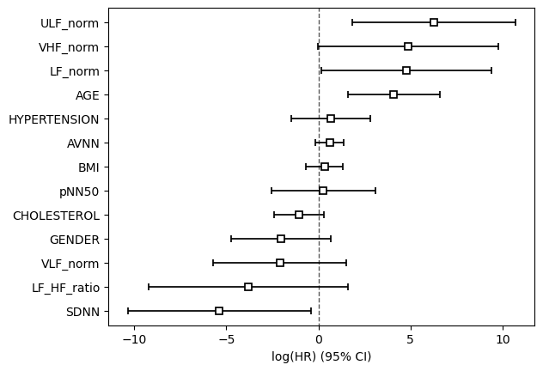
Multivariate Survival Analysis – HRV metrics with all covariates
Task 1
Hazard Ratios for Predictors of Mortality
Model Performance:
C-index = 0.937
AIC: 74.34
Significant p-values that passing proportional hazards assumption:
AGE, LF, ULF, SDNN, VHF
Key Coefficients:
AGE, LF, VHF: Positive → Higher values = higher mortality risk
SDNN: Negative → Higher SDNN = lower mortality risk
Conclusion The model is promising, with key HRV metrics and Age as a confounder significantly improving survival prediction.
Positive coef expected: AGE, GENDER (male), BMI, CHOLESTEROL, HYPERTENSION, VHF
Negative coef expected : AVNN, SDNN, pNN50, ULF, LF/HF ratio
Context dependent: LF, VLF
Alice ALBRECHT
Interview for Research Data Analyst
February 4th, 2025
Notes:
Hazard Ratio Plot Interpretation
• AGE, VHF, and LF → Positive coefficients: Higher values are associated with increased mortality risk, which aligns with expectations.
• SDNN → Negative coefficient: Higher SDNN reflects better HRV and autonomic function, which correlates with improved survival and lower mortality risk.
Conclusion
Adding Age, Gender, Cholesterol, and Hypertension further refines the model while keeping LF, SDNN, ULF, and VHF as key HRV metrics for survival.
The fact that nearly all variables pass the proportional hazards assumption makes this model both statistically strong and highly promising for interpretation. Age is the main confounder improving the model; other variables (Gender, Cholesterol, Hypertension) are potential confounders but have a lesser impact.

Slide 21
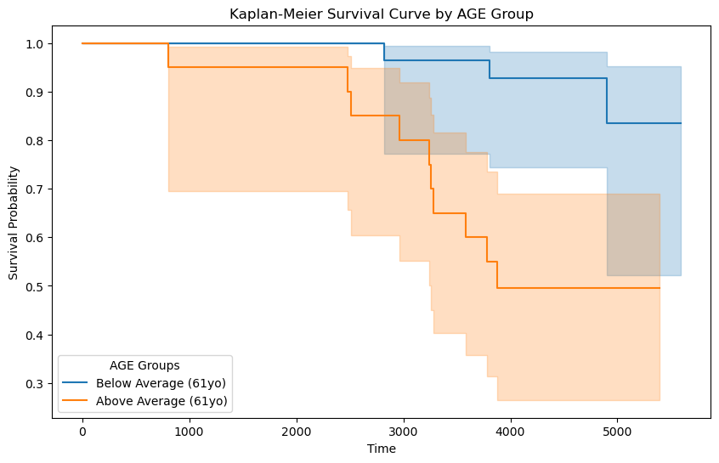
Univariate Survival Analysis – AGE
Task 1
Log-Rank Test Interpretation
p-value > 0.05 → Feature is not significant, indicating no clear difference in survival between groups.
p-value <= 0.05 → Feature is significant, suggesting a statistically significant difference in survival between groups.
Age remains significant in both univariate and multivariate models, confirming its strong impact on survival. This aligns with the general understanding that older age is associated with higher mortality risk.
Log-rank test p-value: 0.0007 ✅
Alice ALBRECHT
Interview for Research Data Analyst
February 4th, 2025

Slide 22
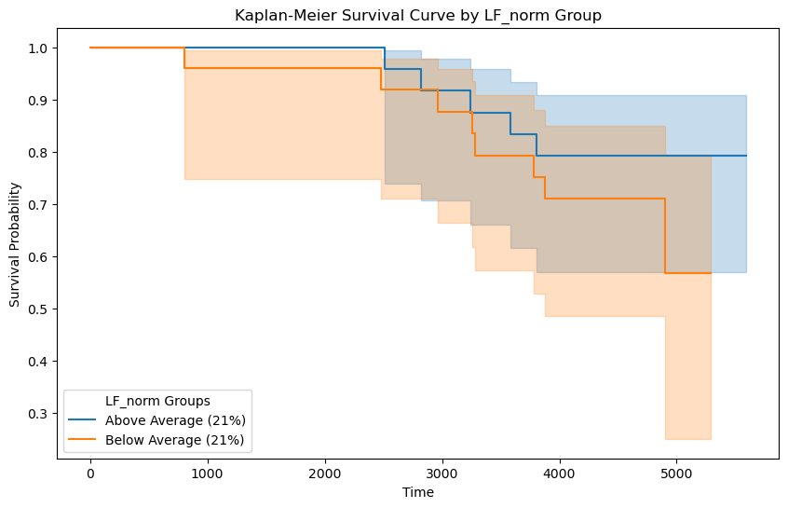
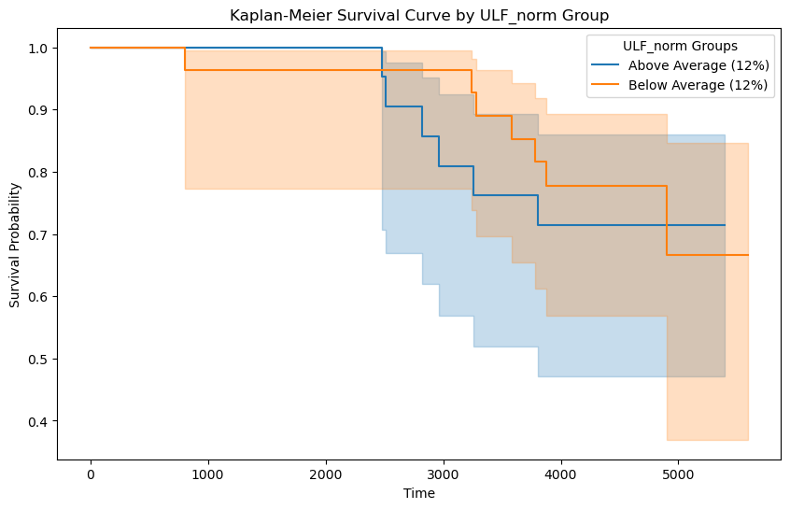
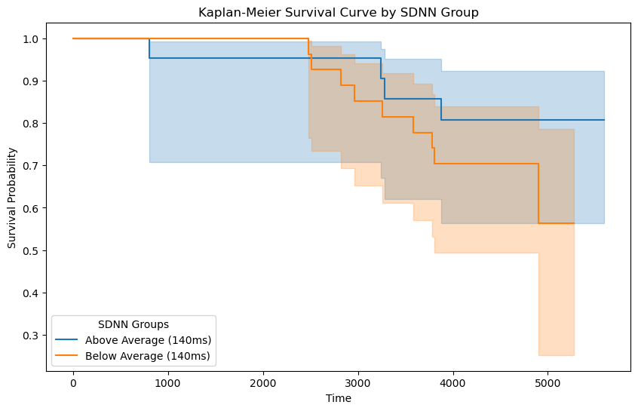
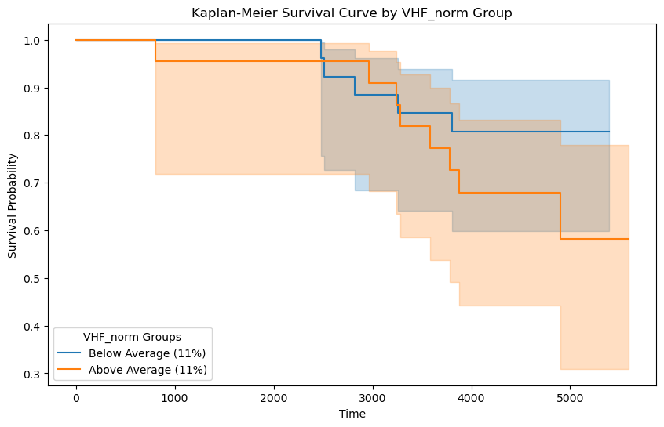
Univariate Survival Analysis – HRV metrics
Task 1
Log-Rank Test Interpretation
p-value > 0.05 → Feature is not significant, indicating no clear difference in survival between groups.
p-value <= 0.05 → Feature is significant, suggesting a statistically significant difference in survival between groups.
HRV metrics (LF, ULF, SDNN, VHF) are not significant univariately but become significant in the multivariate model, suggesting their combined effect with age improves survival prediction.
Log-rank test p-value: 0.3519 ❌
Log-rank test p-value: 0.7159 ❌
Log-rank test p-value: 0.2736 ❌
Log-rank test p-value: 0.2701 ❌
Alice ALBRECHT
Interview for Research Data Analyst
February 4th, 2025

Slide 23
Assignment Task 2
Automatic Sleep Staging and
Performance Evaluation
Alice ALBRECHT
Interview for Research Data Analyst
February 4th, 2025

Slide 24


Sleep Stages Annotations
Task 2
Experts
Sleep stages annotated manually with 30-second epochs.
The SHHS dataset uses the Rechtschaffen & Kales guidelines (6 stages). For comparison with modern standards, the stages are adapted to ASMM Guidelines, combining S3 and S4 into N3.
Predicts sleep stages using EEG (C4), EOG (left), and EMG (chin) signals.
Provides automated sleep stage labeling based on these signals, offering a more efficient and consistent approach.
YASA
Model
Alice ALBRECHT
Interview for Research Data Analyst
February 4th, 2025

Slide 25
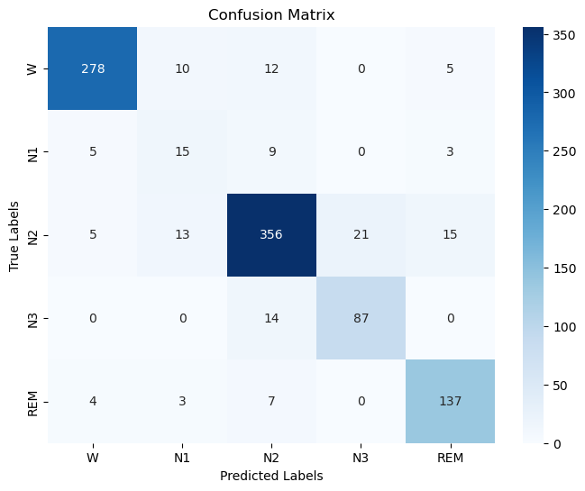
Performance Evaluation: Confusion Matrix
Task 2
The confusion matrix shows strong agreement between expert-labeled sleep stages in the SHHS dataset and the YASA model’s predictions.
The only challenge is with the N1 stage, which is often ambiguous due to its transitional nature between wakefulness and light sleep.
Alice ALBRECHT
Interview for Research Data Analyst
February 4th, 2025

Slide 26
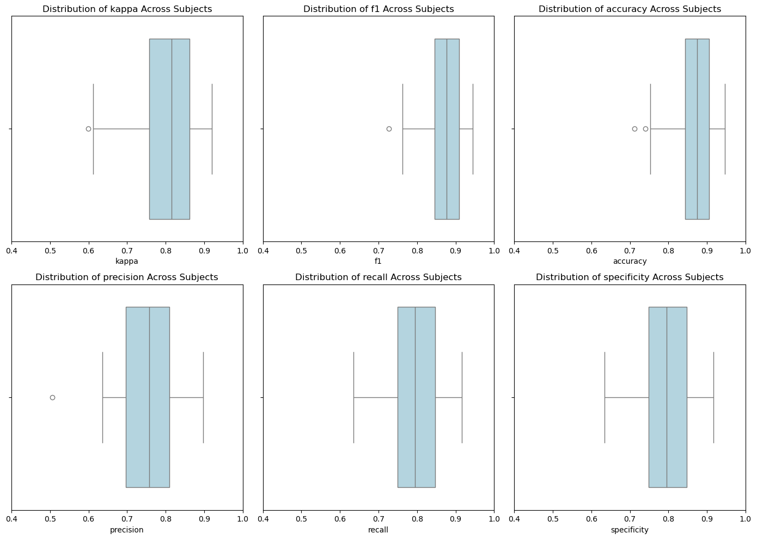
Performance Evaluation: Other Metrics
Task 2
The YASA model performs well in predicting sleep stages:
• Kappa (0.81): High agreement with expert labels, minor inconsistencies.
• F1 Score (0.87): Balanced precision and recall.
• Accuracy (0.87): High classification accuracy.
• Precision (0.75): Room to reduce false positives.
• Recall (0.80): Good stage identification, room for improvement.
• Specificity (0.80): Strong at identifying non-sleep stages.
Standard deviations show stable performance, with the most variation in kappa and precision. Overall, the model is reliable but can improve in distinguishing certain stages like N1 stage.
Alice ALBRECHT
Interview for Research Data Analyst
February 4th, 2025

Slide 27
Thank you for you attention !
Any Questions ?
Alice ALBRECHT
Interview for Research Data Analyst
February 4th, 2025

